Slide 2
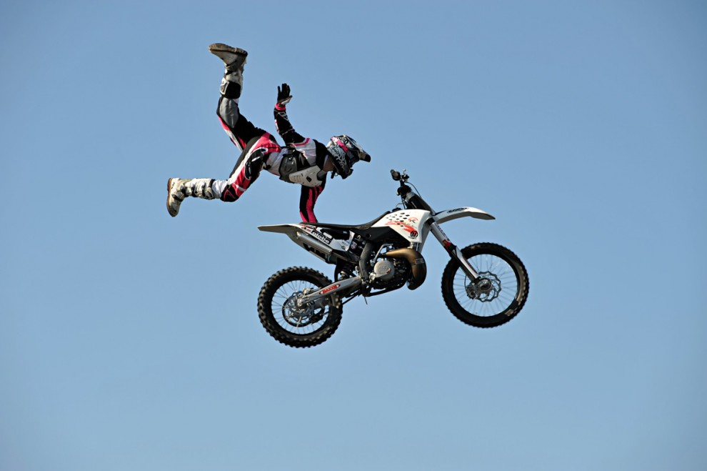
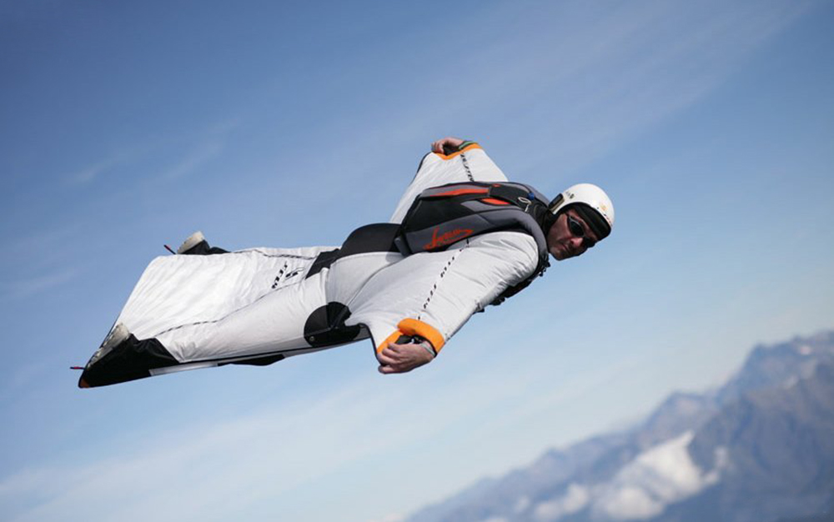
Extreme sports (also called action sports, aggro sports, and adventure sports) is a popular term for certain activities perceived as having a high level of inherent danger.

Slide 3
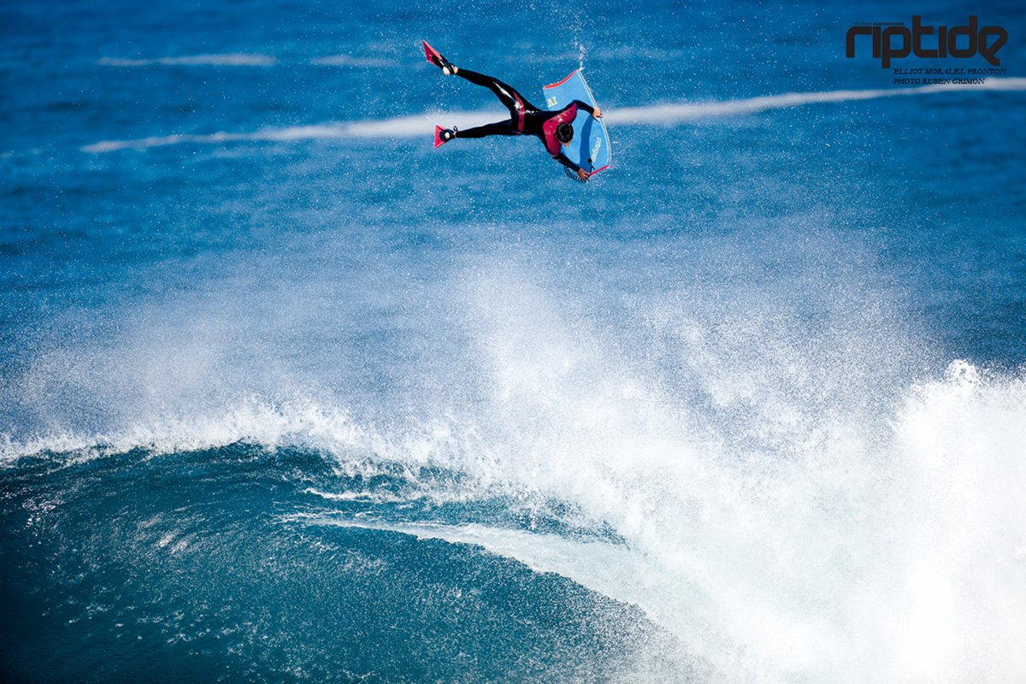
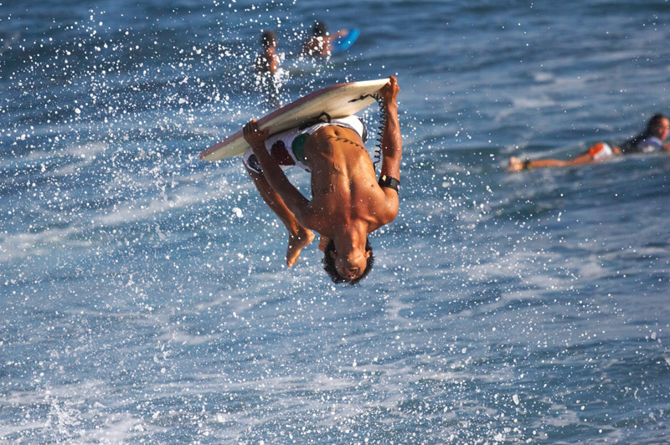
Bodyboarding
Bodyboarding is a kind of wave surfing. But instead of surfboard u have a rectangular piece of hydrodynamic foam. Shape of board depends on riding style, and rider himself. Wiki says that bodyboarding is fastest growing extreme water sports all over the world.

Slide 4
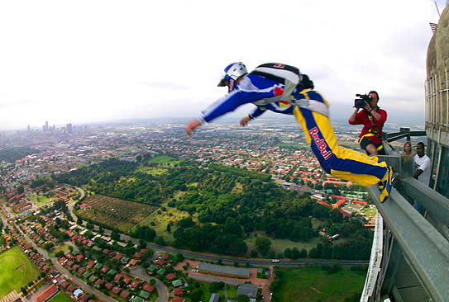
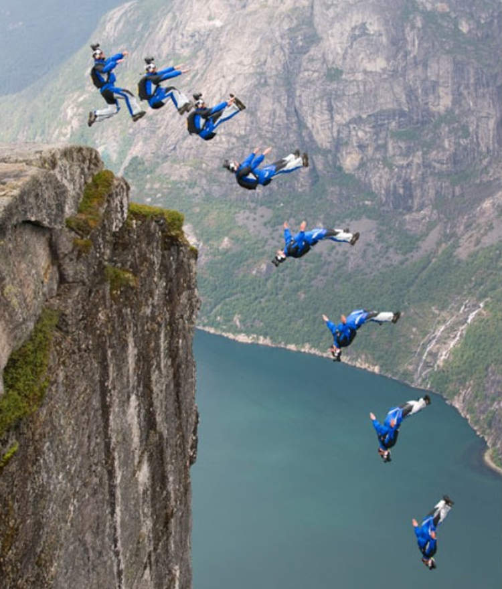
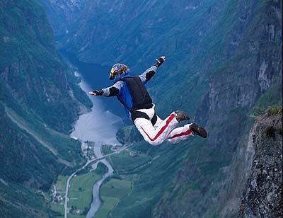
BASE jumping
BASE Jumping:is very extreme activity that includes a parachute (can be used both parachute and wingsuit) to jump from fixed objects, with unopened parachute like skydiving. The acronym “B.A.S.E.” stands for: Building, Antenna, Span, Earth – four categories of objects from which B.A.S.E. jumper can jump.

Slide 5
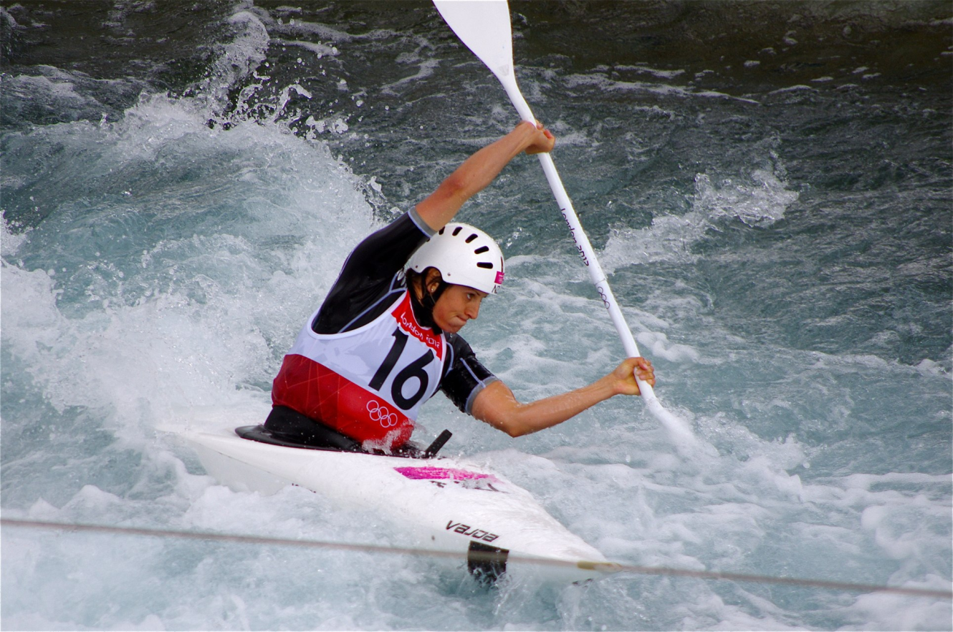
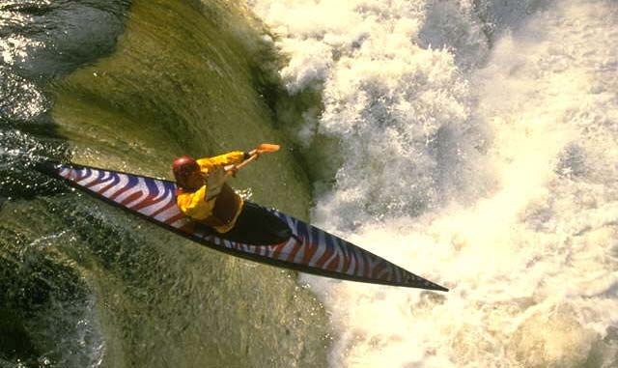
Canoeing
Canoeing: extreme canoeing (a.k.a whitewater canoeing or whitewater racing). These extreme guys race specialised canoes and kayaks down a dangerous whitewater rivers. There is also such a class like Extreme Canoe racing, that includes much more complicated rapids, leave it for real pros ☺

Slide 6
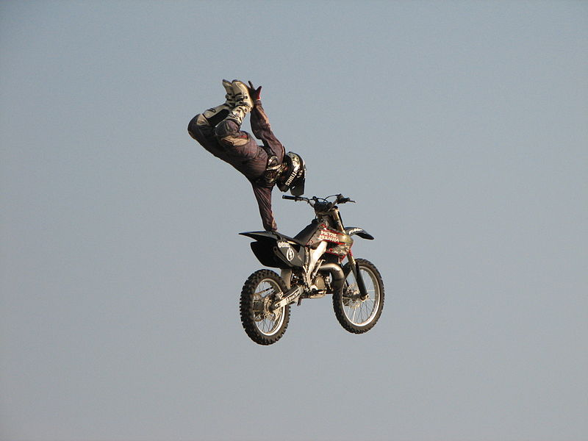
Extreme Motorsport
Extreme Motorsport: includes activities like supercross, motocross, freestyle motocross.

Slide 7
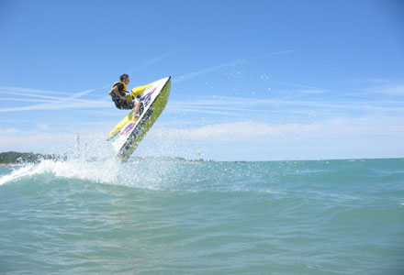
Hang Gliding
Jet Skis
Parkour

Slide 8
Kitesurfing
Ice Climbing
BMX

Slide 9
Trials
Mountain Biking
Paragliding

Slide 10
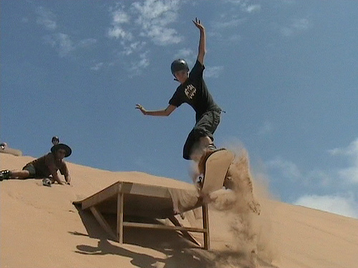
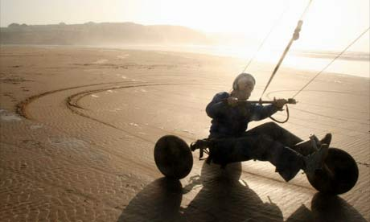
Rock Climbing
Sand Boarding
Sand Kiting

Slide 11
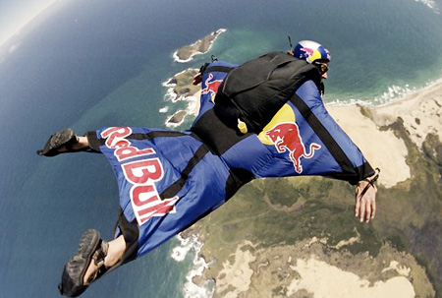
Scootering
Skateboarding
Snowkiting
Wingsuit sky diving

