Slide 1
Ukrainian Ataman

Slide 2
Semi boxing team, established in late 2012, serving in the boxing league World Series Boxing (WSB). Head Coach - Michael Miller. The team created Ukrainian Boxing Federation to address the popular boxing series. The first performance took place on 16 November 2012.

Slide 3
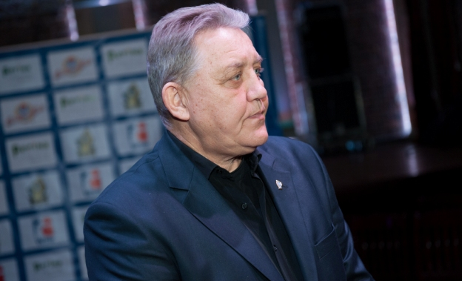
HEAD COACH Valentyn Sobolyevskyy

Slide 4
An honored coach in his home country of Ukraine, Valentyn Sobolyevskyy, will be coaching the Ukraine Otamans in WSB Season IV. Mr. Sobolevsky has worked as the head coach of the Ukrainian national boxing team, the state boxing coach of the Ukrainian Ministry of Youth and Sports and a coach-consultant in Iran.He started his coaching career in 1982 after having graduated from Simferopol State University. In a coaching career spanning more than 30 years he has trained the winner of USSR cup - Serhei Maslyanyy, the junior World Champion and Sydney Olympic Games athlete - Aleksandr Yatsenko, and the winners of USSR and Ukrainian Championships - Ihor Taranov, Vladimir Selyutin, Yevgenii Khramov, Konstantin Loika, Roman Drobakh, and Viktor Vyatkin.

Slide 5
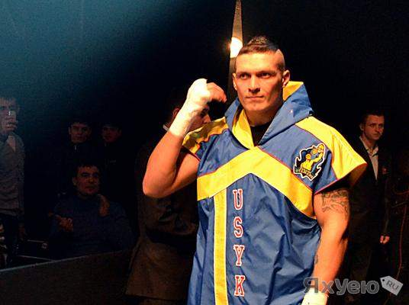

Slide 6
Mr. Sobolyevskyy was also responsible for identifying a promising young fighter called Aleksandr Usyk, who was at that time still a junior, but who has since become the European, World and Olympic Champion.Mr. Sobolyevskyy worked as the head coach of Turkish National Boxing Team from 2006-2010. The Turkish Boxing Federation has stated that this time period was the most successful in the history of the team. Valentyn Sobolyevskyy’s former student from that time, Yakup Kilitch (a member of Turkish national boxing team) went on to become a World and Olympic bronze medalist.

Slide 7
Finally, in 2013 Sobolyevskyy became the head of Ukrainian National Student Boxing Team, which took part in the first World Universiade 2013 (Kazan, Russia) and won three medals. Dmitrii Mytrofanov and Aleksandr Gvozdyk both took gold while Denys Berinchyk took the bronze. He therefore has the experience needed to make his team one of the most successful in the WSB.

