Slide 1
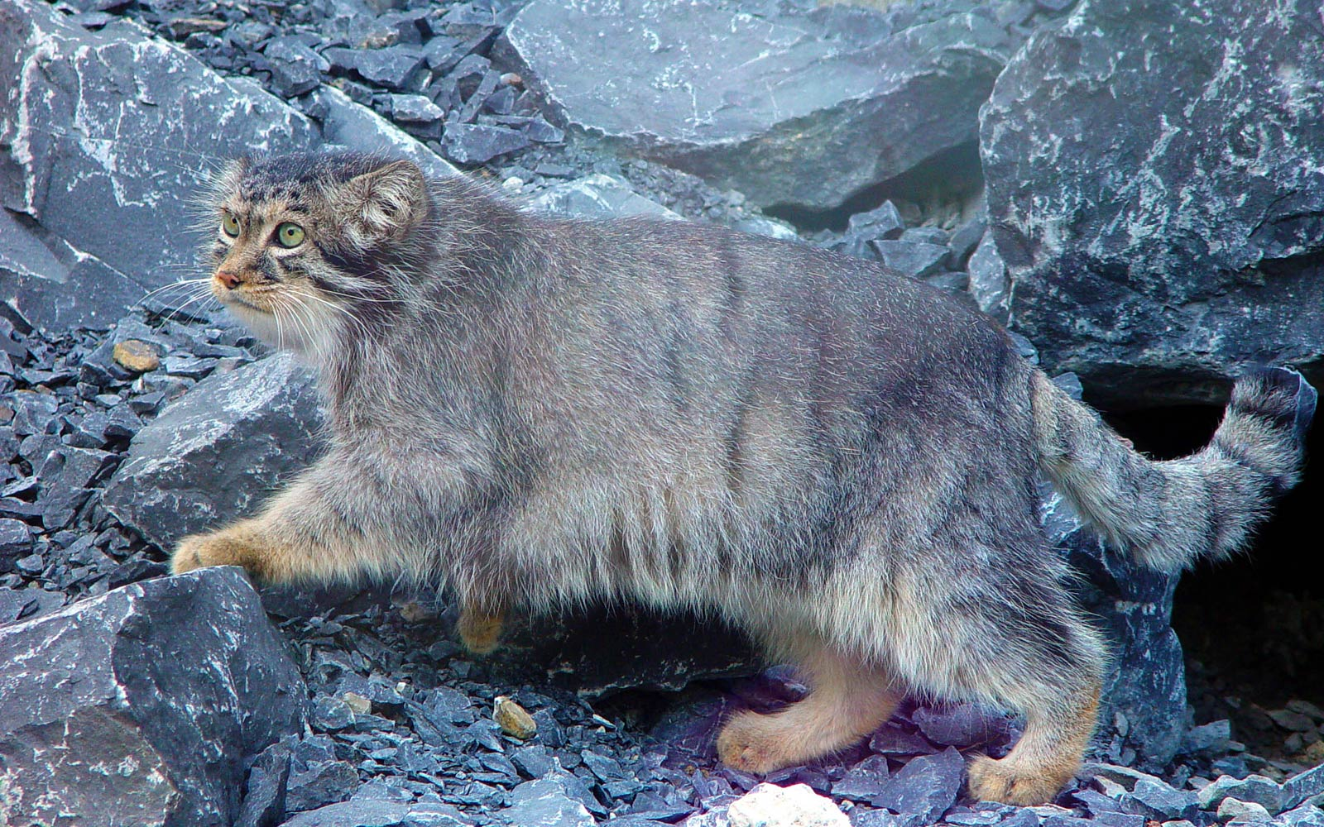
Pallas’s Cat

Slide 2
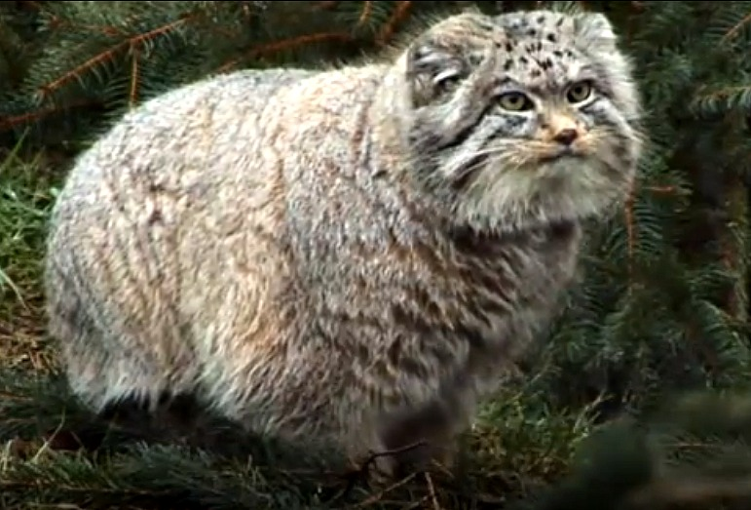
Well-furred cats from the cold Asian steppes, Pallas’s Cats Otocolobus manul are also called Manul, Steppe Cat or Rock Wildcat.

Slide 3
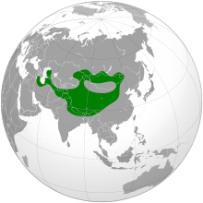
Distribution
Manul occur in Central Asia, from the Caspian Sea through Iran, Afghanistan, Pakistan and northern India to central China, Mongolia and southern Russia.

Slide 4
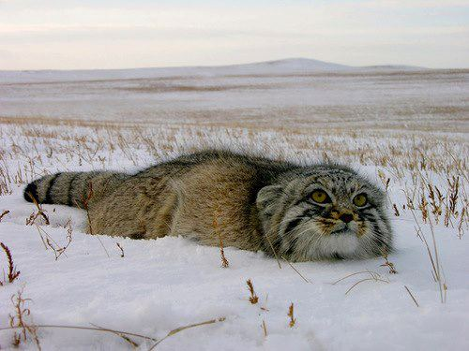
Lifestyle
Pallas’s cats are usually nocturnal but may come out during the day. They move around on their own in a territory that spans 2 to 3 miles. They den in caves, crevices and burrows made by other animals. The Pallas’s cats’ long, dense fur provides insulation against their snowy environment.

Slide 5
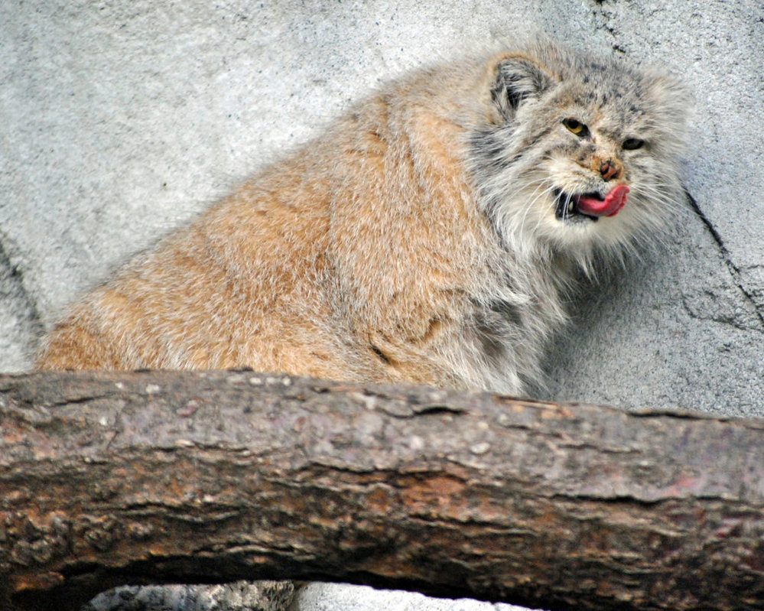
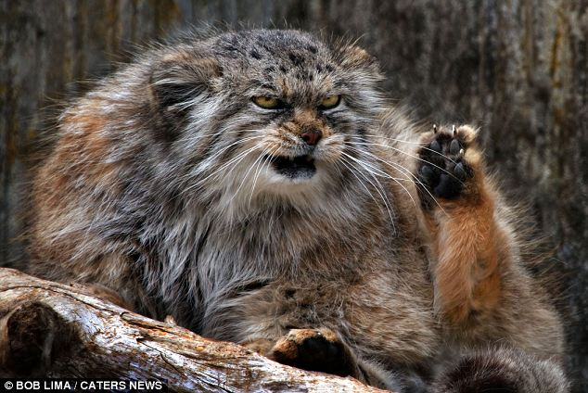
Food
Pallas’s cat eats small mammals such as rodents and pikas, and ground-dwelling birds.

Slide 6
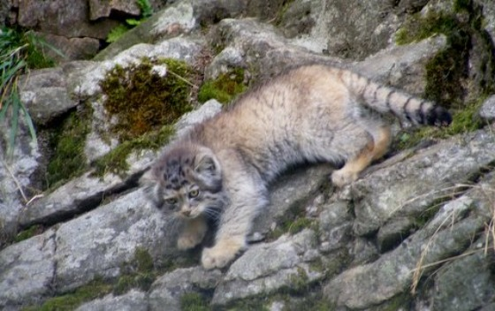
Life Cycle
The Pallas’s cat can usually lives to be 8 to 10 years old. Females give birth in late spring to litters of up to six young. In 4 to 6 months, the kittens are mature. Females are ready to be mothers at 1 year of age but little is known about the cats’ mating behavior.

Slide 7
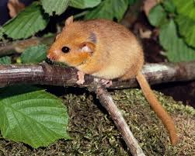
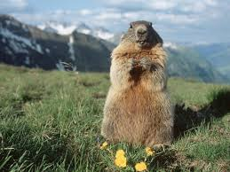
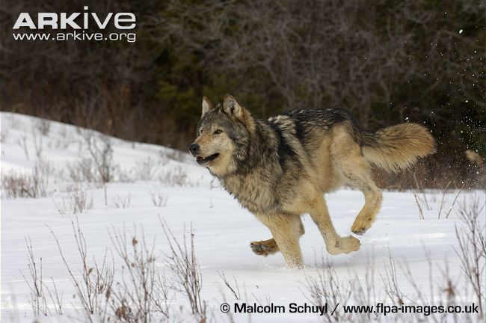
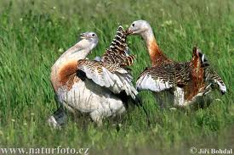
Some of Neighbors
Gazelles, marmots, gray wolves, saiga antelope, steppe eagles, maral deer, desert dormouse, marbled polecat, Marco Polo sheep, great bustard, squirrels

Slide 8
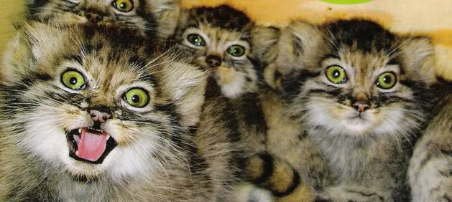
Population Status & Threats
In the 1900s, fur traders hunted Pallas’s cats for their fluffy coats. Eventually, laws were made to protect the cats. The hunt for their fur has slowed but still goes on, threatening the Pallas’s cat’s survival. Efforts to poison pikas to control their population also puts pressure on the cats.

Slide 9
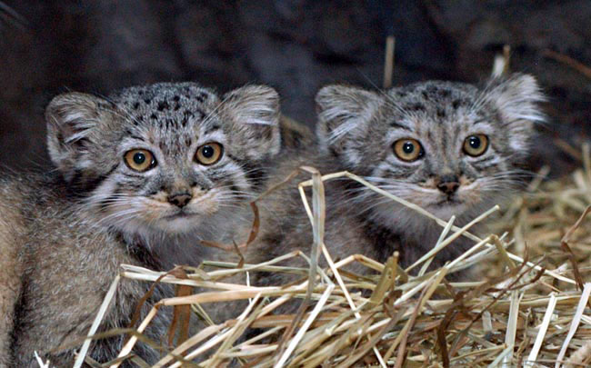
WCS Conservation Efforts
WCS(Wildlife Conservation Society) is working with government officials and scientists in Central Asia to eventually create an International Peace Park that would protect animals in the region.

Slide 10
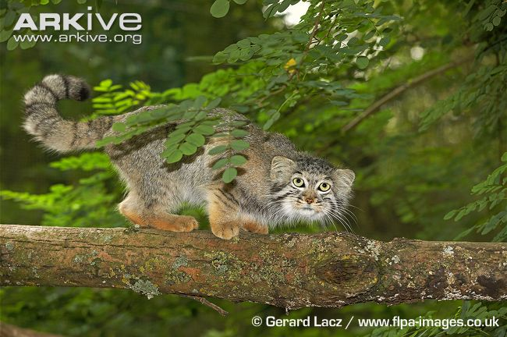
The best hope for Pallas’ Cat is that the inaccessibility and desolation of their habitat will help keep their numbers from being too decimated. Conservation measures must include improving law enforcement efforts and revamping the hunting permit system.

Slide 11
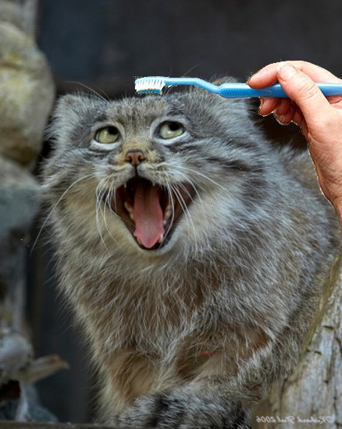

Slide 12
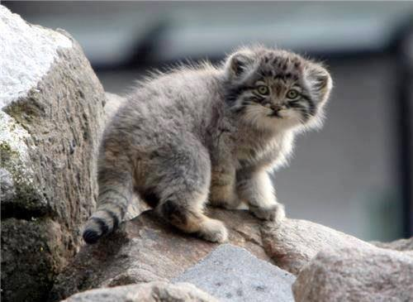

Slide 13
