Slide 1
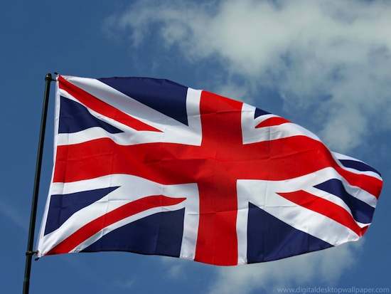
Some interesting facts about Great Britain

Slide 2
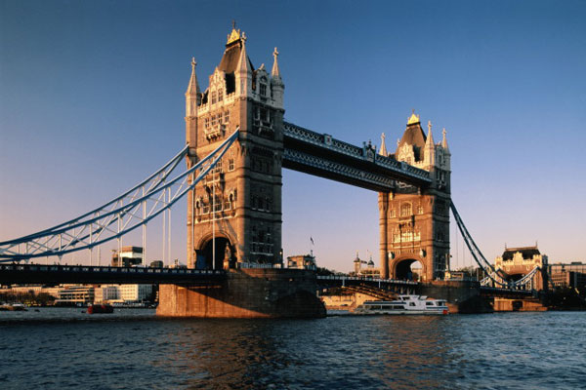
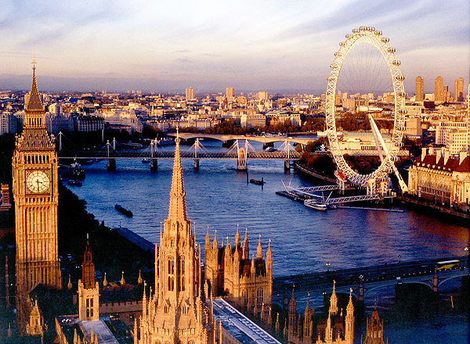
The full official name of the country - The United Kingdom of Great Britain and Northern Ireland.
England is the largest country in the United Kingdom, but the capital of the UK is London.

Slide 3
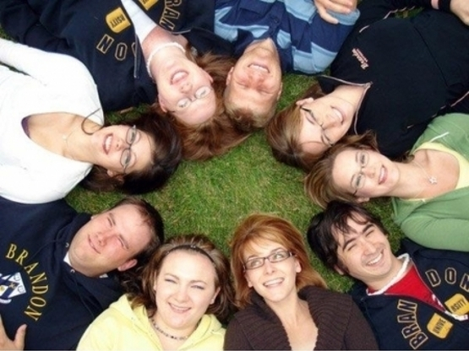
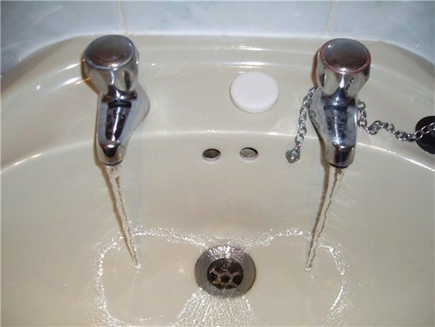
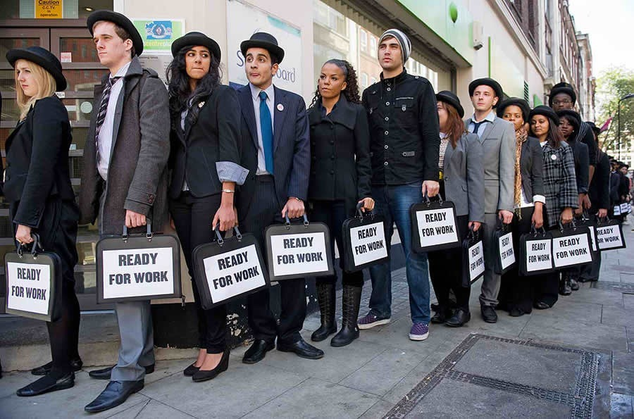
Facts about people:
The British did not wash under running water.
The English are not discuss their private life.
You can engage a stranger in conversation only two ways:
The dream of Englishmen is to become the owner of the land and estate, and engage in a garden there!

Slide 4
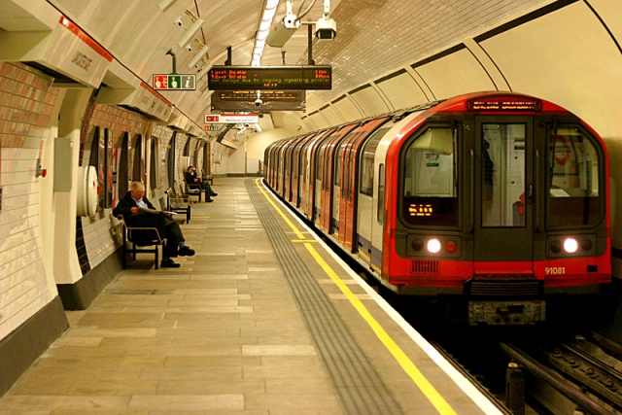
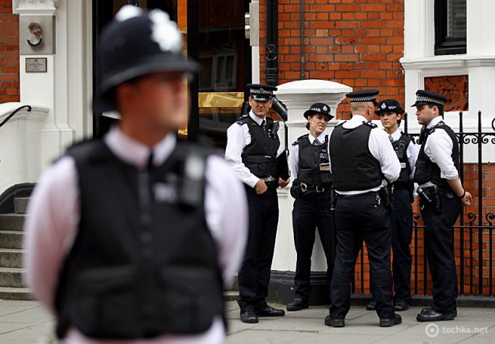
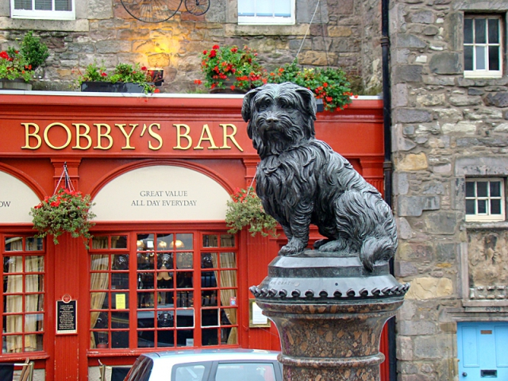
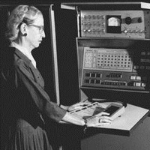
The slogan on the coat of arms of the United Kingdom was written in French: "Dieu et mon droit" («God and my right").
A distinctive feature of the British underground can be called:
Edinburgh has been home to Skye terrier Grey Friar's Bobby, who won the hearts of a nation:
In Great Britain the police are called bobby.
The world's first computer programmer was a woman.
There is a very strict law that prohibited overhanging bed from the window.

Slide 5
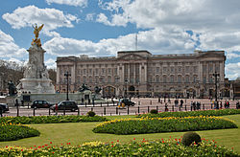
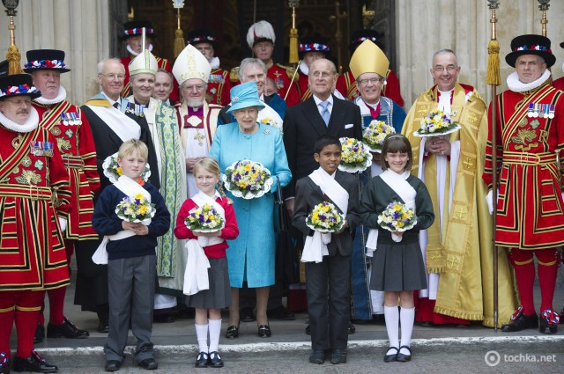
Some facts about the Queen
Official holiday "Birthday British monarch" does not coincide with the actual date of birth of the British Queen:
Buckingham Palace has 775 rooms.
Queen Elizabeth's childhood nickname - Lilibeth as her full name she could not pronounce.
Queen Elizabeth met her future husband Philip when she was 13 years old.
Queen Elizabeth II -the last crowned king of Europe.

