Slide 1
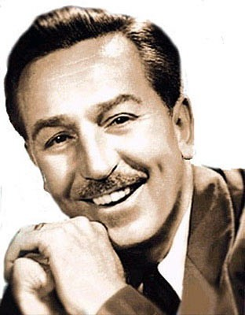
Walt Disney
5.12.1901 – 15.12.1966

Slide 2
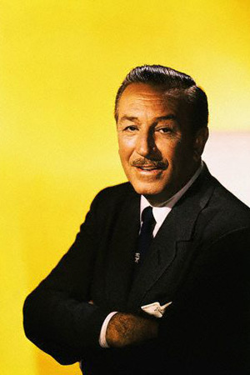
Walt Disney could take the dreams of America, and make them come true. He was very creaive and imaginative person.

Slide 3
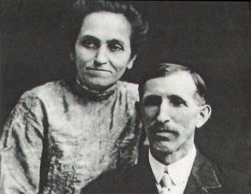
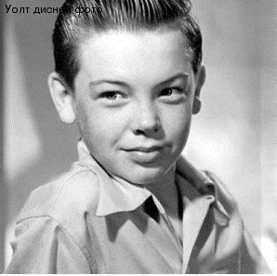
Walt’s parents, Elias and Flora
small Walt Disney

Slide 4
Walt attended McKinley High School in Chicago.

Slide 5
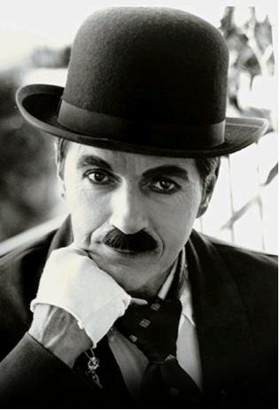
At school he began to entertain his friends by imitating his silent screen hero, Charlie Chaplin.

Slide 6
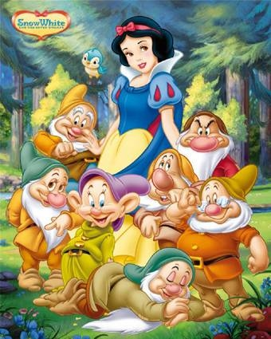
On December 21, 1937, Snow White and the Seven Dwarfs, the first full-length animated musical feature, premiered at the Carthay Theater in Los Angeles.

Slide 8
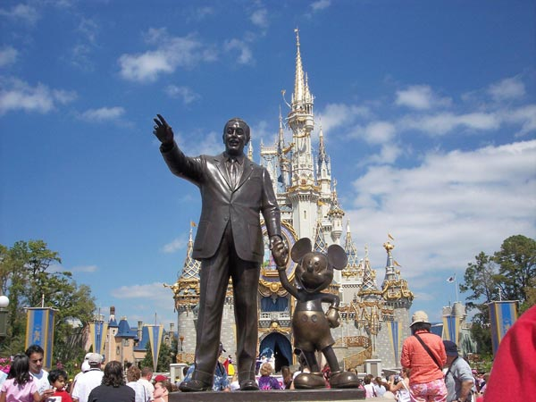
Walt Disney is a legend; a folk hero of the 20th century. His worldwide popularity was based upon the ideals which his name represents: imagination, optimism, creation, and self-made success in the American tradition.

Slide 9
Thank you for attention!

