Slide 1
10 worst catastrophes in the world!

Slide 2
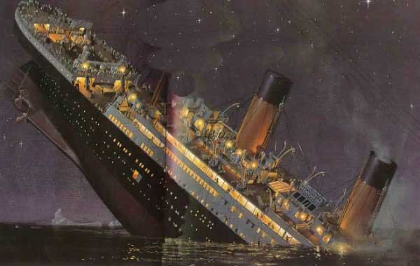
Titanic - $ 150 million
Один из самых известных катастроф стоить всего
150 миллионов долларов (на современные деньги).

Slide 3
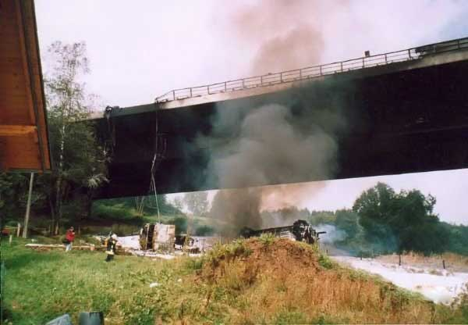
Tanker Truck and Bridge - $ 358 Million
August 26, 2004 car crashed into a fuel truck full,
which caught fire and exploding, destroyed cities.
Cost recovery work - 358 million

Slide 4
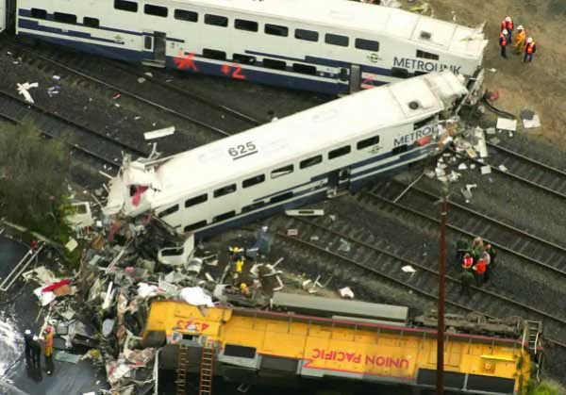
Train collision $ 500 Million
September 12, 2008 in California, the two trains collided.
25 people were killed, monetary loss of MetroLink were
$ 500 million (including payments to families of the dead)

Slide 5
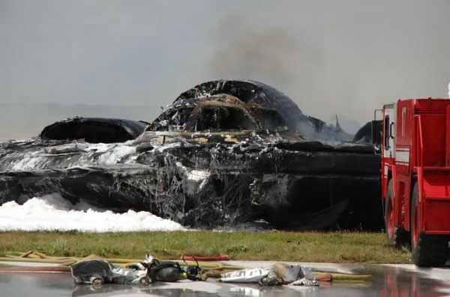
The fall of the bomber B-2 $ 1.4 billion
Bomber B-2 made by stealth technology, collapsed
February 23, 2008. The flames destroyed almost the entire flight.
Both pilots ejected and survived.

Slide 6
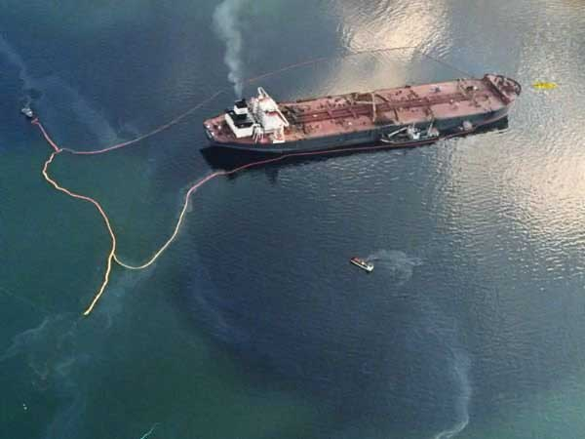
Oil spill tanker Exxon Valdez - $ 2,5 billion
Oil spill tanker Exxon Valdez was not the biggest,
in terms of the amount of oil, but because of the remoteness of
katasrofy, the whole operation of cleaning the oil stains oboschlas
$ 2.5 billion

Slide 7
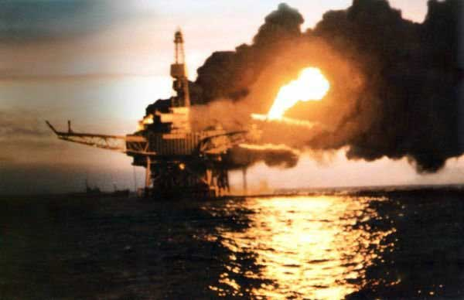
Fire at oil rig - $ 3.4 billion
One of the worst disasters in the history of oil
complexes. Due to an error of technical personnel who
Remember to change the 1 safety valve, there was a
explosion and fire. This disaster took the lives of 167 workers
at a cost of $ 3.4 billion

Slide 8
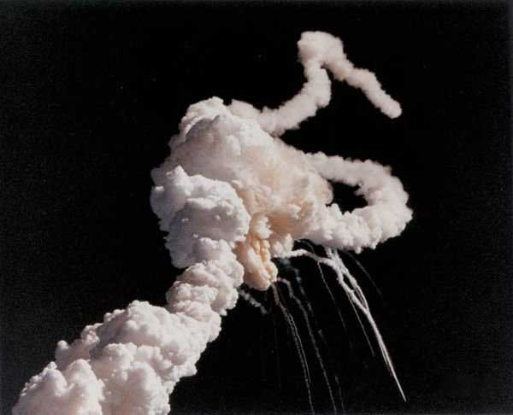
Challenger Explosion - $ 5.5 billion
28 января 1986 после 73 секунд после начала всплеска

Slide 9
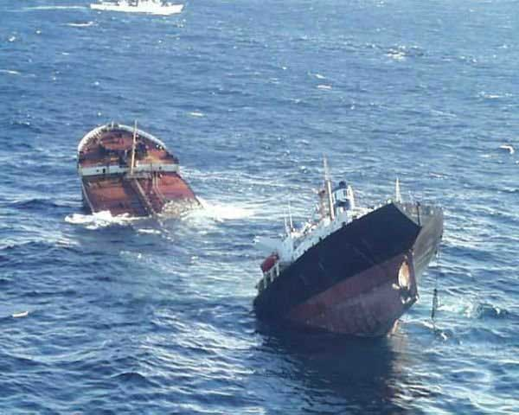
The explosion of the tanker Prestige - $ 12 billion
November 13, 2002 explosion of the oil tanker Prestige led
leakage of 77,000 tons of fuel. Its cleaning cost 12 billion
dollars

Slide 10
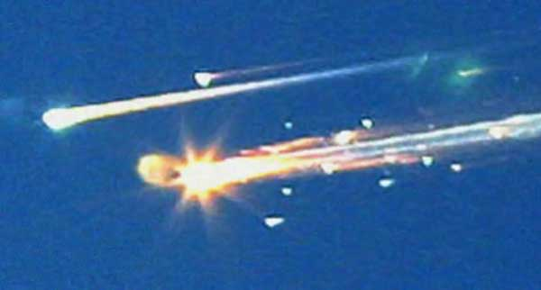
The explosion of the Space Shuttle Columbia - $ 13 billion.
February 1, 2003 space shuttle Columbia failed.
It cost Americans $ 13 million.

Slide 11
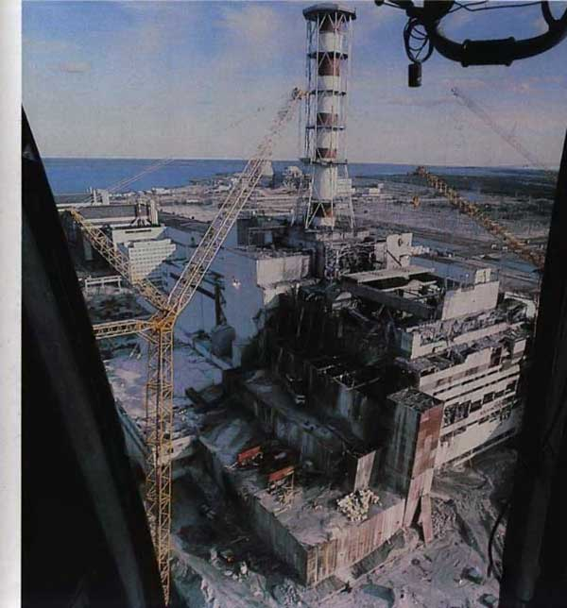
Chernobyl. $ 200 billion
April 26, 1986 there was a
terrible catastrophe in human history.
The explosion of the 4th unit of Chernobyl nuclear power plant, the evacuation of people
elimination of the consequences and costs amounted to pr
a conservative estimate of $ 200 billion

Slide 12
The end

