Slide 1
Healthy Food & Healthy Lifestyle
Done by:
Natalia Maltseva
Form 6(10)-A

Slide 2
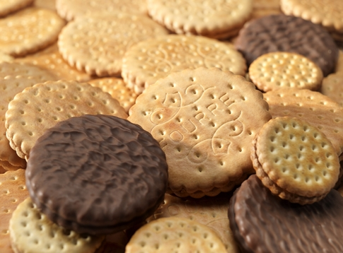
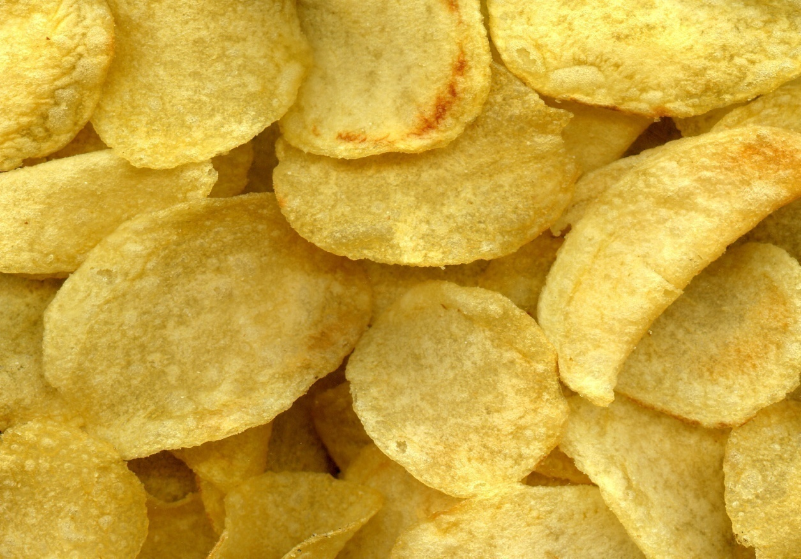
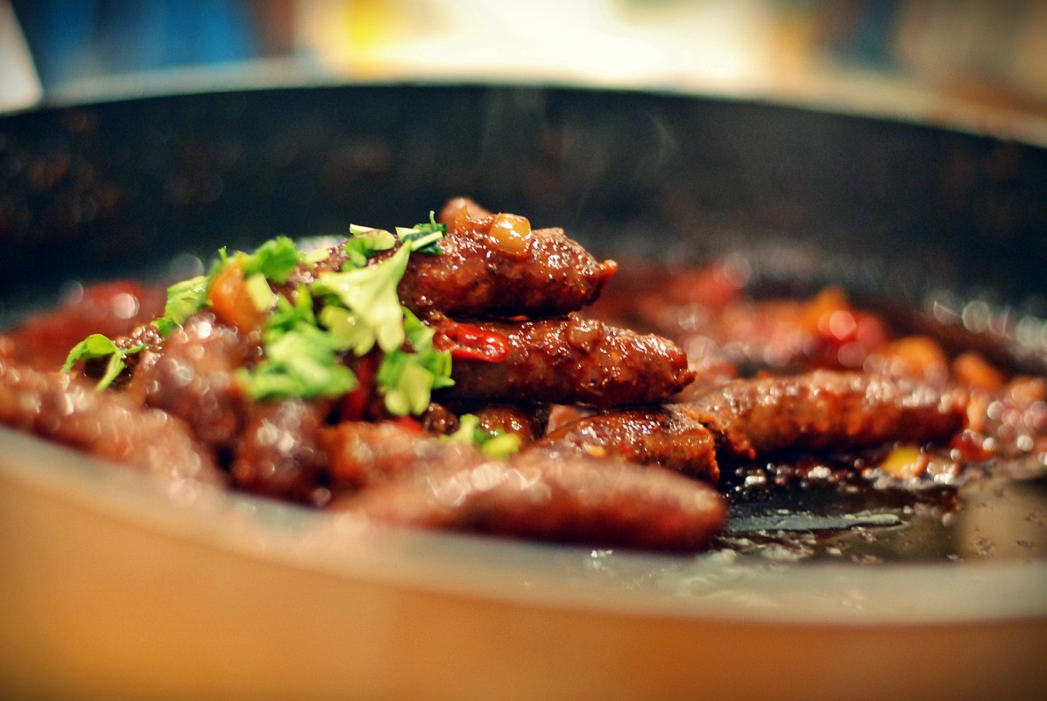
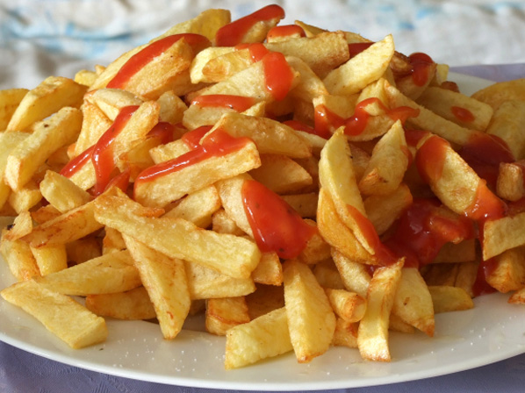
Healthy Food
All food is made up of nutrients which our bodies use. There are different kinds of nutrients: carbohydrates, proteins, fats» vitamins and minerals. Different foods contain different nutrients.
Before we cut down on fat, sugar and salt, we have to know a bit more about the kind of food these things might be in. The biggest problem comes when these things are hidden in other foods: biscuits, crisps, sausages, meat pies, soft drinks and so on.

Slide 3
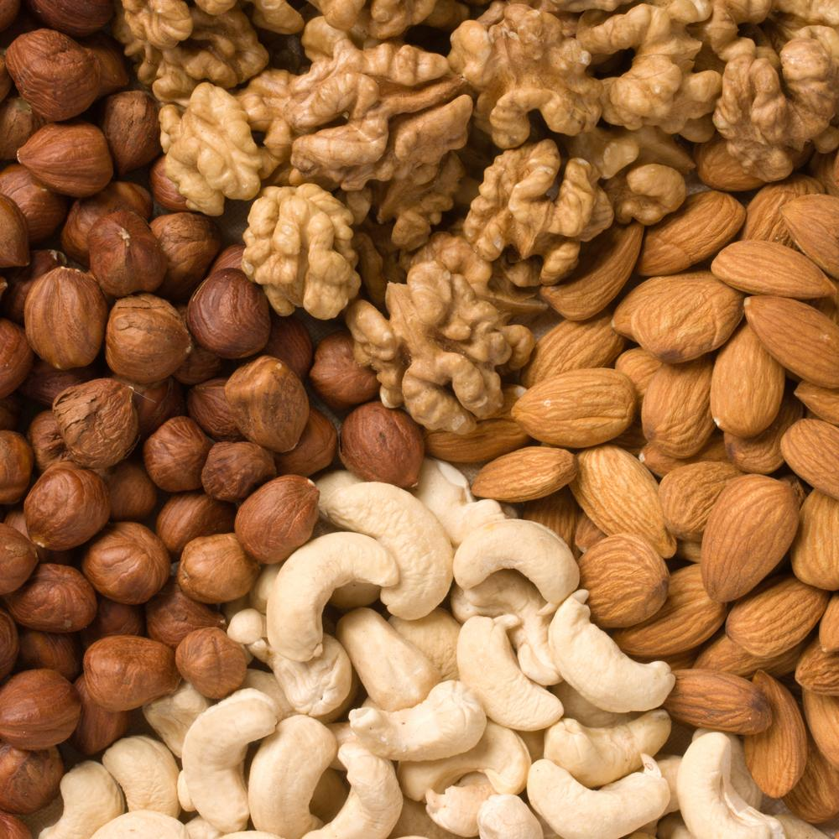
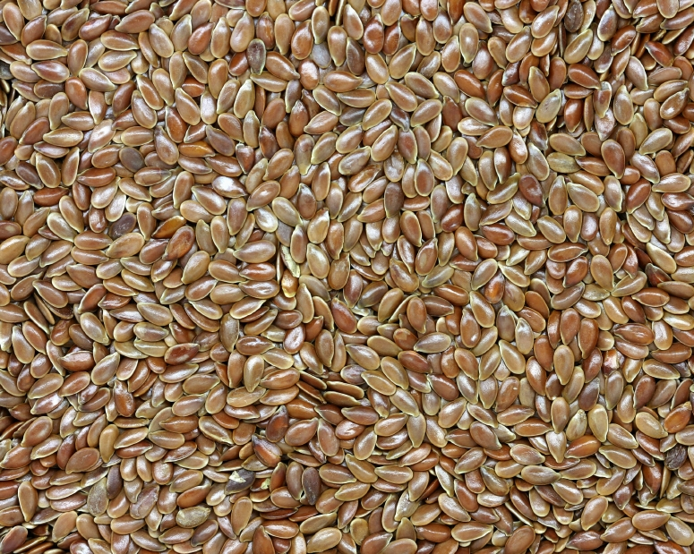
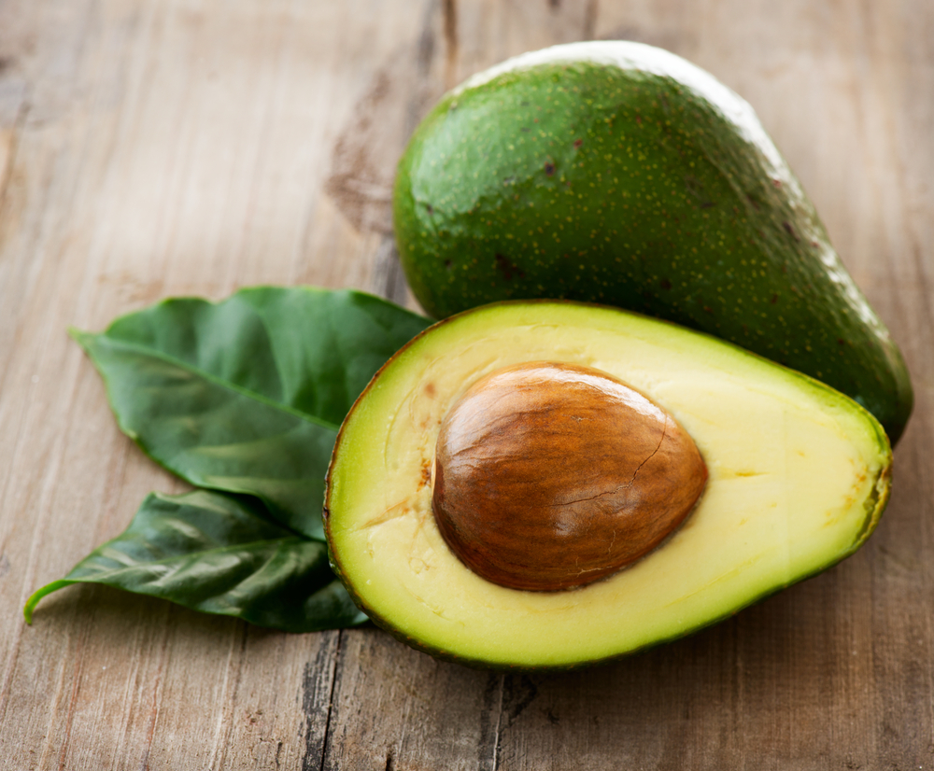
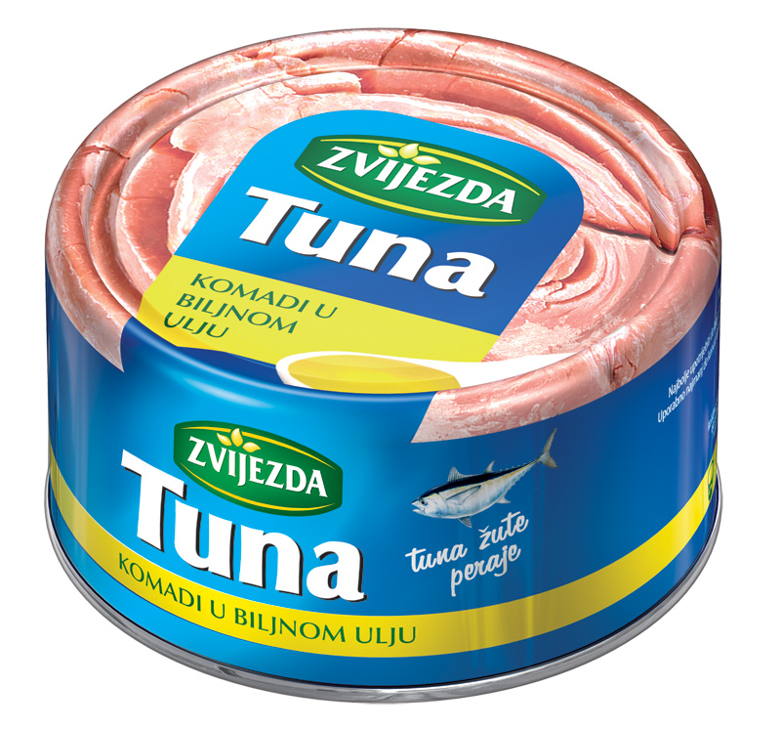
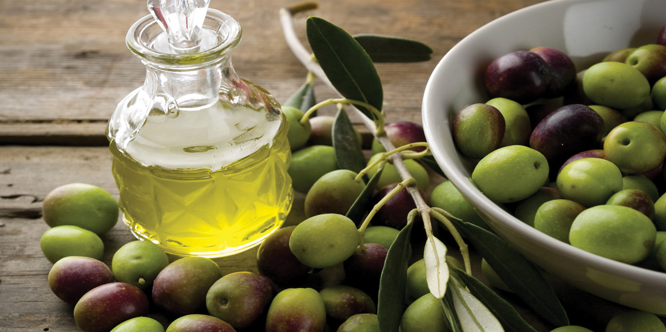
Healthy Food
But we all know that to eat much fat is bad for our health. The matter is that there are different kinds of fat. There are fats that are good for us and fats that are bad for us. Eating less of the bad ones and more of the good ones can actually help us to live longer! Bad fats are the saturated fats, found in animal productions, like red meat, butter and cheese.
Friendly fats are the unprocessed fats found naturally in foods like nuts and seeds, olives, avocados and oily fish, including tuna.

Slide 4
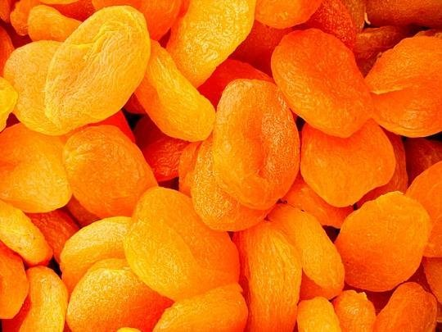
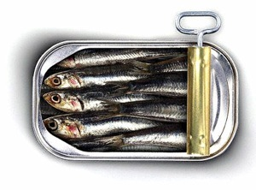
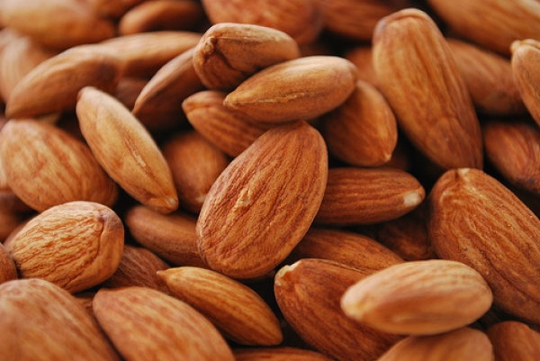
Mental Work
Iron
Iron helps produce hemoglobin, the protein in red blood cells that carries oxygen to your body's tissues.
Iron is also necessary for proper muscle and organ function, and it fills our bodies with energy. If you're feeling tired and weak, have decreased school performance or have difficulty maintaining body temperature, chances are that you may be suffering from an iron deficiency.
You can find Iron in: muesli, dried apricots, pilchards, almonds.

Slide 5
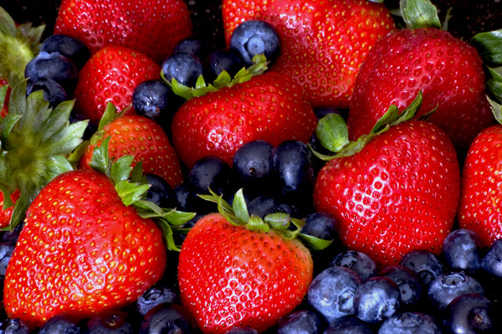
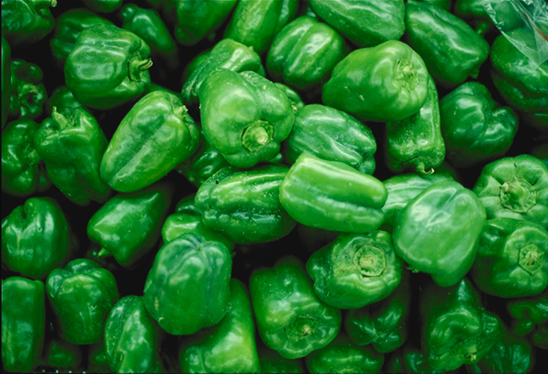
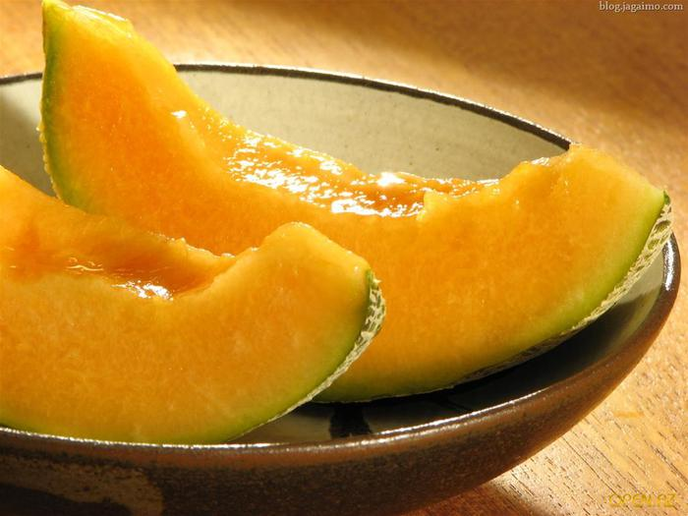
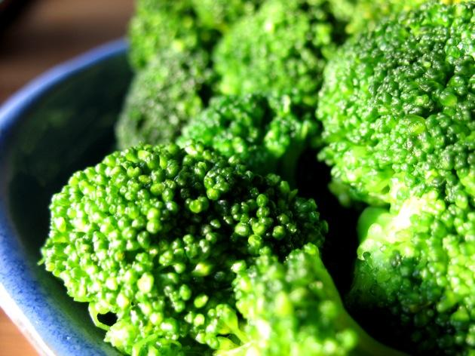
Mental Work
Vitamin C
Vitamin C helps the body maintain healthy tissues and a strong immune system, and it aids in the absorption of iron. Vitamin C is considered a powerful ally if you're trying to avoid or kick a cold or other illness. Together with calcium and iron, it's also an important part of a diet that counteracts lead poisoning.
You can find vitamin C in: berries, green pepper,
melon, broccoli.

Slide 6
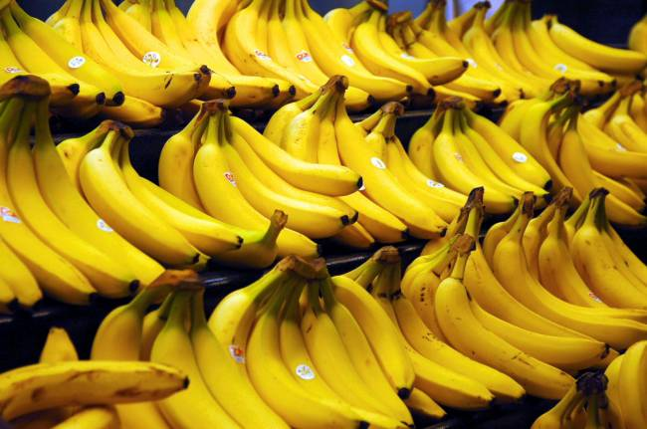
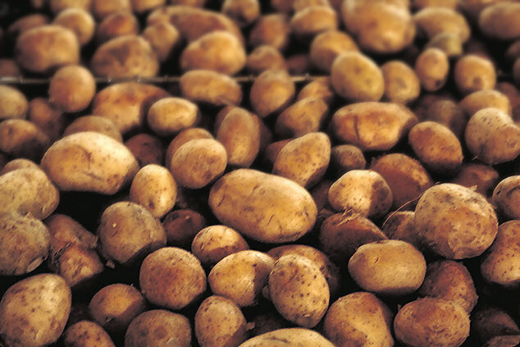
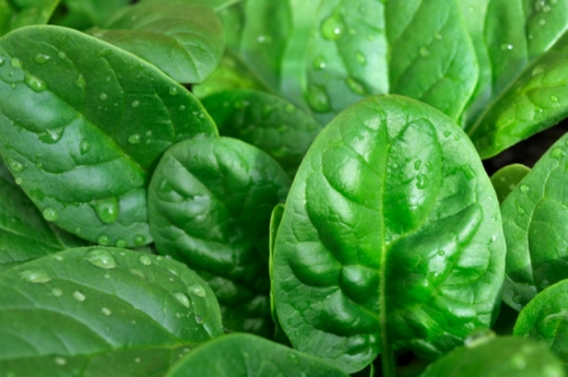
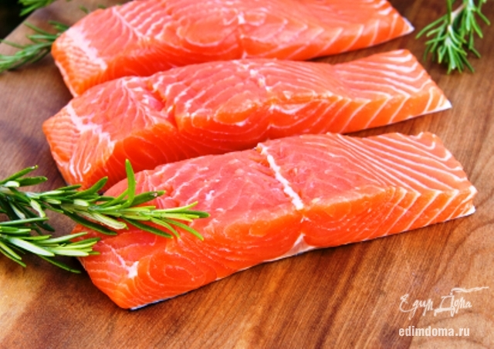
Stressless
Potassium
Potassium is an essential nutrient used to maintain fluid and electrolyte balance in the body. Potassium is part of every cell in the body, and life would be impossible without it. It’s important to eat enough potassium every day to feel your best, and to help prevent certain chronic conditions.
You can find potassium in: bananas, potatoes,
spinach, salmon.

Slide 7
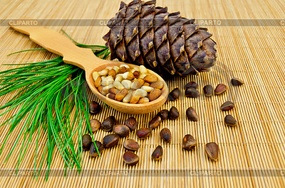
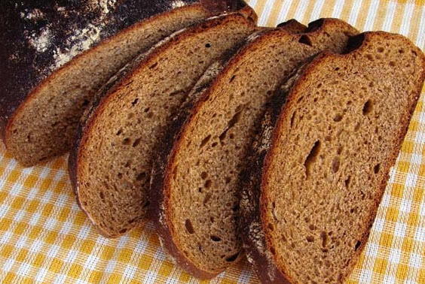
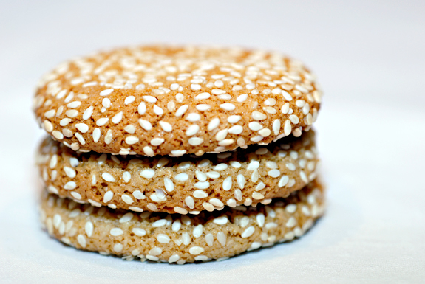
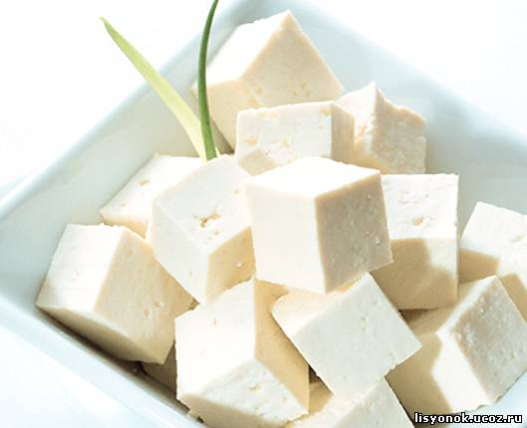
Stressless
Magnesium
Magnesium is an essential mineral required by the body for maintaining normal muscle and nerve function, keeping a healthy immune system, maintaining heart rhythm, and building strong bones. Magnesium is also involved in at least 300 biochemical reactions in the body. A deficiency in magnesium can lead to muscle spasms, cardiovascular disease, diabetes, high blood pressure, anxiety disorders, migraines, osteoporosis, and cerebral infarction.
You can find magnesium in: cedar nuts, rye bread, sesame, tofu.

Slide 8
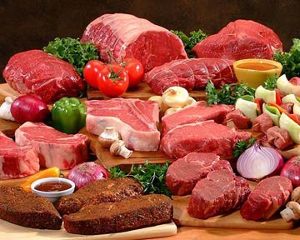
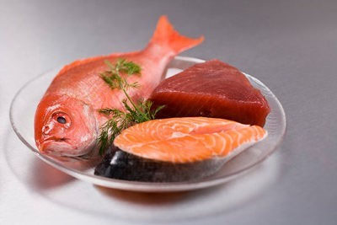
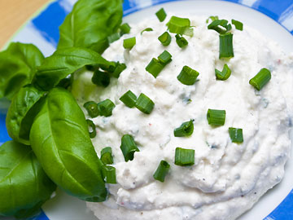
Energy
Protein
Protein is a macro nutrient composed of amino acids that is necessary for the proper growth and function of the human body. Protein is the most basic building block of all the tissues in the body. In addition to growth and repair of the body protein plays a key role in the production of enzymes, digestion, and proper immune function.
You can find protein in: lean red meat, fish, poultry, cottage cheese.

Slide 9
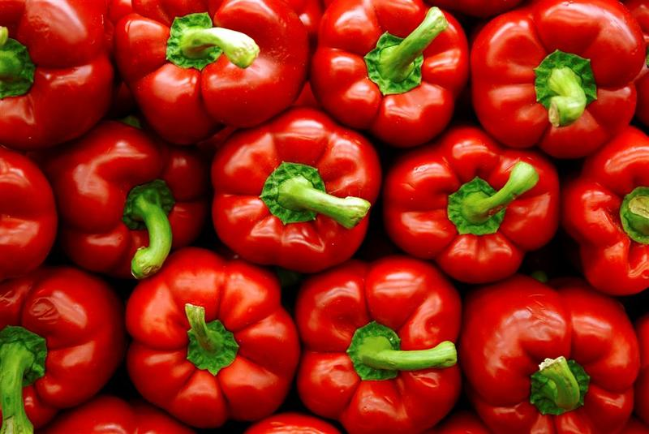
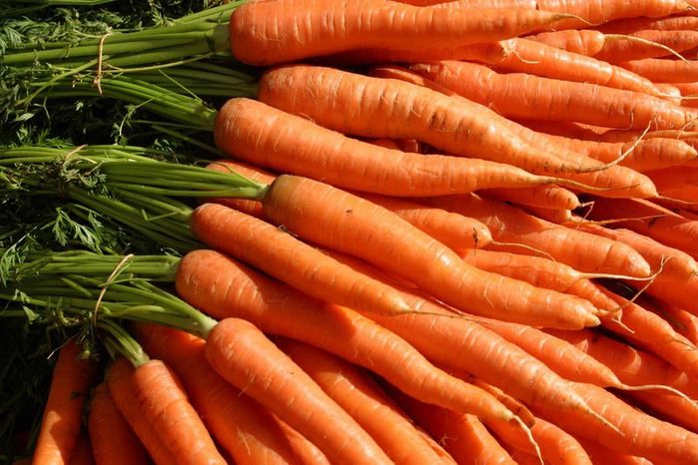
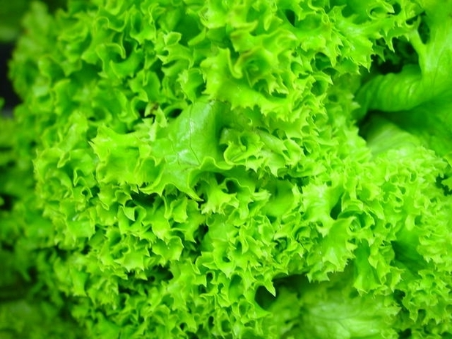
Energy
Beta-carotene
Beta Carotene is a carotenoid compound responsible for giving fruits and vegetables their orange pigment. A powerful antioxidant, beta carotene has been found to help protect against cancer and aging. Beta-carotene is a fat soluble vitamin, so eating the following foods with a fat like olive oil or nuts can help absorption.
You can find beta-carotene in: mango, red pepper, carrot, lettuce.

Slide 10
Healthy Lifestyle
Nowadays our life is getting more and more tense. People live under the press of different problems, such as social, ecological, economic and others. They constantly suffer from stress, noise and dust in big cities, diseases and instability. A person should be strong and healthy in order to overcome all difficulties. To achieve this aim people ought to take care of their physical and mental health. There are several ways to do it.
The state of your body depends on how much time you spend doing sports. At least everybody must do morning exercises every day.

Slide 11
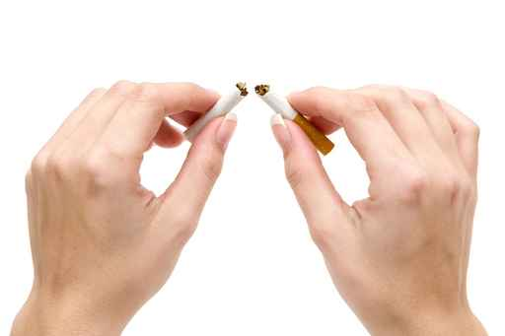
Healthy Lifestyle
To be healthy, people should get rid of their bad habits. It's necessary to stop smoking and drinking much.
Everyone should remember that cigarettes, alcohol and drugs destroy both body and brain.
Besides according to statistics most of crimes are committed by people under the influence of drugs and alcohol.

Slide 12
Thanks for your attention!

