Slide 1
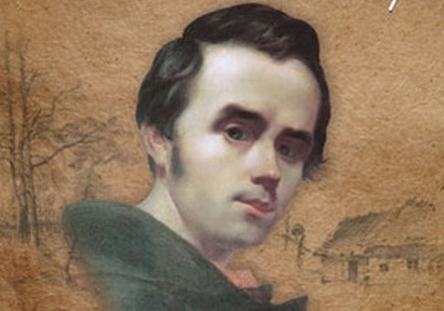
«Pictures of Taras Shevchenkо»
Olena Chernobaeva Form 10

Slide 2
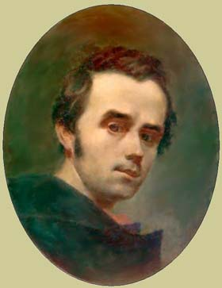
Self-Portrait 1840-43 oil ,on canvas.

Slide 3
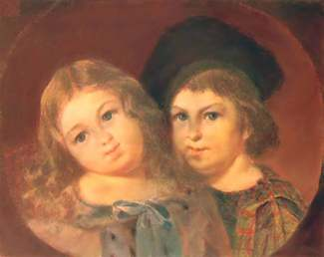
Portrait of children Repnin - Volkonsky oil, on canvas, 1841

Slide 4
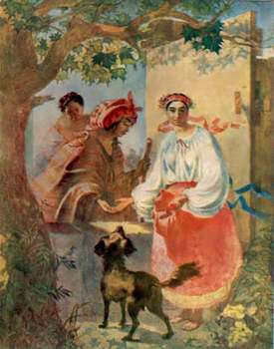
Gypsy fortune-telling 1841, watercolor.

Slide 5
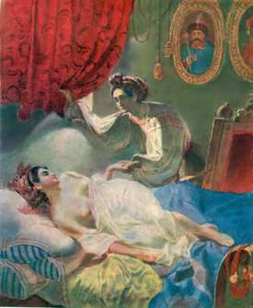
Maria. Illustration for "Poltava" by Pushkin 1840, watercolor.

Slide 6
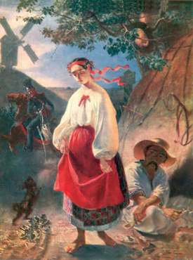
Katerina 1842, oil, on canvas.

Slide 7
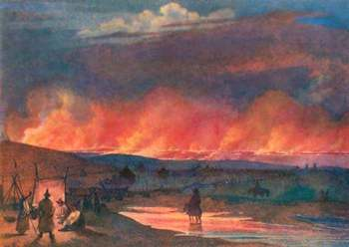
Fire in the Steppe 1848, watercolor on paper.

Slide 8
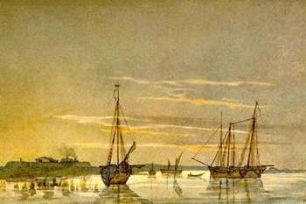
Schooner at the fort Kos-Aral watercolor on paper.

Slide 9
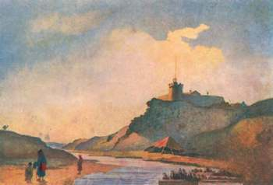
Fort Kara-Butak 1848, watercolor on paper.

Slide 10
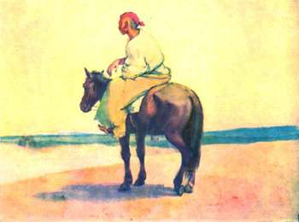
Cossack on horseback 1848-49, watercolor on paper.

Slide 11
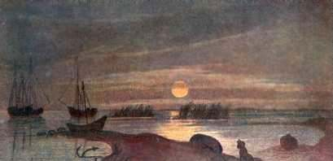
Moonlit Night 1848-49, watercolor on paper.

Slide 12
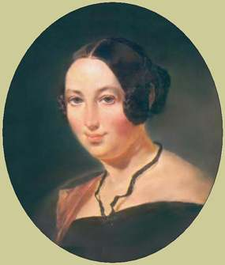
Portrait H.M.Maevskoy 1843, oil on canvas.

Slide 13
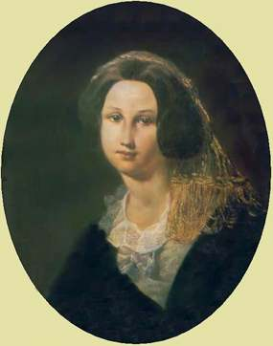
Portrait of E. Keykuatovoy 1842, oil on canvas.

Slide 14
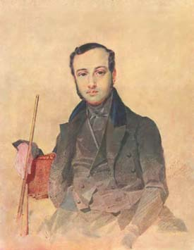
Portrait Grebinky, watercolor, 1837.

Slide 15
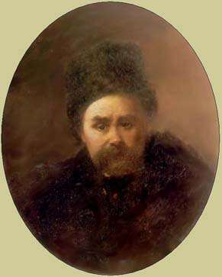
Self-portrait 1861, oil on canvas.

Slide 16
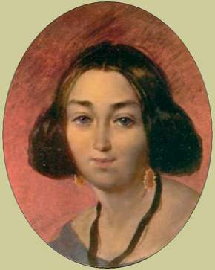
Portrait of a G.I Zakrevskaya 1843, oil on canvas.

