Slide 1
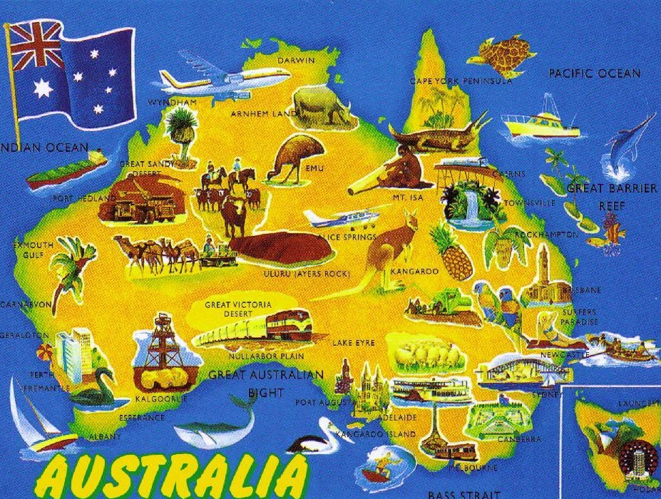
AUSTRALIA
Australia is the only country in the world that is also a continent.
Australia lies between the South Pacific Ocean and Indian.
The name of the country comes from Latin word “australis” which mean southern.

Slide 2
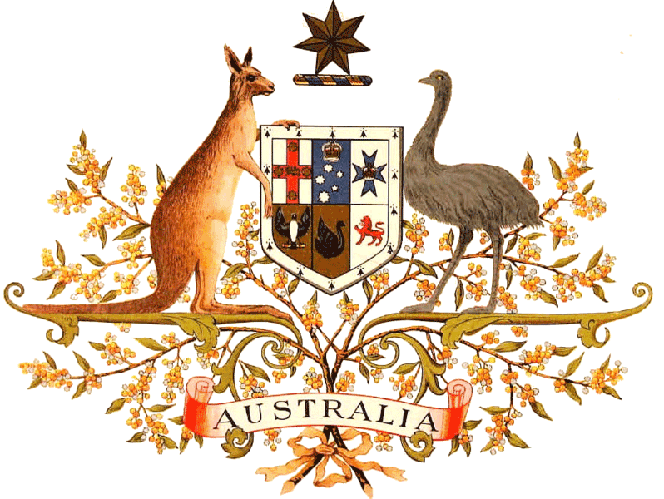
The Commonwealth of Australia is a federation of states.
Australia has six states.
Australia has two territories – the Australian Capital Territory and the Northern Territory.
The capital of the country is Canberra.

Slide 3
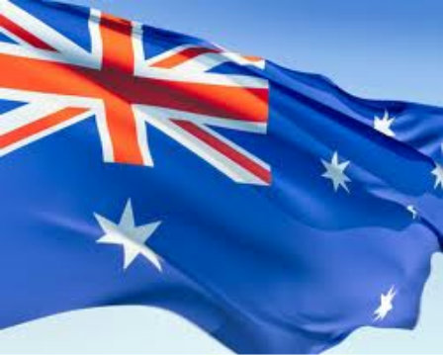
Australia is a constitutional monarchy like Great Britain.
Australia is a member of the Commonwealth of Nations which is an association formed by Britain and some former colonies.
Australia is one of the world’s developed countries.
Australia has modern factories, highly productive mines and farms, and busy cities.
The most important trading partners of Australia are Japan and the United States.

Slide 4
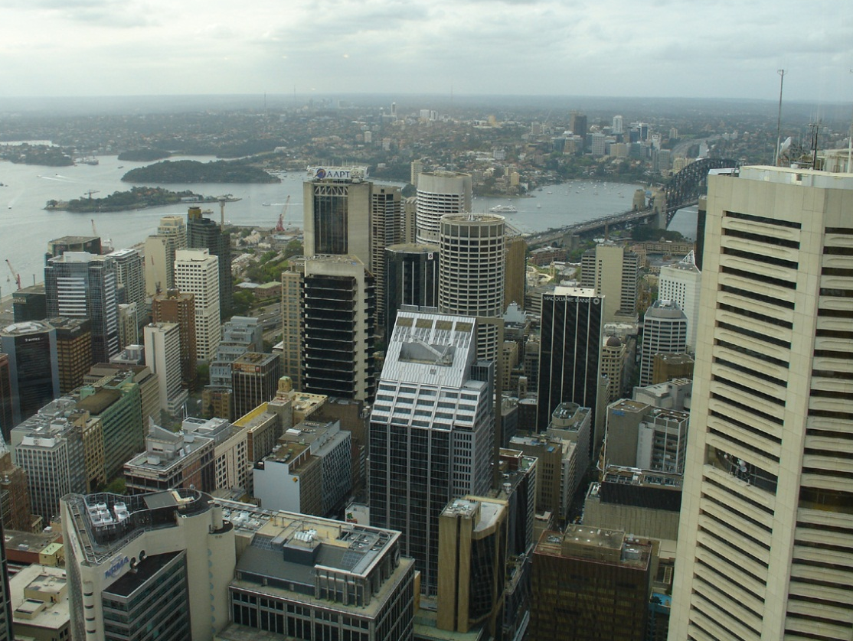
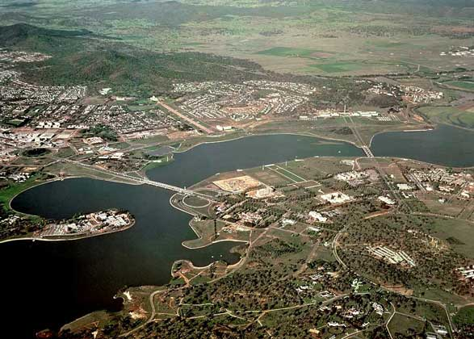
Sidney and Canberra are the largest city.

Slide 5
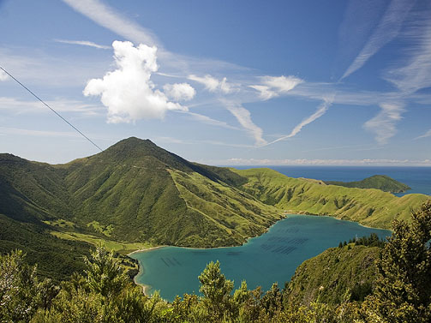
NEW ZEALAND

Slide 6
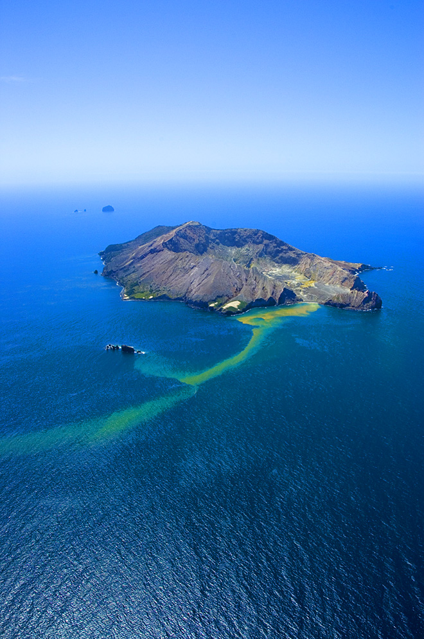
New Zealand is an island country in the Southwest Pacific Ocean.
New Zealand belongs to a large island group called Polynesia.
Wellington is the capital of New Zealand and Auckland is the largest city.
English is the official language of New Zealand.
Many native people speak their own language Maori.

Slide 7
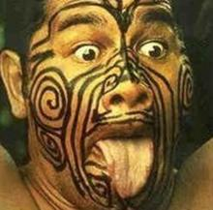
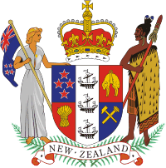
The country once belonged to the British empire.
New Zealand is a constitutional monarchy.
Britain gave New Zealand a constitution in 1852, when it was a British colony.
New Zealand has one of the highest standard of living in the world.
The first people who settled in New Zealand were a brown-skinned people called Maoris.

Slide 8
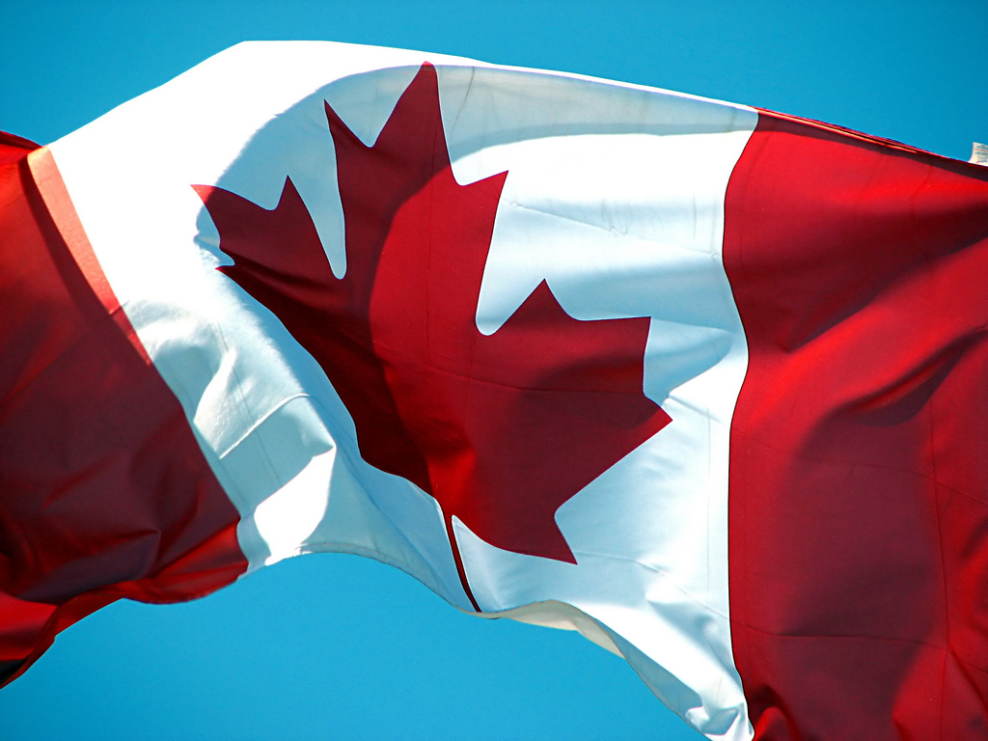
CANADA
Canada is the second largest country in the world.
About 28 million people in Canada.
Canada is a federation od 10 provinces and 2 territories.
Canada is an independent nation.

Slide 9
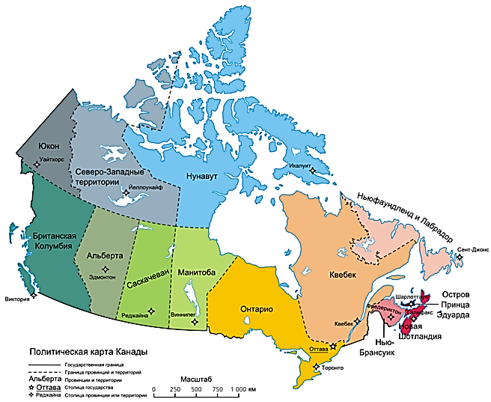
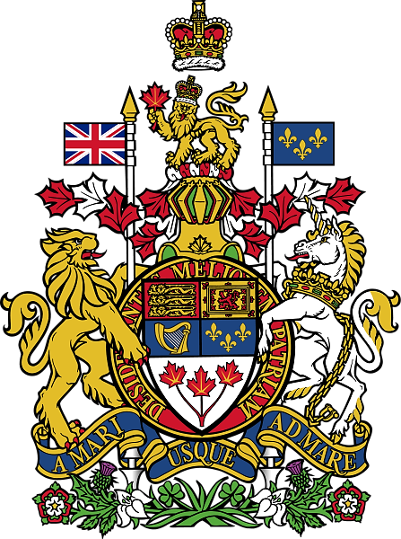
Canada’s people are varied.
77 % of Canada’s people live in cities or towns.
Native people – American Indians and Eskimos.
English and French are official languages of the country.
Ottawa is the capital of the country.
Toronto and Montreal are largest urban areas.

