Slide 1
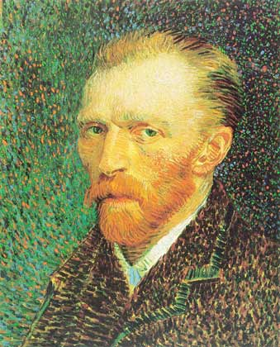
Vincent Willem van Gogh

Slide 2
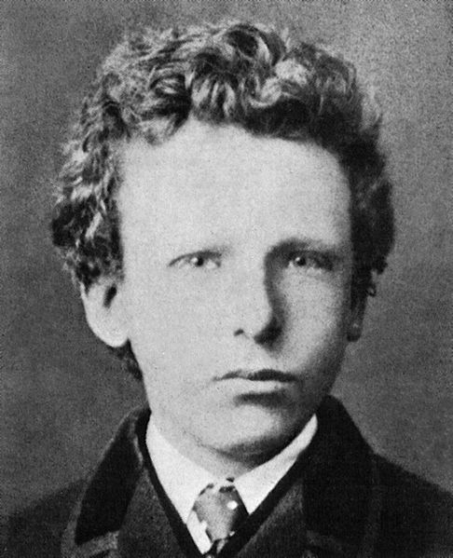
Vincent Willem van Gogh was born in Groot-Zundert village in the province of Brabant in the south of the Netherlands. As a child, Vincent was serious, silent and thoughtful. He attended the Zundert village school from 1860. In July 1869, his uncle Cent helped him obtain a position with the art dealer Goupil & Cie in The Hague. After his training, in June 1873, Goupil transferred him to London, where he lodged at 87 Hackford Road, Brixton, and worked at Messrs.
On 27 July 1890, aged 37, Van Gogh is believed to have shot himself in the chest with a revolver.

Slide 3
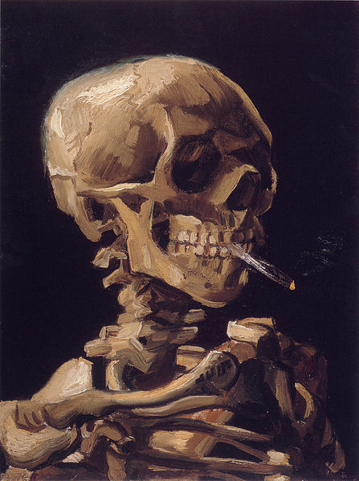
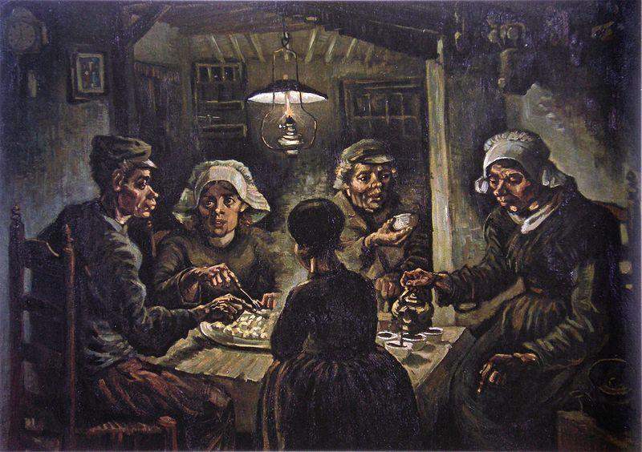
Skull of a Skeleton with Burning Cigarette, 1885–1886
The Potato Eaters, 1885

Slide 4
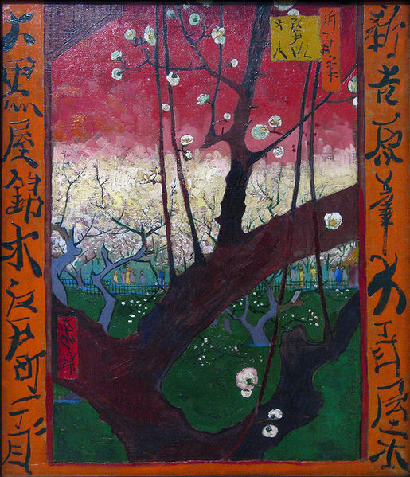
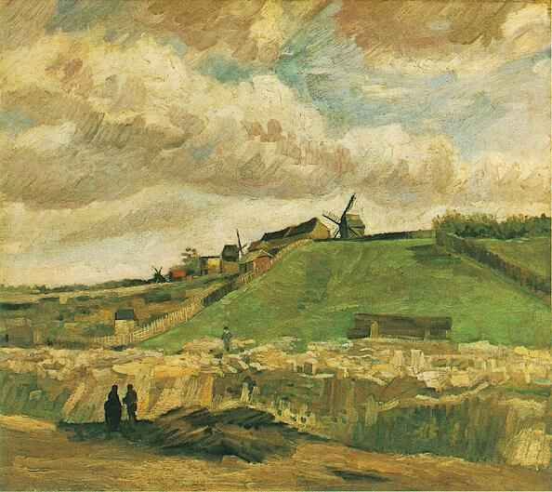
Montmartre hill, 1886
The Blooming Plumtree, 1887

Slide 5
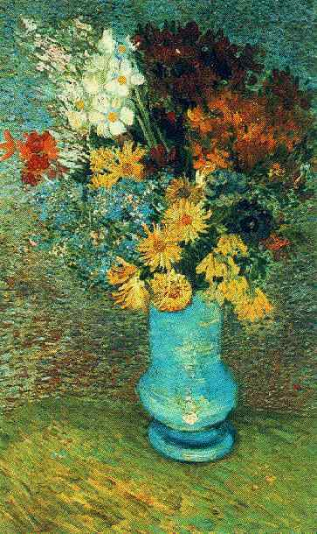
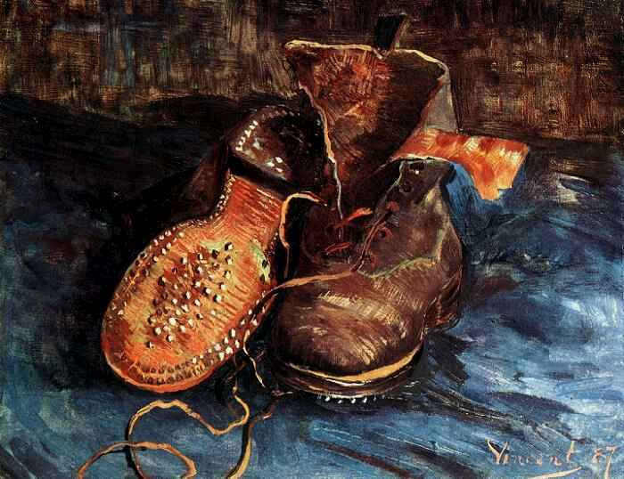
A pair of shoes, 1887
Bouquet of flowers in a blue vase, summer 1887

Slide 6
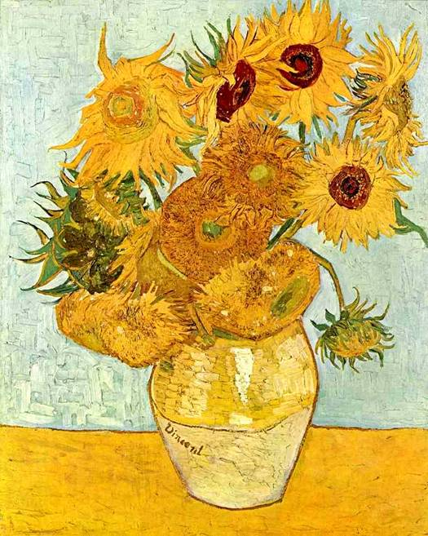
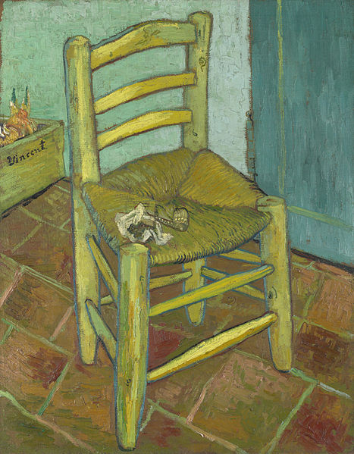
Vase with Twelve Sunflowers, August 1888
Van Gogh's Chair, 1888

Slide 7
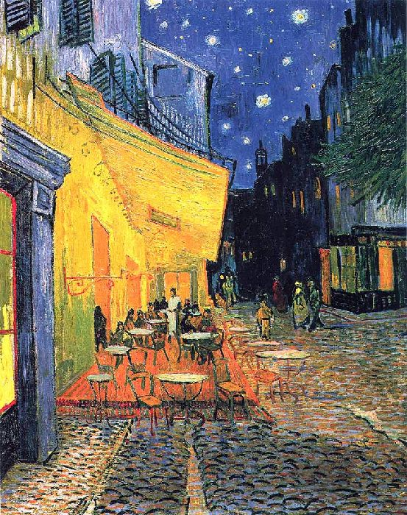
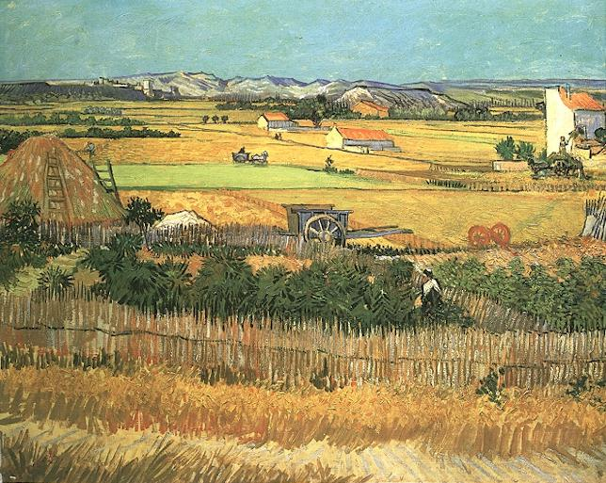
Harvesting in La Crau, with Montmajour in the background, 1888
Night Cafe at Arles, 1888

Slide 8
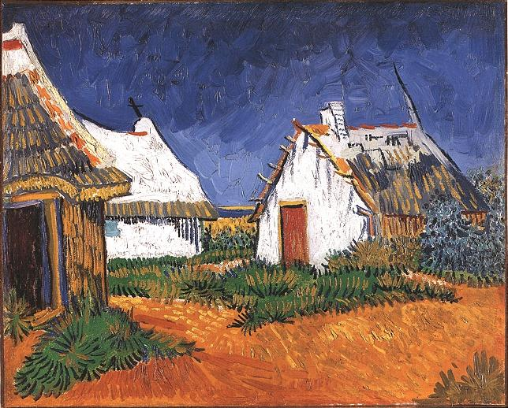
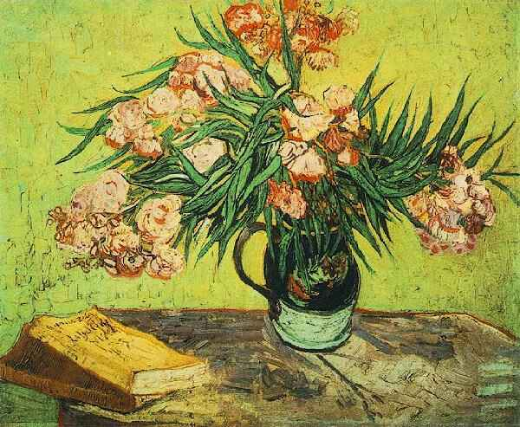
Vase with oleanders and books, August 1888
Three white cottage in Sainte-Marie, in June 1888

Slide 9
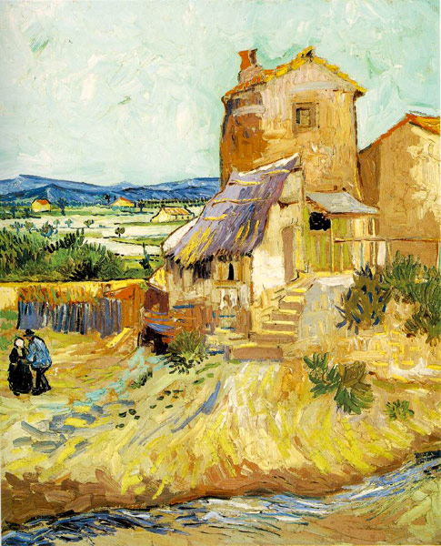
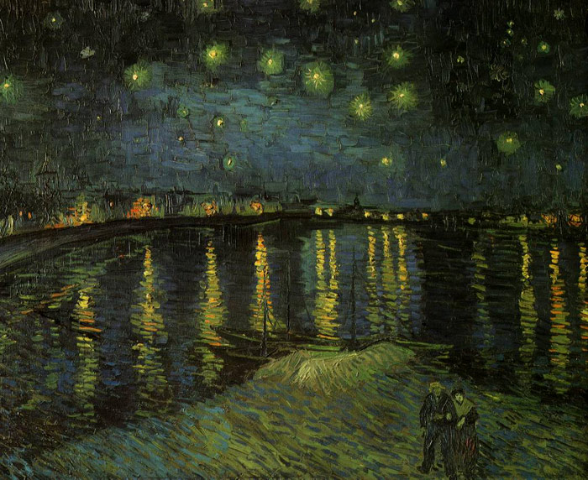
The Old Mill, 1888
Starry Night over the Rhone, September 1888

Slide 10
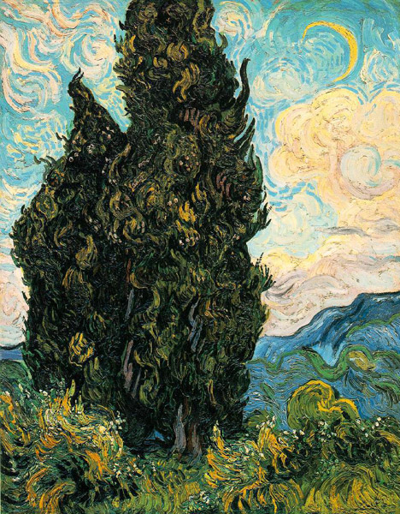
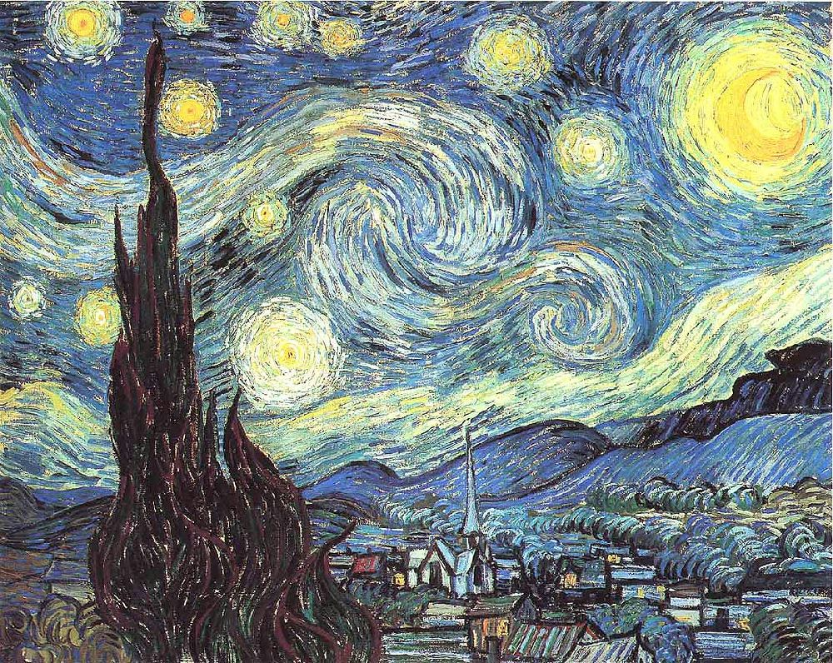
Nightlights. Saint-Remy, 1889
Cypresses, 1889

Slide 11
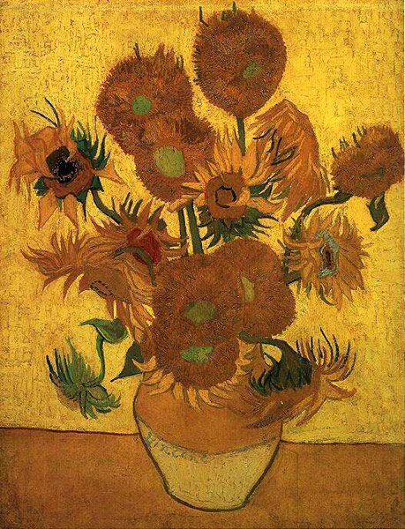
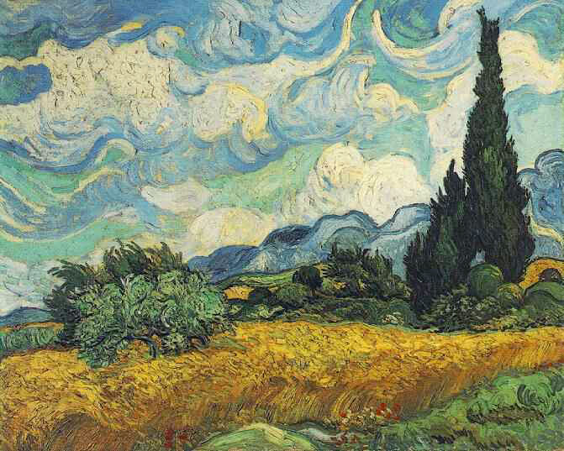
Wheatfield with Cypresses, June 1889
Vase with Fifteen Sunflowers, January 1889

Slide 12
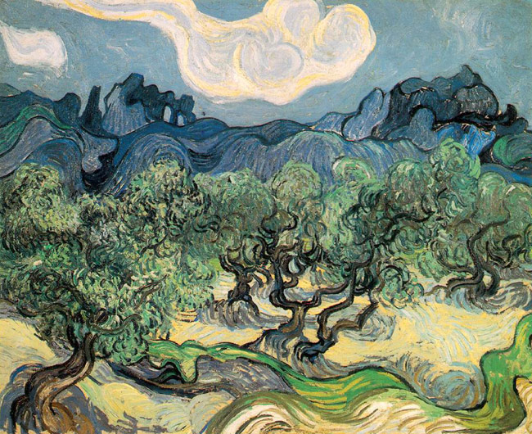
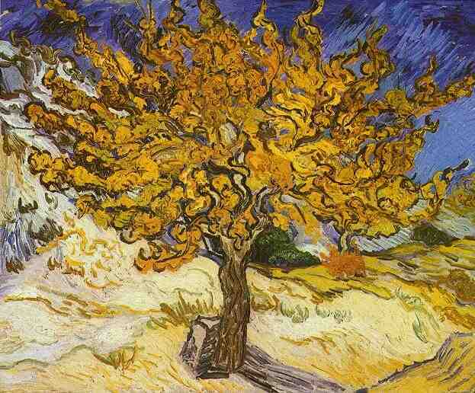
Mulberry tree, 1889
Olive trees on the background Alpillya, 1889

Slide 13
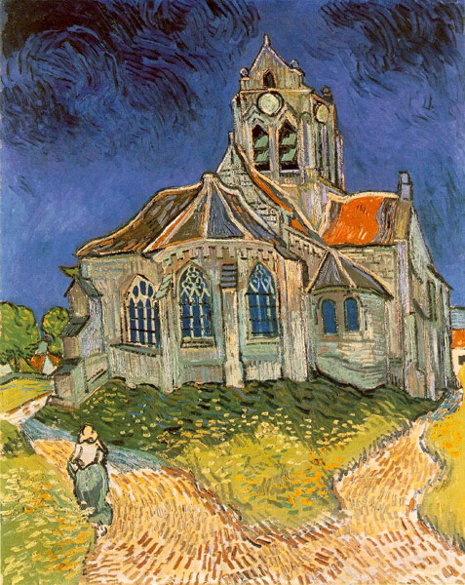
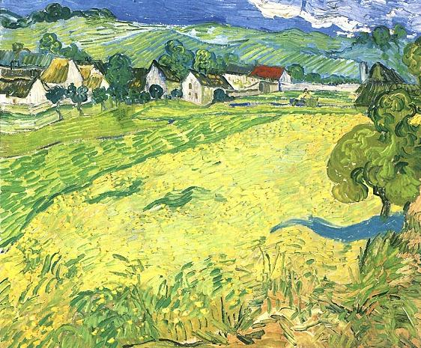
View on Vessenot near Auvers, May 1890
The Church at Auvers, June 1890

Slide 14
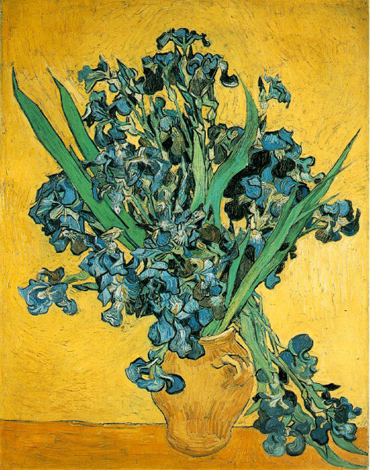
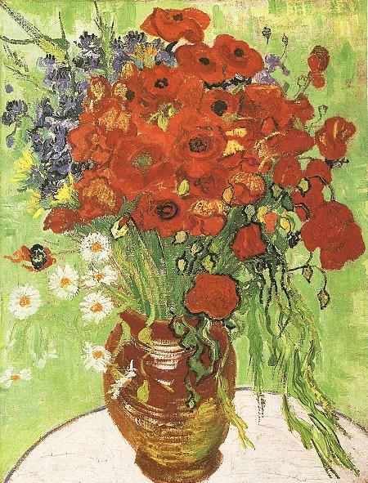
Irises, May 1890
Still life with red poppies and daisies, June 1890

Slide 15
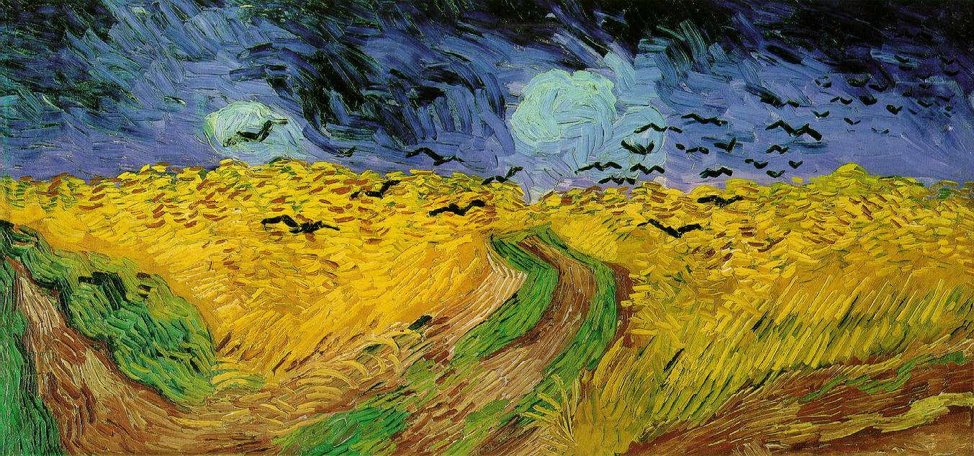
A flock of crows over grain field, 1890

