Slide 1
Japanese cuisine

Slide 2
Japan, an island country, so for the Japanese staple food products have always been the sea.
Sea gave Japanese food-fish, seaweed, cuttlefish, crabs, clams and octopus.
Unlike their ancestors except fish Japanese consume today and all kinds of meat.

Slide 3
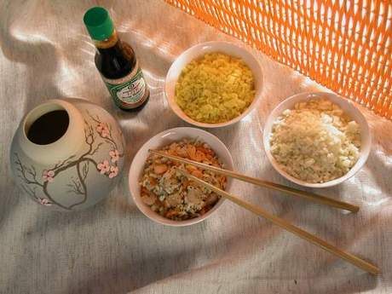
Japanese nowadays very popular in the world.
The reason for this success:
Low calorie Japanese dishes
Japanese food is very healthy: low in fat
Tastes good
easy to digest

Slide 4
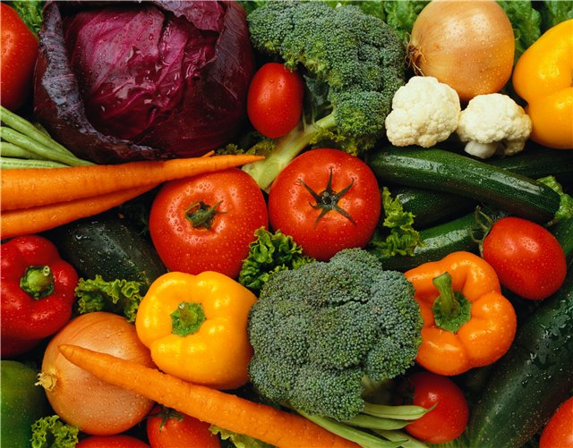
Mandatory part of Japanese food are vegetables. Present in various forms, colors and flavors options. Use several types of onions, from the golden round tamanogi, which is most common in us. To white and narrow longbow hosonegi. There are many types of radishes and radish, which gives the dish a delicious taste and necessary raznotsvete. vegetables accompany each dish as of taste and aesthetic reasons.

Slide 5
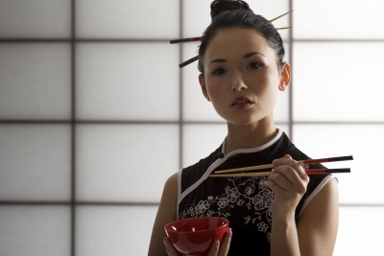
Japanese etiquette during mealtimes.
Eaten with chopsticks
Do not use a spoon to even sip of soup-bowls
Not at the table eating, each guest sits at a separate table, which immediately put all the dishes ranging from soup and ending with sweet
The Japanese are very important beauty decoration table and serving dishes.

Slide 6
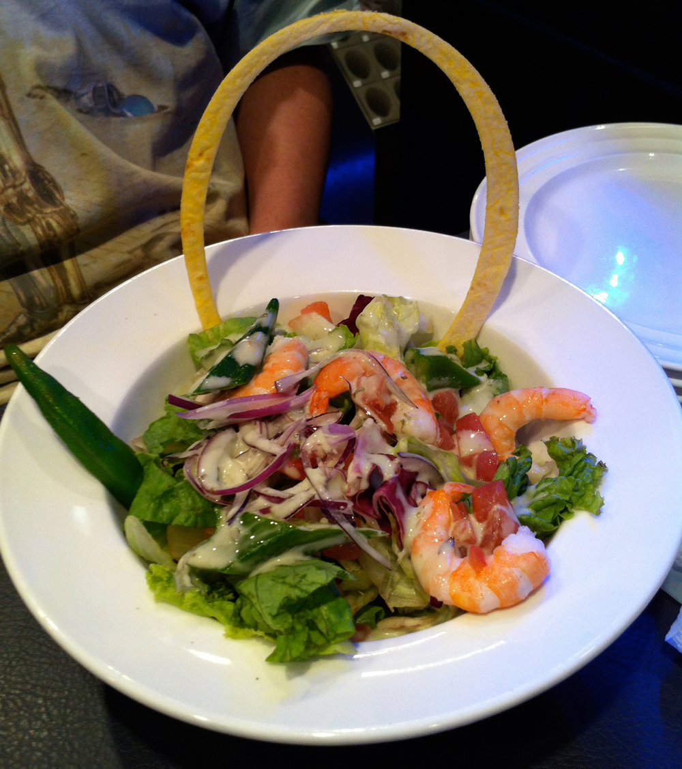
Salads and Appetizers
Haru-no-sarada
Tacos-but-but-sous-mono

Slide 7
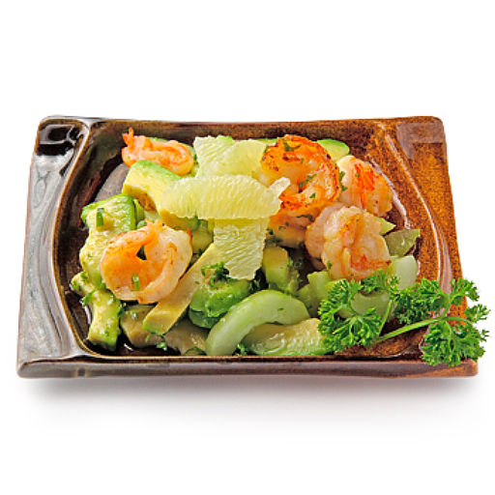
Haru-BUT Sarada
Multicolored VEGETABLE SALAD
Kohlrabi - 1 pc.
cucumber -1 pc.
salad - 1 Kachan
onion - 1 pc.
maize - 0.5 banks (140 g)
radish - 10 pcs.
soy sauce - 3 tbsp. spoons
pinch of sugar, salt
lemon vinegar - 3 tbsp. spoons
sesame oil - 5 drops

Slide 8
Kohlrabi cut into cubes. Cucumber and onion cut into thin rings, lettuce leaves to disassemble, wash and chop. Radish cut into thick plates. Vegetables put in a glass bowl and add the canned corn. In a saucepan, prepare gravy: this mix soy sauce with sugar, salt, vinegar and oil. Beat well with a fork and pour over the salad just before it podachey. Salat this is suitable for all types of Japanese dishes.

Slide 9
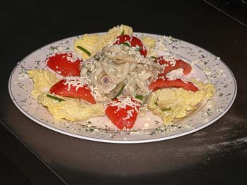
BUT SUCH SOUS NO MONO
SNACK SQUID
Squid, ready to use, 200 g
Cucumber - 1 pc.
Rice vinegar - 3 tablespoons
Lemon - 0.5 pc.
For seasoning:
Lemon juice - 4 tbsp. spoons
Sugar - 1st.lozhka
Shoyu - 3 tbsp. spoons
Grated ginger for decoration

Slide 10
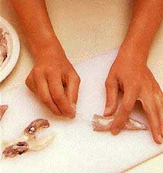
Cut squid thin slices, sprinkle with rice vinegar. Cut lemon slices, cucumber - thin slices. Prepare the seasoning, pour it squid and cucumber slices.

Slide 11
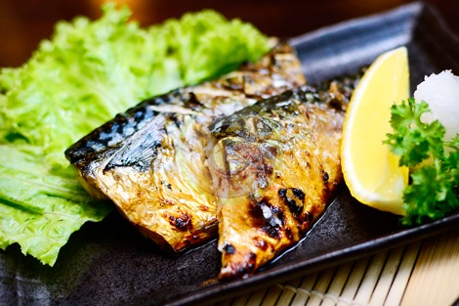
FISH AND SEAFOOD
Iwasawa but agemono
Saba but teriyaki

Slide 12
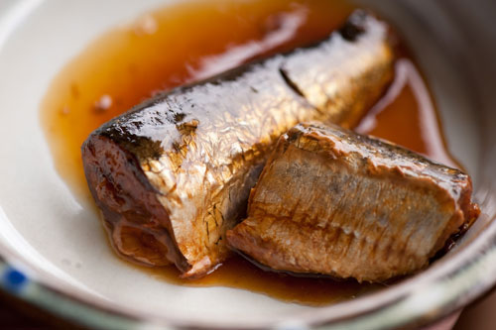
Iwasawa BUT AGEMONO
Fried iwashi
Fresh fish, 4 pcs.
Shiso leaf-8
Celery-1 \ 2 stalks
Green pepper 1 pc.
Cornstarch
Vegetable oil

Slide 13
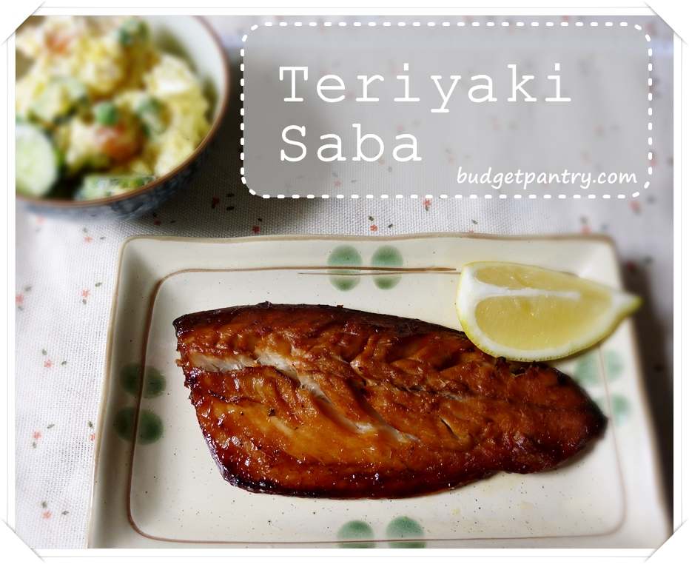
SABA-BUT teriyaki
Roasted mackerel
Mackerel (fillet) - 4 pieces
Lemon - 1 pc.
Daikon - 1 pc
For the sauce:
Shoyu - 1 \ 4 cup
Dessert wine - 1 \ 4 cup
Sugar - 1 tbsp. spoon
Grated ginger - 1 \ 2 tbsp. spoons

Slide 14
Rinse and dry the mackerel fillets. Prepare the sauce by mixing all the ingredients and lay the fish fillets in it for 20 minutes. Then fry on the grill grate. Serve with lemon slices and grated daikon.

Slide 15
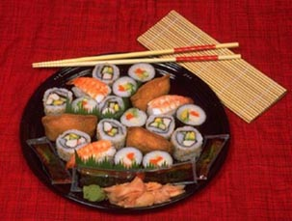
To cut each fish into two pieces of loin. They put shiso leaves, slices of green pepper and celery purified. Fold each piece of fish with vegetables in a roll, starting from the tail. Fasten with a thin wooden stick or toothpick. Sprinkle starch and frying in oil well.

Slide 16
Soups
Basis soups - dashi broth, prepared on the basis of seaweed.
Suimono
Tori then horenso-but suimono

Slide 17
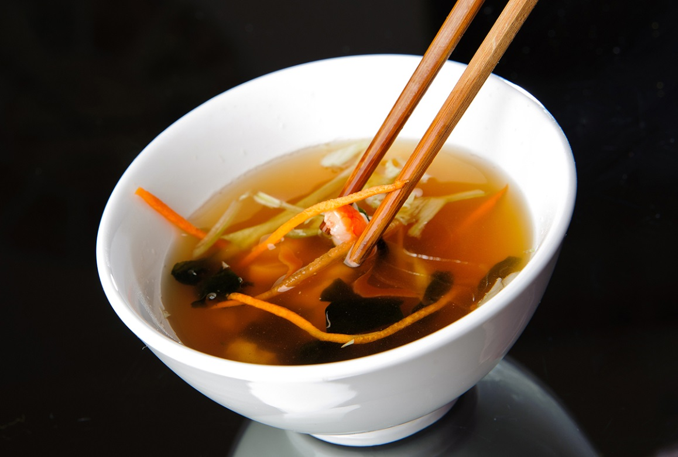
Suimono
Clear soup
Dasi - 3 cups
Red fish fillet - 200 g,
Green onions - 1.,
Vodka - 1 tsp,
Light shoyu - 1 tsp,
Salt and lemon.

Slide 18
Rub the fish with salt on both sides and leave for 15 minutes. Rinse in water, dry on a paper napkin, cut into pieces. Dasa heat, add shoyu and vodka, bring to boil, lay the fish in the boiling broth and cook for 1 minute.
Remove the fillets, arrange on plates, pour broth. Decorate finished soup with chopped green onions and lemon wedges.

Slide 19
Tori then horenso-but suimono
Tori then horenso-but suimono
Dasi - 2/3stakana,
Chicken without skin and bones - 30 g
A small bunch of spinach.

Slide 20
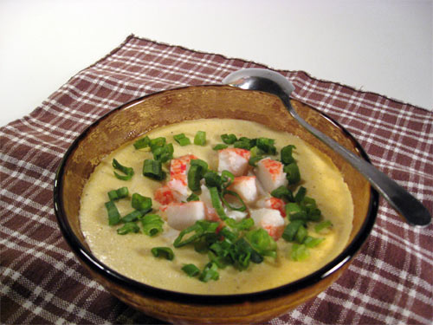
Chop the meat and spinach. In dashi lay meat, bring to a boil, remove the foam, add the spinach, reduce heat and simmer until tender.

Slide 21
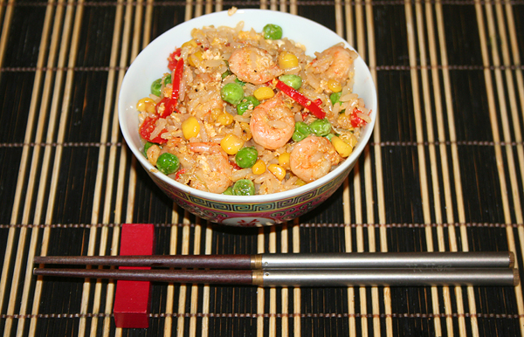
Tandon
Rice with vegetables and prawns
Dasi - 1 cup
Sugar - 1.5 st. spoons,
Shoyu - 4 tbsp. spoons,
Dessert wine - 2 tbsp. spoons,
Rice - 2.5 cups,
Shrimp - 4 pcs.,
Green pepper or other green vegetables - 4 slices,
4 slices of eggplant.

Slide 22
Boil the rice. Stir in broth, sugar, shoyu and wine in a small deep frying pan and cook, stirring, for 2-3 minutes. Fry the shrimp and vegetables. Arrange the rice on a deep plate, add 1 to each shrimp and 2 pieces of vegetables, pour on top of the hot broth.

