Slide 1
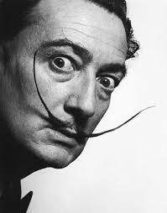
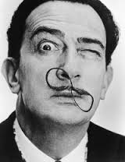
Salvador Dali.
Maryna Kysliak . 10-B

Slide 2
Dali is well known for his surrealist works and many consider him the most brilliant Surrealist of his time. But to understand the enigma that is Salvador Dali, one must take a look back into his childhood, his family, and his inspirations.

Slide 3
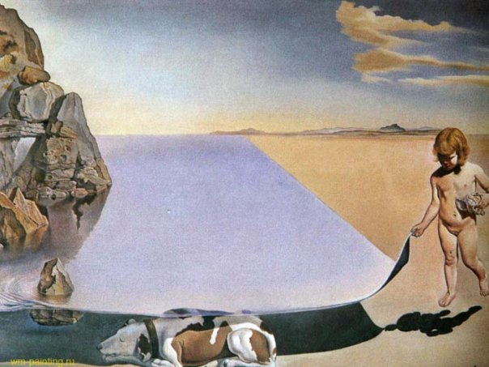
Я в возрасте шести лет, когда я верю, что стал девочкой, а пока с большой осторожностью приподнимаю кожу моря, чтобы рассмотреть собаку, которая спит под сенью воды.

Slide 4
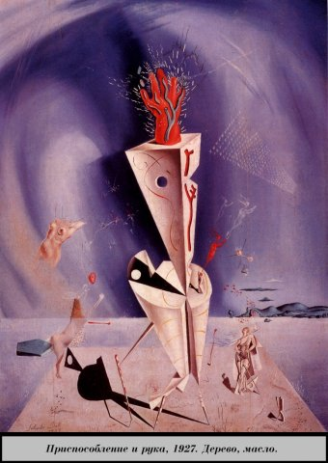
By the age of 10, Dali began to show an interest in art. He produced his first painting. By the time, he was 15; he had already set up his own art exhibition.

Slide 5
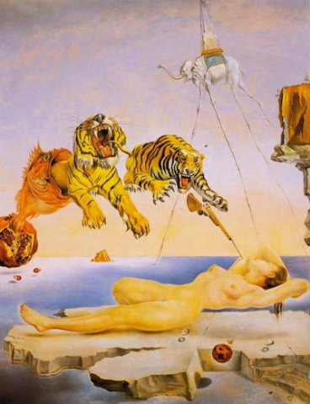
In 1929, Salvador Dali developed an interest in Surrealism, and joined the movement. He began developing his method, which he eventually would name «Paranoic-critical» and describe as a «spontaneous method of irrational knowledge».
Сон, вызванный полетом пчелы вокруг граната за секунду до пробуждения

Slide 6
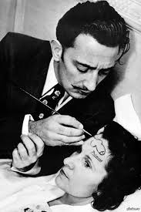
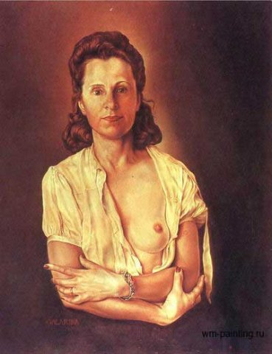
In 1929, Dali met Gala Eluard, with whom he eloped in 1932. She became his model, his agent, his inspiration, and eventually, his reason for living. She would be the only woman in his life for the remainder of his years.

Slide 7
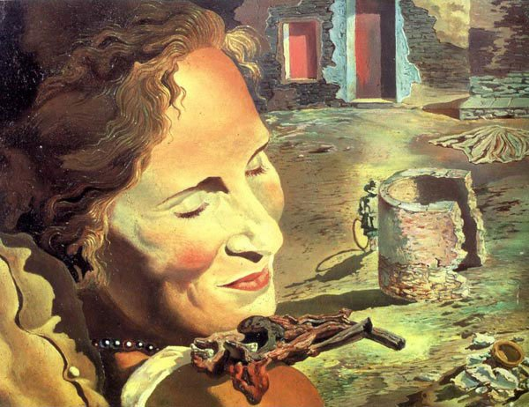

Slide 8
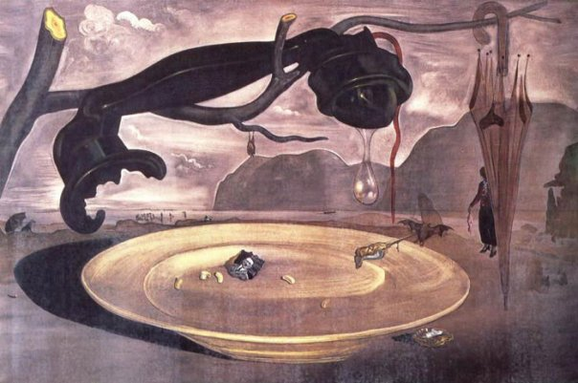
In the 1930's, he took up a great interest in Hitler, and not Lenin, who was favoured by the other surrealists. This created a strain with his friends, and in 1939, Dali decided to move to the United States.
Тайны Гитлера

Slide 9
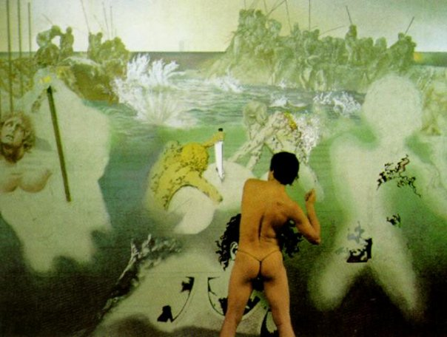
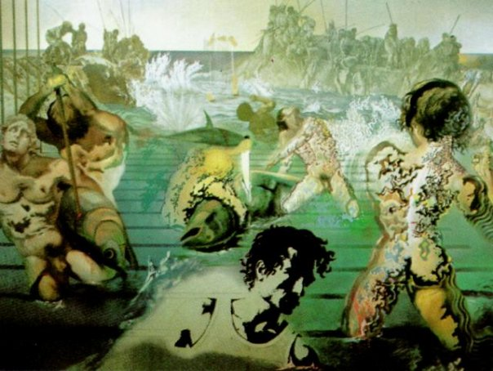
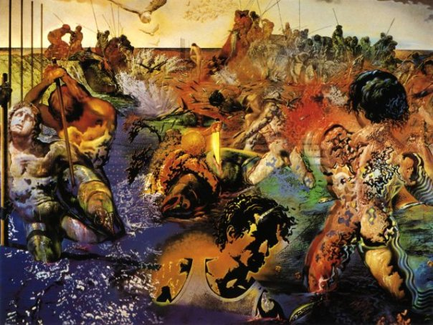
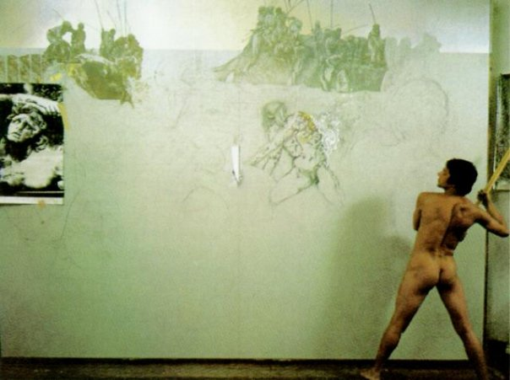
Work

Slide 10
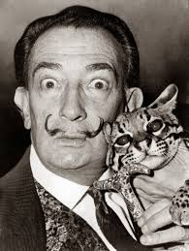
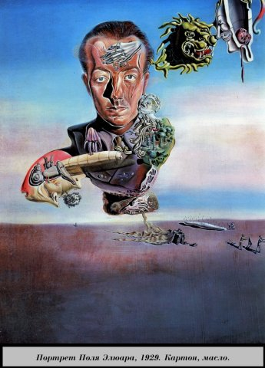

Slide 11
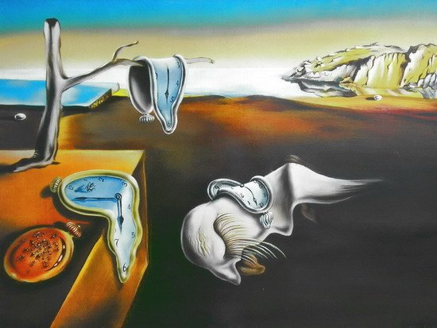
Постоянство памяти

Slide 12
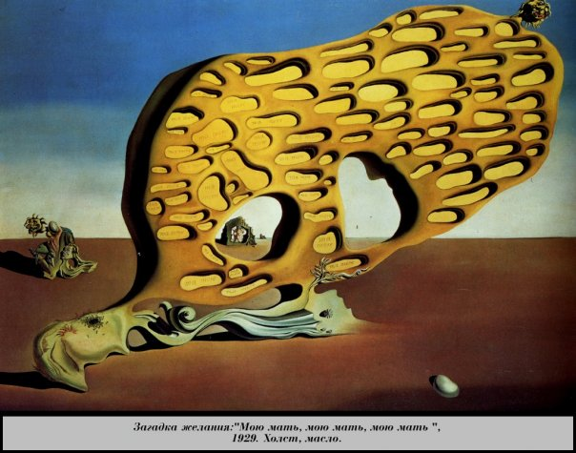

Slide 13
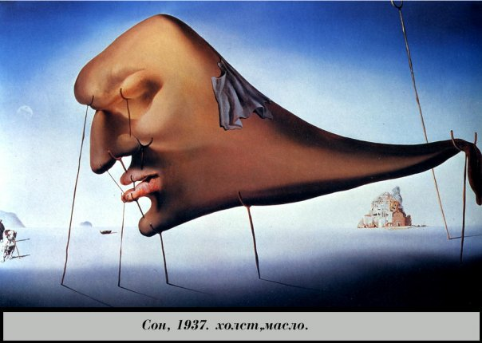
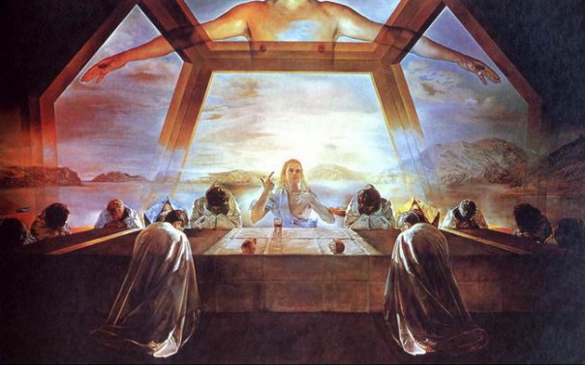
Тайная вечеря

Slide 14
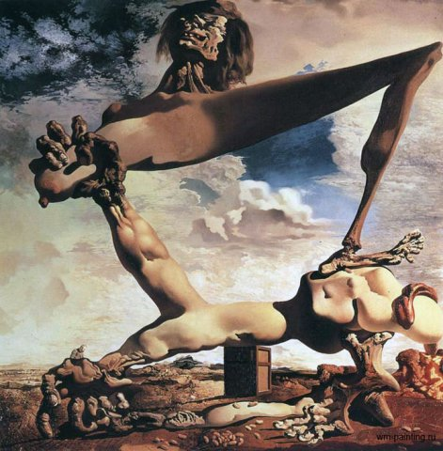
Гражданская война

Slide 15
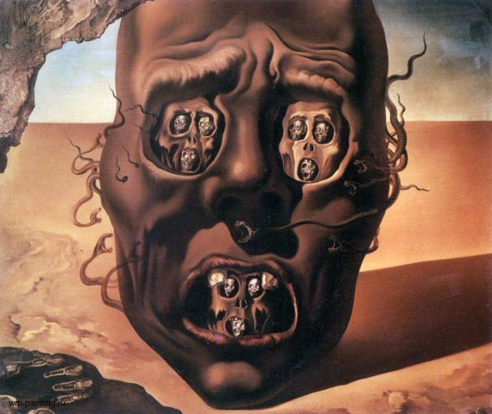

Slide 16
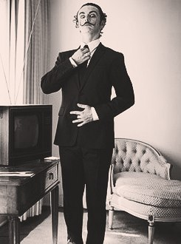

Slide 17
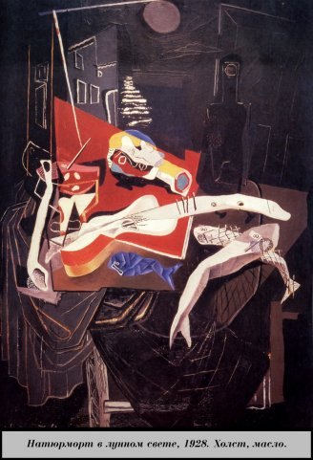

Slide 18
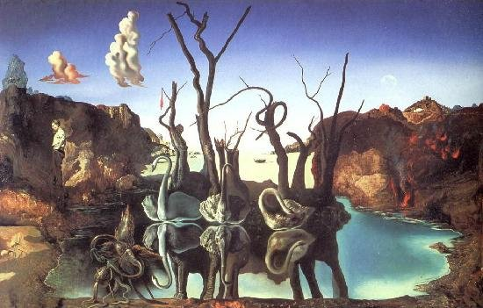

Slide 19
