Slide 1
Kyiv national university of culture and arts

Slide 2
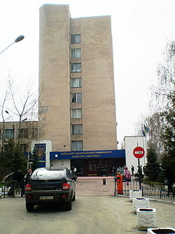
The Kyiv national university of culture and arts is higher educational establishment of IV's level of accreditation.

Slide 3
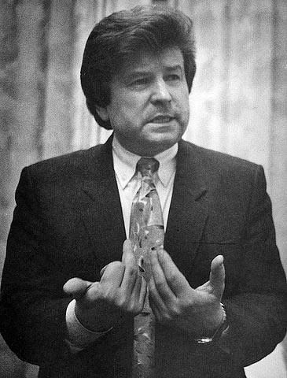
History of establishment
In 1968 was founded the Kyiv State Institute of Culture of the name of Korniychuk. 21 April 1993 for the post of rector of the Kiev State Institute of Culture and Arts was appointed informal leader of students, Doctor of Pedagogical Sciences, Professor Mykhaylo Poplavskiy, who began a new stage in the history of the university.

Slide 4
Structure of University
The Art Institute
The Faculty of music:
Department of Arts and bandura
Department of Folklore, folk song performance and choir singing
Department of pop songs
Department of Instrumental Music
One of the university faculty on the basis of which regular artistic groups - academic student choir ANIMA (founded in 1968), People's Choir. Stanislaus Pavlyuchenko, folklore ensemble "Kralytsia" (founded in 1991).

Slide 5
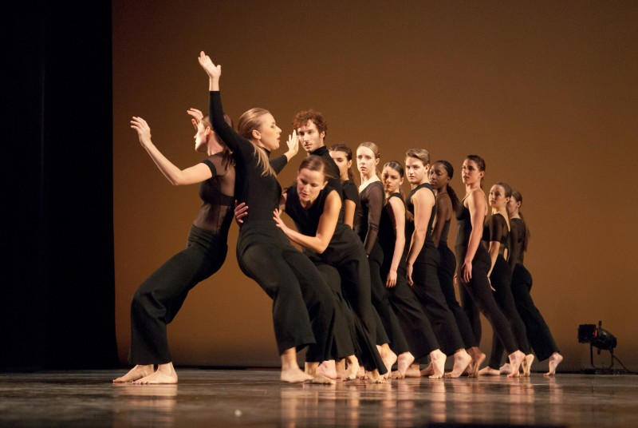
The Faculty of directing and choreography:
Department directing of music and massive celebrations
Department of directing drama theater and dramatic art
Department of classical dance
Department of folk dance
Department of classical choreography
Department of modern dance

Slide 6
The Institute of movies and television:
Department of directing television
Department of television journalism, TV announcers and presenters
Sound engineering department
Department of camera skill
Department of Film Actors

Slide 7
Institute of Management and Economics:
Department of Economics
Department of Fashion Industry
Department of Management showbiz
Department of Computer Science

Slide 8
The Institute of hotel and restaurant, tourism business:
Department of Hotel and catering business
Department of the international tourism

Slide 9
Institute of Design and Advertising:
Department of fashion design
Department of Drawings and paintings
Department of Design Environment
Department of Graphic Design and Advertising

Slide 10
Institute of Journalism and International Relations:
Department of International Relations
Department of publishing and network publications
Department of Journalism
Department of Translation
Department of Public Relations and Advertising
Department of Sociology

Slide 11
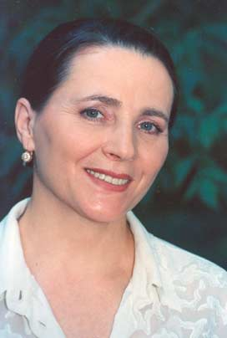
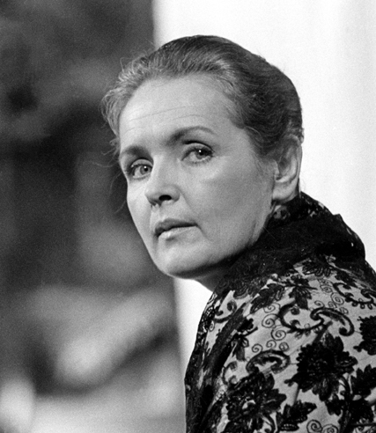
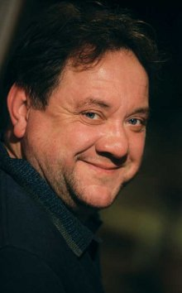
Lecturers:
Yan Tabachnik
Roman Viktiuk
Pavlo Zibrov
Nina Matvienko
Alla Kudlay
Ada Rogovtseva
Larisa Tsvetkova
Oksana Bilozir
Bogdan Beniuk

Slide 12
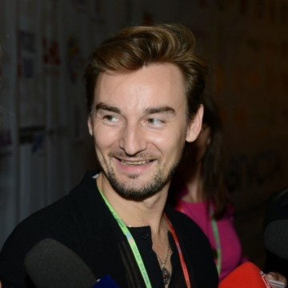
Graduates:
Iryna Bilyk
Natalia Valevska
Natalia Mogilevska
Ani Lorak
Tatiana Denisova
Viktor Pavlik
Alan Badoev

