Slide 1
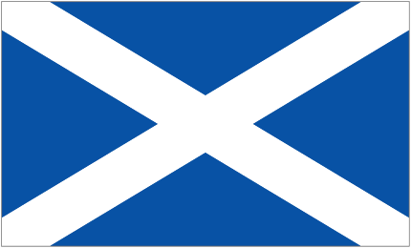
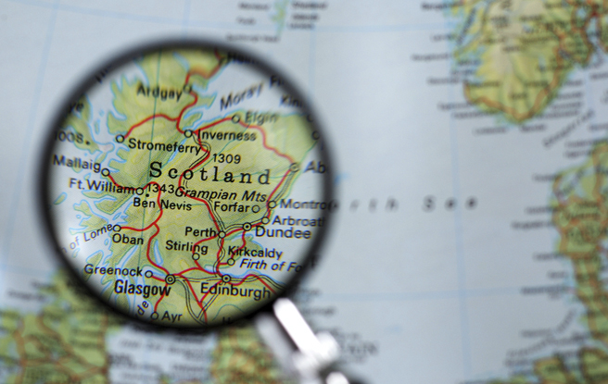
Let’s Learn About Scotland
Scottish Holidays and
National Cuisine
by Anastassia Kreytor

Slide 2
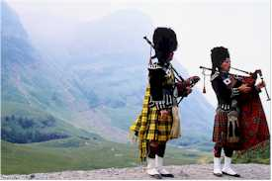
Scotland is famous for…
Haggis- a food made from the organs of sheep and oatmeal.
Kilts - traditional Scottish woolen cloth costume with a tartan or plaid pattern. This is a skirt that men wear.
Bagpipers - people who play the bagpipes, a traditional Scottish instrument .

Slide 3
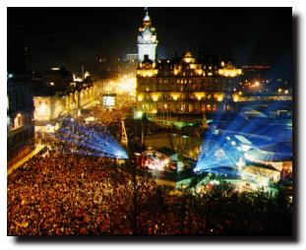
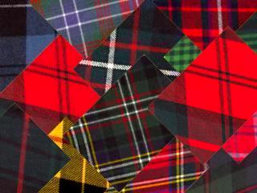
Scottish Culture
Scots celebrate many holidays.
Scottish families are called clans and each clan has a special plaid to show what their family is. These are the plaids on their kilts.

Slide 4
The most important holidays are:
The Edinburgh Military Tattoo;
Halloween;
Christmas;
Boxing Day;
New Year’s Day (Hogmanay);
Burn’s Supper.

Slide 5
The Edinburgh Military Tattoo
The Edinburgh Military Tattoo is a show given by military bands and display teams.
It takes place Edinburgh annually, at the same time as the Edinburgh Festival.

Slide 6
Halloween
Halloween in Scotland is all about the supernatural, witches, spirits and fire.
Robert Burns, the famous Scottish poet, wrote about the myths, legends and traditions associated with Halloween in Scotland in his poem 'Halloween', written in 1785.

Slide 7
Christmas
Until 1958, when Christmas Day was declared a public holiday, people worked normally on this day although the children did get presents. . The Christmas traditions in Scotland are similar to that of the U.S., although the Scottish people do have some interesting customs of their own.

Slide 8
Boxing Day
Boxing Day is a day the higher classes gave gifts to the lower classes. The holiday is named Boxing Day because the tradition of giving gifts of cash, food, clothing and other goods to the less fortunate were placed into boxes for easier transportation.

Slide 9
New Year’s Day
Hogmanay is the Scots word for the celebration of the New Year. Its official date is the 31st of December.
Ne’erday is Scots dialect for New Year’s Day, January the 1st.

Slide 10
Burn’s Supper
A Burn’s Supper is a celebration of the life and poetry of the poet Robert Burns, author of the version of the Scots song Auld Lang Syne.

Slide 11
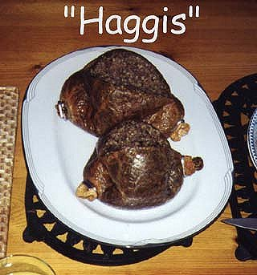
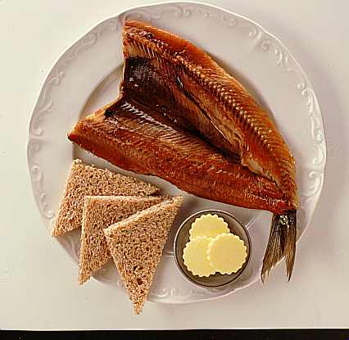
What Scots Like to Eat

Slide 12
The most important dishes are
Haggis
Fish and Chips
Shortbread
Whisky
Also:
Strong black tea
Beer
Pies
Different kinds of soups

Slide 13
Recitation of the poem “Address to a Haggis” by R.Burns is an important part of the Burn’s supper.
During Burn’s lifetime haggis was a popular dish for the poor, since it made use of parts of a sheep and oatmeal.
Today Haggis is regarded fondly as a traditional Scottish dish

Slide 14
Fish and Chips
Fish and chips is the national fast food champion of the whole of the United Kingdom, not just Scotland. In Scotland, fish and chips from a fish and chip shop is usually referred to as a fish supper.

Slide 15
Shortbread
Shortbread is traditionally formed into one of three shapes: one large circle divided into segments ("Petticoat Tails"); individual round biscuits ("Shortbread Rounds"); or a thick rectangular slab cut into "fingers.“
The word "short" in Shortbread means that it contains a lot of shortening (butter), which makes it break and crumble easily. This is the sign of a good Shortbread.

Slide 16
Whisky
Scotch Whisky (or simply "Scotch") is certainly the best known Scottish drink. Scotch Whisky (only the Irish and American varieties are spelled with an "e") is distilled from a barley liquor and flavoured with peat tainted water. Known as the Water of Life or Uisge-Beatha in Gaelic.

Slide 17
Also the Scots like

Slide 18
Thanks for your attention!

