Slide 1
Largest cities of the United Kingdom

Slide 2
London

Slide 4
The London Eye

Slide 5
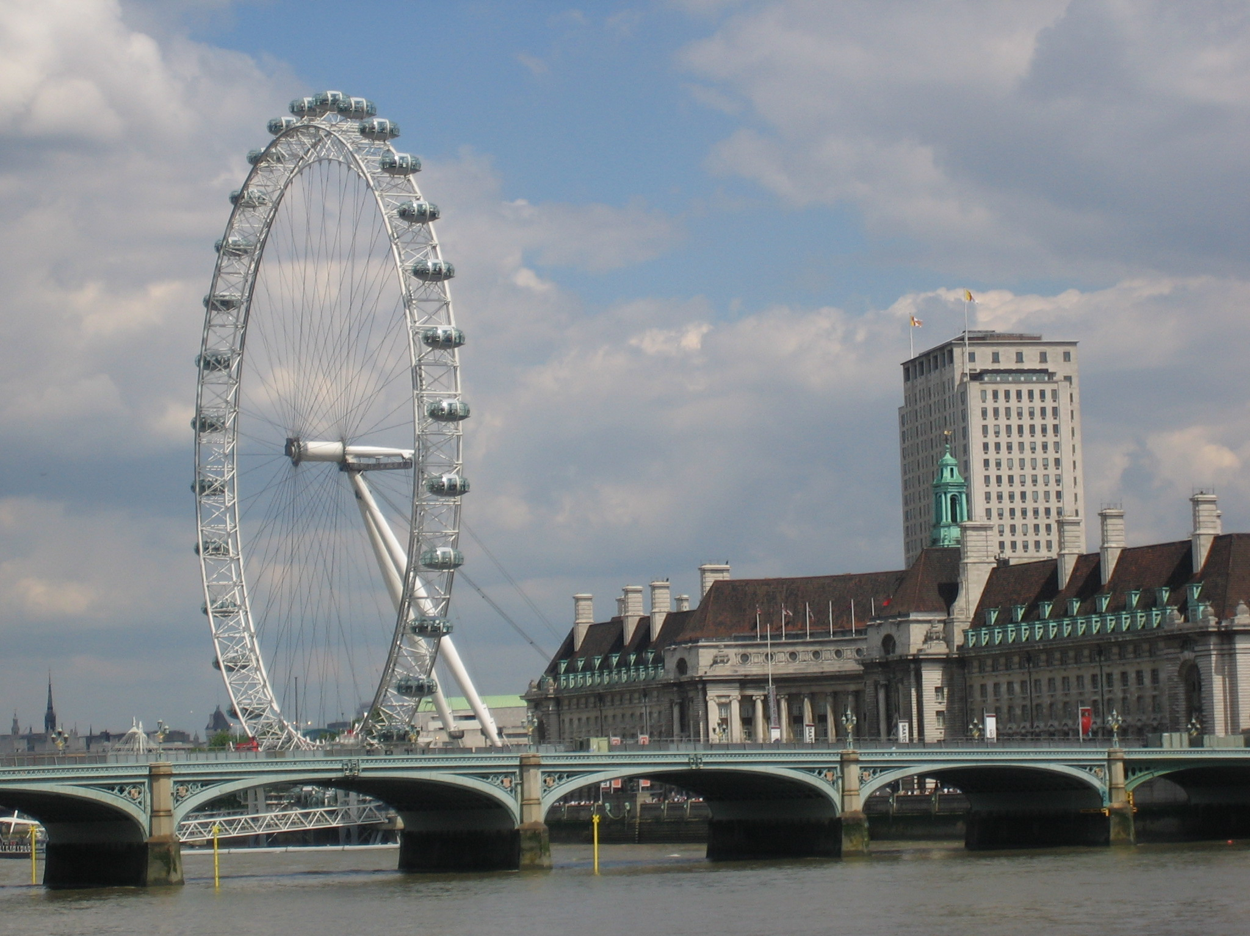
Buckingham Palace

Slide 6
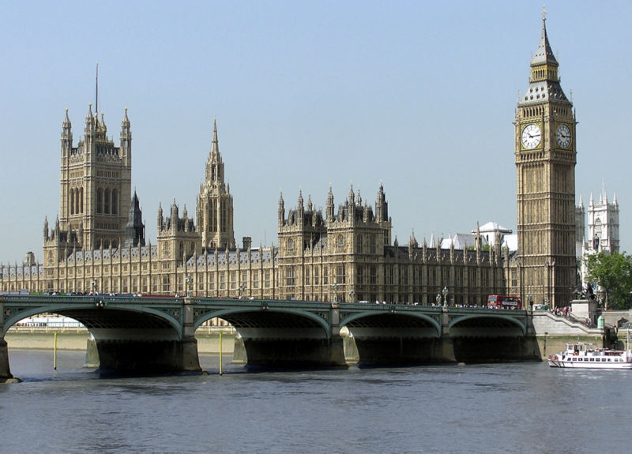
London is the capital city of England and the United Kingdom, and the largest city, urban zone and metropolitan area in the United Kingdom, and the European Union by most measures.

Slide 7
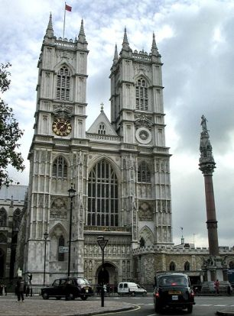
Westminster Abbey

Slide 8
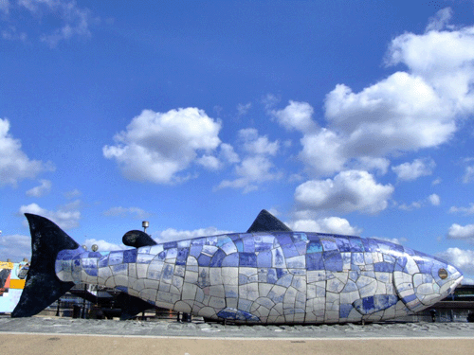
Belfast

Slide 9
Belfast Castle

Slide 11
Belfast of is the capital of, and largest city in, Northern Ireland. Most of Belfast is in County Antrim, but parts of East and South Belfast are in County Down.

Slide 12
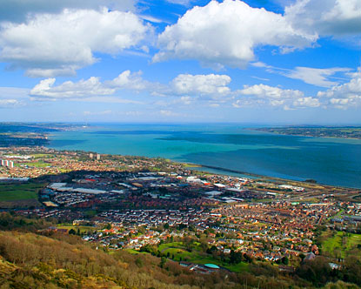

Slide 13
Edinburgh

Slide 15
Edinburgh Castle

Slide 16
Edinburgh is the capital of Scotland and the second largest city in the country. Located in the south-east of Scotland, Edinburgh lies on the east coast of the Central Belt, along the Firth of Forth, near the North Sea.

Slide 18
Liverpool

Slide 20
Hilton Hotels

Slide 22
Liverpool is a city and metropolitan borough of Merseyside, England, United Kingdom along the eastern side of the Mersey Estuary. It was founded as a borough in 1207 and was granted city status in 1880. It is the fourth most populous British city, and third most populous in England, with a 2011 population of 466,400[3] and is at the centre of a wider urban area, the Liverpool City Region, which has a population of around 2 million people.[4]

Slide 25
Glasgow

Slide 28
Glasgow is the largest city in Scotland. It is situated on the River Clyde in the country's West Central Lowlands.
In the late 19th and early 20th centuries Glasgow grew in population, eventually reaching a peak of 1,128,473 in 1939,[12] and was the fourth-largest city in Europe, after London, Paris and Berlin.

Slide 29
Glasgow Hotels

Slide 30
Glasgow University

Slide 31
Manchester

Slide 34
Manchester is a city and metropolitan borough in North West England with an estimated population of 503,000.[4] Manchester lies within the United Kingdom's third largest urban area which has a population of 2,240,230.[5] People from Manchester are known as Mancunians and the local authority is Manchester City Council. Manchester is situated in the south-central part of North West England, fringed by the Cheshire Plain to the south and the Pennines to the north and east.

Slide 37
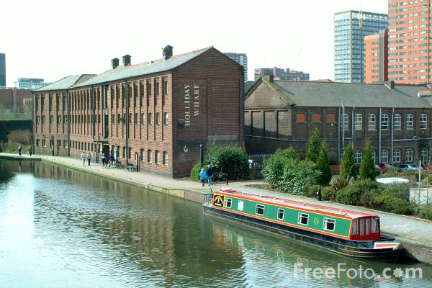
Birmingham

Slide 38
Things to Do in Birmingham

Slide 39
Birmingham canals

Slide 41
Birmingham is a city and metropolitan borough in the West Midlands of England. It is the most populous British city outside the capital London with 1,074,300 residents (2011 census), an increase of 96,000 over the previous decade. The city lies at the heart of the West Midlands conurbation, the second most populous urban area in the United Kingdom with a population of 2,284,093 (2001 census). Its metropolitan area is also the United Kingdom's second most populous with 3,683,000 residents.

Slide 43
The end

