Slide 1
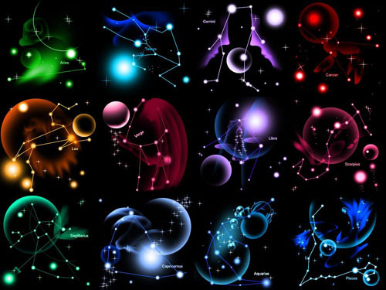
Signs of zodiac
By Stupar Dasha 9-2

Slide 2
12 Signs of zodiac

Slide 3
Signs of zodiac : Fire

Slide 4
Signs of zodiac : Water

Slide 5
Signs of zodiac : Earth

Slide 6
Signs of zodiac : air

Slide 7
Woman’s signs of zodiac:

Slide 8
Man’s signs of zodiac:

Slide 9
My sign of zodiac is Virgo

Slide 10
Signs of zodiac, with whom I will be happy.

Slide 14
Signs of zodiac, with whom I will not be happy.

Slide 17
THE END

