Slide 1
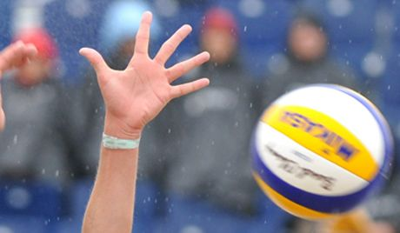
Natalia Goncharova

Slide 2
Natalia Goncharova - Ukrainian and Russian volleyball player, a striker, a player of team Russia, world champion in 2010. Honored Master of Sports of Russia.

Slide 3
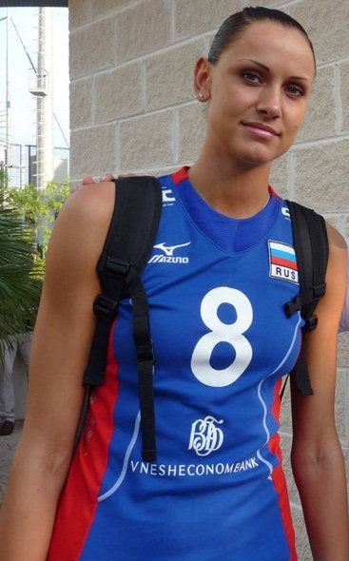
Natalia Goncharova was born in the city Skole of Lviv region. Volleyball began to engage in Ivano-Frankivsk, where she moved with her family. First coach - Peter Pogrebennik.

Slide 4
In mid-2010 was approved by the change of Natalia Goncharova's volleyball citizenship from Ukrainian to Russian. After that, head coach of Russia Vladimir Kuzyutkin included Natalia member of the Russian national team.

Slide 5
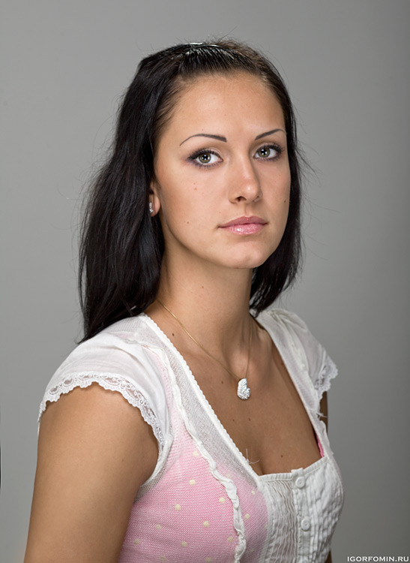
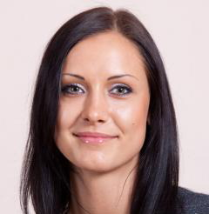
In July 2010, Natalia Goncharova, the national team won the Cup of Russia Boris Yeltsin, and in September - the silver medalist of European qualification Grand Prix 2011.

Slide 6
