Slide 1
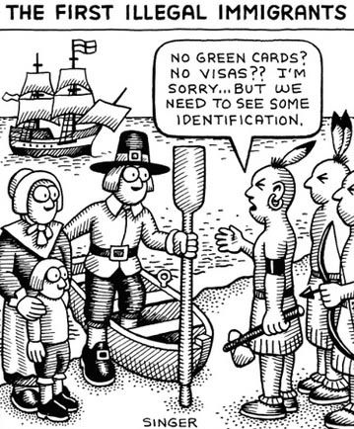
Illegal migration

Slide 2
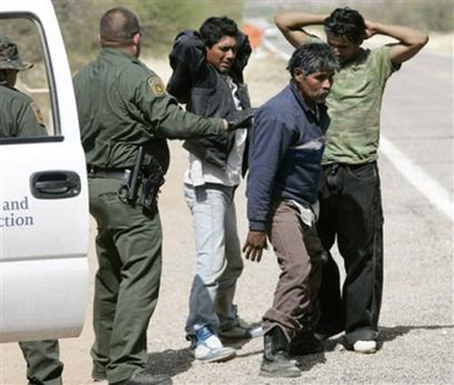
Migration

Slide 3
Illegal immigrant population in the USA

Slide 4
Illegal immigrant population in the USA

Slide 5
Pros and cons
- Burden on tax-based resources. - Disparity between immigrants who follow the rules and those who don't.
- They risk death when traveling the desert to reach the borders.
- Continued growth of the demand for cheap labor and low wages.
+ It helps keep the economy moving by filling low-wage jobs.
+ It provides a better life to individuals and families who enter the country illegally. + It creates a pool of consumers for a variety of goods and services.

Slide 6
Pros and cons
+ Farmers are able to plant and harvest less expensively. + Illegal immigrants pay sales taxes. + Illegal residents, who are property owners, also pay real estate taxes.
- Potential negative effects on working and middle-class citizens. - Millions of U.S. dollars sent outside the country. - Unbalanced ethnic diversity.

Slide 7
Economic benefits

Slide 8
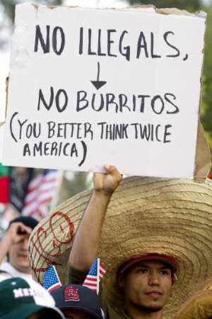
Deportation and human rights

Slide 9
Orphans
About 88.000 orphans left in the USA because of the deportation of their parents

Slide 10
Violence at home
1 of 4 women in the USA suffer from husband’s violence

Slide 11
New opportunities for migrants

Slide 12
Thank you for your attention!

