Slide 1
Top10 the most romantic places in Ukraine
Kuznetsova Polina
Grop 42

Slide 2
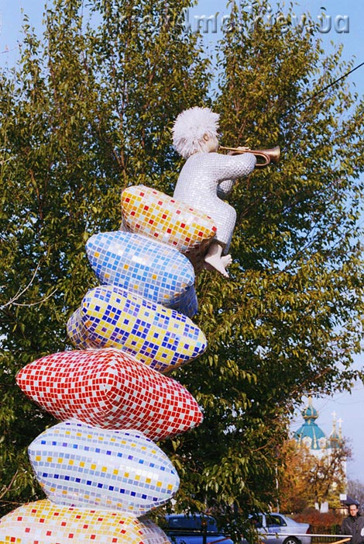
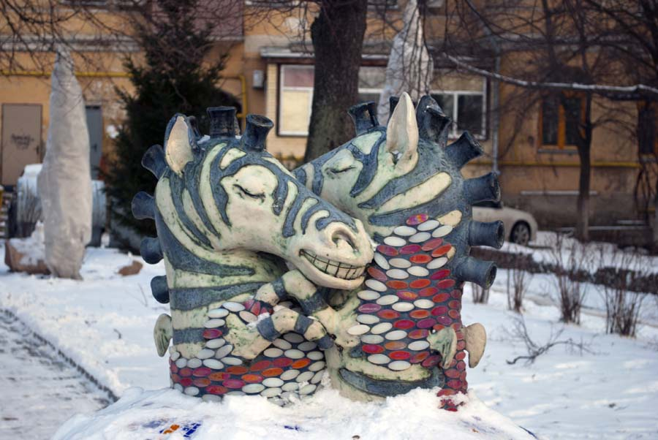
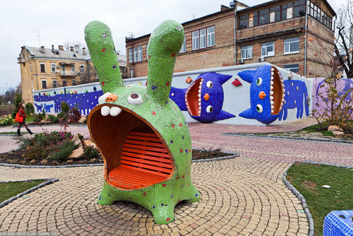
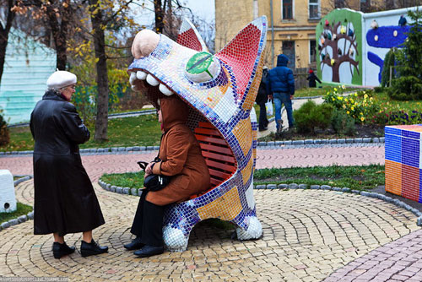
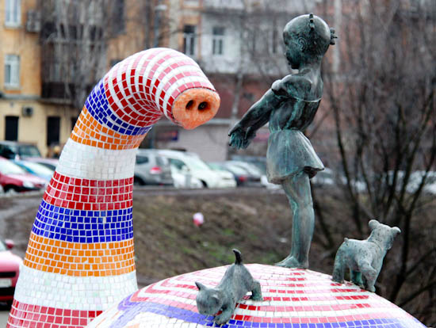
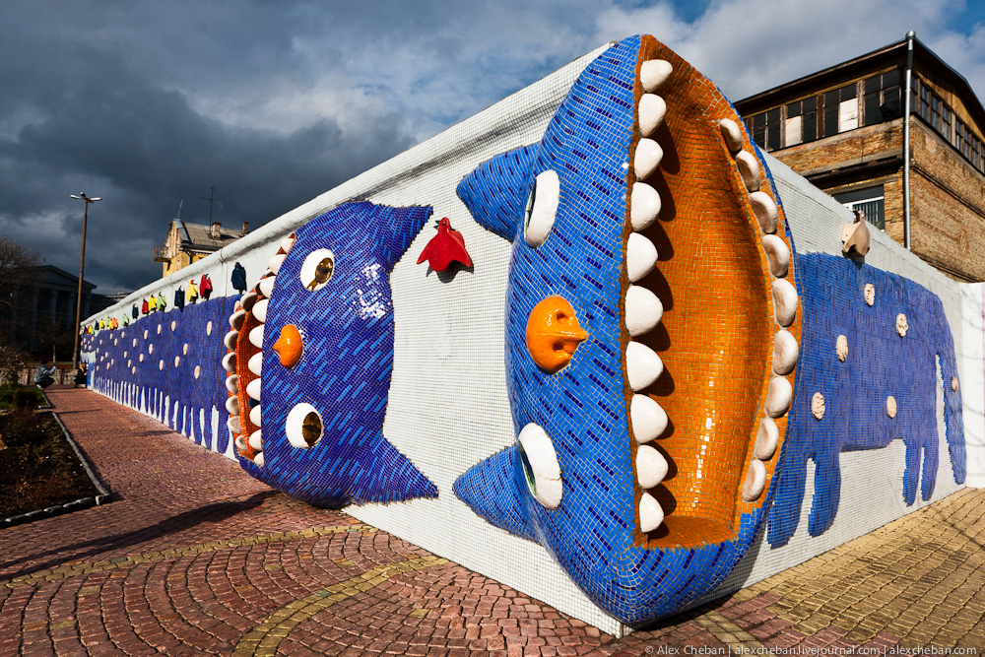
10. Landscape Alley in Kyiv
Landscaped walkway called one of the kindest places in the capital, and indeed it is surely no man passed here without even the slightest smile on your face.
Alley was built in 1980 on the site of ancient Upper Kyiv architect Abraham Miletskym. In 2009, Alley received a second life through colorful sculptures of animals and children.

Slide 3
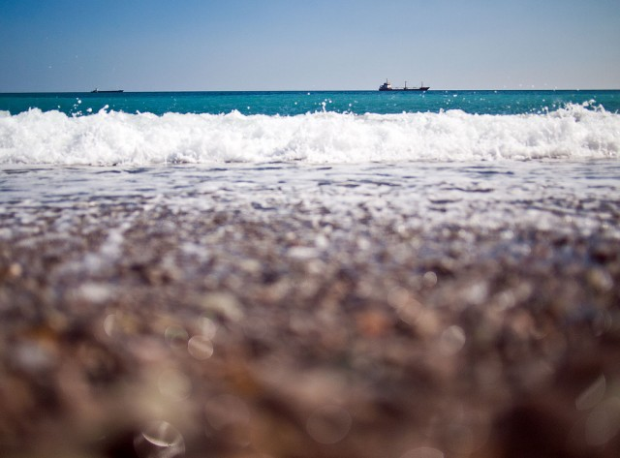
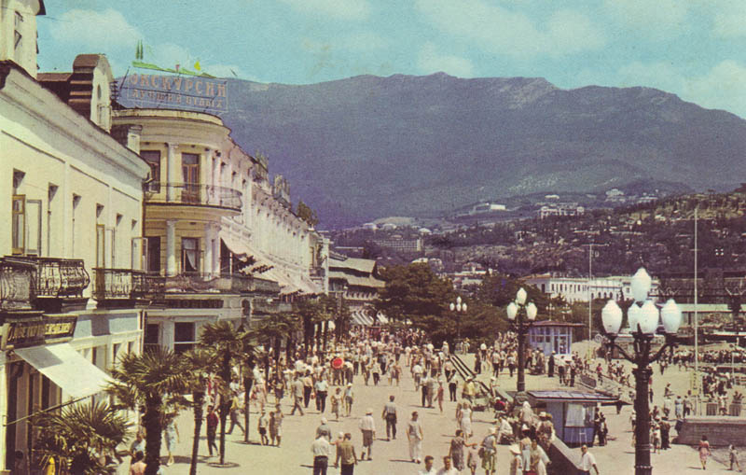
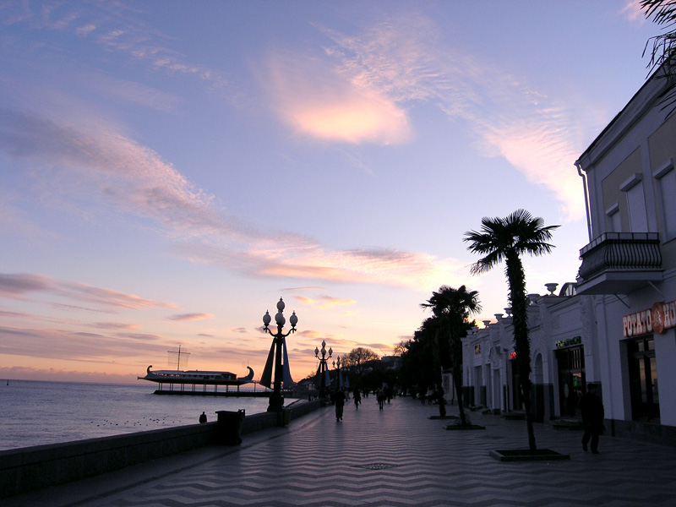
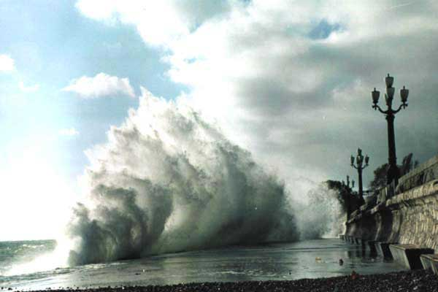
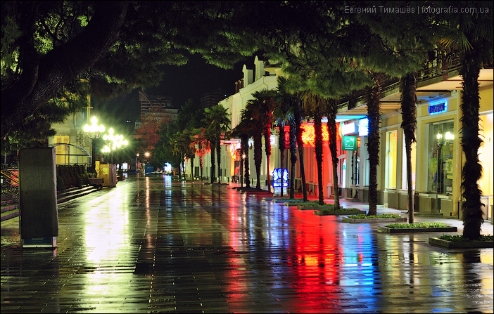
9. Yalta seafront
At a time when public beach not like a colony of seals, what could be nicer for the warm soft sand and the sea? :) Yalta seafront as the rest of the southern coast of Crimea - a great place for walking, both day and night. The main thing - do not walk on it during a winter storm .

Slide 4
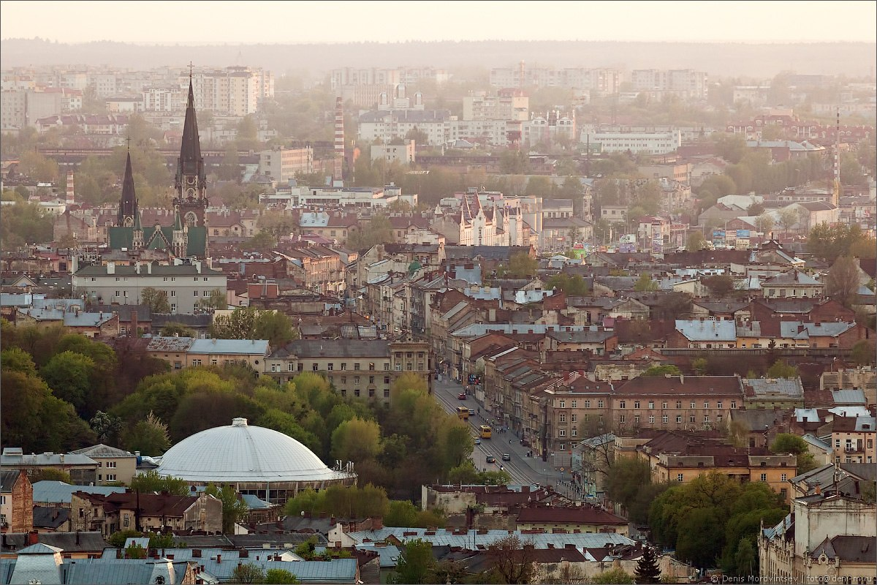
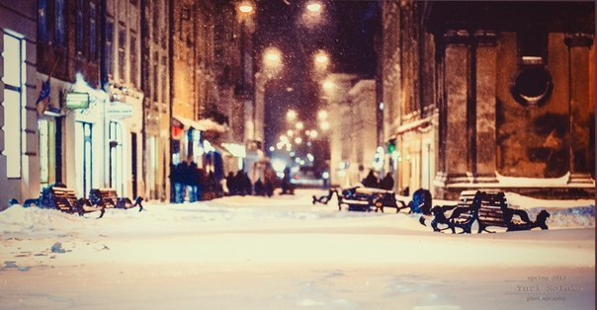
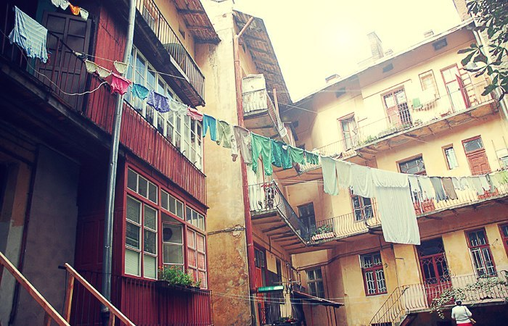
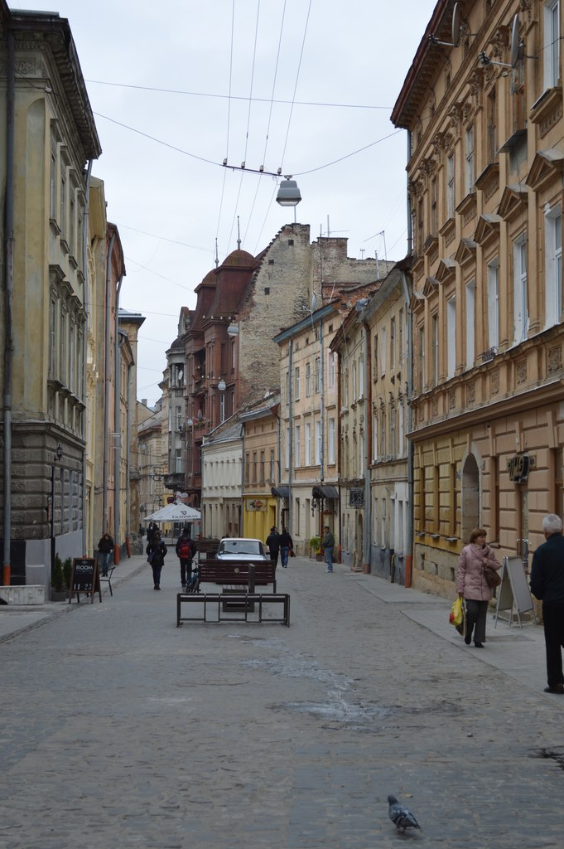
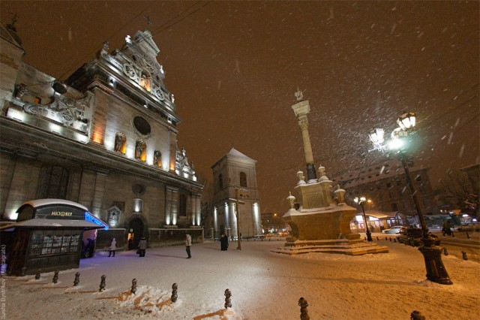
8. Lviv yards
The cozy Lviv yards can escape at any time - winter in which some coffee "Cafes, or in the warmer months - at the next bench. Melt into the crowd, or vice versa - to hide from the world and spend time alone together.

Slide 5
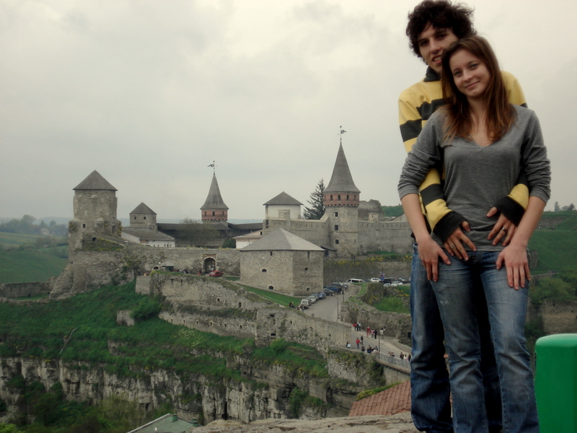
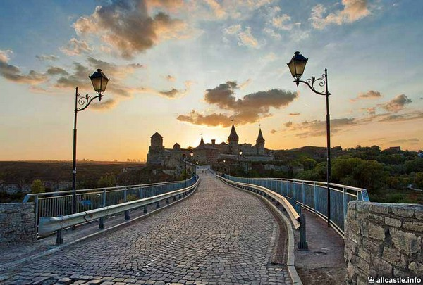
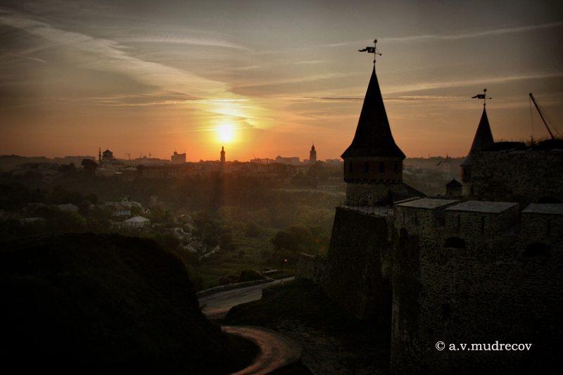
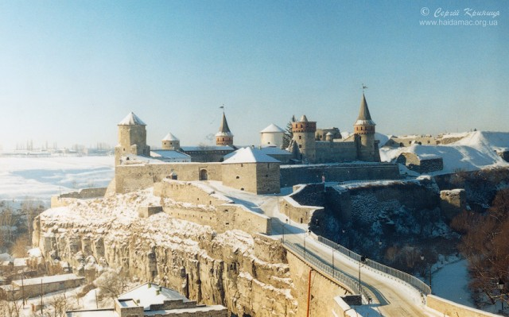
7. Castle in Kamenetz-Podolsk
Arena filming for historical films, Kamenetz-Podolsk with his fortress is a great option for a romantic weekend.

Slide 6
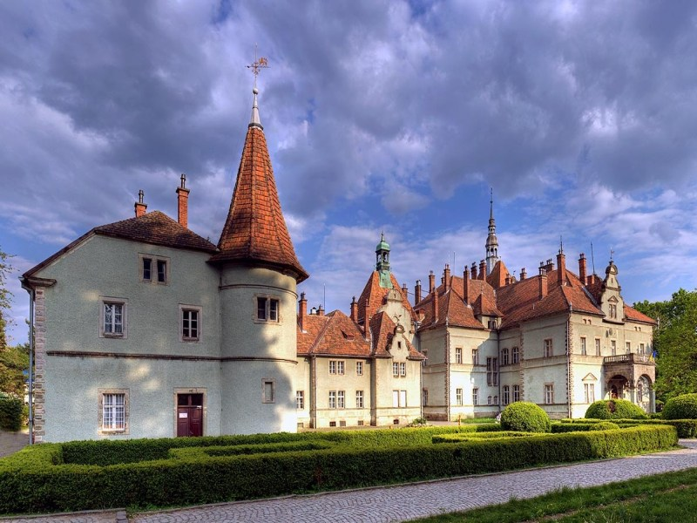
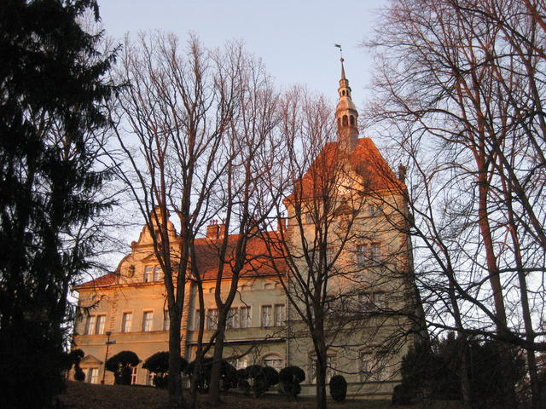
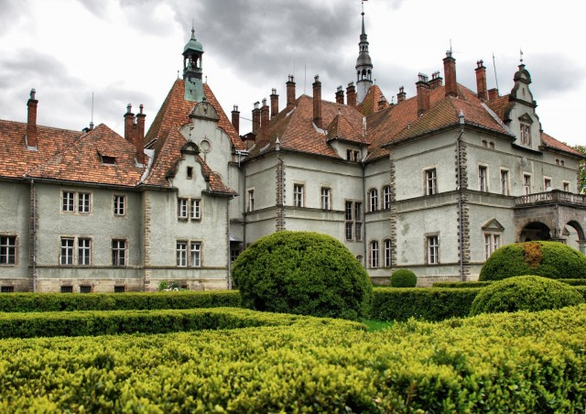
6. The castle of Count Schonborn (Carpathians)
A former hunting castle of Count Schonborn, now a unit of Carpathian resort located in the mountains and has about himself ordered the park and an artificial lake.

Slide 7
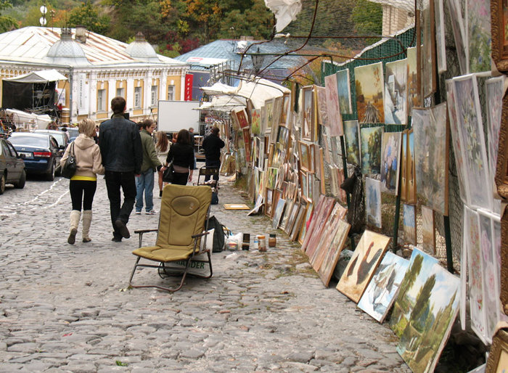
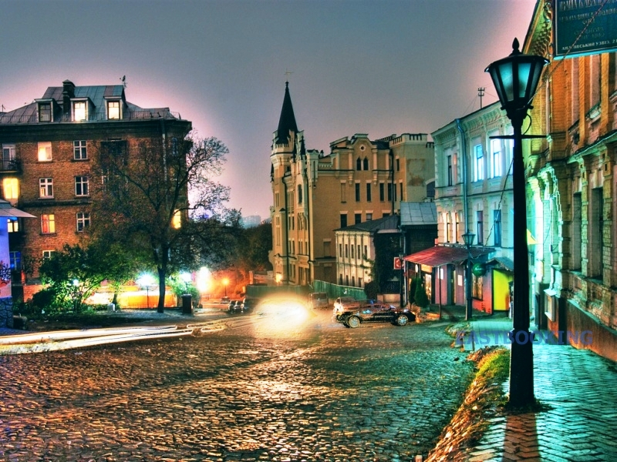
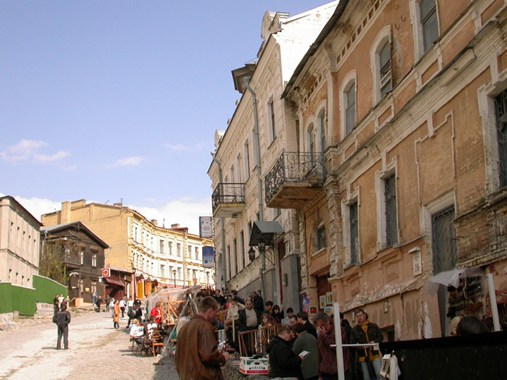
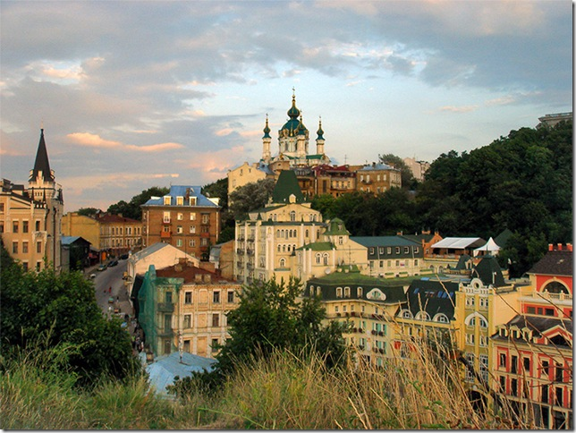
5. Andrew's Descent
Street artists and writers, Andrew's descent has always been a good place for walking from the top to hem Kyiv.

Slide 8
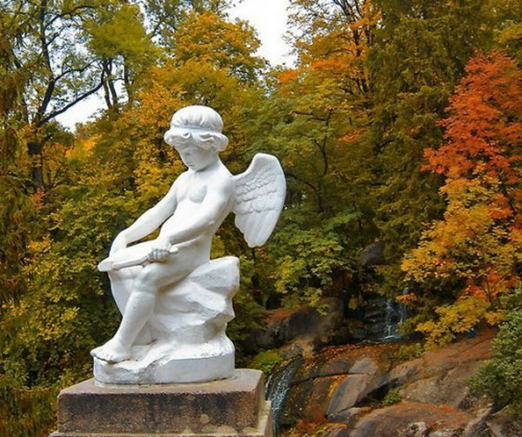
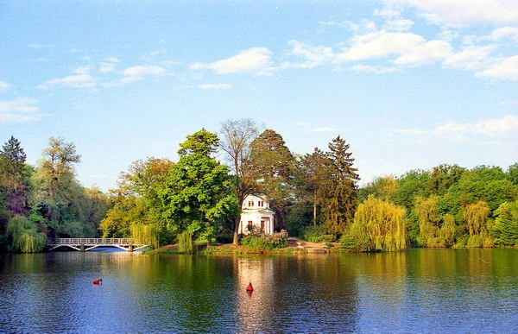
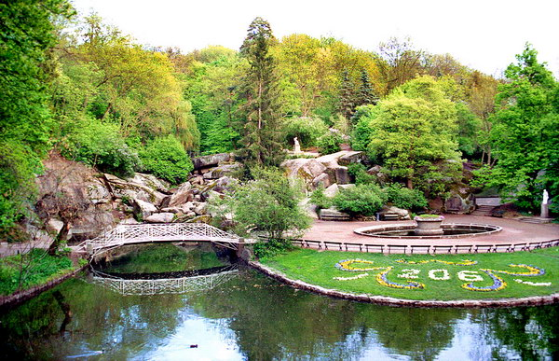
4. Park Sofievka
Sofievku that has become a living monument of eternal love, annually attracts more than 500,000 tourists. The park was divided into nearly treeless area, but now it's covered with several thousands of exotic trees and plants that amaze visitors.

Slide 9
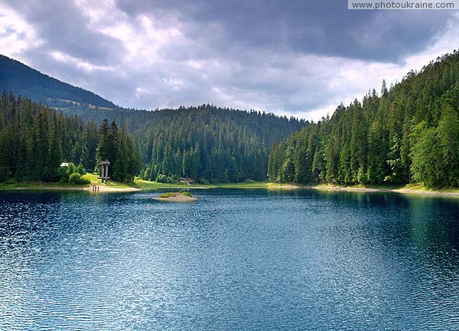
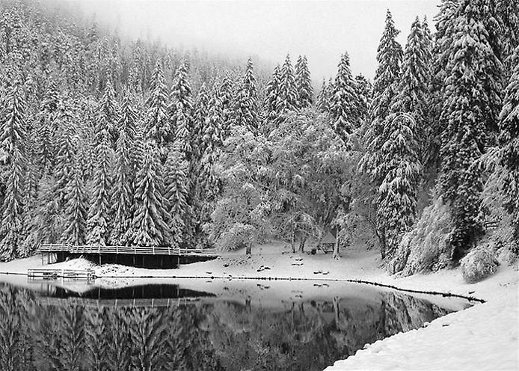
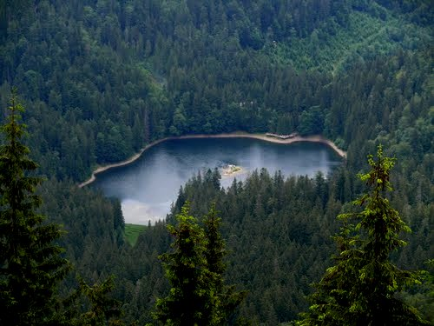
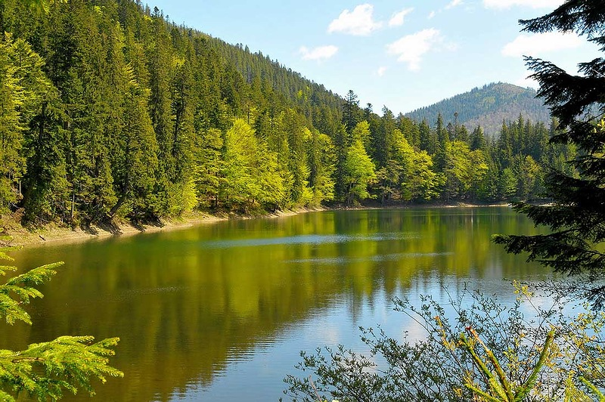
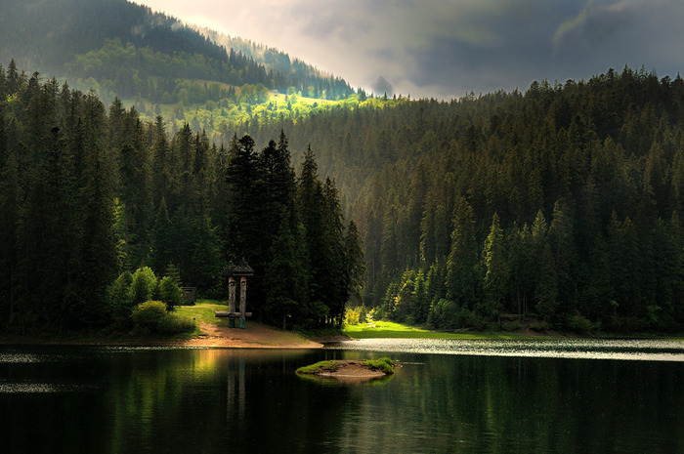
3. Lake Synevyr
The picturesque corner of Ukrainian Carpathians lake located at an altitude of nearly a thousand meters, has an interesting legend about the origin of its name.
According to legend, the lake formed by the flow of tears count's daughter Sin, the place where her lover, a simple shepherd Verkhovynsky Vir, on the orders of the Count was killed boulders on its earthy origins.

Slide 10
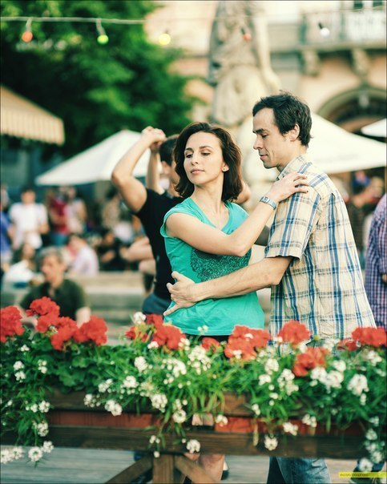
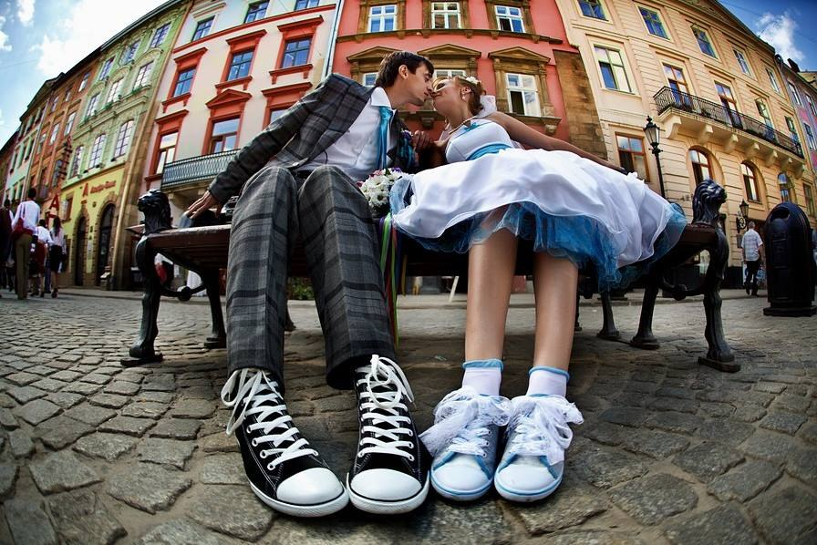
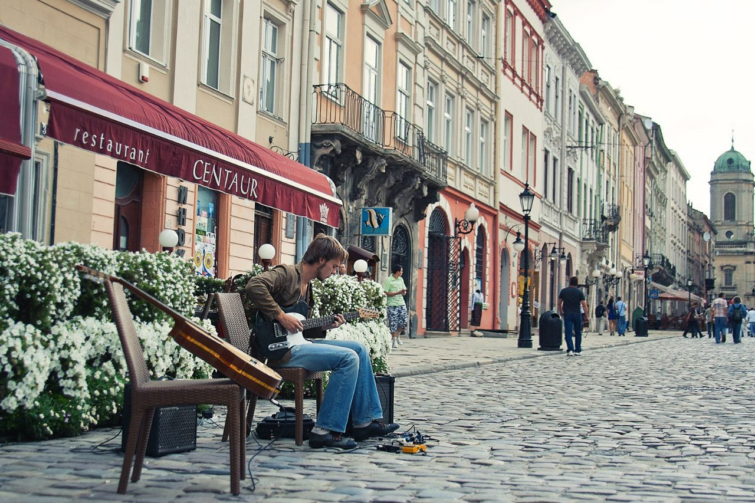
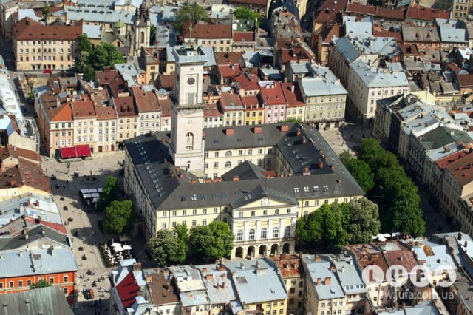
2. Market Square in Lviv
The heart of the city, which lies at the crossroads of his ways, absorbed the essence of this city - a cozy cafe, old stone buildings and modern shops.

Slide 11
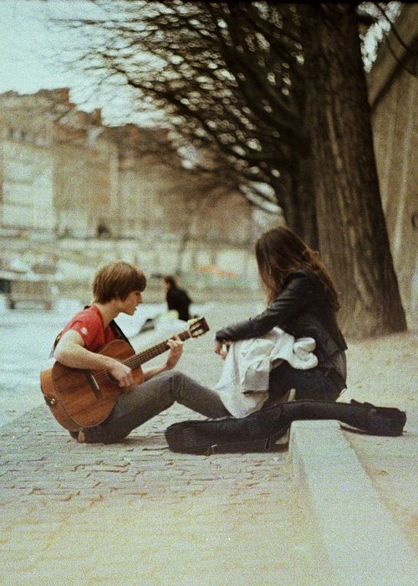
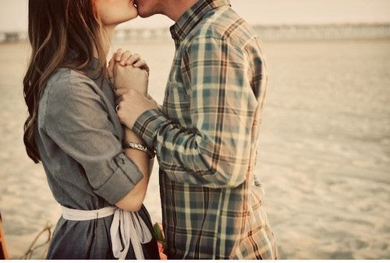
1. Anywhere
The first place we decided to leave it blank - because there is no universal romantic place not only in Ukraine but all over the world. For each person a place can be anywhere - in the shabby streets of a provincial town on the bench at your favorite park or on a steep rock on the BlackSea.

Slide 12
Thank you!!!:)

