Slide 1
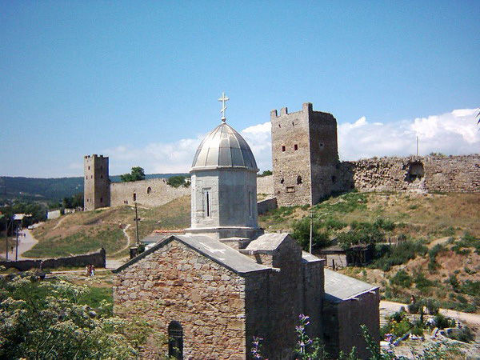
Feodosiya

Slide 2
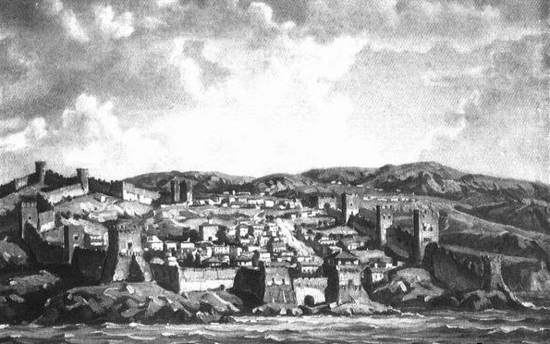
Tip of Theodosius
The first settlers lived in dugouts and napivzemlyankah.Zruchne geographical location at the crossroads of trade routes, fertile land and convenient harbor created favorable conditions for the rapid development of the city. Wage Naval Service was the primary occupation of most free citizens Feodosia.

Slide 3
Parks and gardens
Morsad
Jubilee park
Avenue of heroes
Komsomol park
Pushkin Square
Park Sanatorium of Ministry of Defence

Slide 4
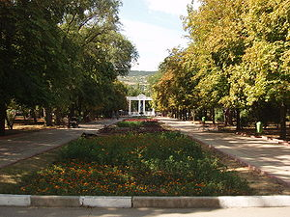
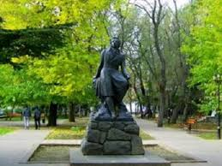
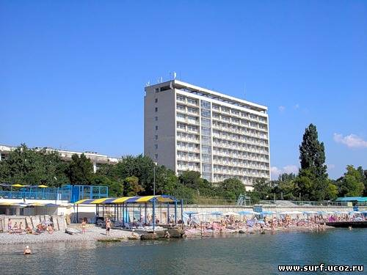
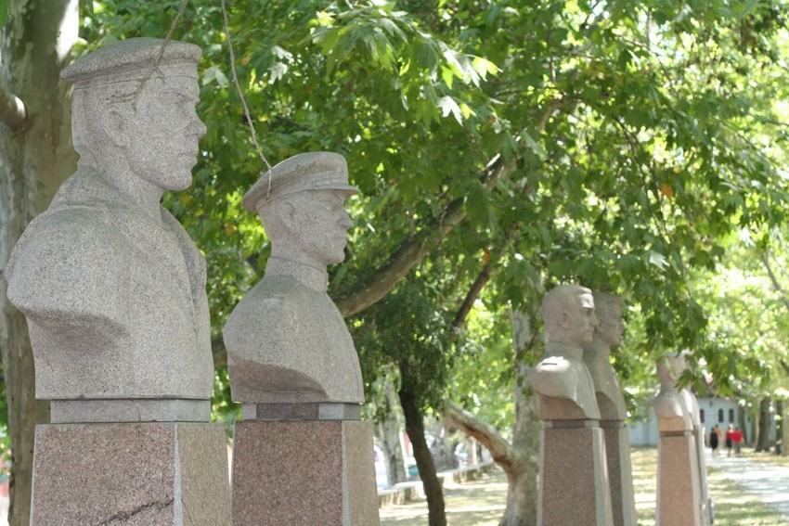
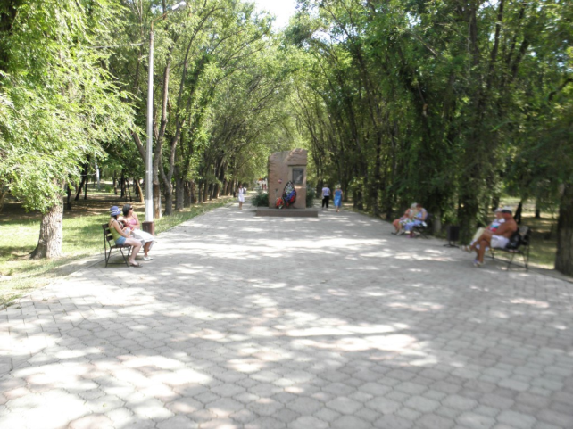
Pushkin Square
Park Sanatorium of Ministry of Defence
Jubilee park
Avenue of heroes
Komsomol park

Slide 5
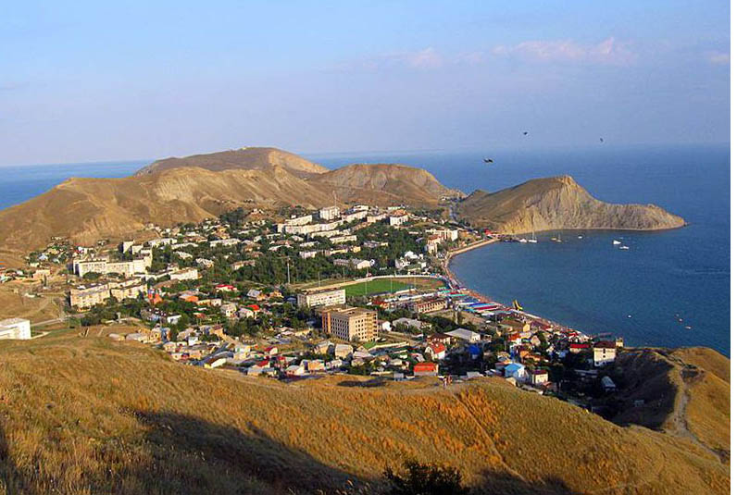
climate
Theodosia climate , warm and dry enough , combines the influence of the sea , the plains and foothills. High summer temperatures are relatively easily transferred through the action of refreshing breezes. Winters are short , with little snow . Sea bathing season lasts from May to October. The city is literally laced with sunshine.

Slide 6
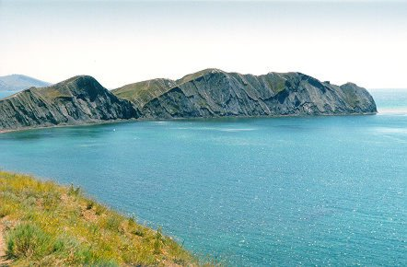
geographical position
Theodosius located in the south -east of the Crimean peninsula on the banks of a broad bay of the Black Sea and is located on the border , where the mountain chain smoothly into the steppe. Big Feodosia stretches for miles along the Black Sea coast and includes 16 settlements - Seaside, Shore , Ordzhonikidze , Koktebel, Shebetovka , Resort , etc.

Slide 7
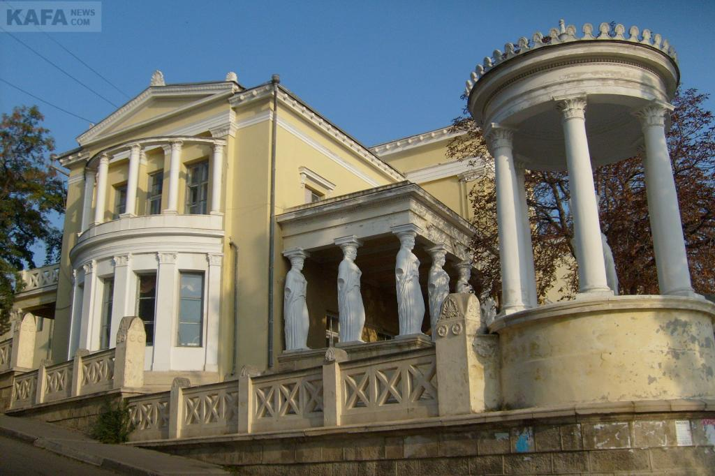
architecture
Different cultures and the fate of many peoples have left their mark in the architectural appearance of this ancient city . Buildings constructed in the XIX- XXv.v . did not violate the original architectural style of the city and make it look like a Mediterranean city .

Slide 8
Medicine and Health
Theodosius - a well-known health resort of Crimea. Beneficial merger mountain , sea and steppe climate , clean and warm sea , mineral water " Feodosia " and effective therapeutic mud - are factors that each season attract many tourists not only from Ukraine , Russia and neighboring CIS countries , but also foreign nationals.
Notes:
Leisure and Cultural Activities

Slide 9
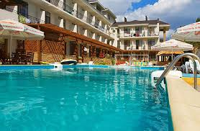
Leisure and Cultural Activities
Tour operators and museums offer familiarity with the sights of ancient Theodosia - Genoese fortress , the world's largest collection of paintings by the great artist Ivan Aivazovsky , local history museum , museum A. Green , visit Koktebel , the New World, the Dolphinarium , tours of the palaces of southern Crimea , boat trips to the reserve world level " Karadag " and other tours around Crimea .

Slide 10
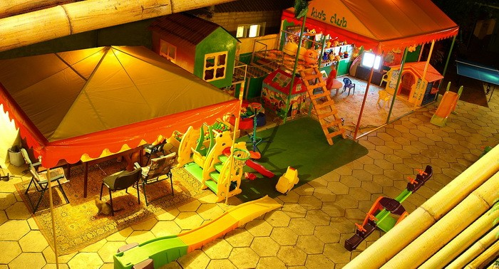
entertainment
Like any resort town of Feodosia offers a wide variety of entertainment.
On the beaches of organized skiing , windsurfing, water skiing , motorcycles, parachutes and gliders , etc. Many beaches have water slides , beach bars .
Plenty of cozy cafes, bars , restaurants, billiard clubs , discos are waiting for you around the clock on the central waterfront and downtown .

Slide 11
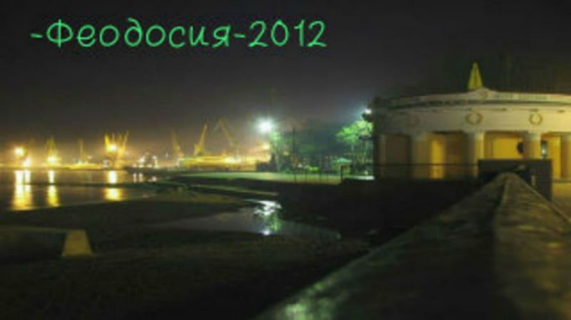
modern Theodosius
Population modern Feodosia than 90 thousand people. In the area of ​​Big Feodosia , where besides the city includes several townships Seashore, Ordzhonikidze , Koktebel, Shebetovka , Spa and ten villages, home to over 120,000 residents. In the city there are new modern neighborhoods, landscaped embankment, created and landscaped new beaches , broken many parks and gardens with fountains and seating areas for children and adults .

