Slide 1
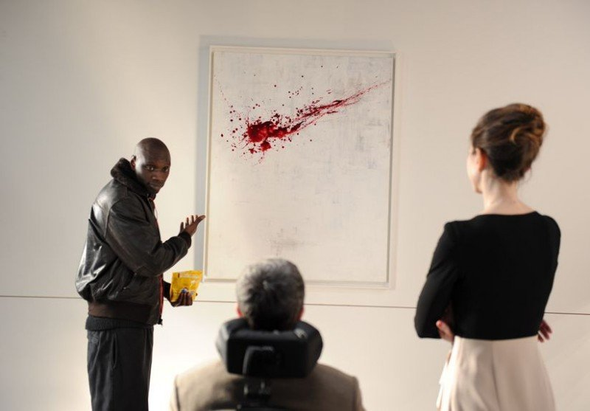
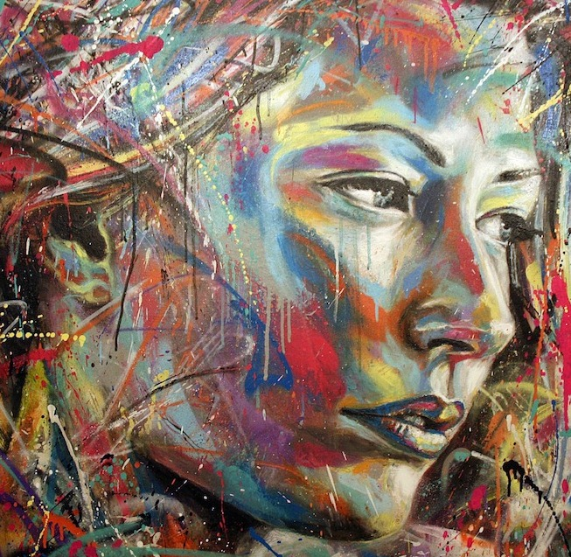
Painting

Slide 2
Content:
Art is eternal.
Art genres. My favorite picture
The great Russian and English painters from the past
Museums

Slide 3
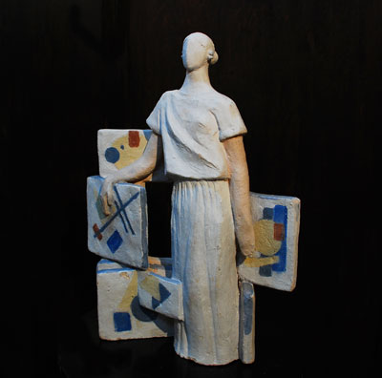
Art is eternal
Art is eternal, because these feelings, and the true causes of the deep meaning associated with the nature of man, and thus essentially constant in time and geography. And we define it unmistakably present.

Slide 4
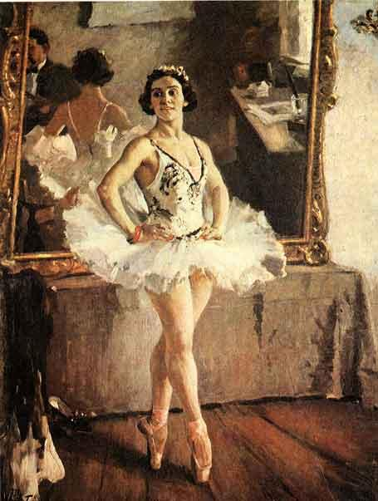
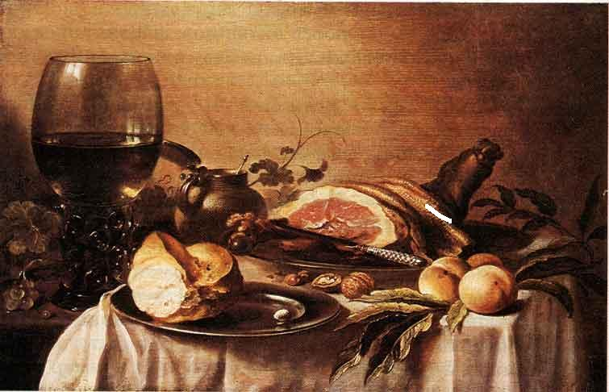
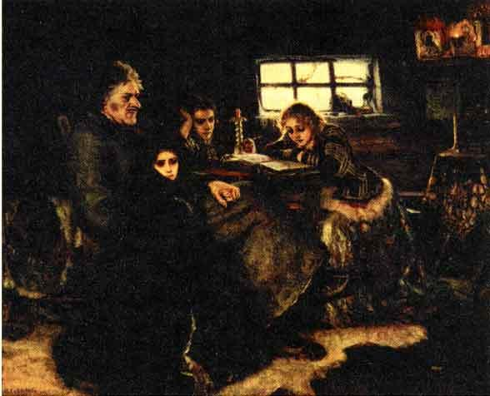
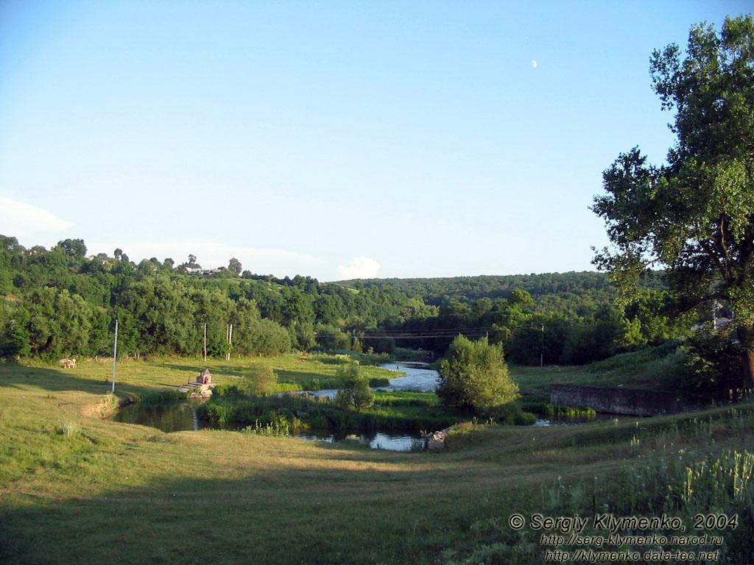
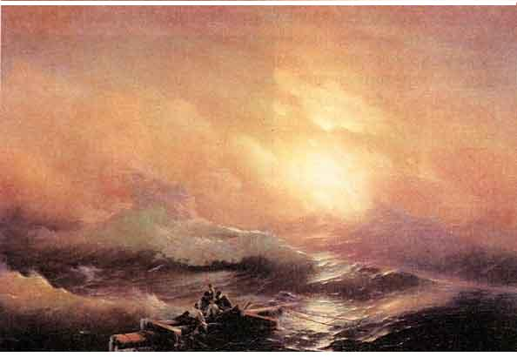
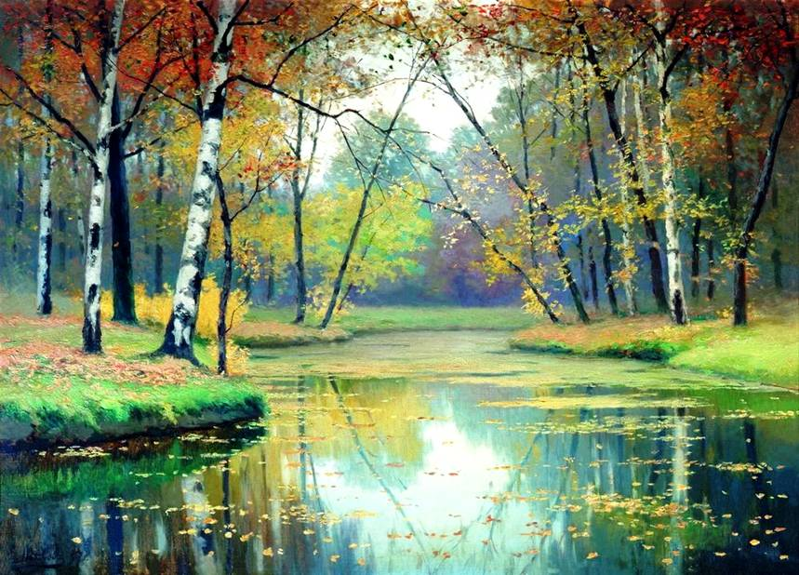
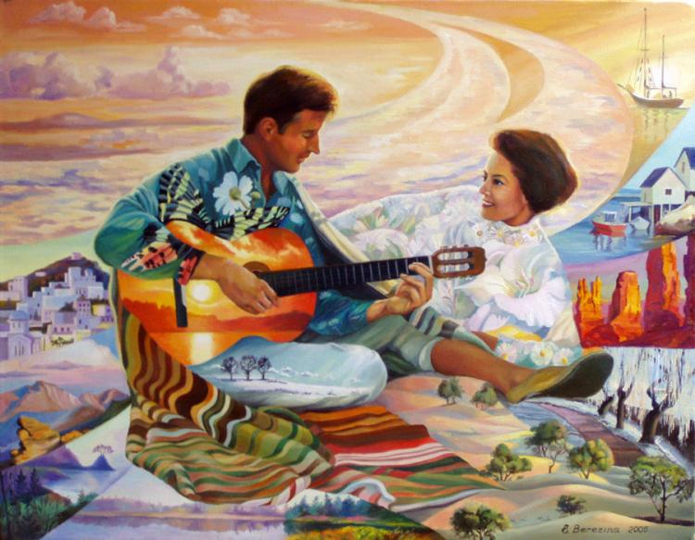
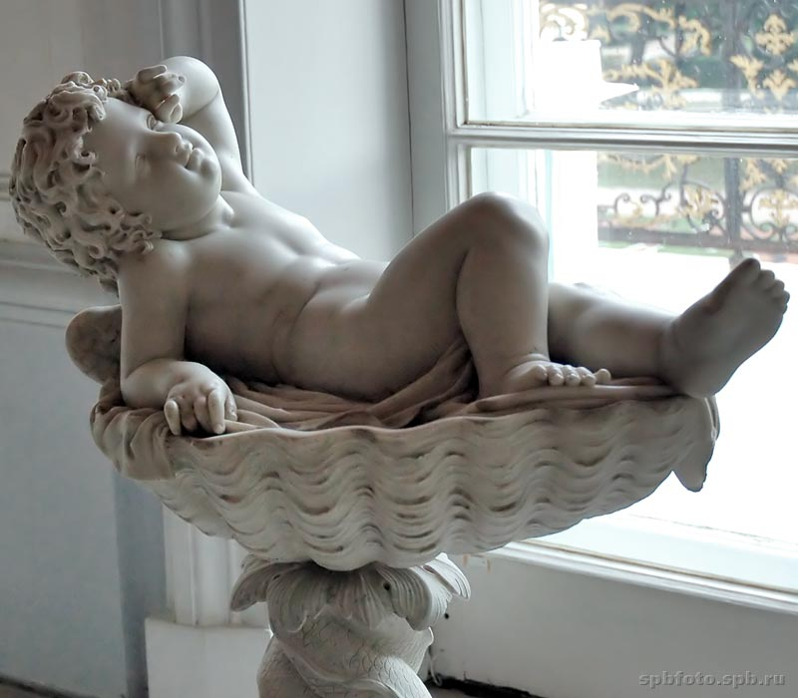
Art genres:
Historical painting
Portrait
Sculpture
Genre painting
Landscape
Scenic view
Seascape
Still life

Slide 5
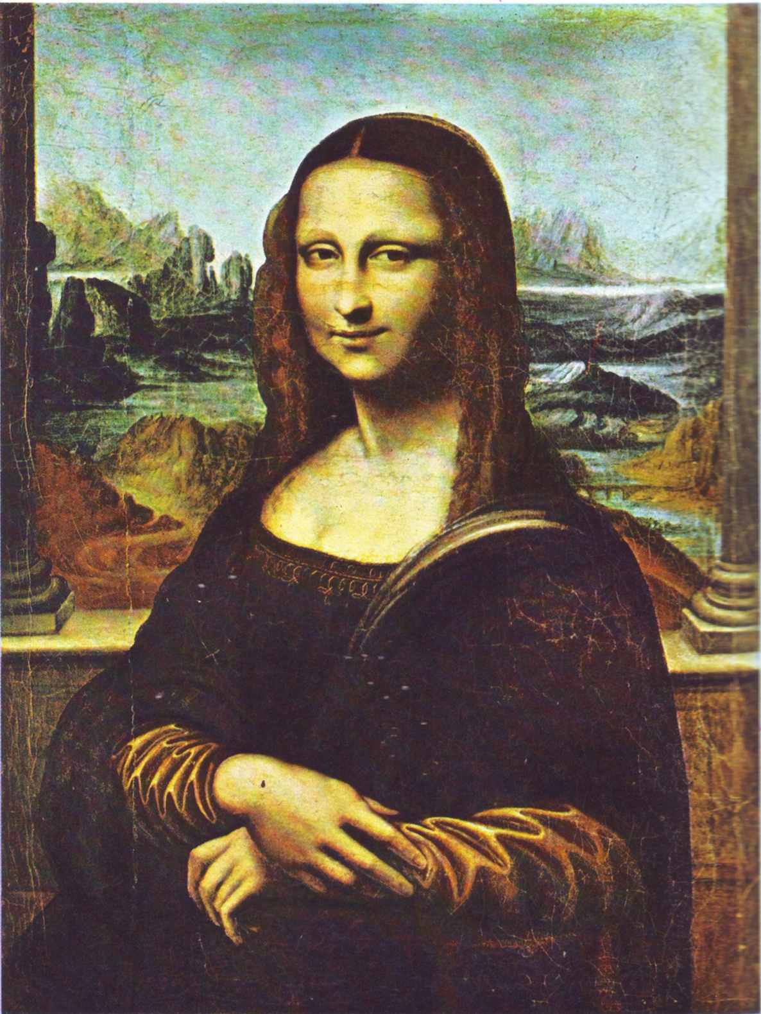
My favorite picture
Mona Lisa is the most beautiful picture in the world. Definetly it was hard work for Leonardo da Vinci because lady on the picture as alive. She sits in a chair , her hands clasped together , the opera one hand on her arm , and the other resting on top , turning in her chair almost towards the viewer. You can't understand her feeling. She different every times. Green dress in thin assemblies with yellow sleeves in the folds , cut low on the white chest. The head is slightly rotated. These small details characteristic pattern is very attracted to her. "Mona Lisa" - Portrait of Mrs. Lisa del Giocondo. This painting by Leonardo da Vinci is one of the most famous paintings in the world. It was written around the year 1503-1505.

Slide 6
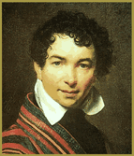
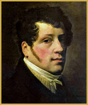
The great Russian painters
Orest Adamovich Kiprensky (1782-1836) Gorgeous and subtle portraits of the artist prescribed Kiprensky brought him fame and true recognition among his contemporaries. In his portraits reflect the beauty of excitement, sophisticated inner world of images and state of mind.
Sylvester Shchedrin artist (1791-1830) Russian master landscape romanticism and lyrical interpretation of nature. Completely surrendering romantic landscape and environment perception, like Shchedrin makes his paintings, falling interest artists of the time to the landscape

Slide 7
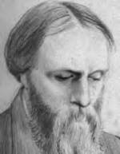
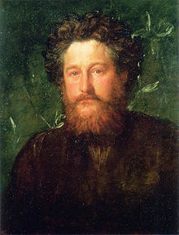
The great English painters
Edward Burne-Jones (1833-1898) was an English painter, draftsman, a master of arts and crafts. Probably the most successful of his works can be called in different areas of monumental decorative art, magnificent stained glass windows, mosaics.
William Morris (Morris) (1834-1896)is an English artist, writer, art theorist, and public figure. Products workshops Morris decorated interiors they differ certain functional justification and tectonic balanced composition, clarity of ornament, stylized floral motifs, restrained color combinations, a number of features they anticipate the "modern" style.

Slide 8
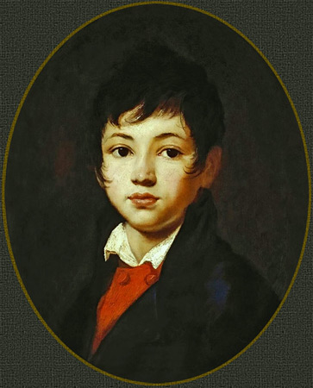
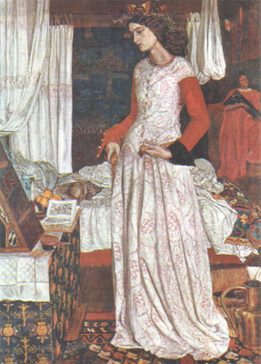
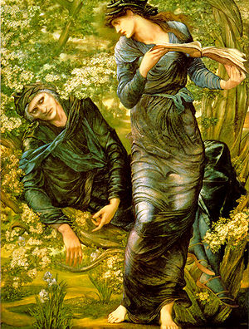
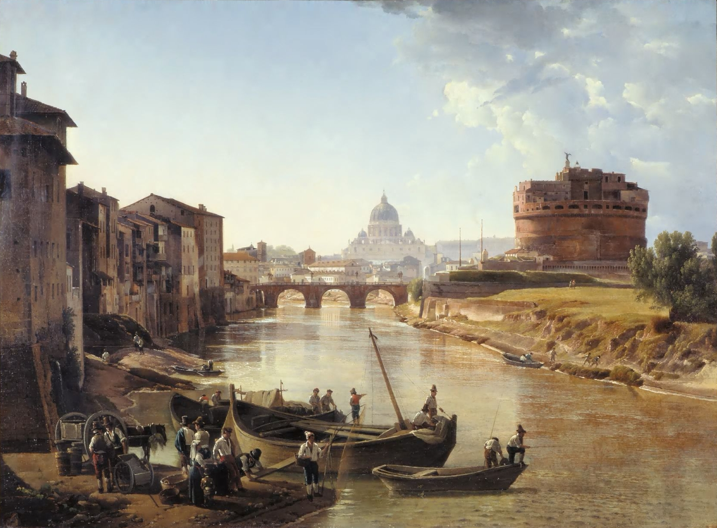

Slide 9
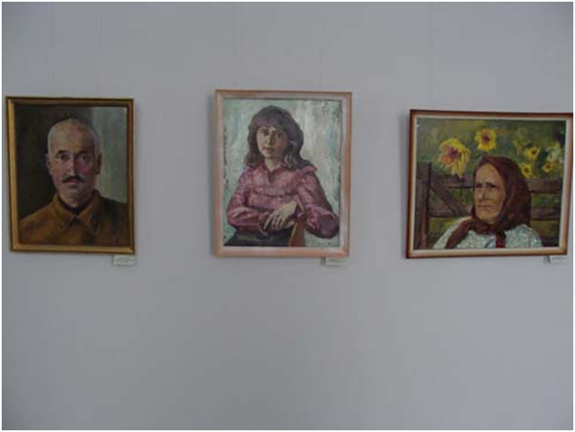
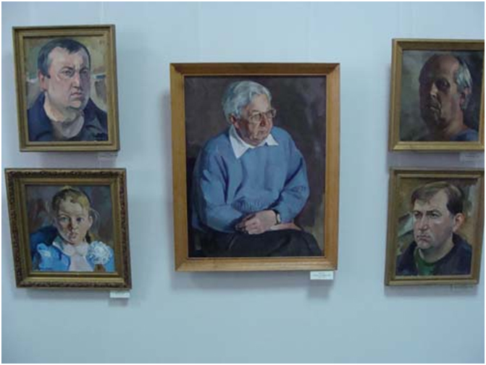
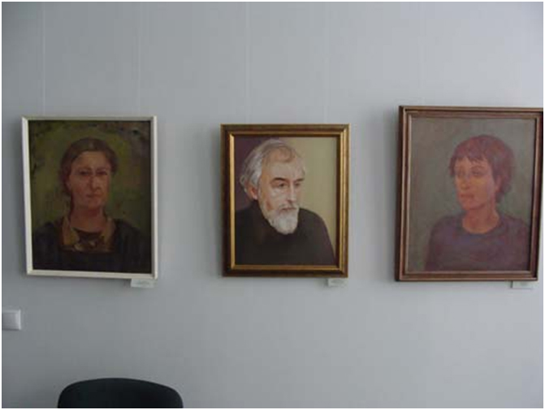
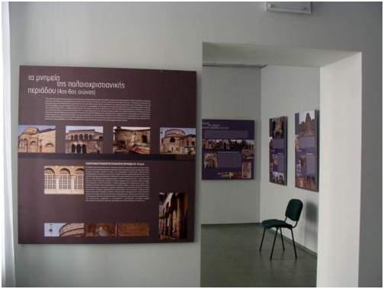
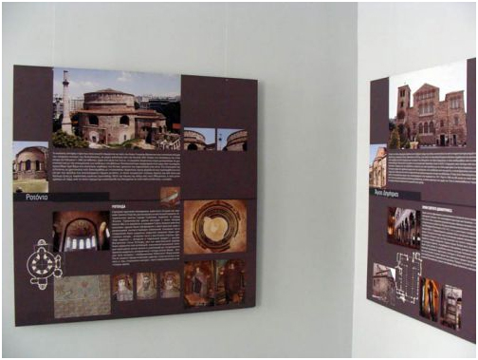
Museum
Art Museum. AI Kuindzhi was opened on 29 November 2010, in the historic part of the city, in a mansion built in the early twentieth century . The museum exposition shows all stages of life outstanding landscape . The exposition ends with the perpetuation of the memory of the artist. Here these pictures , which gave the city after the first republican exhibition landscape "Memorial AI Kuindzhi "( 1973) , exhibited a bust , a bas-relief design of the monument AI Kuindzhi books about outstanding artist . Two halls of the museum exhibits paintings by local artists .

