Slide 1
Are the oceans getting saltier?

Slide 2
Introduction
In April 2011, NASA plans to launch the Aquarius satellite into orbit with a mission of answering a critical question about the Earth below: how is the salinity of Earth's ocean changing?
A remote-sensing sea surface salinity satellite (SSS), Aquarius will record how much salt ocean waters contain across the globe.

Slide 3
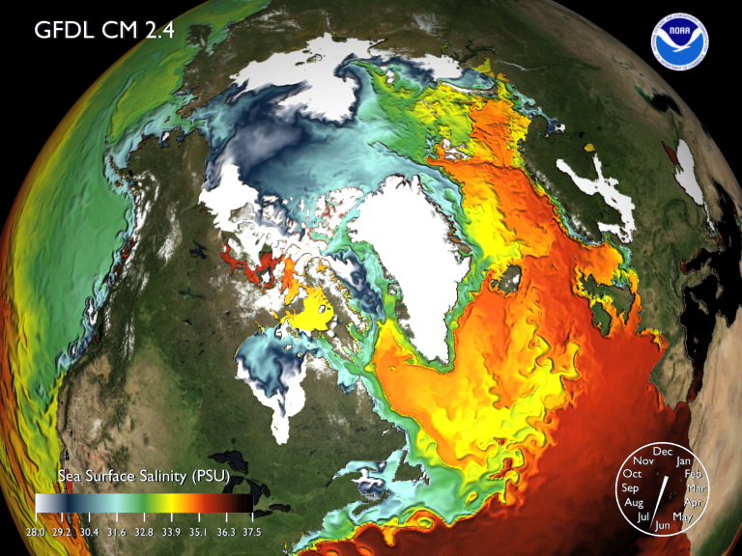

Slide 4
Let’s talk about salinity
Measuring the amount of salty ocean seasoning might seem like a trivial venture considering the cost and scale of the project, which has been in development for around a decade. But ocean salinity is about a lot more than just salt.
“Salinity, along with temperature, determines the density of the seawater, which will drive the 3-D ocean circulation that plays a key role in modulating the climate,” said Yi Chao, project scientist on the Aquarius mission.

Slide 5
Why it’s useful to know the current level of the World Ocean salinity?
Consequently, ocean salinity is a barometer for change in the global water cycle — the rate of precipitation versus evaporation — it can also lend clues as to the rates at which water temperatures are rising and ice sheets are melting.
As ocean temperature has risen in recent decades and ice sheets have melted at faster rates, studies have indicated that, on average, seawater is becoming fresher. Yet, site-specific salinity surveys also note that subtropical regions (25 to 30 degrees latitude) in particular have actually gotten saltier.

Slide 6
Thanks for watching!
☺

