Slide 1
Prezentation Topic: Oxford Form 10-a School 3 Valeria Vasiljeva

Slide 2
Oxford is a city in central southern England.

Slide 3
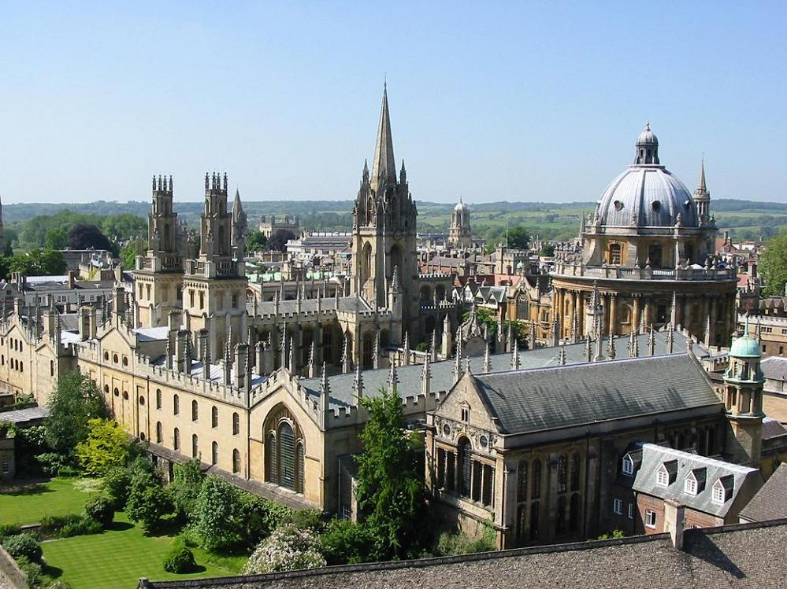
The city is known for being a university town as home of the University of Oxford, the oldest university in the country and the English-speaking world and one of the most famous and prestigious higher education institutions of the world.

Slide 4
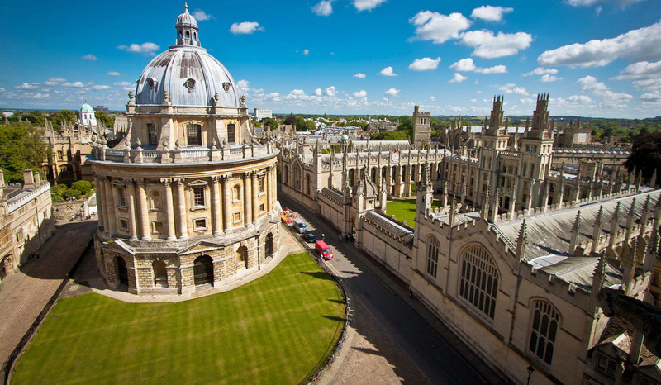
Buildings in Oxford demonstrate an example of every English architectural period since the arrival of the Saxons, including the iconic, mid-18th-century Radcliffe Camera.

Slide 5
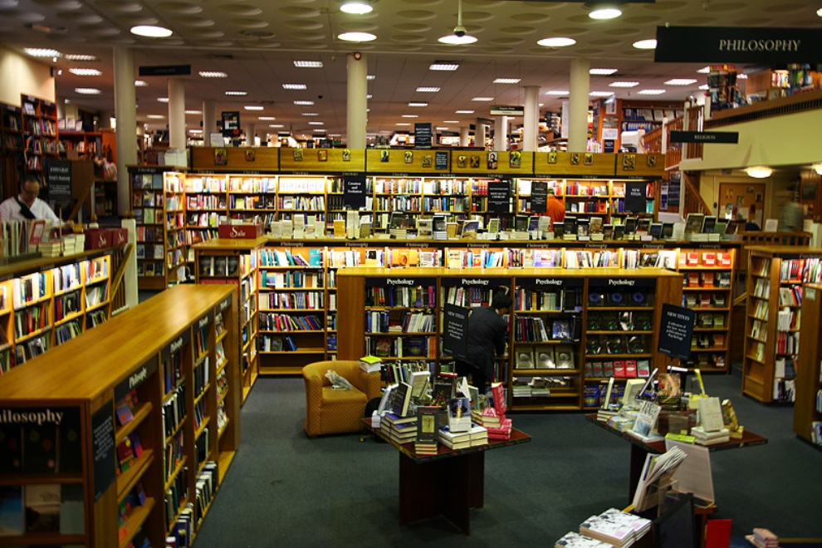
Blackwell's Bookshop is a large bookshop which claims the largest single room devoted to book sales in the whole of Europe, the cavernous Norrington Room (10,000 sq ft).

Slide 6
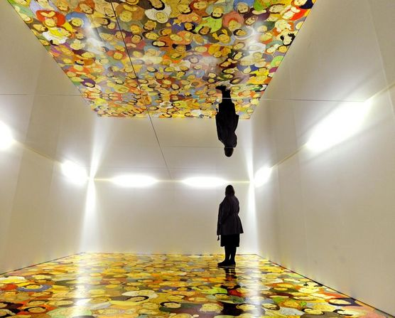
Modern Art Oxford is an art gallery established in 1965 in Oxford, England. From 1965 to 2002, it was called The Museum of Modern Art, Oxford.

Slide 7
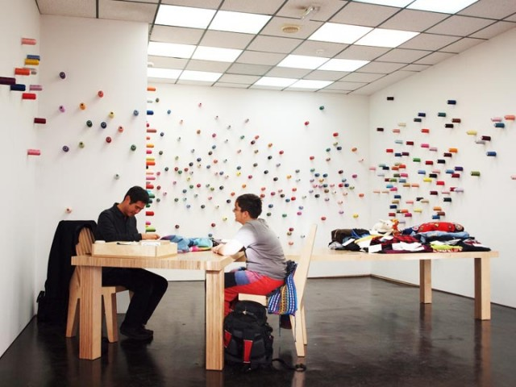
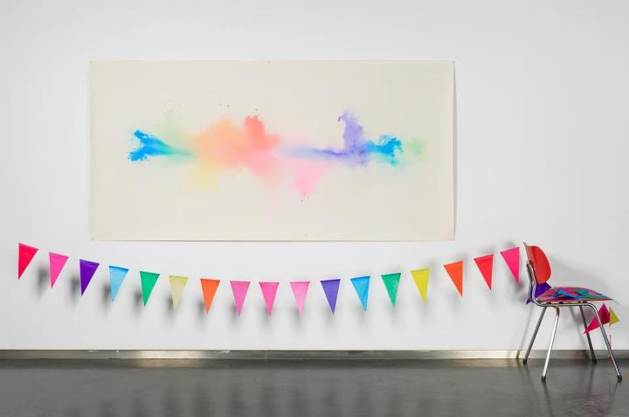

Slide 8
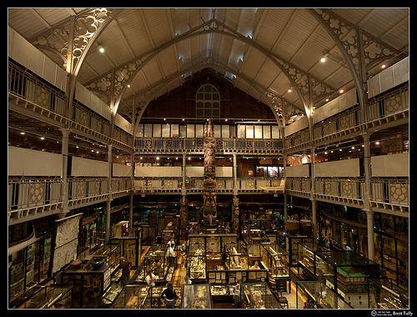
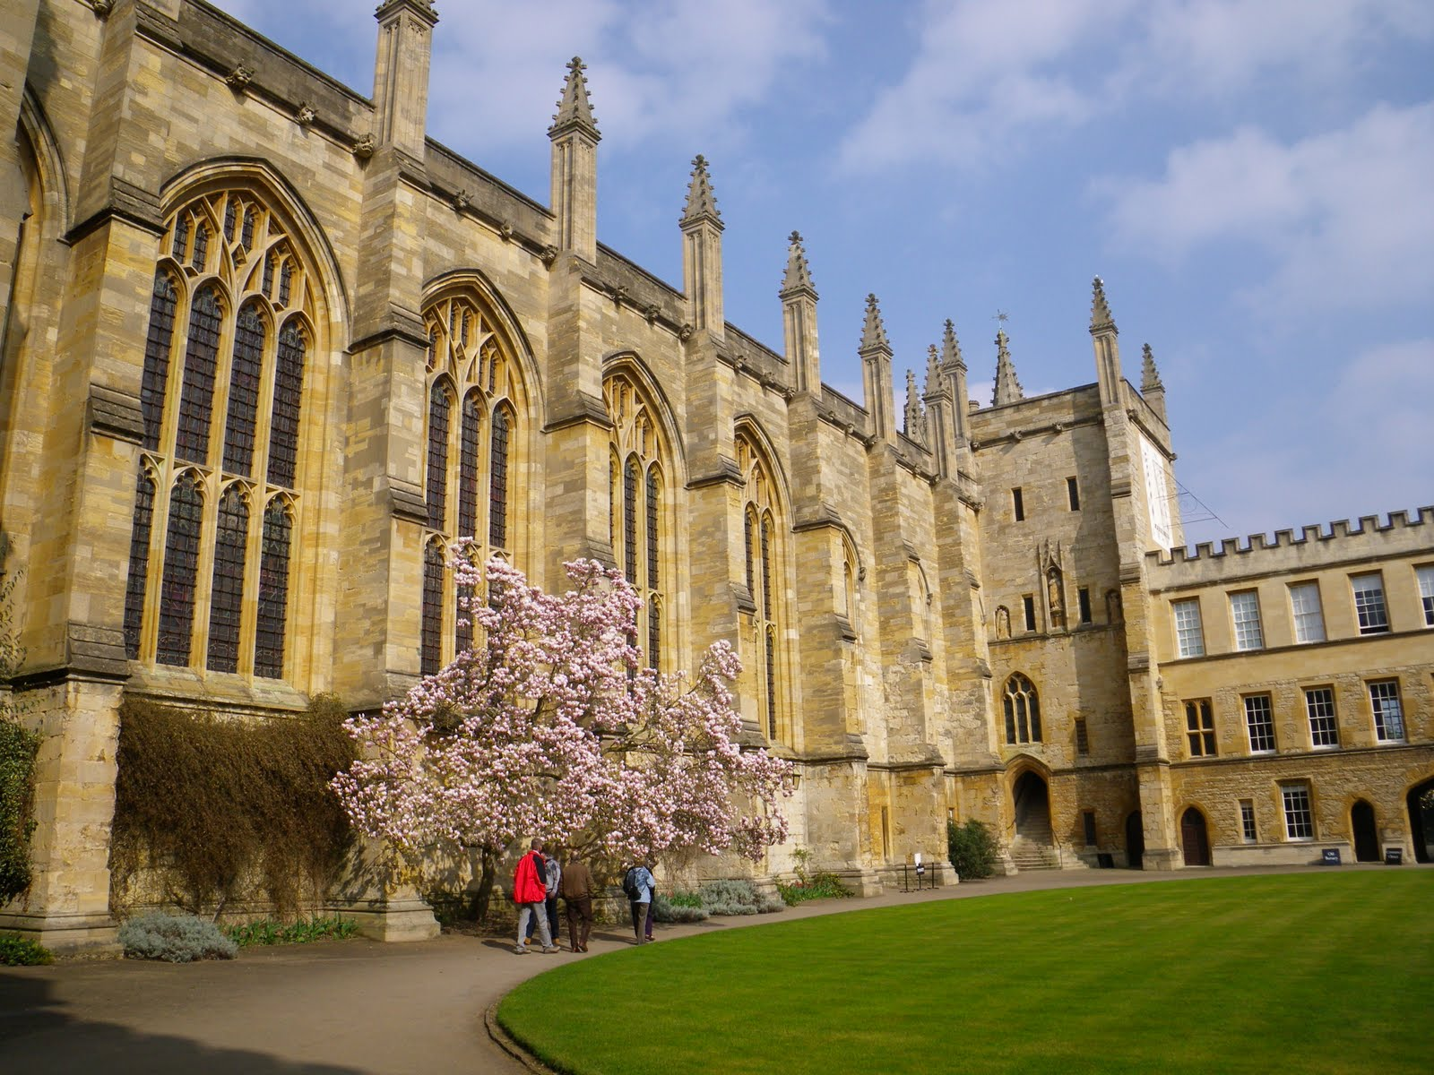
The Pitt Rivers Museum is a museum displaying the archaeological and anthropological collections of the University of Oxford in Oxford, England.

Slide 9
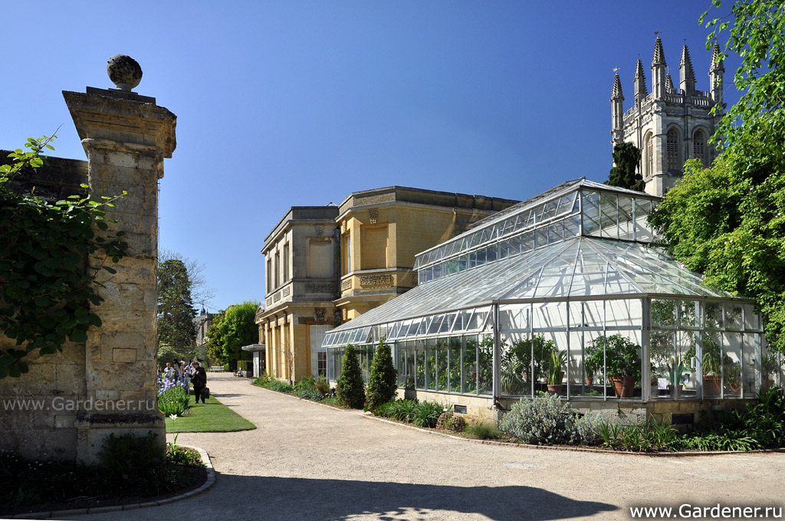
The University of Oxford Botanic Garden is an historic botanic garden in Oxford, England. It is the oldest botanic garden in Great Britain and one of the oldest scientific gardens in the world.

Slide 10
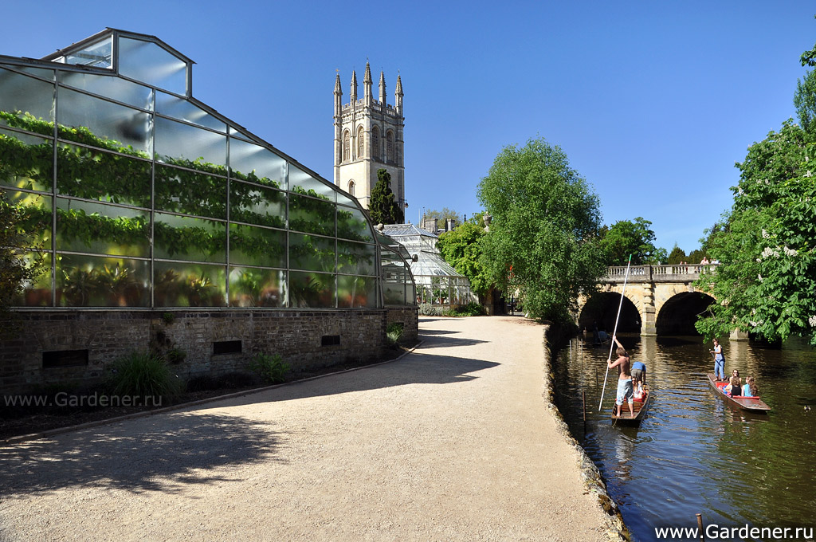

Slide 11
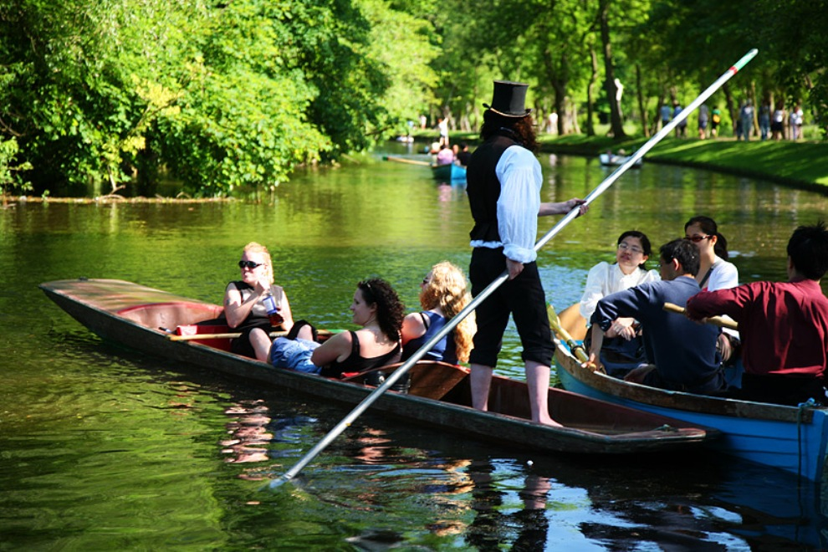

Slide 12
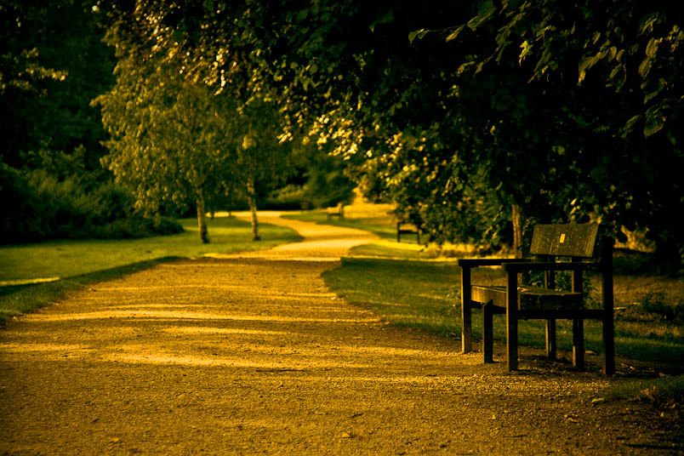
The Oxford University Parks is one large parkland area slightly northeast of the Oxford city centre in England. It is open to the public during the day, and has beautiful gardens, large sports fields, and rare and exotic plants.

Slide 13
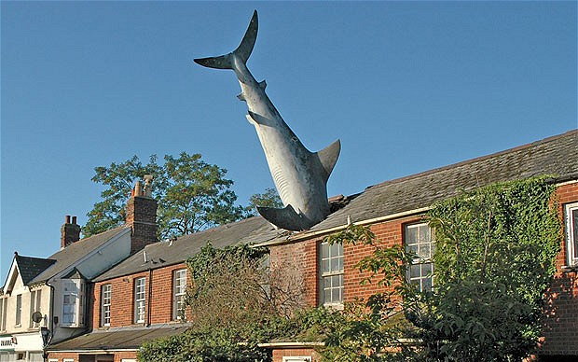
The Headington Shark is a sculpture situated at 2 New High Street, Headington, Oxford, England, depicting a shark embedded head-first in the roof of the house.

Slide 14
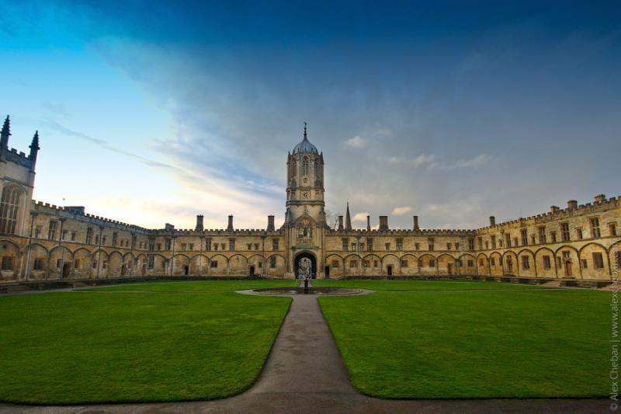
Christ Church College - one of the most famous, beautiful and richest colleges of Oxford.

Slide 15
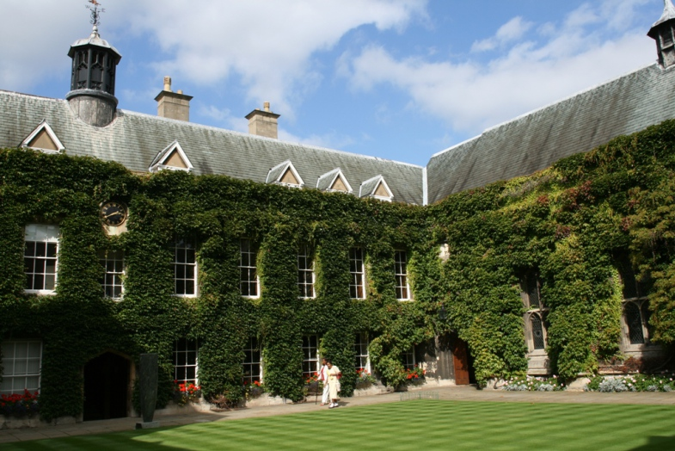

Slide 16
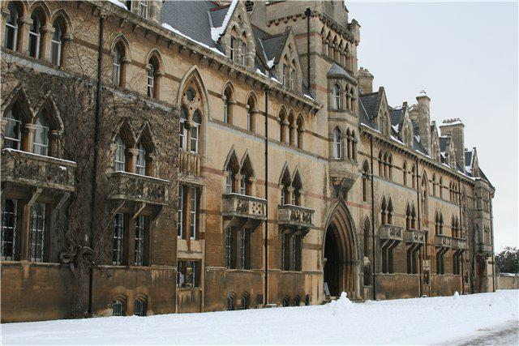

Slide 17
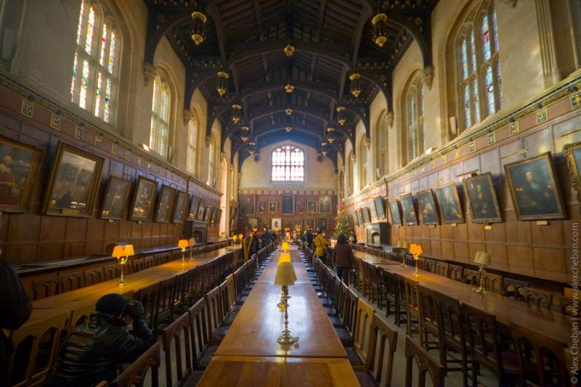
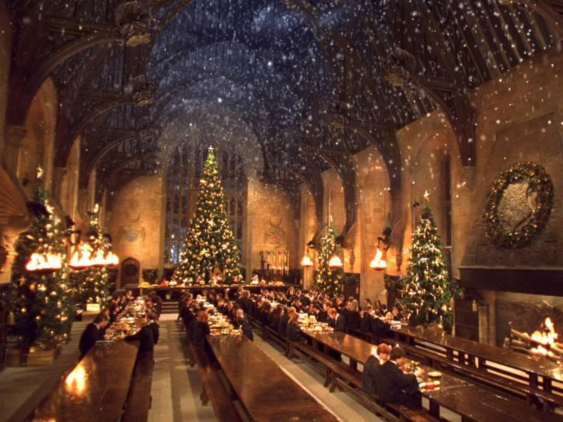
You can imagine what it looks like thanks to the Harry Potter films: scenes of lunch with students and teachers of Hogwarts were filmed here.

Slide 18
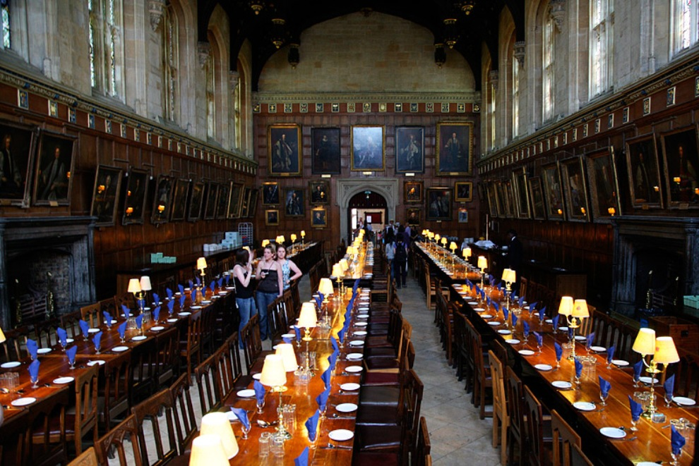
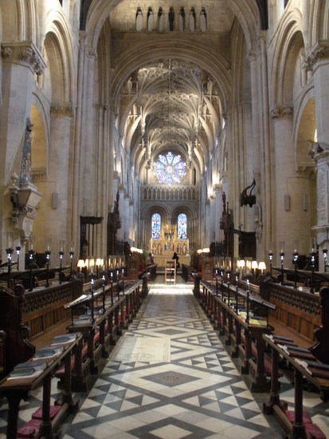
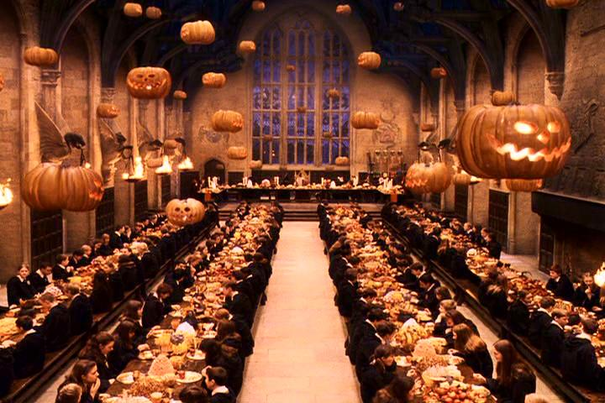

Slide 19
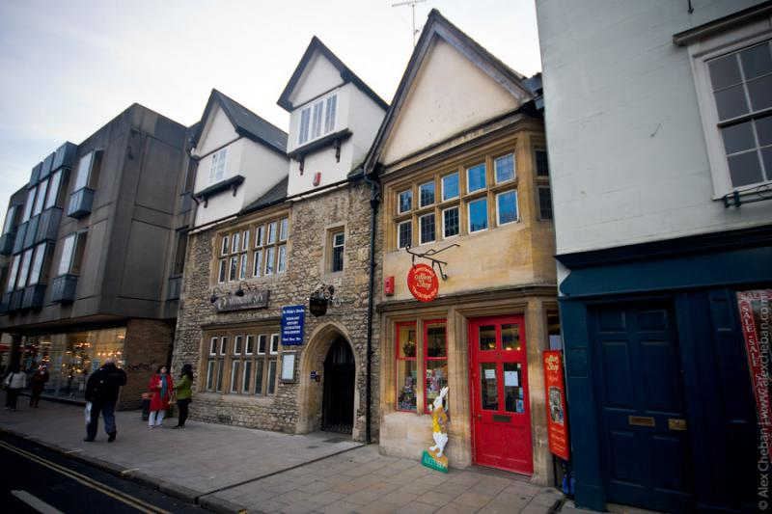
Charles Dodgson - known under the nickname Lewis Carroll - studied and later taught here. Opposite the gate leading to the college across the street is another attraction - a famous shop "Alice's Shop".

Slide 20
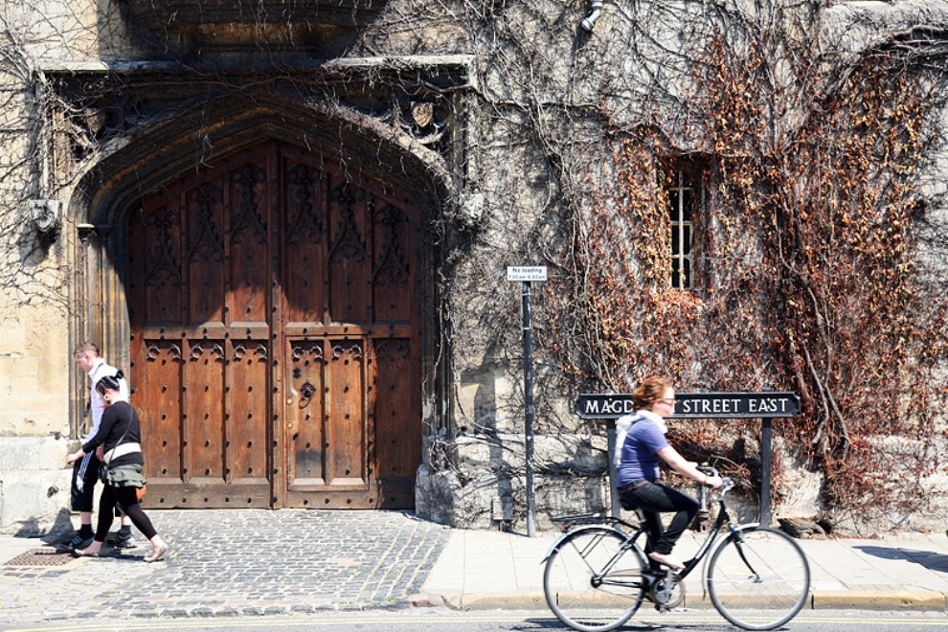

Slide 21
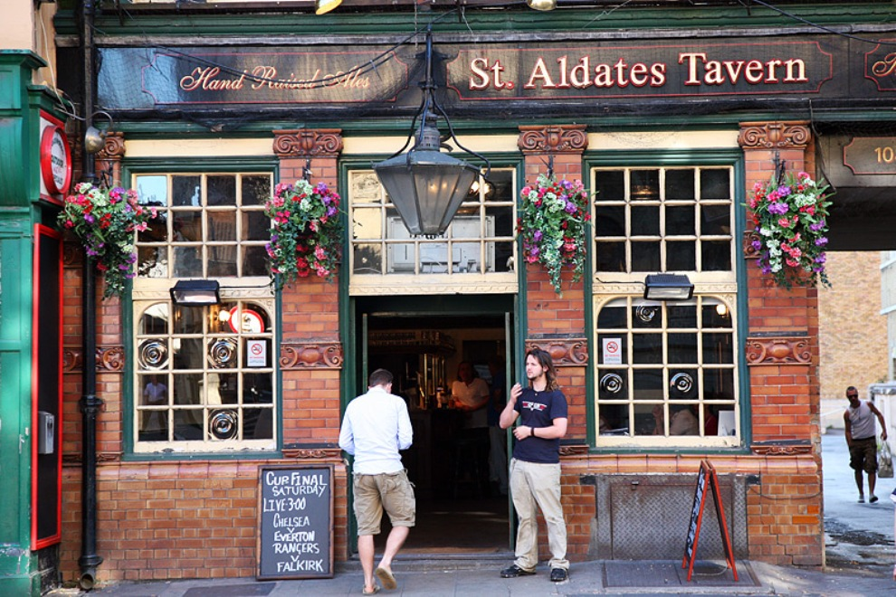

Slide 22
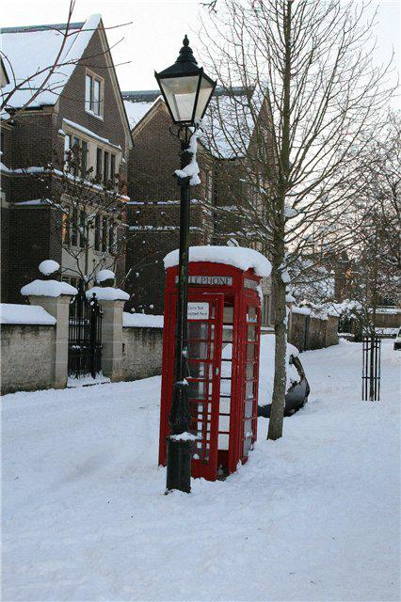
References
http://en.wikipedia.org
http://comunidade.sol.pt
http://www.timetravel-britain.com

