Slide 1
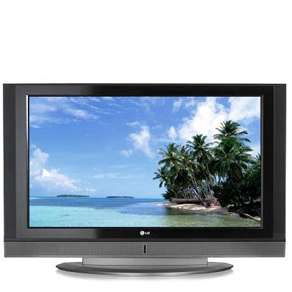
My favorite TV Program .

Slide 2
My favorite TV program Galileo

Slide 3
Galileo – Russian popular science television program on channel STS . This program starts at 3 p .m . every day.

Slide 4
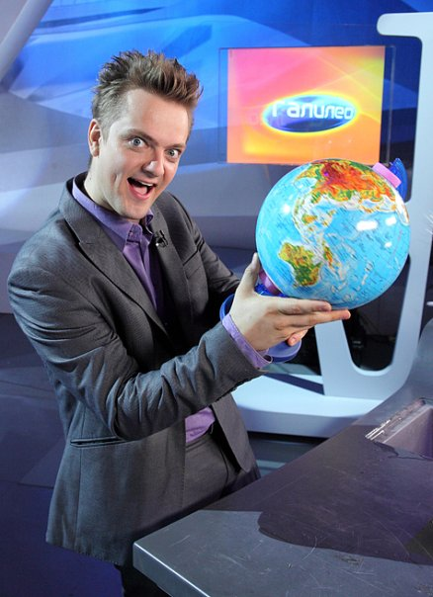
Leading this show Alexander Pushnoy. He very is cheerful and loves to make experiment.

Slide 5
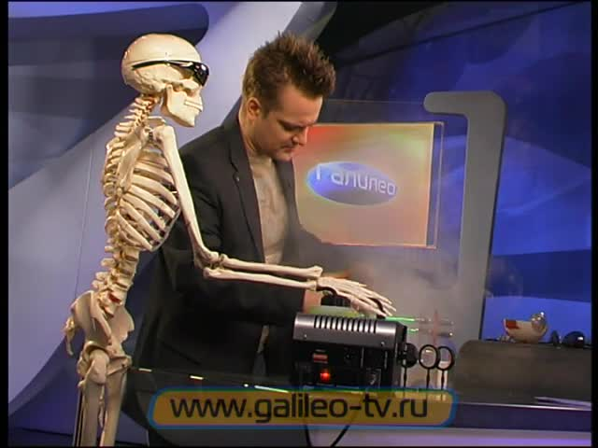
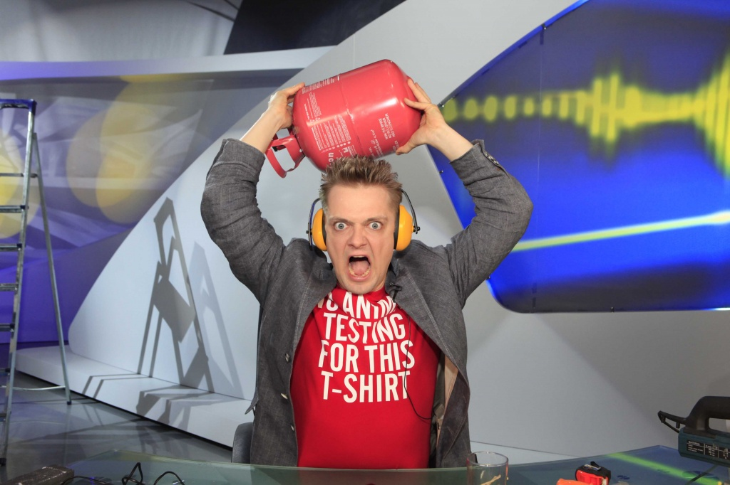
This show is very informative. They show a lot of interesting.

Slide 6
Thank you for your attention.

