Slide 1
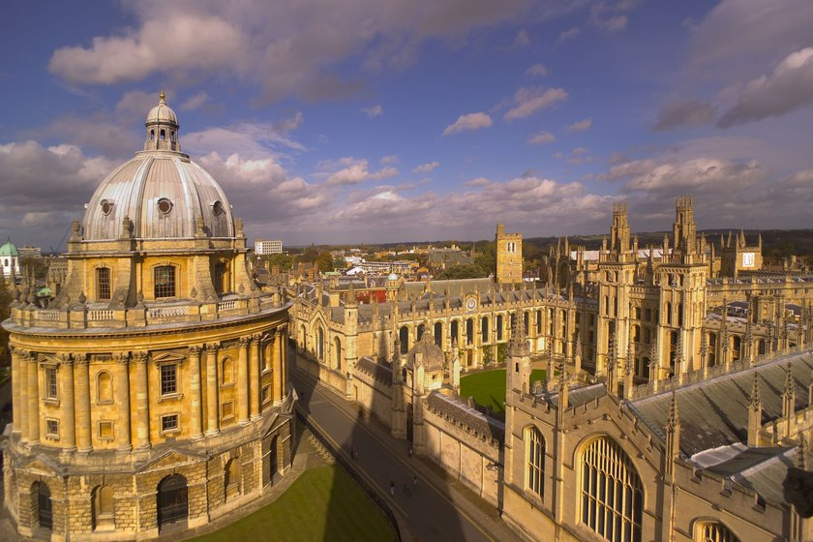
Oxford

Slide 2
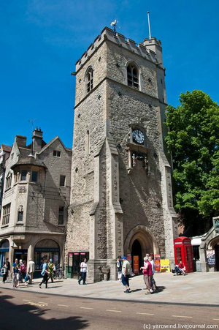
Carfax Tower
In central Oxford's Carfax Tower is ..

Slide 3
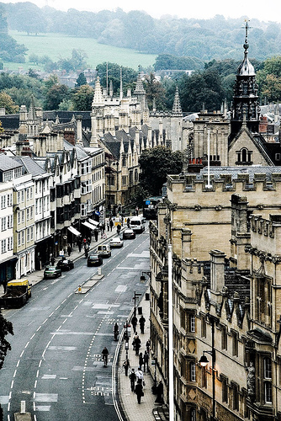
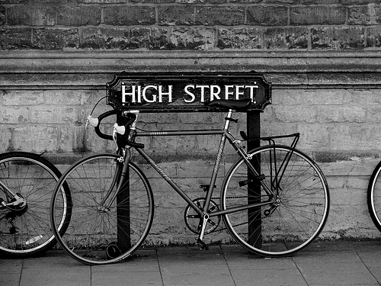
Walk down the long street High, one of the most amazing streets of England

Slide 4
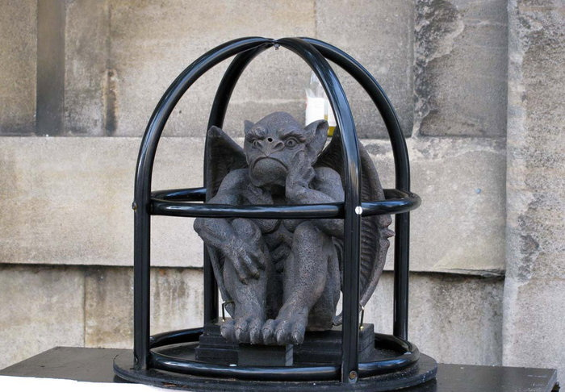
Oxford Cathedral, despite such a grand name, is a small chapel at the college the "Church of Christ". Oxford Cathedral - the smallest in England, but that does not stop him from being one of the most famous. In the 13th century it was the cathedral of Oxford announced the proclamation of St. George the patron saint of England and the English people.

Slide 5
Magdalen College was founded in 1458 by William Veynfleta, Bishop of Winchester. statutes included provision for the founder of the choral foundation of men and boys (a tradition that has continued to the present day), and referred to the pronunciation of the name College of English. Another unrelated college named Hall of Magdalen, adjacent to Magdalen College eventually became part of Hertford College.

Slide 6
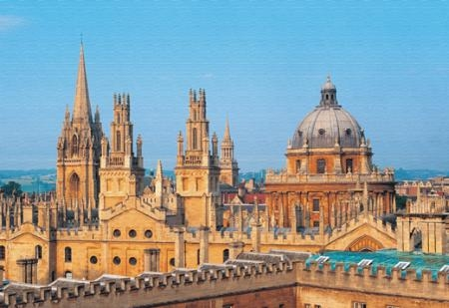
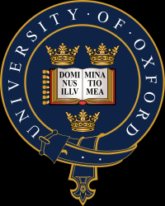
This is the Oxford University. Oxford University finished: Roger Bacon, Oscar Wilde, John Donne, Sir Christopher Wren…

Slide 7
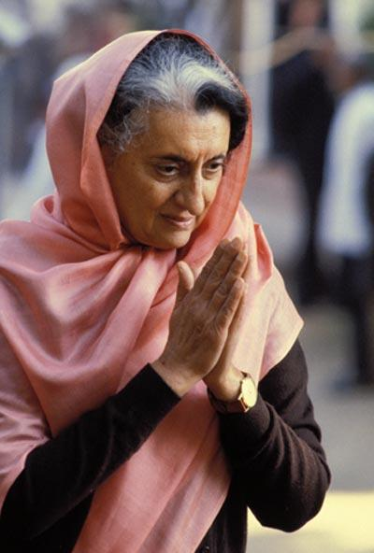
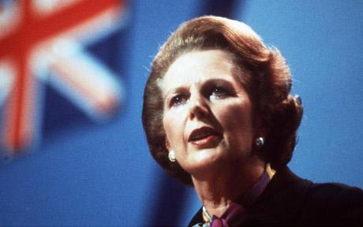
But many of the most famous women in the world, such as Indira Gandhi and Margaret Thatcher fine completed the colleges of Oxford.

Slide 8
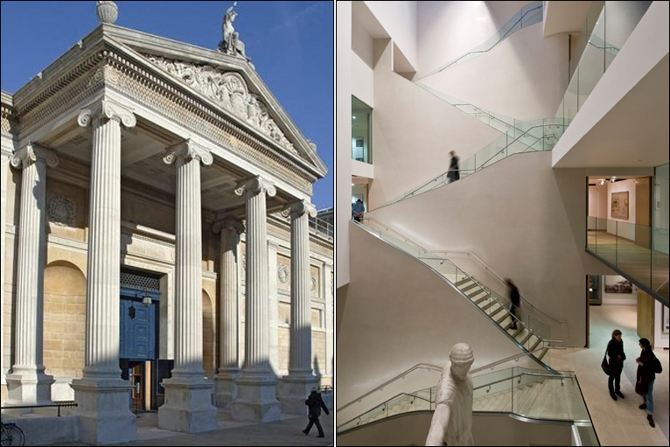
At Oxford, the famous Ashmolean Museum - the oldest museum in Britain, founded in 1683.

Slide 9
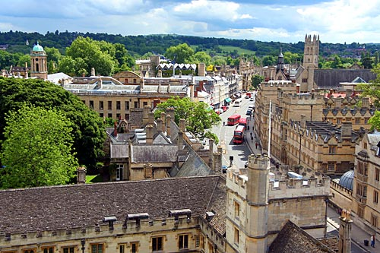
You may be surprised steady stream buses, pedestrians and quickly reaching the center of the city looks more as London.

