Slide 1
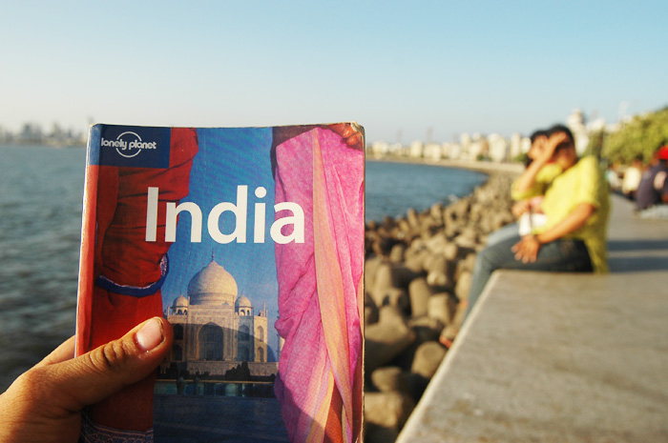

Slide 2
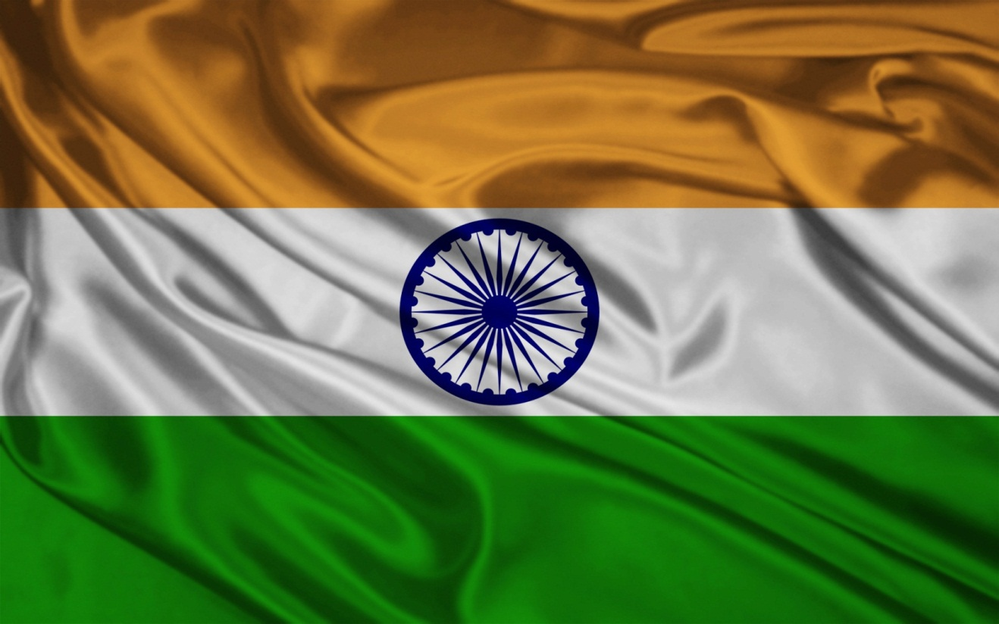
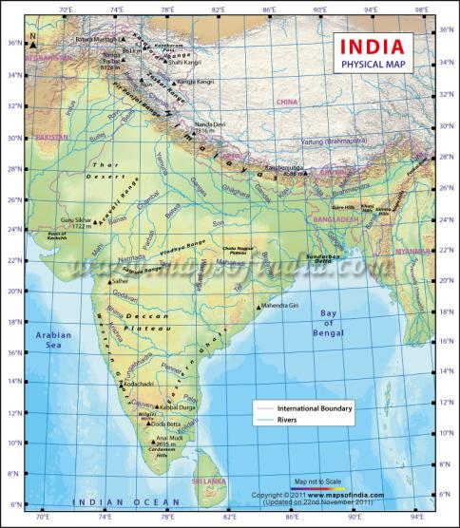
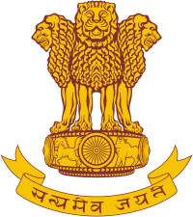
Flag , emblem and map of India

Slide 3
Republic of India
Capital: New Delhi
Area: 3.3 Million sq. km
Climate: Tropical. There are four seasons: winter (December-February) summer (March-June) monsoon season (June-September) post monsoon season (October-November)
Population: 1,166 million
Nationality : Indian
Religion: Hindus, Muslims, Christians, Sikhs, Buddhists.
Language: There are 22 different languages in India. Hindi is an Official Language. English is the second language.
Border Countries: Afghanistan, Pakistan, China, Bhutan, Nepal, Myanmar, Bangladesh.
Independence: 15th August 1947
Government: The President of India is the Head of the State. The Prime Minister is the Head of the Government.

Slide 4
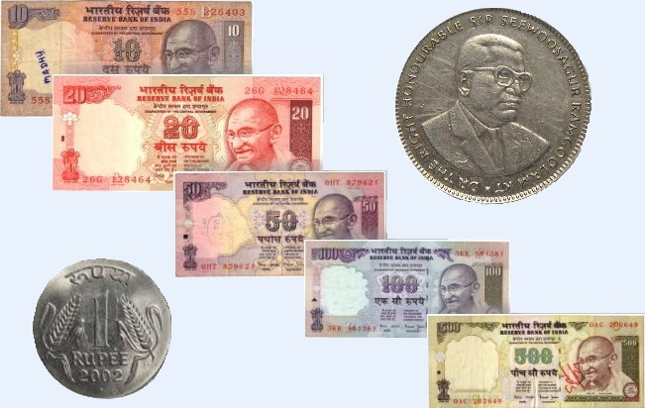
Currency - Indian Rupee.

Slide 5
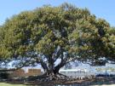
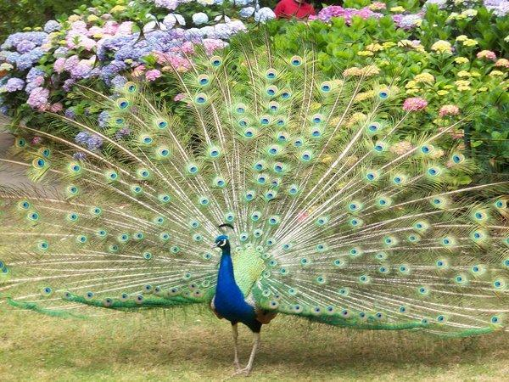
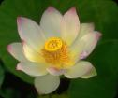
Nature
The National Animal The National Bird is the
is the Tiger. Peacock.
The National tree is the Banyan Tree (Fig Tree).
The National Flower The National Fruit is the
is the Lotus. Mango.

Slide 6
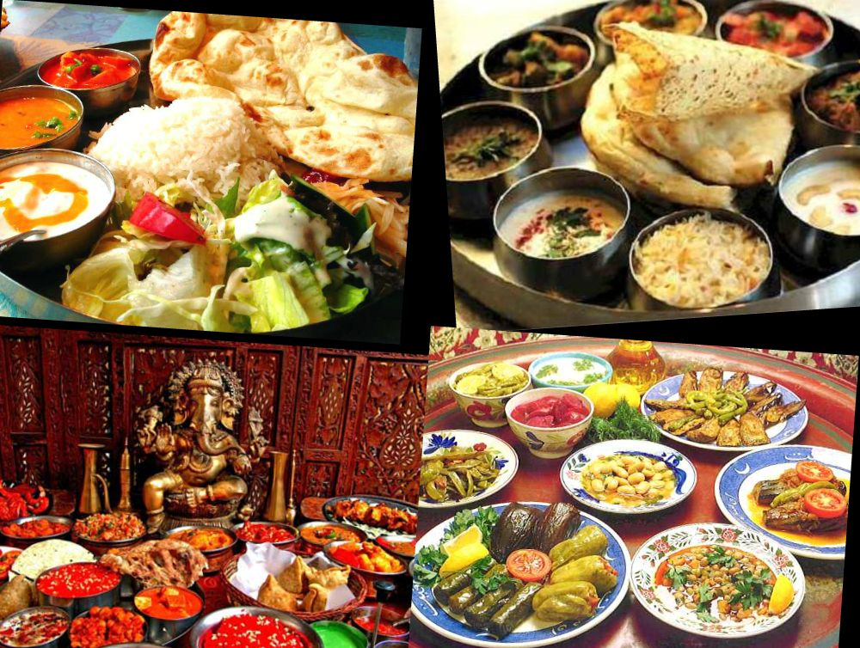
Cuisine
In India, food consecrated tradition cuisine is varied, a special influence on her had two religions: Hinduism and Muslim. In India many vegetarians.

Slide 7
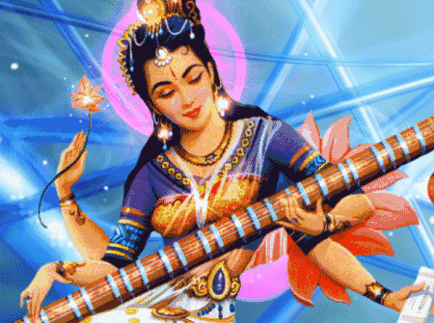
Music
The basis of Indian music – Sangeet .This combination of three art forms: vocal music, instrumental and dance.

Slide 8
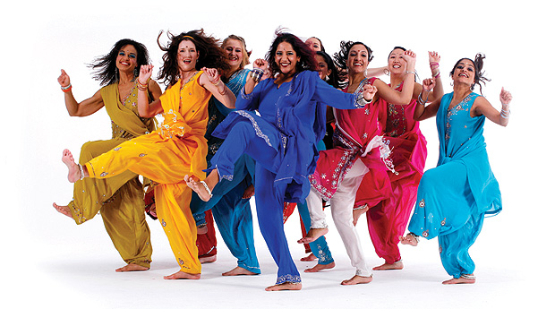
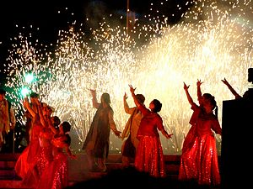
Dance and Cinema
Indian dances are the oldest in the world, dance is used complex hand gestures and facial expressions.
In the south there are Tollywood (Telugu movie) and Kollywood (films in Tamil)
Cinema India removed not only in Bollywood.
Cinema in India is constantly evolving.

Slide 9
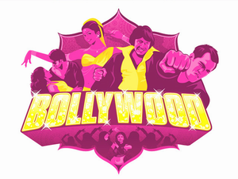
Bollywood
Bombay + Hollywood = Bollywood
Bollywood - the Indian film industry is synonymous with the city of Mumbai.
Bollywood studios are known Filmalaya and Film City
Great attention is paid to a Bollywood movie musical component..

Slide 10
Now I want to show you the trailer

Slide 11
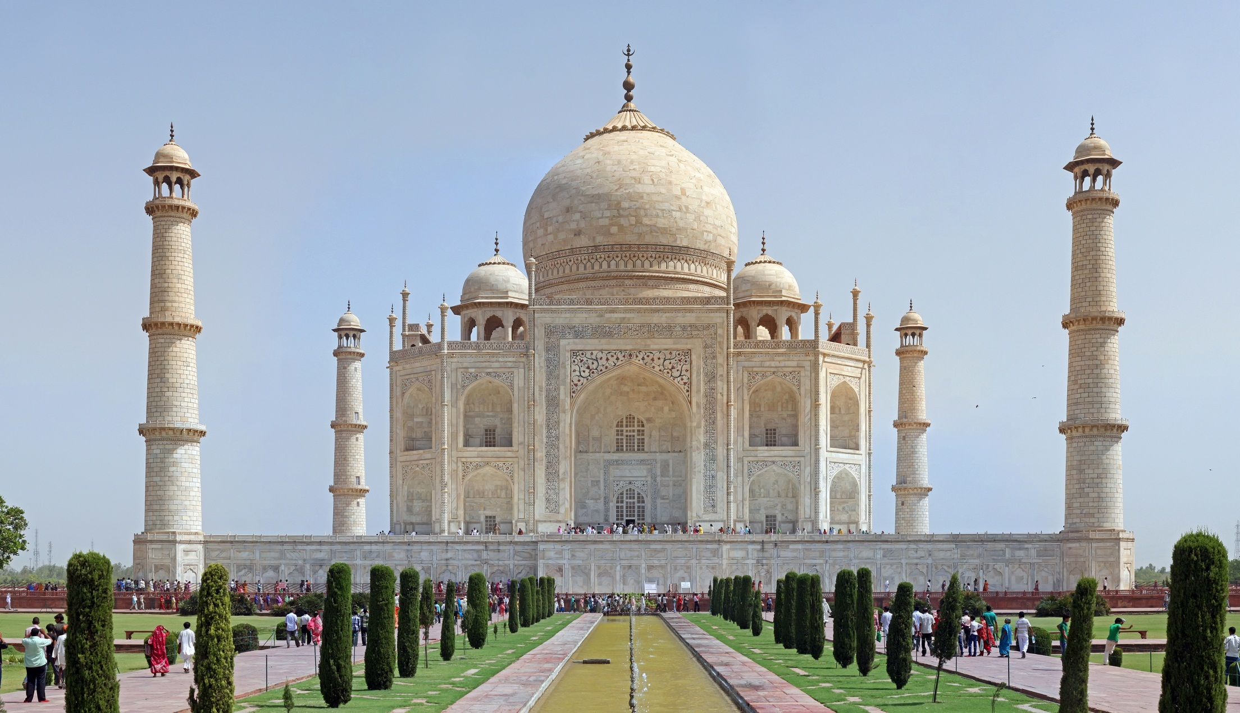
Taj Mahal

Slide 12
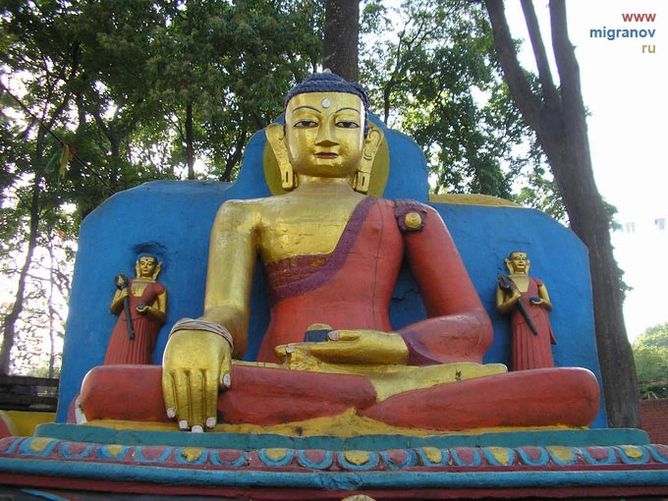
Buddha

Slide 13
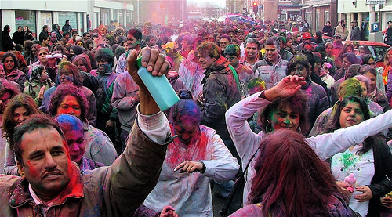
Holi festival

Slide 14
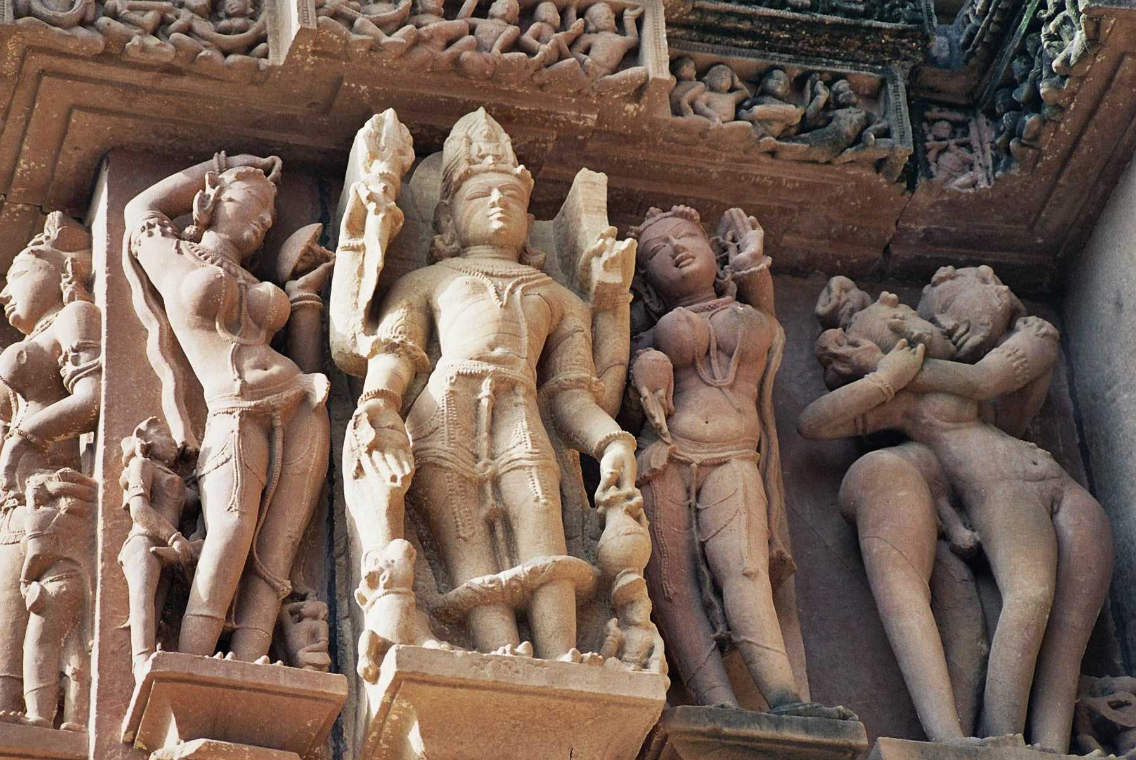
Sculpture

Slide 15
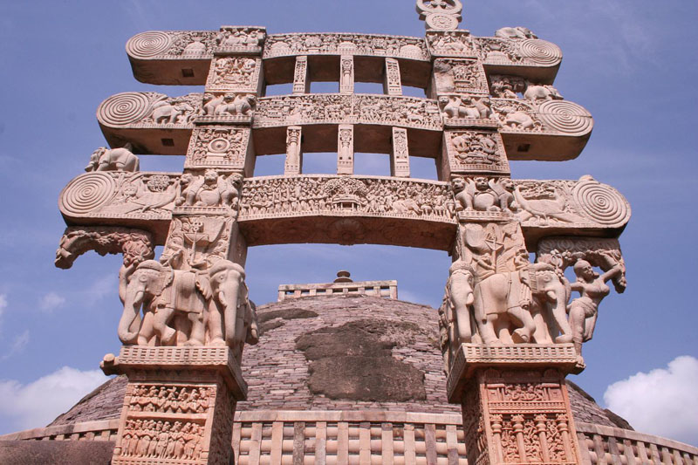
The Great Stupa at Sanchi

Slide 16
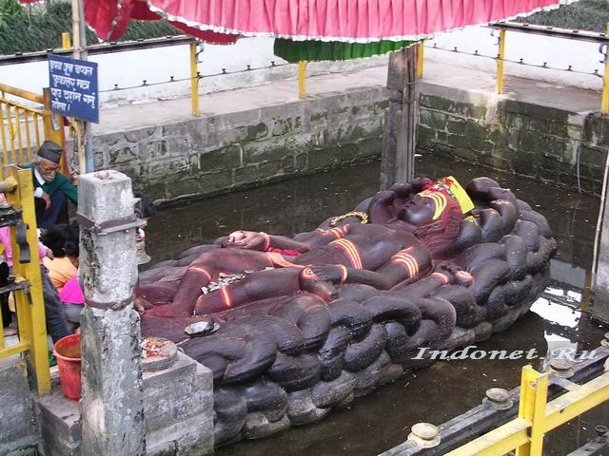
Sculpture of Vishnu

Slide 17
India - a fascinating land with a rich culture full of secrets and mysteries of the centuries-old, and know it can only have been there.
thank you

