Slide 1
Invention
Evseenko Ann, 11-1

Slide 2
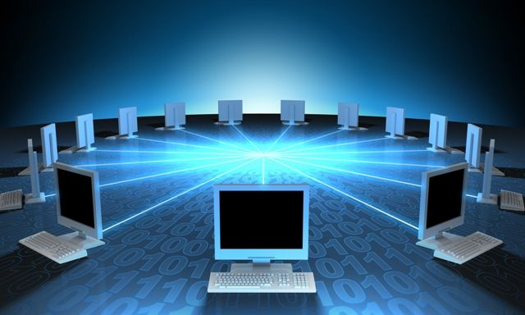
Some people consider the internet as the most important invention ever. My personal opinion is that every invention has its time, and the internet is the greatest invention of our time. I will support my theory in the following paragraphs.

Slide 3
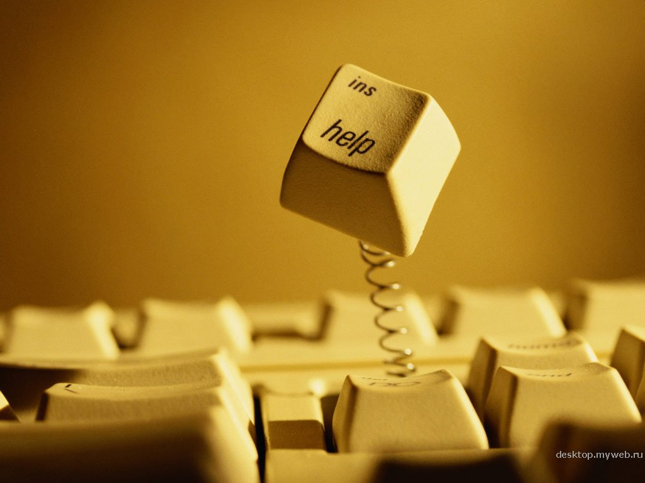
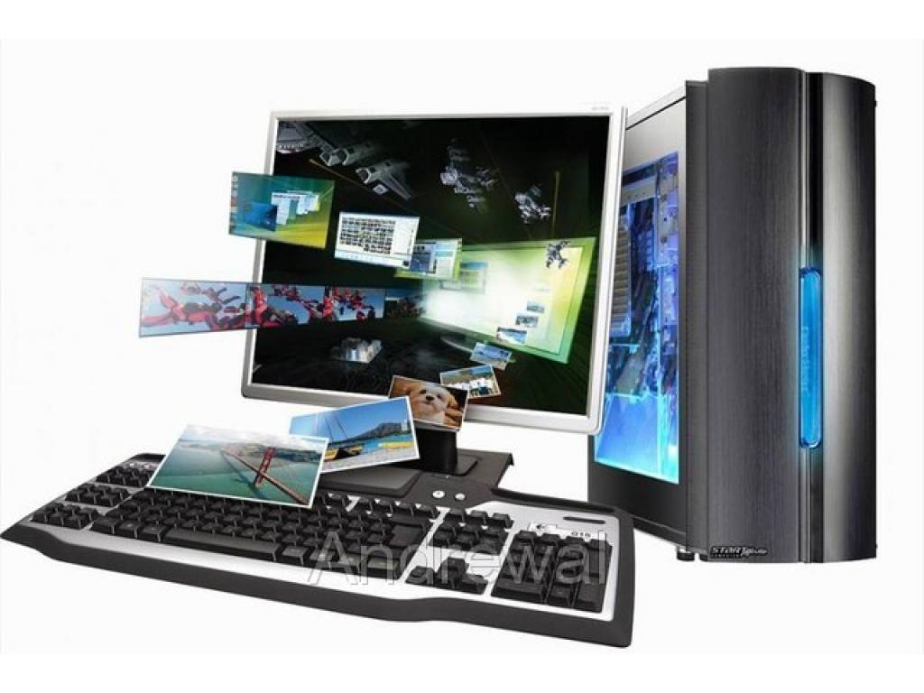
Firstly, the internet provides enormous amount of information. Everyone can find all types of information on millions of topics. That way they can find data for their work or school projects. Also, people are able to find information on every subject they are interested in

Slide 4
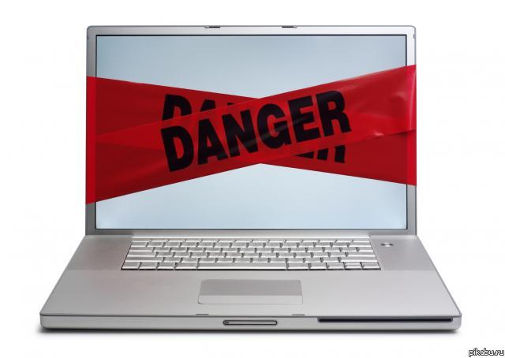
However, this easy access to so much information can sometimes be dangerous. For example, someone could search the web to find a way to build a bomb. This kind of information, if not in the right hands, can be very dangerous.

Slide 5
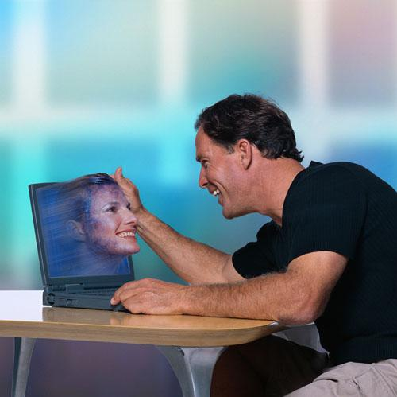
Secondly, people are using the internet for communication. Also, there are millions of chat rooms and even dating sites. Communication through the internet is easy and available to everyone with a computer.

Slide 6
With it, people can keep in touch with their friends in distance, or make new ones. Nevertheless, this way of communication can sometimes be inefficient. Face-to-face conversation, at least in my opinion, is much better

Slide 7
Last but not least, I want to say that the invention of the internet could not be even possible without some earlier inventions and discoveries. As I said above every invention has its time. First it was the discovery of fire, then the invention of the wheel. Later it was the electricity, the telegraph and the computer. All this led to the invention of the internet.

Slide 8
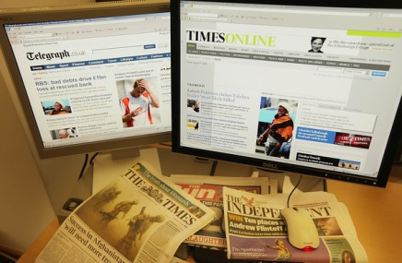
It can be concluded that, there are many great inventions, every one of them important for its time. The internet, even with its flaws, is the most important invention of our modern time.

Slide 9
Thank you for attention !

