Slide 1
Ethnical diversity
Name
School

Slide 2
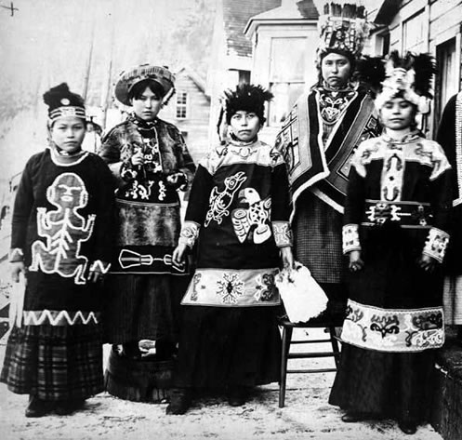
Ethnic and racial categories

Slide 3
Races of the USA

Slide 4
Colonial period

Slide 5
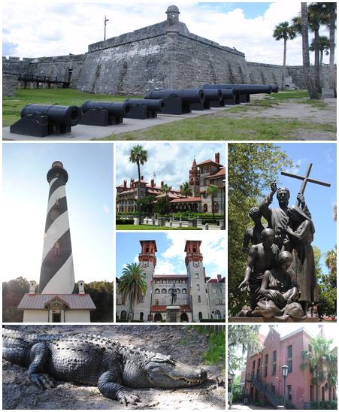
French colonies
St Augustine – the oldest city in the USA was found in 1564

Slide 6
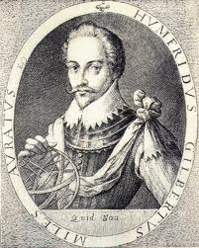
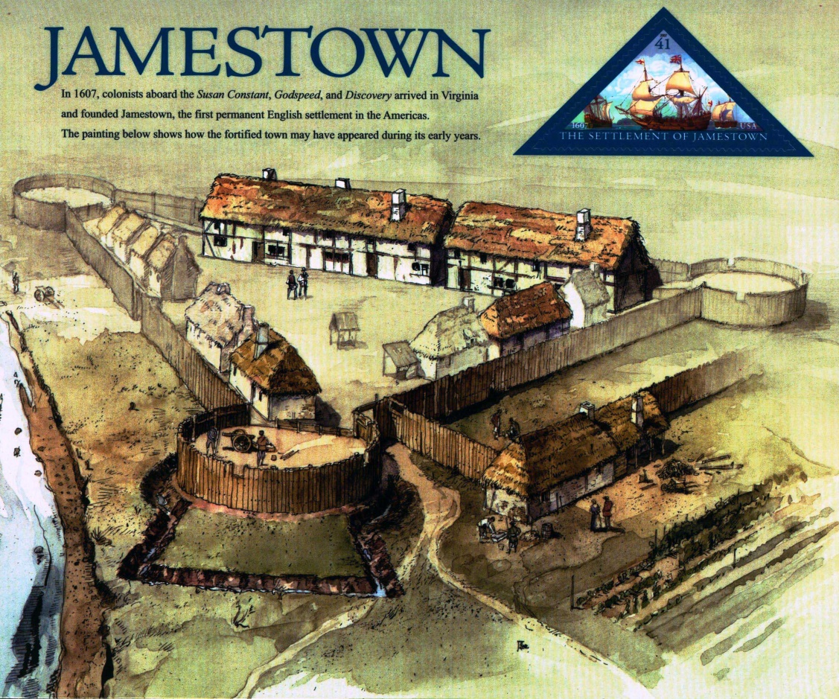
British colonies
Humphrey Gilbert

Slide 7
Spanish colonies

Slide 8
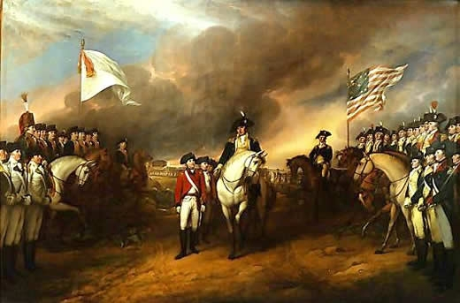
Revolutionary war

Slide 9
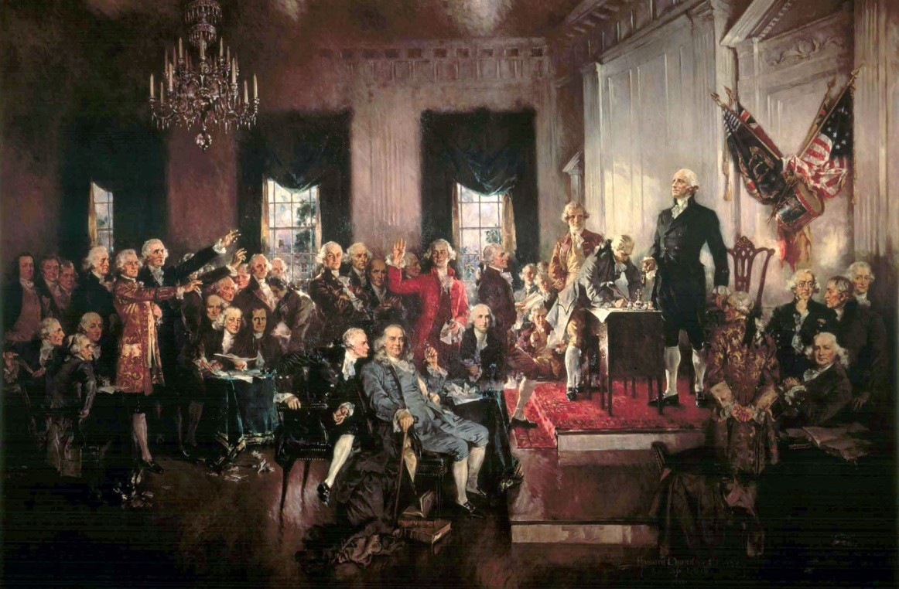
The US’s constitution

Slide 10
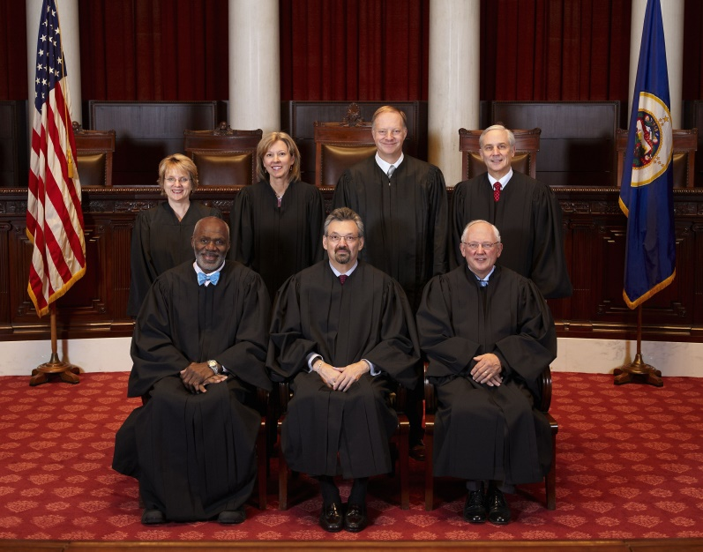
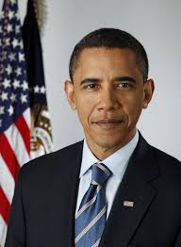
Three branches of power
Legislative
Executive
Judical
The Congress
The Supreme Court
The President

Slide 11
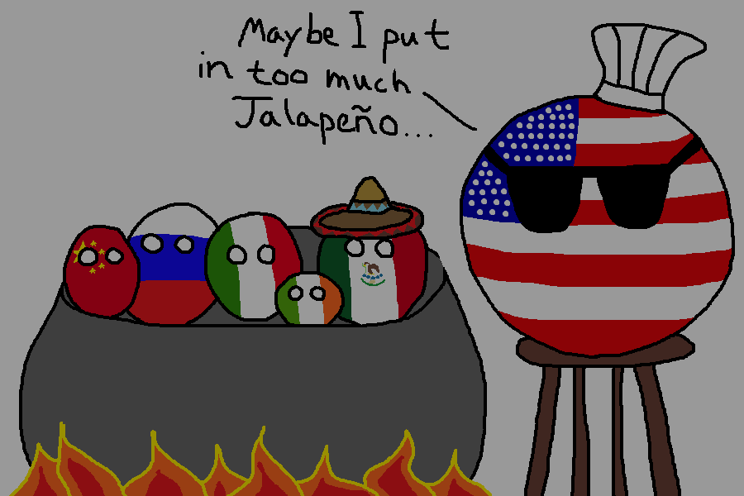
Thank you for your attention!

