Slide 1
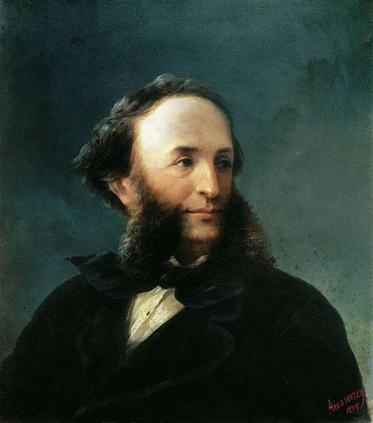
Ivan Aivazovsky

Slide 2
“Art is long, life is short”

Slide 3
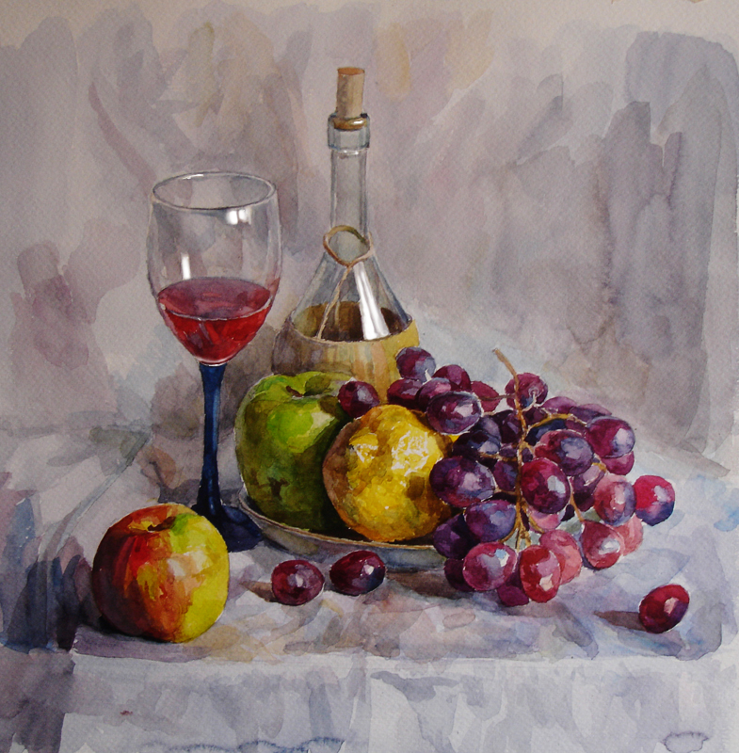
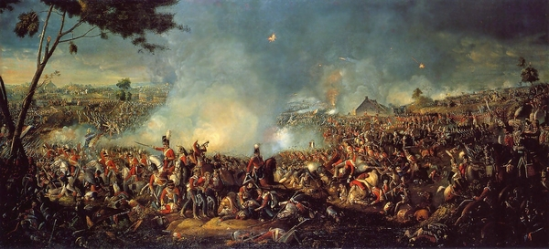
I keen on:
Landscape
Seascape
Still life
Historical battles
Flowers

Slide 4
My favorite painter is Ivan Aivazovsky.

Slide 5
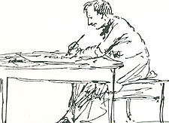
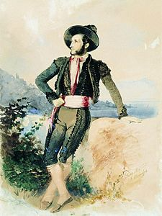
Biography
Born - Hovhannes Aivazian (baptized) 29 July 1817 Feodosia, Taurida, Russian Empire (present-day Crimea, Ukraine)
Died - 2 May 1900 (aged 82) Feodosia, Russian Empire

Slide 6
Biography
Ivan Konstantinovich Aivazovsky was a Russian Romantic painter. He is considered one of the greatest marine artists in history. Baptized as Hovhannes Aivazian, Aivazovsky was born into an Armenian family in the Black Sea port of Feodosia and was mostly based in his native Crimea.

Slide 7
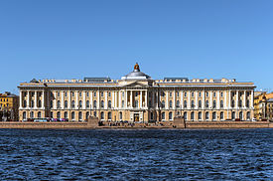
Imperial Academy of Arts

Slide 8
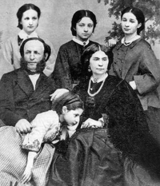
Aivazovsky with his first wife, Julia, and their four daughters

Slide 9
His most popular picture are
The Ninth Wave (1850)
The vast majority of his works depict the sea.

Slide 10
Aivazovsky's painting of his second wife Anna Burnazian (1882)

Slide 11
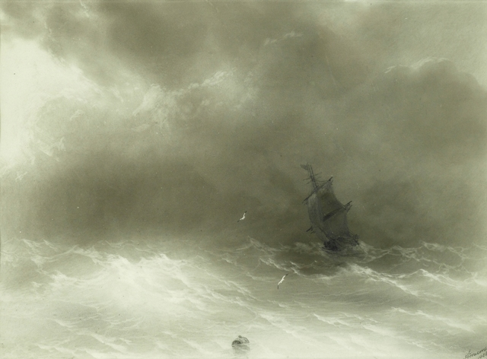
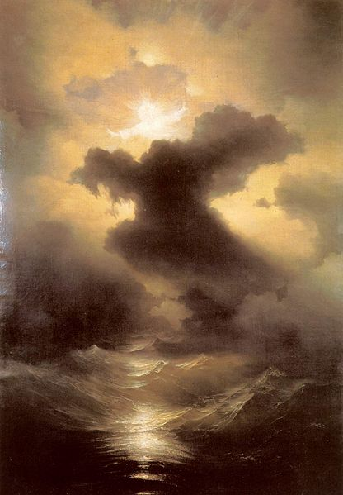
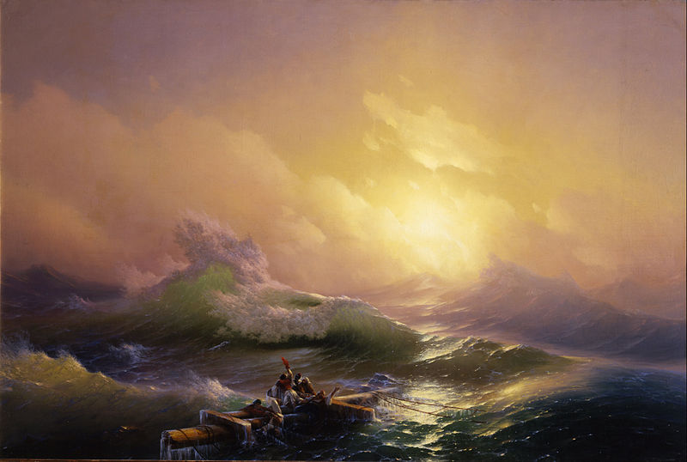
Aivazovsky the artist

Slide 12
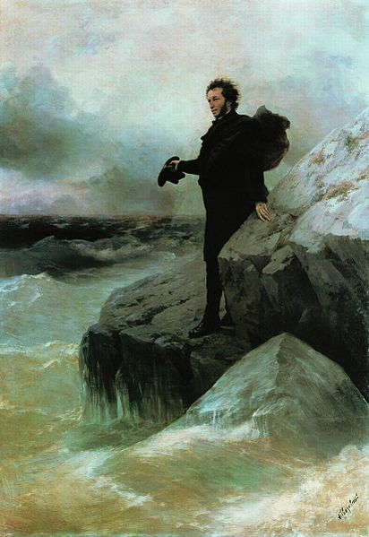
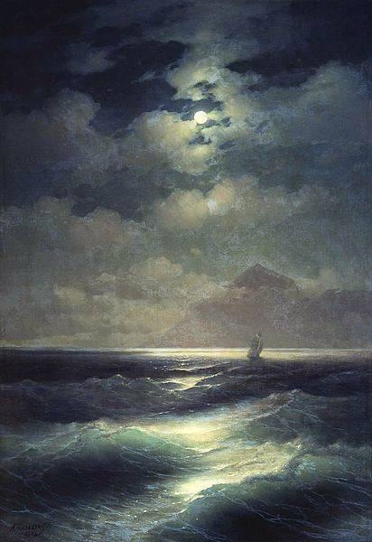
Pushkin farewell to the sea Sea view by Moonlight

Slide 13
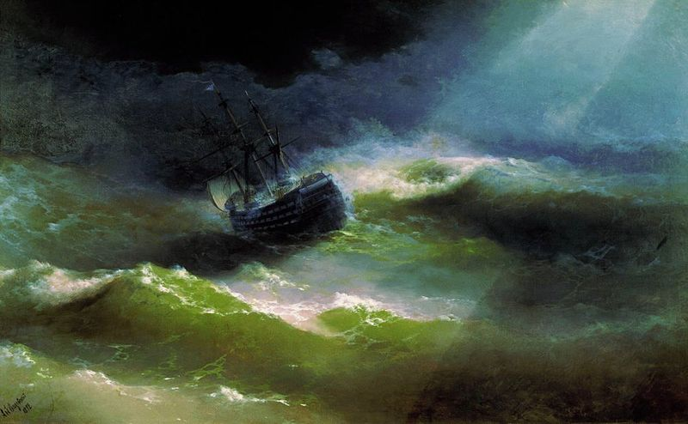
Ship «Empress Maria» in storm

Slide 14
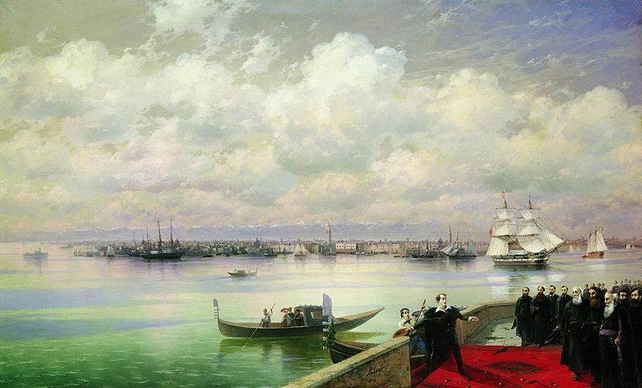
Armenian themes

Slide 15
As for me I appreciate the picture “Storm on Black sea.”

Slide 16
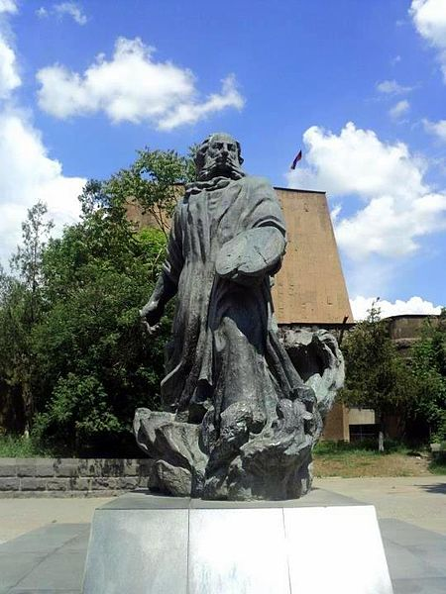
Posthumous honors
Monuments in Ukraine, Armenia and Russia stand in Aivazovsky's memory. A statue of the artist can be found in front of the Feodosia Art Gallery, his former home. A statues of Aivazovsky and his brother Gabriel is located in Simferopol, Crimea's administrative center.

Slide 17
Aivazovsky's gravestone in Feodosia

Slide 18
Except for painting I am fond of such kind of art:
Cinema
Photography
Design
Literature

Slide 19
Literature

Slide 20
Cinema
Paddington Bear movie

Slide 21
Thank you for your attention!

