Slide 1
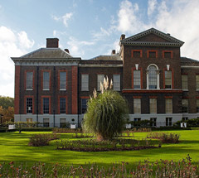
Kensington Palace

Slide 2
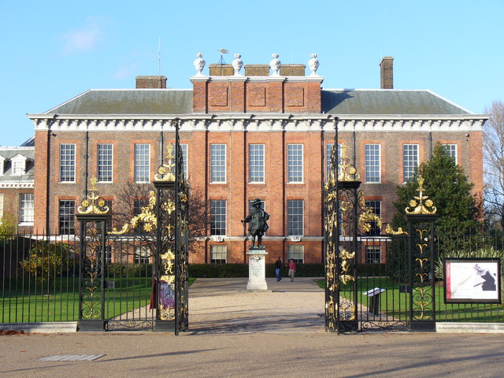
History

Slide 3
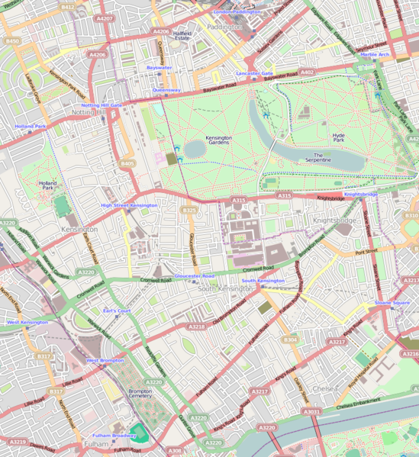
Location in Kensington

Slide 4
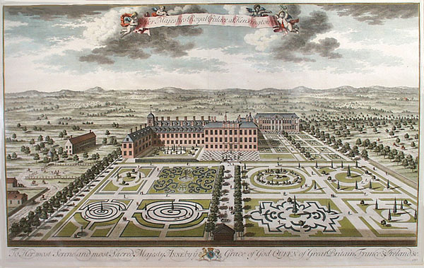
Kensington Palace south front with its parterres, engraved by Jan Kip, 1724.

Slide 5
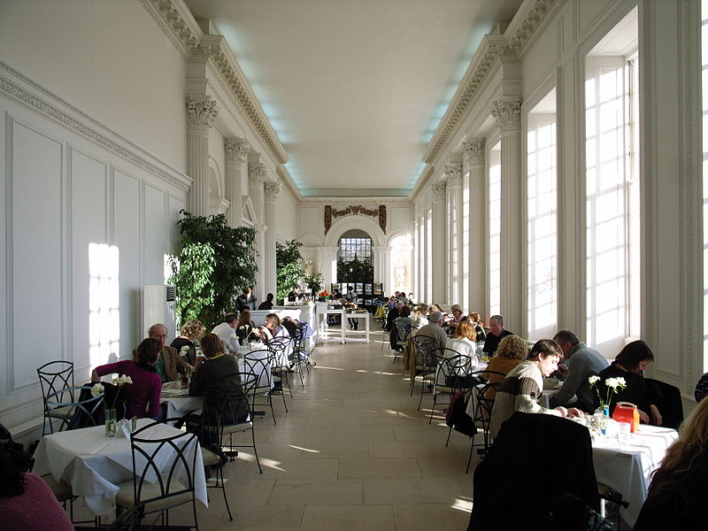
Interior, Kensington Palace Orangery

Slide 6
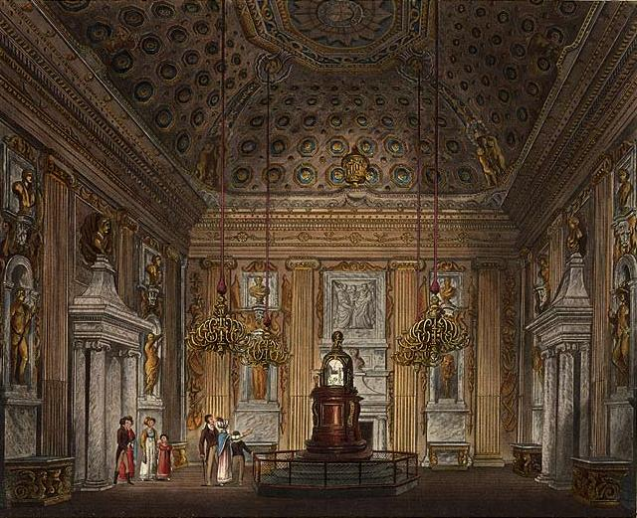
The Cupola Room

Slide 7
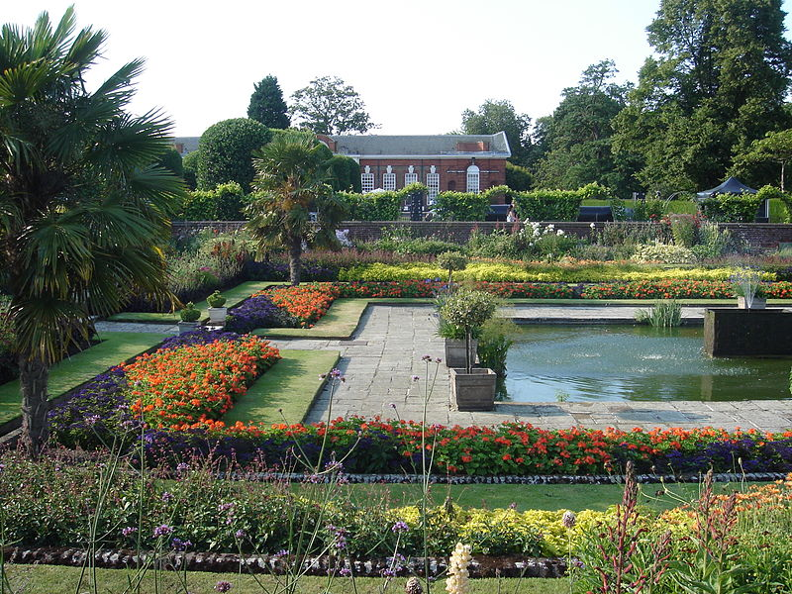
Orangery

Slide 8
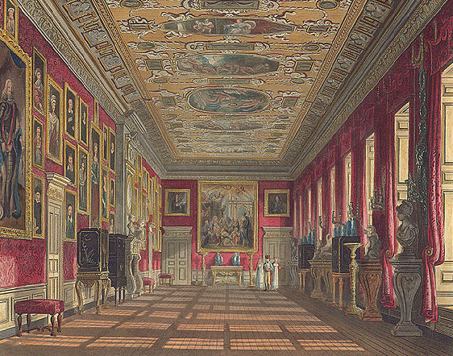
The King's Gallery at Kensington Palace

Slide 9
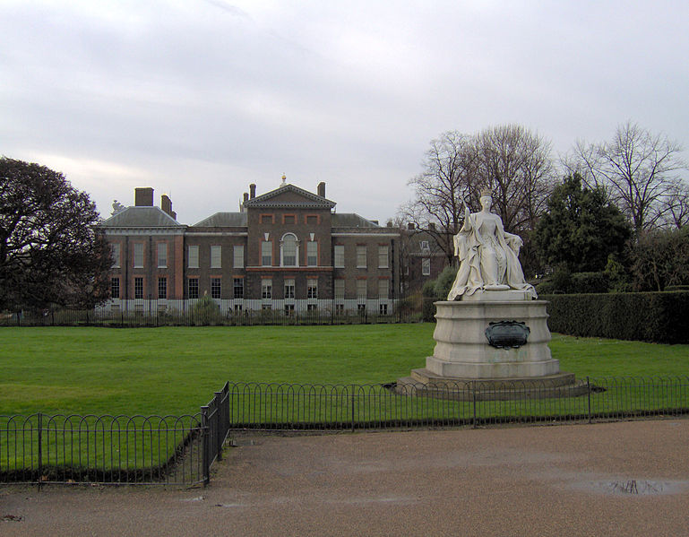
Kensington Palace

Slide 10
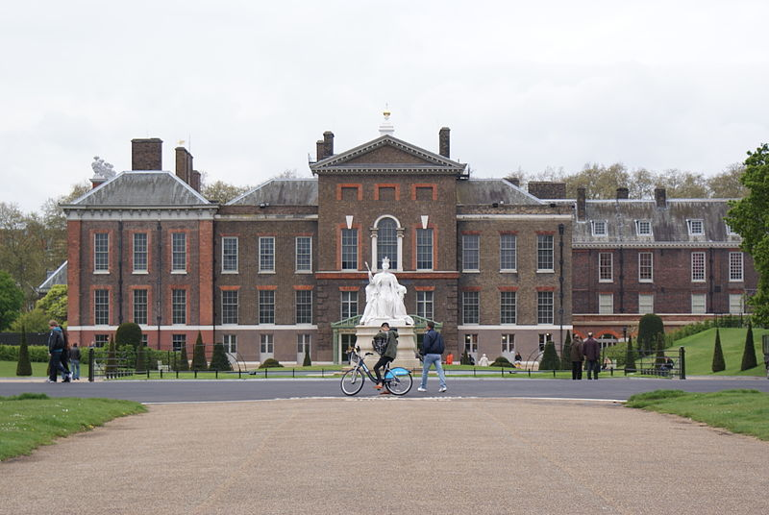
Kensington Palace in 2012

Slide 11
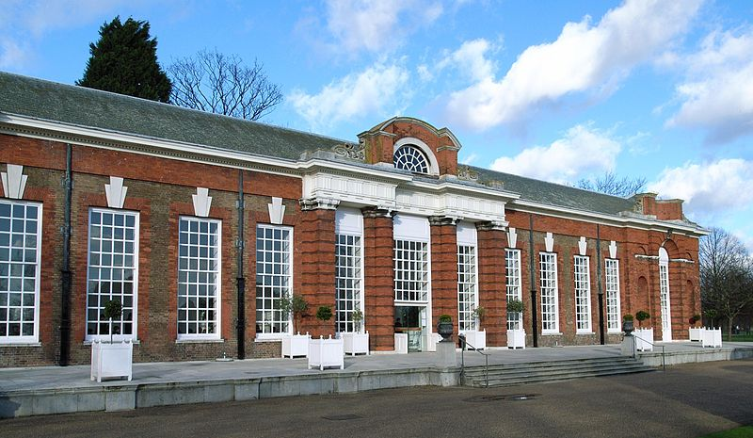
Kensington Palace Orangery

Slide 12
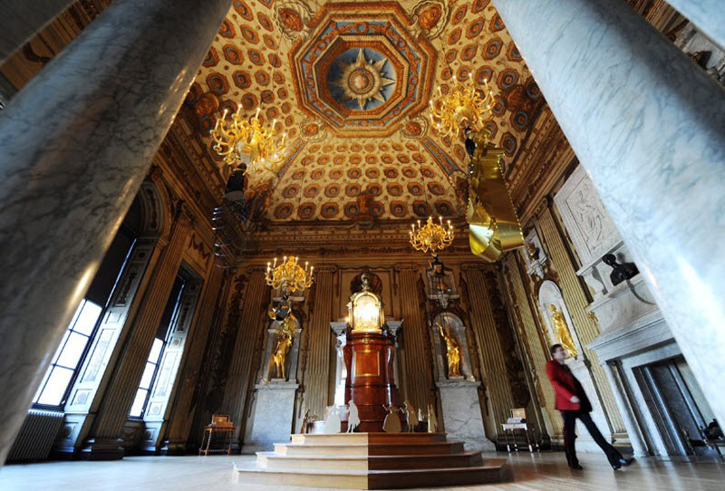
Kensington Palace

Slide 13
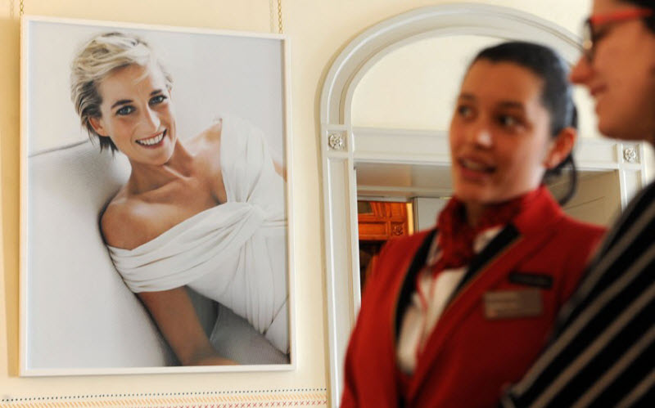
Princess Diana

Slide 14
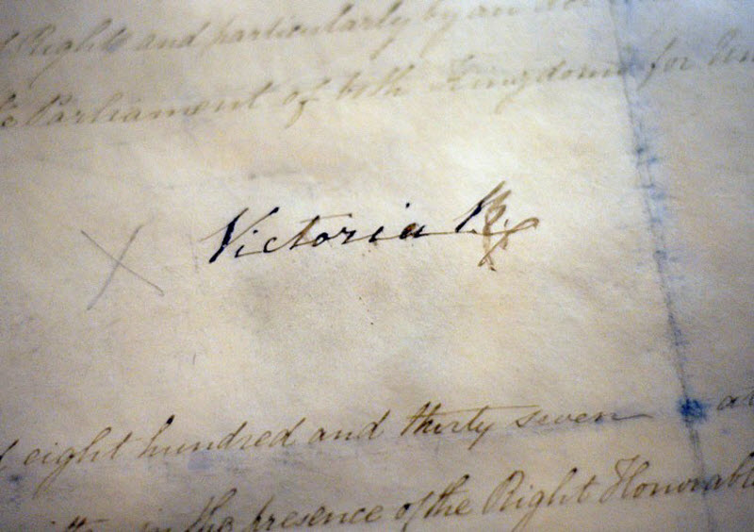
Signature of Queen Victoria

Slide 15
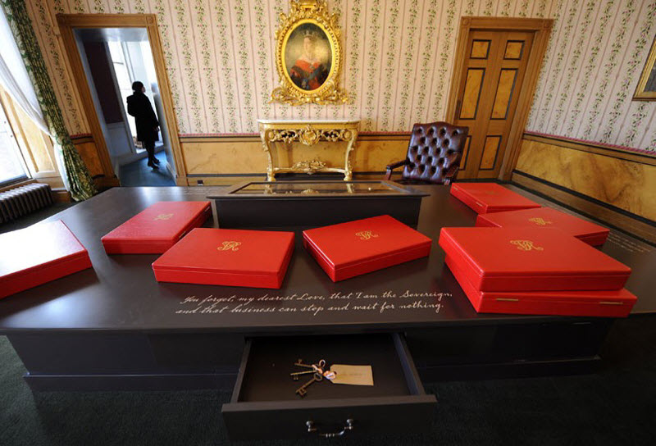
Cabinet of Queen Victoria

Slide 16
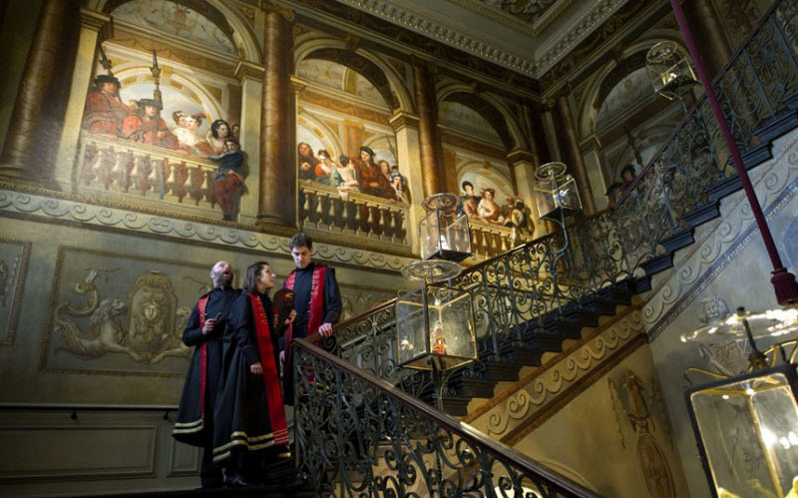
Royal Stairs

Slide 17
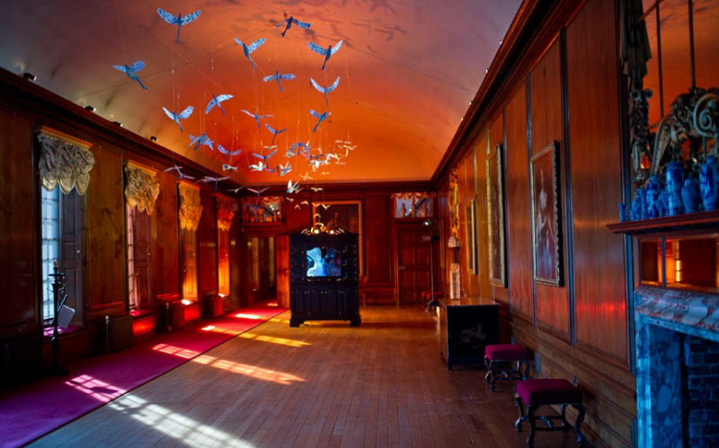
Royal Gallery

Slide 18
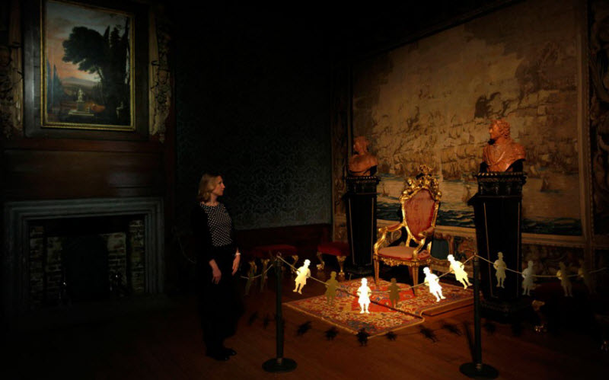
Throne Room

Slide 19
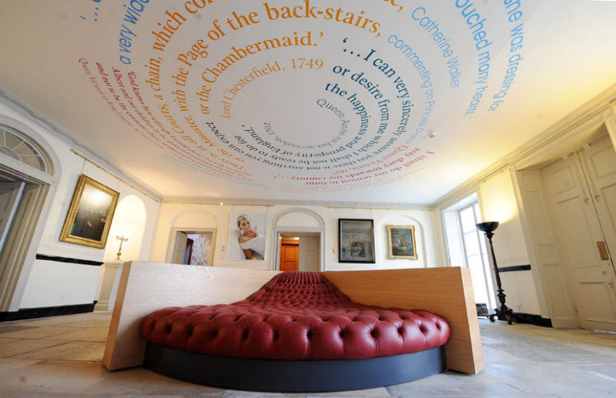
Lobby

Slide 20
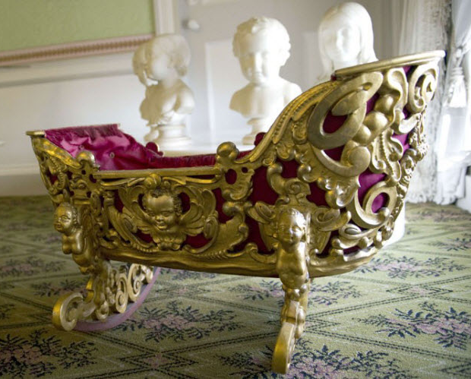
Gold cradle

Slide 21
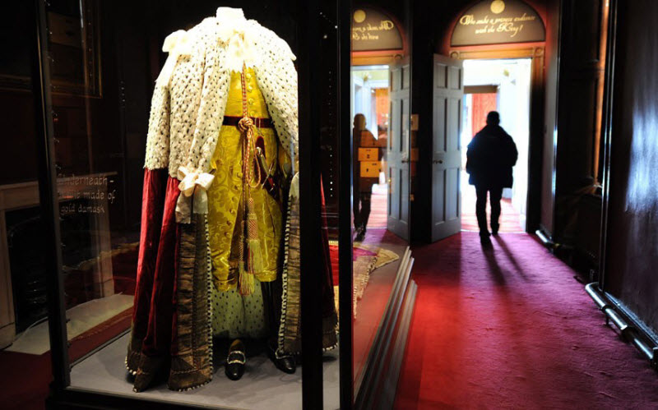
Coronation of King George the Third vestments

