Slide 1
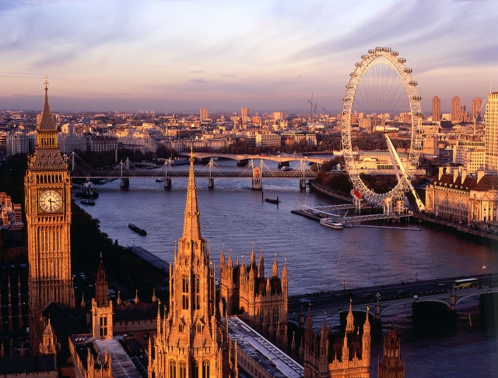
Great Britain

Slide 2
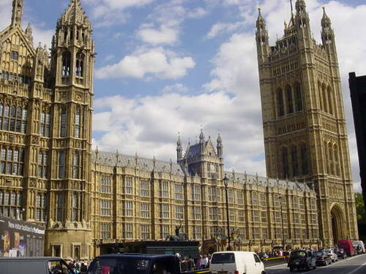
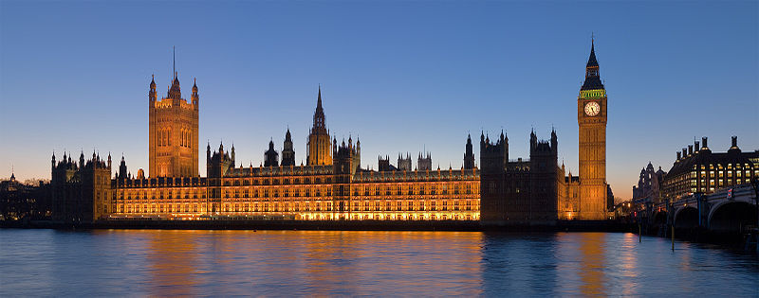
The Palace of Westminster Вестминстерский дворец
The Palace of Westminster, also
known as the Houses of
Parliament or Westminster
Palace, is the meeting place of
the two houses of the
Parliament of the United
Kingdom—the House of Lords
and the House of Commons. It
lies on the north bank of the
River Thames, close to the
historic Westminster Abbey. The
Palace is one of the centres of
political life in the United
Kingdom.

Slide 3
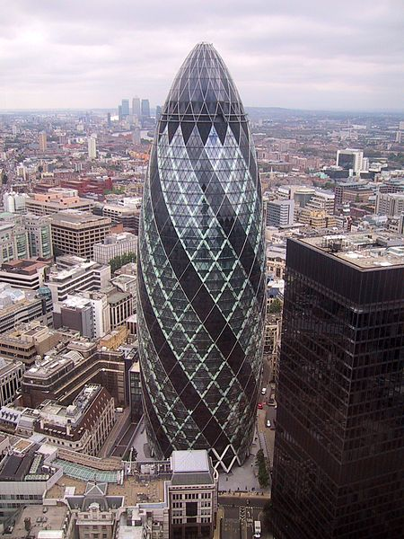
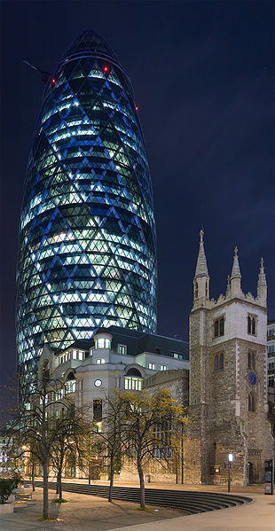
St Mary Axe was a medieval parish in London whose name survives on the street it formerly occupied. (Башня Мэри-Экс, 30 или Сент-Мэри Экс 30, Небоскрёб Мэри-Экс)

Slide 4
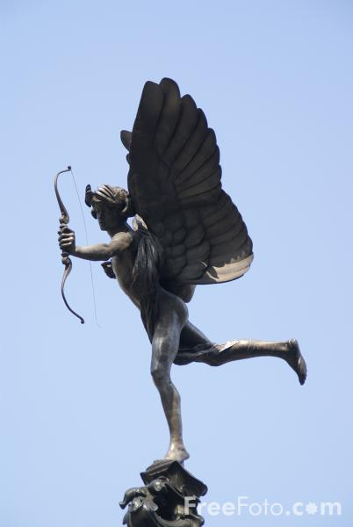
Piccadilly Circus Площадь Пикадилли
Piccadilly Circus is a famous road junction and
public space of London's West End in the City of
Westminster, built in 1819 to connect Regent
Street with the major shopping street of Piccadilly.
In this context, a circus, from the Latin word
meaning "circle", is a round open space at a street
junction. The Circus is particularly known for its
video display and neon signs mounted on the
corner building on the northern side, as well as
the Shaftesbury memorial fountain and statue of
an archer popularly known as Eros. It is
surrounded by several noted buildings.

Slide 5
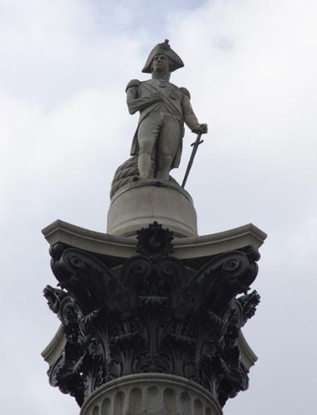
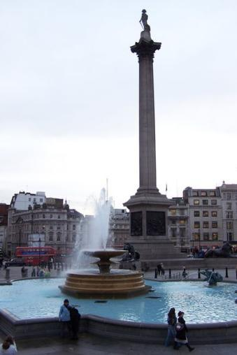
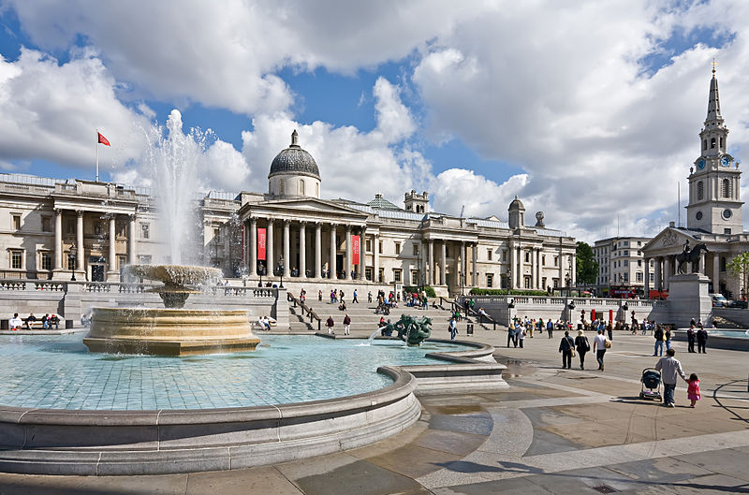
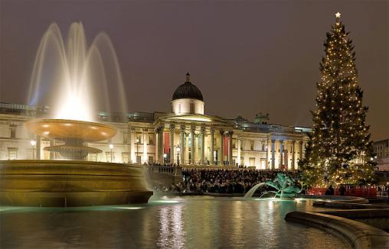
Trafalgar Square Трафальгарская площадь
Trafalgar Square is a public
space and tourist attraction
in central London, England.
At its centre is Nelson's
Column. There are a number
of statues and sculptures in
the square. The square is also
used for political
demonstrations and
community gatherings, such as
the celebration of New Year's
Eve .

Slide 6
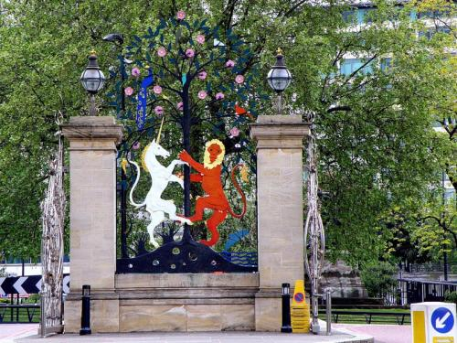
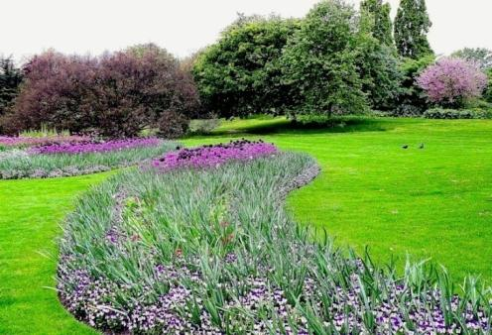
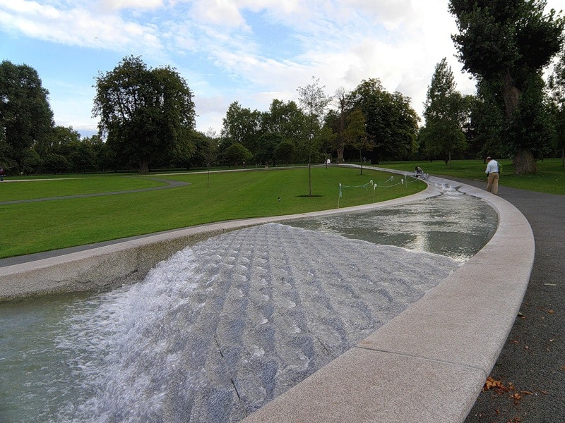
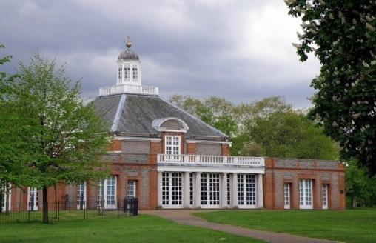
Hyde Park Гайд-парк
Hyde Park is one of the largest parks in central London, England and one of the Royal Parks of London

Slide 7
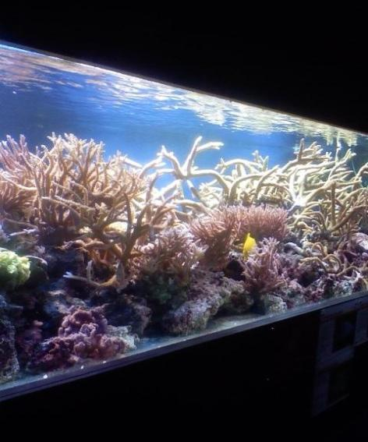
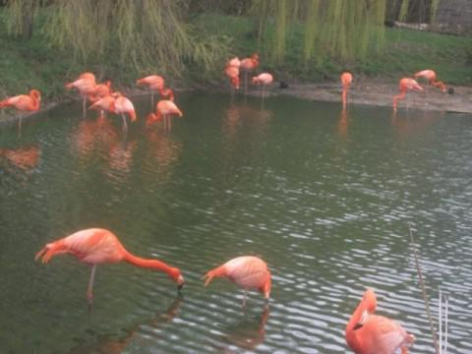
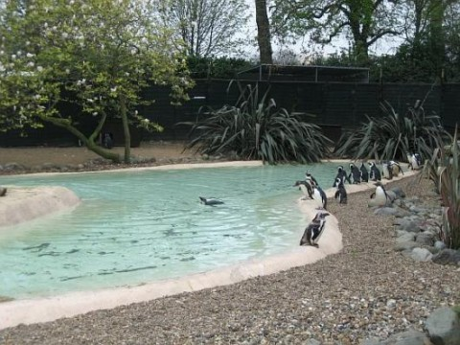
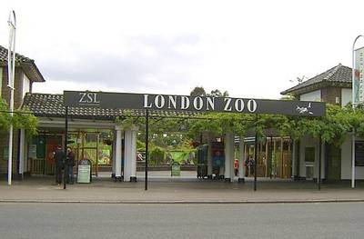
The London Zoo Лондонский зоопарк
London Zoo is the
world's oldest
scientific zoo. Today
it houses a collection
of 755 species of
animals, with 16,802
individuals, making it
one of the largest
collections in the
United Kingdom.

Slide 8
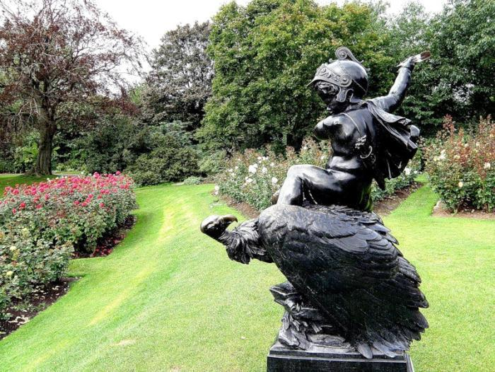
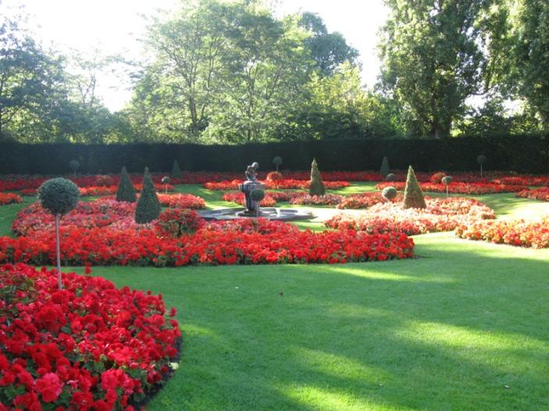
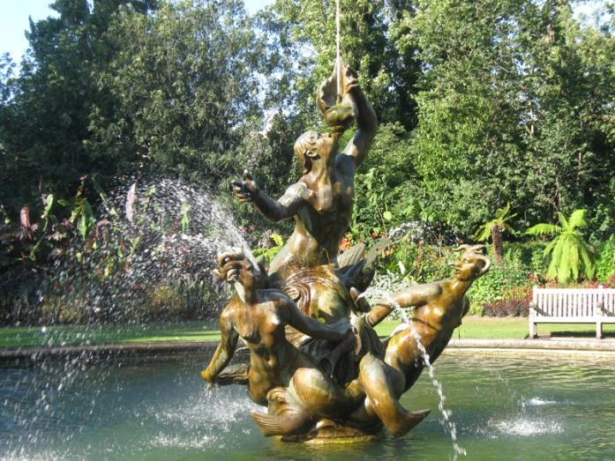
The Regent’s Park Риджент парк
The Regent's Park is the
largest grass area for sports in
Central London and offers a
wide variety of activities, as
well as an Open Air Theatre,
the London Zoo and many
cafes and restaurants.

Slide 9
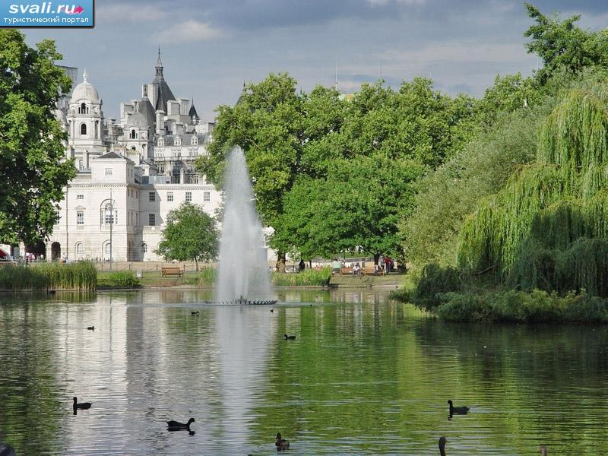
St. James’s Park Парк св. Джеймса
St James's Park is probably the most
beautiful of the capital's central
parks.
Now the most ornamental park in
London with good views of
Whitehall rooftops, St James's Park
a popular place to stroll, feed the
ducks or watch the pelicans.
Popular in the summer with
sunbathing office workers, a band
plays throughout the summer.
There are a lot of ducks, geese,
pelicans and black swans on the
lake. The bridge over it gives a view
of Buckingham Palace.

Slide 10
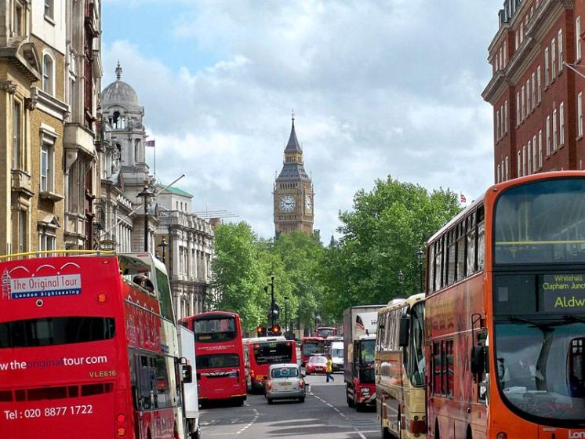
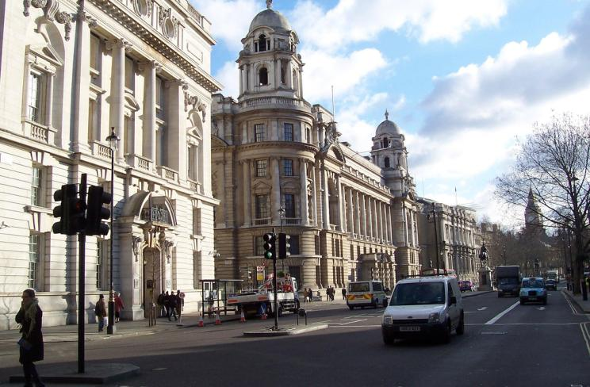
Whitehall Уайтхолл
Whitehall is a road in
Westminster, in London, England
The name is taken from the vast
Palace of Whitehall that used to
occupy the area but which was
largely destroyed by fire in 1698.
Whitehall was originally a wide
road that ran up to the front of
the palace. Trafalgar Square was
built at its northern extremity in
the early 19th century. The
streets cover a total distance of
about 1 kilometre.

Slide 11
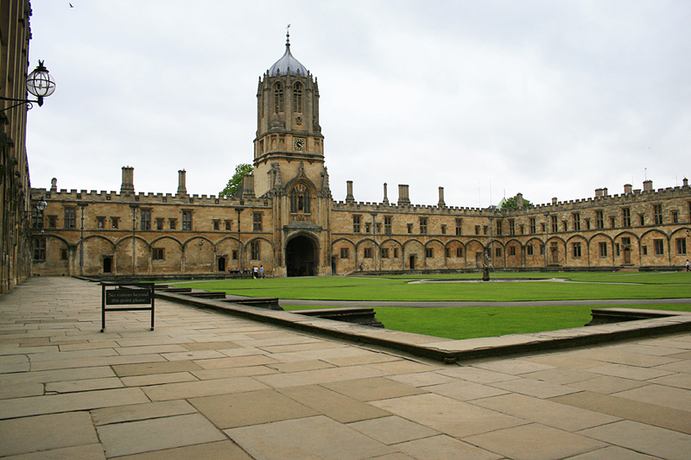
Oxford University
The University of Oxford (informally Oxford University, or simply Oxford) is a public university located in Oxford, United Kingdom. It is the second oldest university in the world and the oldest university in the English-speaking world.
The two ancient universities (Cambridge and Oxford)have many common features and are often jointly referred to as Oxbridge.

Slide 12
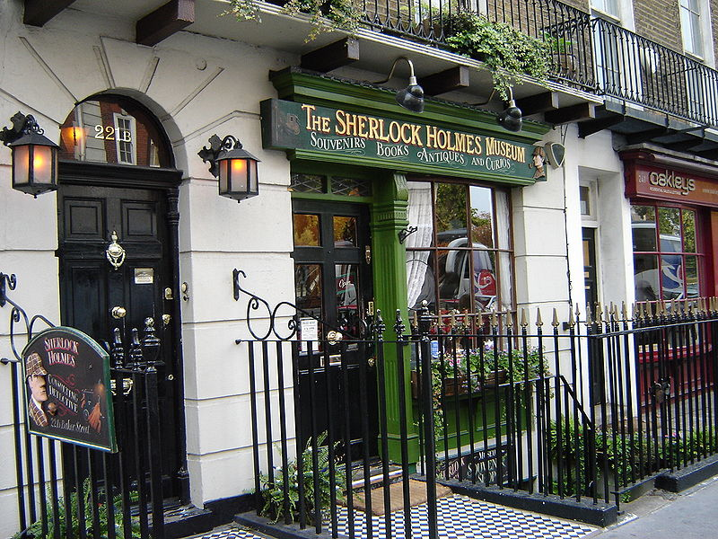
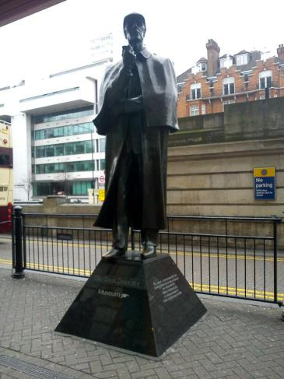
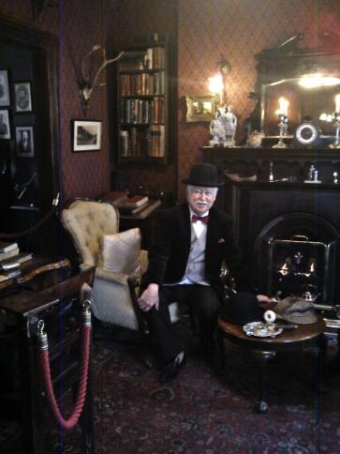
The Sherlock Holmes Museum Музей Шерлока Холмса
The Sherlock Holmes Museum is a popular privately-run museum in London, England, dedicated to the famous detective Sherlock Holmes. It opened in 1990 and is situated in Baker Street.

Slide 13
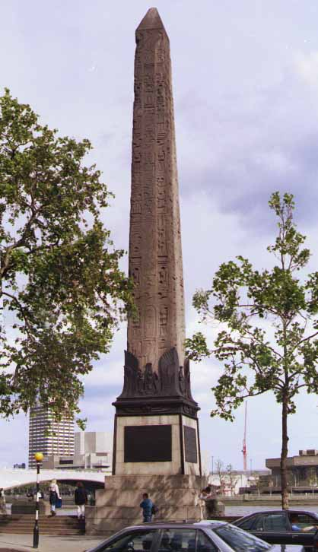
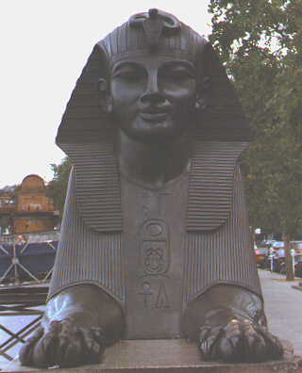
Cleopatra’s Needle Игла Клеопатры
Anyone visiting London for the first time and walking along the Thames may be surprised to come across an original Egyptian obelisk.
This obelisk is known as Cleopatra's Needle …though it has very little to do with Cleopatra at all.
It is known as Cleopatra's Needle as it was brought to London from Alexandria, the royal city of Cleopatra.
Cleopatra's Needle stands on the Thames. Two large bronze Sphinxes lie on either side of the Needle. These are Victorian versions of the traditional Egyptian original.

Slide 14
Источники:
1. http://images.yandex.ru/
2. http://ru.wikipedia.org/wiki/
3. http://www.tourister.ru/world/europe/united-kingdom/city/london/placeofinterest

