Slide 1
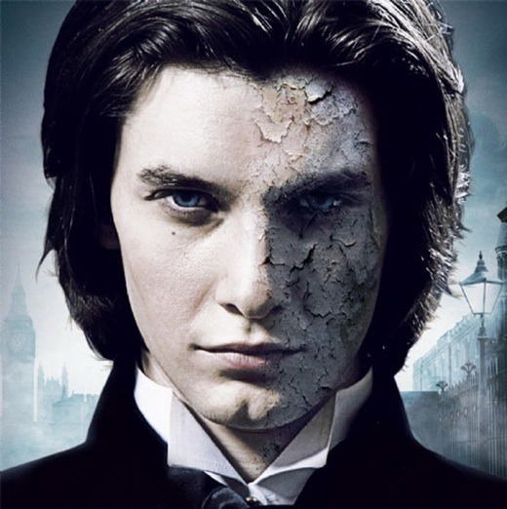
Oscar Wilde
«The Picture of Dorian Gray»

Slide 2
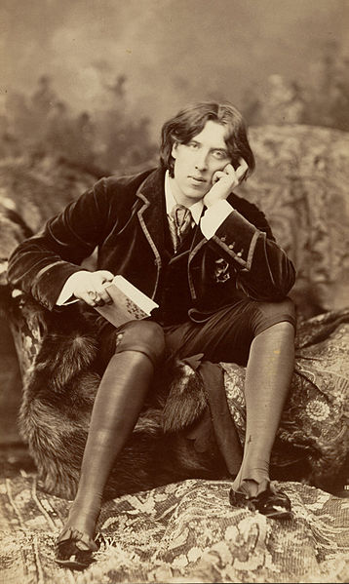
Oscar Wilde - Irish poet, dramatist, writer. He was born in Dublin October 16, 1854.

Slide 3
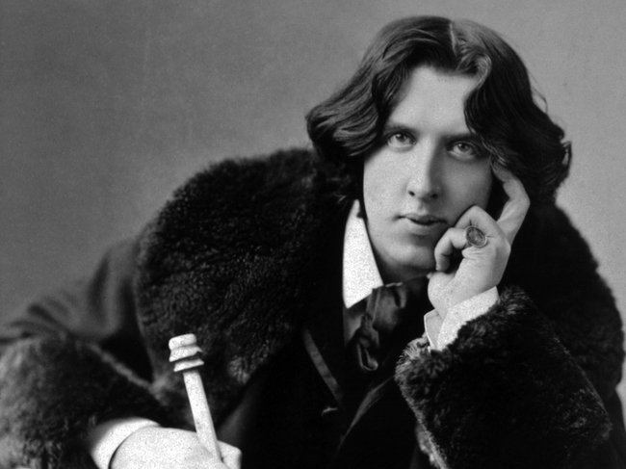
After writing in different forms throughout the 1880s, he became one of London's most popular playwrights in the early 1890s. Today he is remembered for his epigrams, his only novel (The Picture of Dorian Gray), his plays, and the circumstances of his imprisonment and early death.

Slide 4
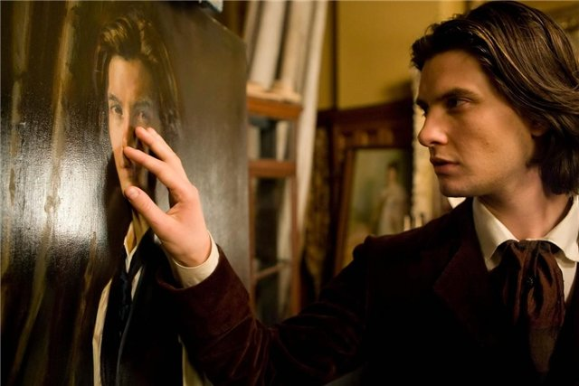
The Picture of Dorian Gray is the only published novel by Oscar Wilde, appearing as the lead story in Lippincott's Monthly Magazine on 20 June 1890, printed as the July 1890 issue of this magazine.

Slide 5
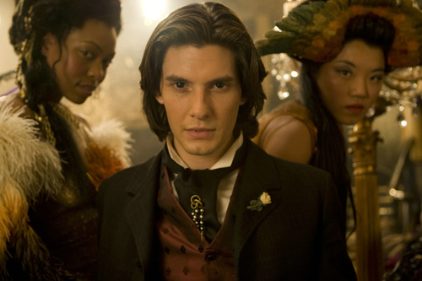
The novel tells of a young man named Dorian Gray. Basil is impressed by Dorian's beauty and becomes infatuated with him. Dorian meets Lord Henry Wotton, a friend of Basil's, and becomes enthralled by Lord Henry's world view. Espousing a new hedonism, Lord Henry suggests the only things worth pursuing in life are beauty and fulfillment of the senses. Realizing that one day his beauty will fade, Dorian expresses a desire to sell his soul to ensure the portrait Basil has painted would age rather than he. Dorian's wish is fulfilled, and when he subsequently pursues a life of debauchery, the portrait serves as a reminder of the effect each act has upon his soul, with each sin displayed as a disfigurement of his form, or through a sign of aging.

Slide 6
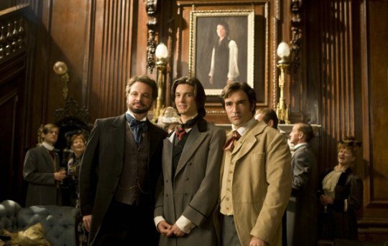
The main characters are:
Dorian Gray – a handsome and narcissistic young man who becomes enthralled with Lord Henry's idea of a new hedonism.
Basil Hallward – an artist who becomes infatuated with Dorian. Dorian helps Hallward realise his artistic potential, as Basil's portrait of Dorian proves to be his finest work.
Lord Henry "Harry" Wotton – an imperious and decadent dandy who is a friend to Basil initially, but later becomes more intrigued with Dorian's beauty.

Slide 7
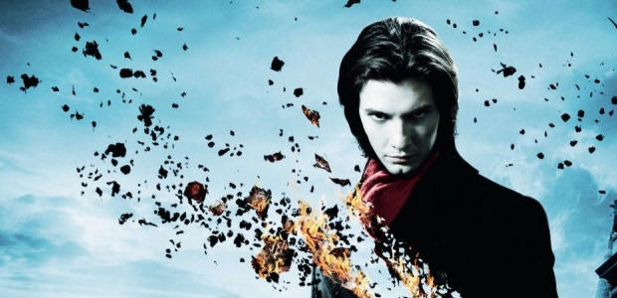
Overall, initial critical reception of the book was poor, with the book gaining certain notoriety for being 'mawkish and nauseous', 'unclean', 'effeminate' and 'contaminating'. The Irish Times wrote that «The Picture of Dorian Gray» was first published to some scandal. This had much to do which caused something of a sensation amongst Victorian critics when first published. A large portion of the criticism was leveled at Wilde's perceived hedonism, and its distorted views of conventional morality.

