Slide 1
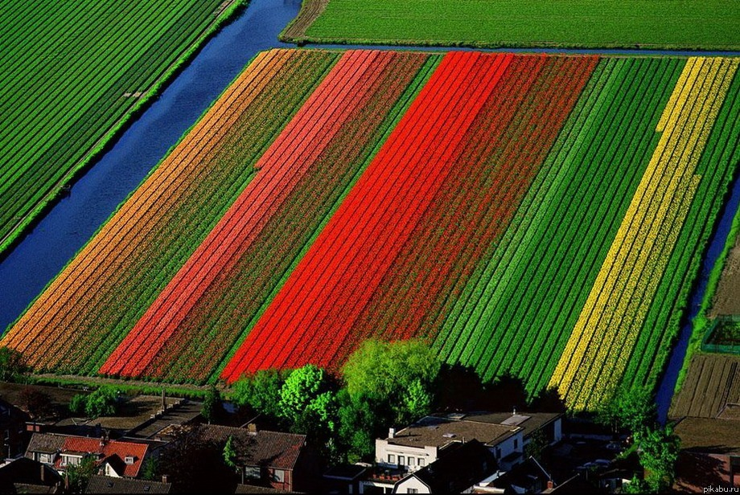
Interesting places of the world

Slide 2
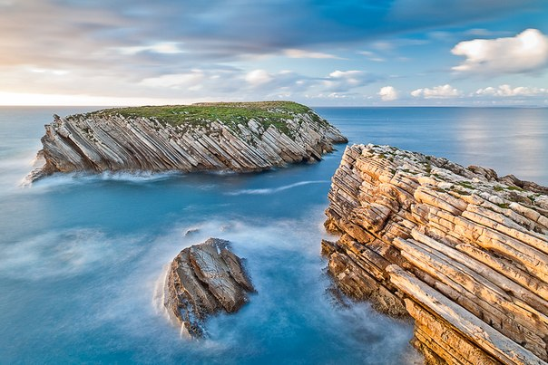
Coast Peniche, Portugal

Slide 3
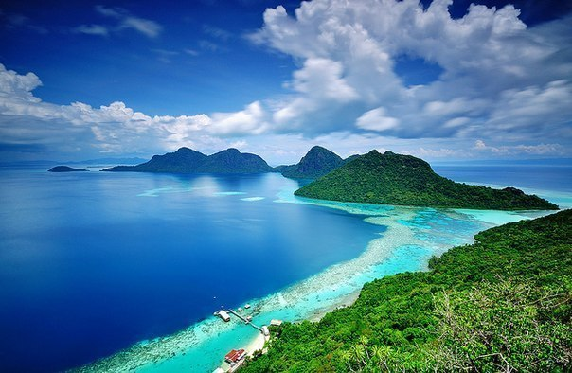
Beach of Sabah, Borneo, Malaysia

Slide 4
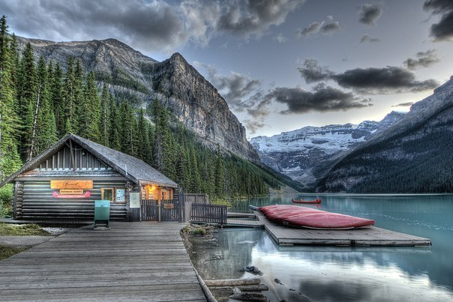
Louise Lake, Banff National Park, Canada

Slide 5
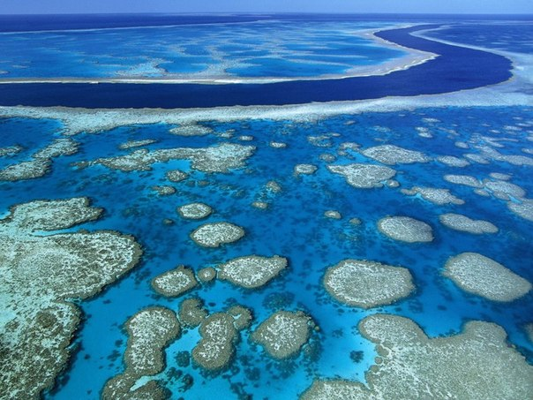
Great Barrier Reef, Australia

Slide 6
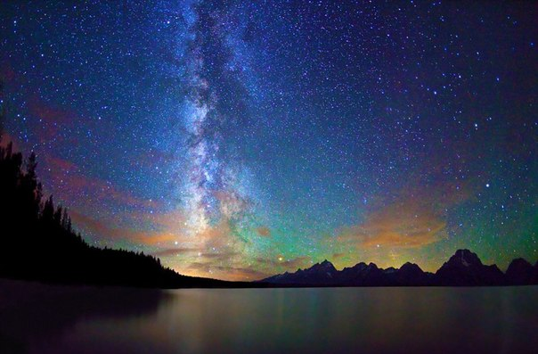
Milky Way over Jackson Lake in National Park Grand Teton, Wyoming, USA

Slide 7
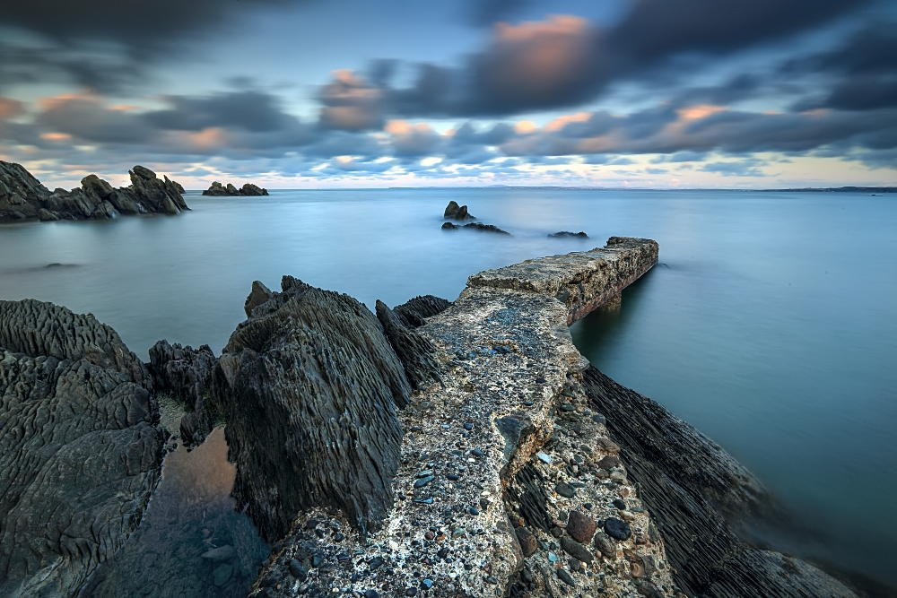
Donegal, Ireland

Slide 8
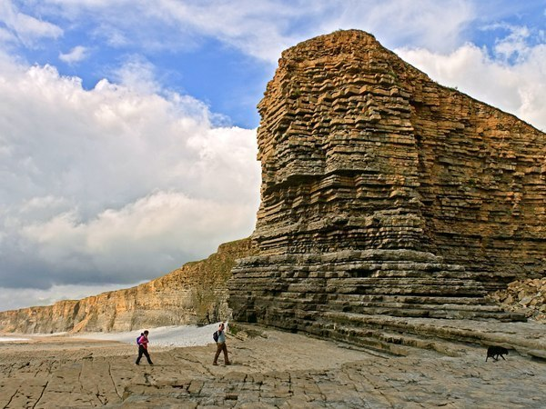
Coast Path, Wales

Slide 9
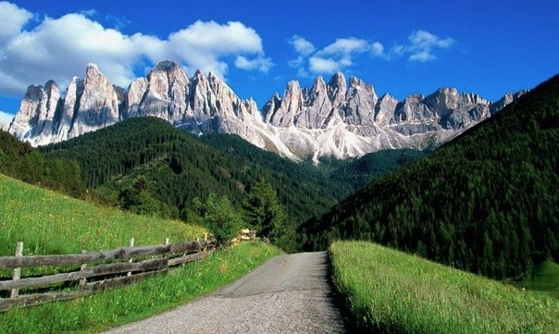
The road in the Dolomites, Italy

Slide 10
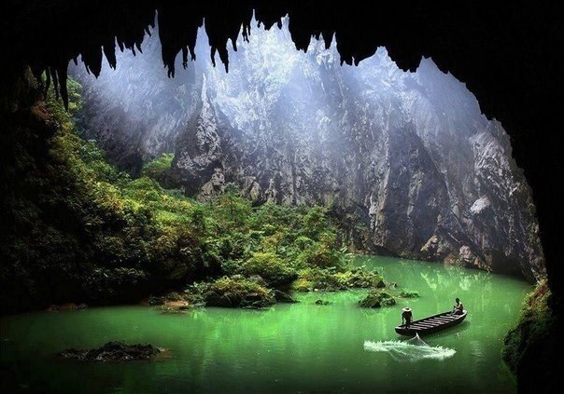
Lake in the cave, China

Slide 11
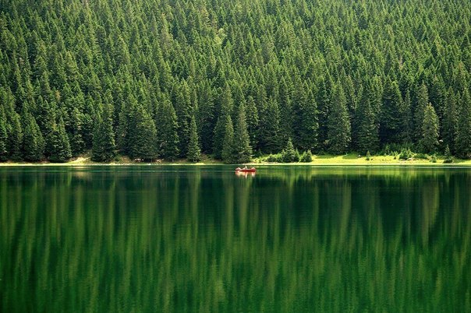
Black Forest Lake, Durmitor, Montenegro

Slide 12
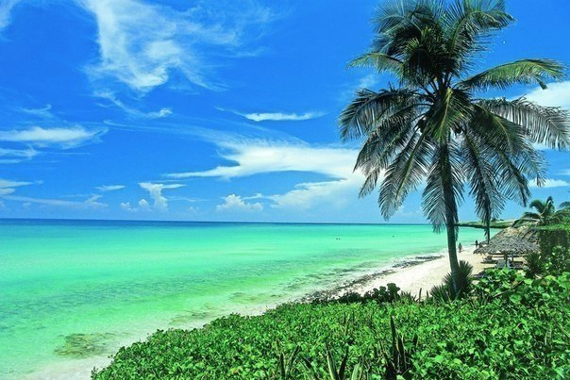
Beach in Varadero, Cuba

Slide 13
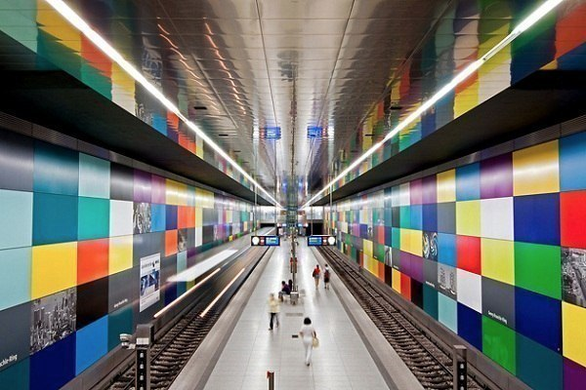
Munich subway station, Bavaria, Germany

Slide 14
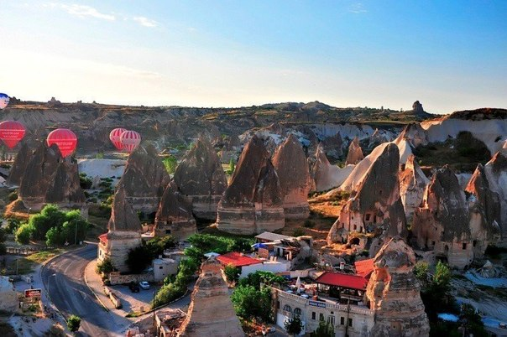
Cappadocia, Turkey

Slide 15
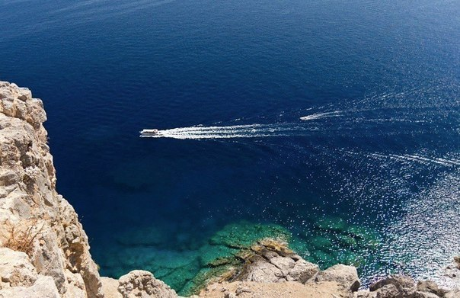
Coast of Lindos, Greece

Slide 16
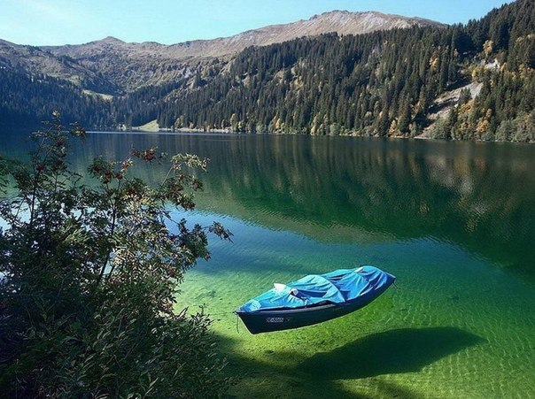
Lake Koenigssee, Germany

Slide 17
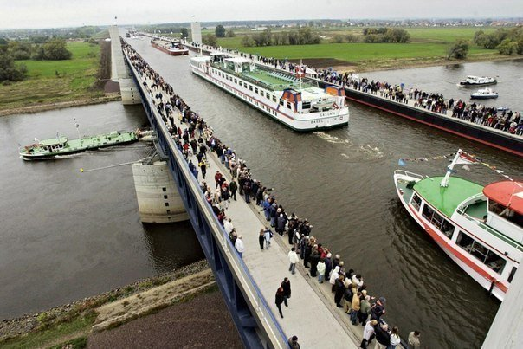
Germany, river above the river: Magdeburg Water Bridge

Slide 18
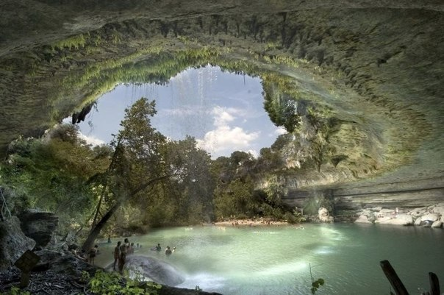
Lake in the cave, Texas, United States

Slide 19
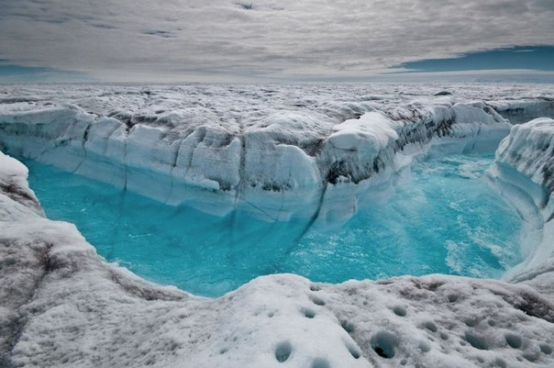
Blue River in a glacier, Greenland

Slide 20
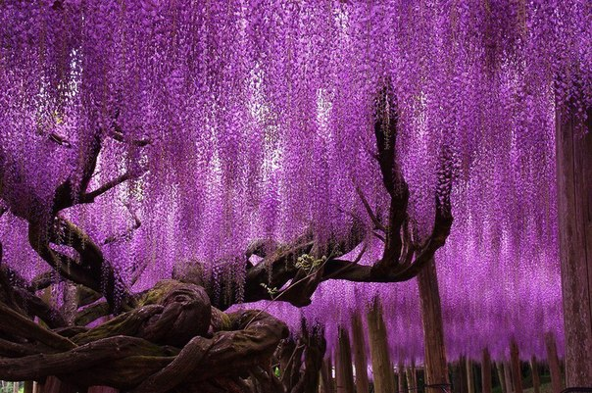
Tree in park flowers Ashikaga, Tochigi, Island of Honshu, Japan

Slide 21
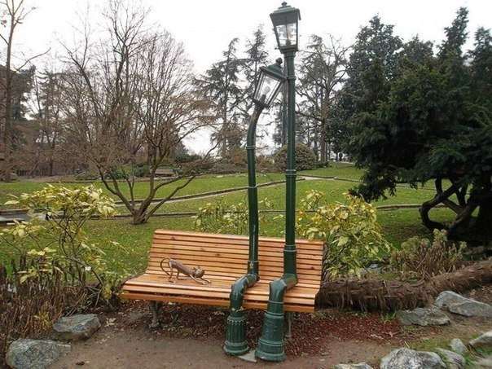
Lights in the park of Turin, Italy

Slide 22
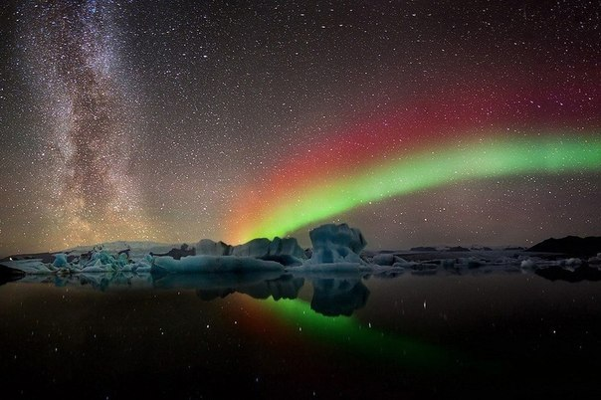
The night sky and the Northern Lights over the glacier Yokulsarlon, Iceland

Slide 23
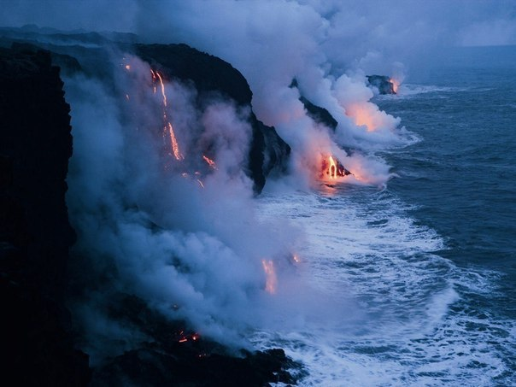
The boiling ocean, Hawaii, USA

Slide 24
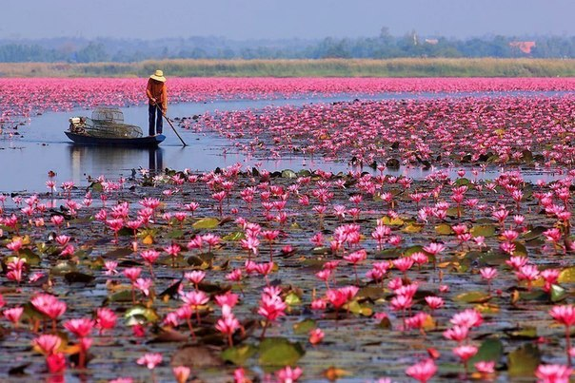
Lake, Thailand

Slide 25
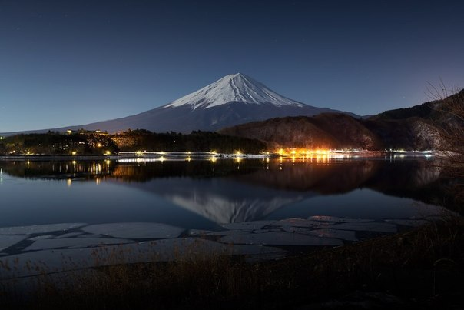
View of the evening Fujiyama, Honshu, Japan

Slide 26
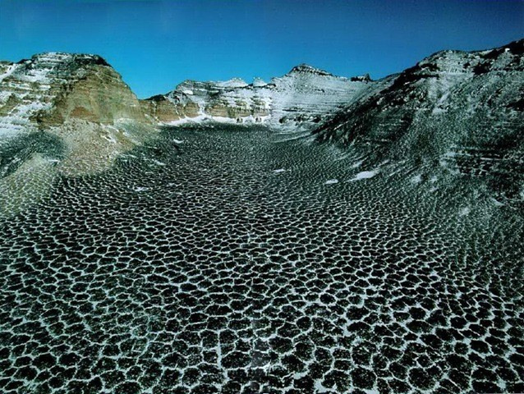
Thank you for your attention!

