Slide 1
Apple Inc.

Slide 2
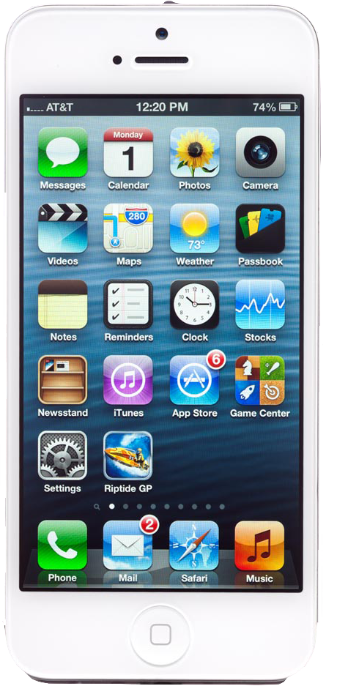
Road Map
History
Some Interesting Facts About Apple
Company Profile
Mission & Vision
Market Share
SWOT Analysis
Conclusion

Slide 3
1974
The idea for Apple Computers was
BORN

Slide 4
1974
1976
The idea for Apple Computers was
First Computer was
SOLD
BORN

Slide 5
1984
The Macintosh was
INTRODUCED

Slide 6
1984
1985
The Macintosh was
Steve Jobs
INTRODUCED
was discharged

Slide 7
1986
1990

Slide 8
1990
1993

Slide 9
1994
1996

Slide 10
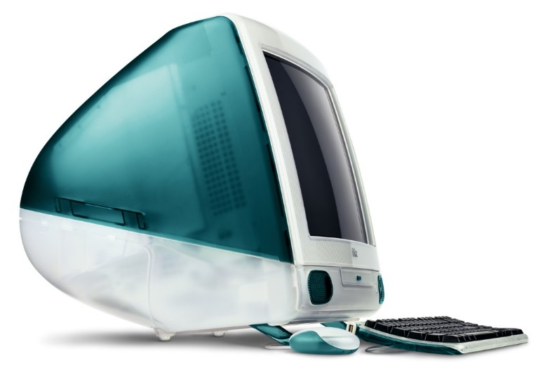
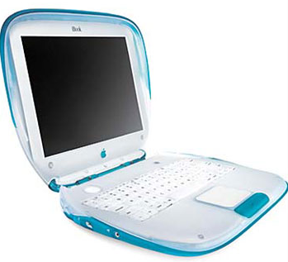
1998
1999
Apple introduced all-in-one
Also Apple unveiled
the iMac
the iBook

Slide 11
And the Innovations continue…

Slide 12
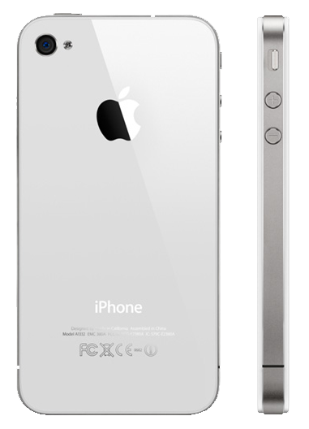
Some Interesting Facts About Apple

Slide 13
Apple was started by
Steve Jobs
Steve Wozniak

Slide 14
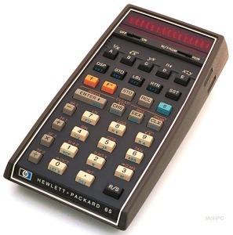
To raise enough money they sold…
Steve Jobs
Steve Wozniak

Slide 15
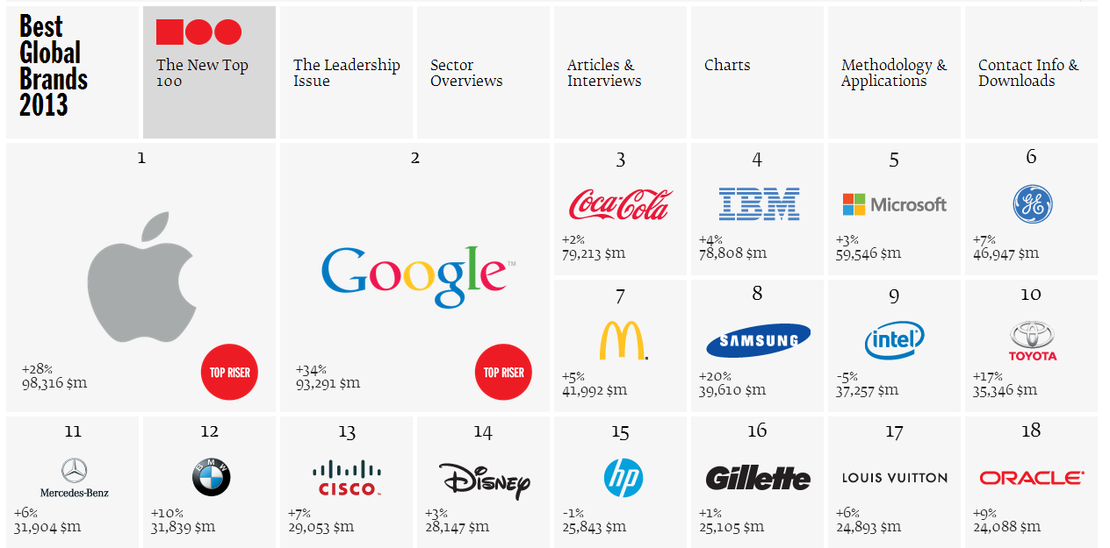
Best Global Brands 2013

Slide 16
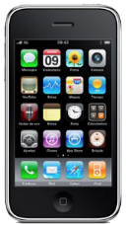
APPLE SOLD 40 MILLION iPHONES LAST YEAR.
110,000 iPhones per day
Notes:
And 4,583 iPhones per hour.
And 76 iPhones per minute.
And 1.27 iPhones per second!
The iPhone is now sold in 89 countries.

Slide 17
Now, Apple generated revenue of
$156 billion
officially bigger than Microsoft ($73.7 billion)

Slide 18
Even bigger than the GDP of
100 other countries

Slide 19
$470.94 B
$231.2 B
Enterprise Value
Total GDP

Slide 20
Apple makes their employees work on
FAKE PROJECTS
until they can be trusted!

Slide 21
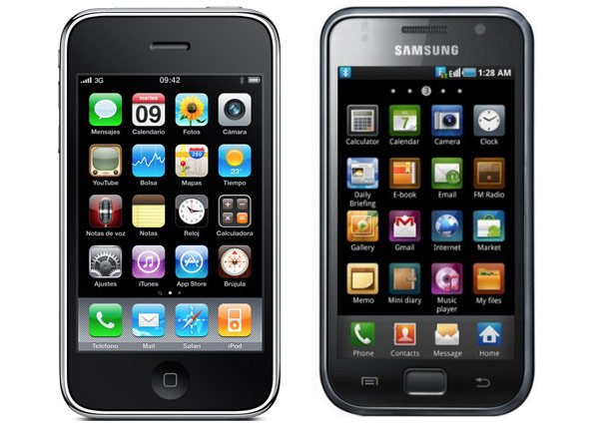
Early Galaxy S phones and their software were
heavily influenced by the iPhone.
Apple
Galaxy S

Slide 22
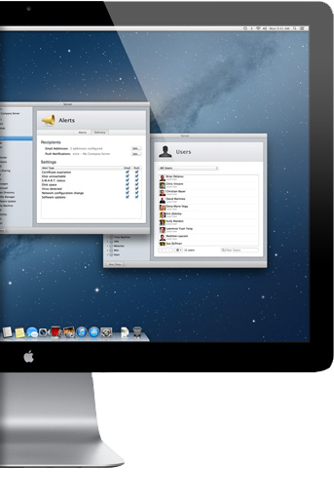
Apple Inc.
Company Profile
Vision & Mission

Slide 23
Apple Inc. Current Profile
Name | Apple Incorporation
Former CEO | Steve Job
New CEO | Tim Cook
Revenue | $ 156.508 billion (2012)
Area served | Worldwide
Headquarter | California, United States.
Total number of employees | 72,800

Slide 24
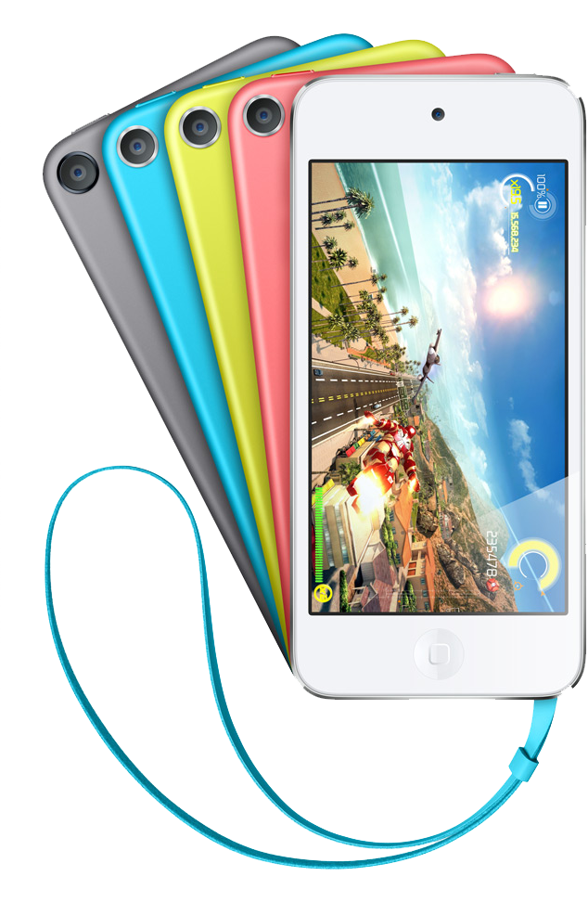
Mission Statement
"Apple is committed to bringing the best personal computing experience to students, educators, creative professionals and consumers around the world through its innovative hardware, software and Internet offerings."

Slide 25
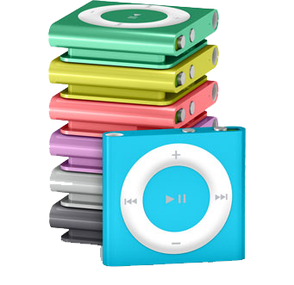
Vision Statement
We are “committed” in producing high quality products and providing high quality service thus setting high industry standards for other competitors.

Slide 26
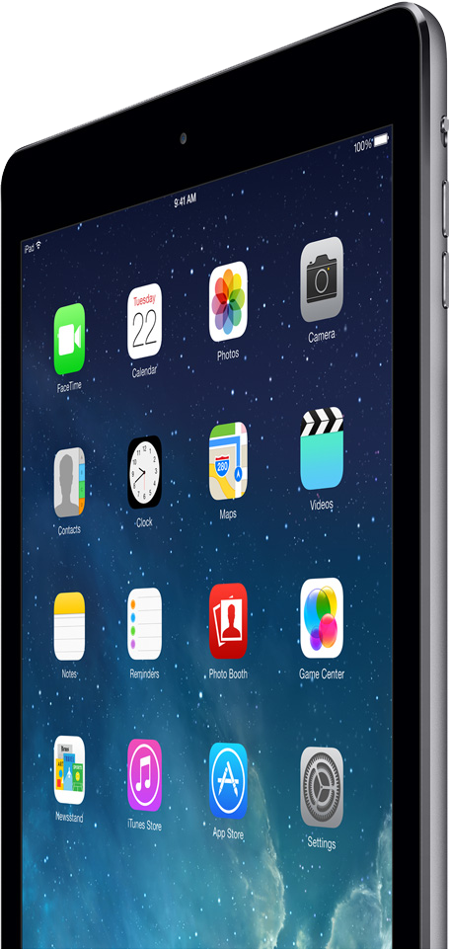
Apple Inc.
Product Market Share
Local & International
Markets

Slide 27
From Where Apple is Making Money

Slide 29
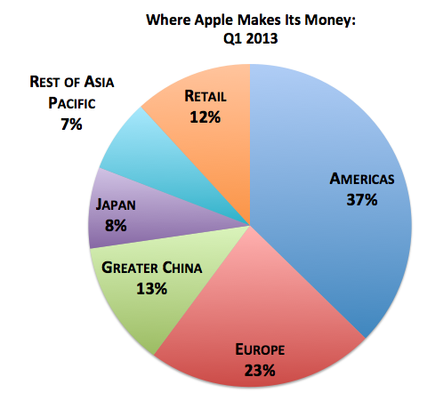
Global Market Share

Slide 30
Current Growing Products of Apple are…
iPads
iPhones

Slide 31
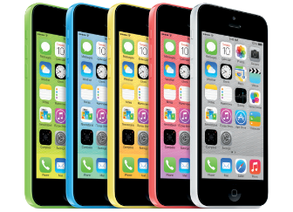
Apple Inc.
Competitors &
Products line

Slide 32
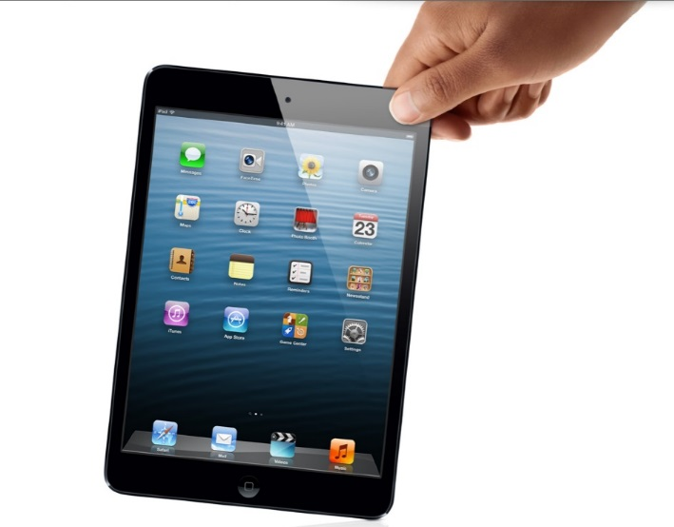
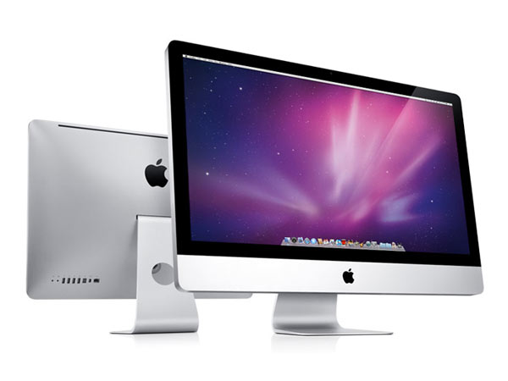
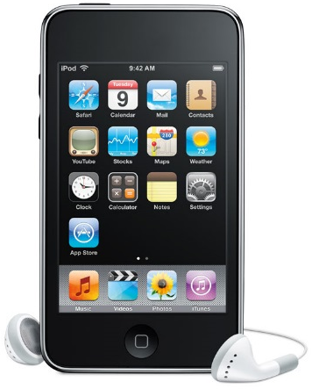
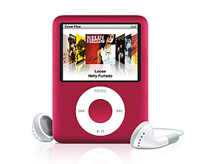
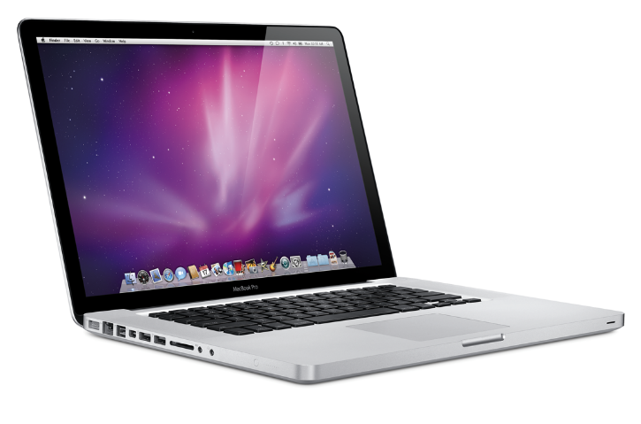
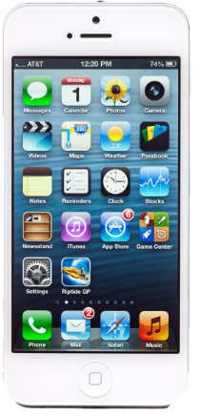
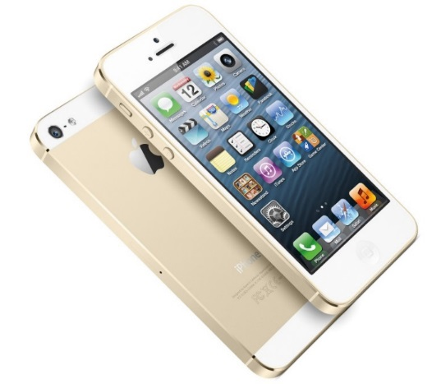
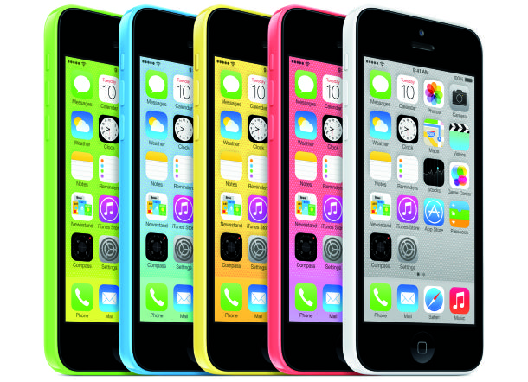
iMac
iPod
iPod Nano
iPad
Mac Book Air
iPhone 4s
iPhone 5s
iPhone 5C

Slide 33
Apple Inc. Competitors
Apple has many competitors like in computers…

Slide 34
Apple Inc. Competitors
In smart phones industry

Slide 35
Apple Inc. Competitors
In iPads industry

Slide 36
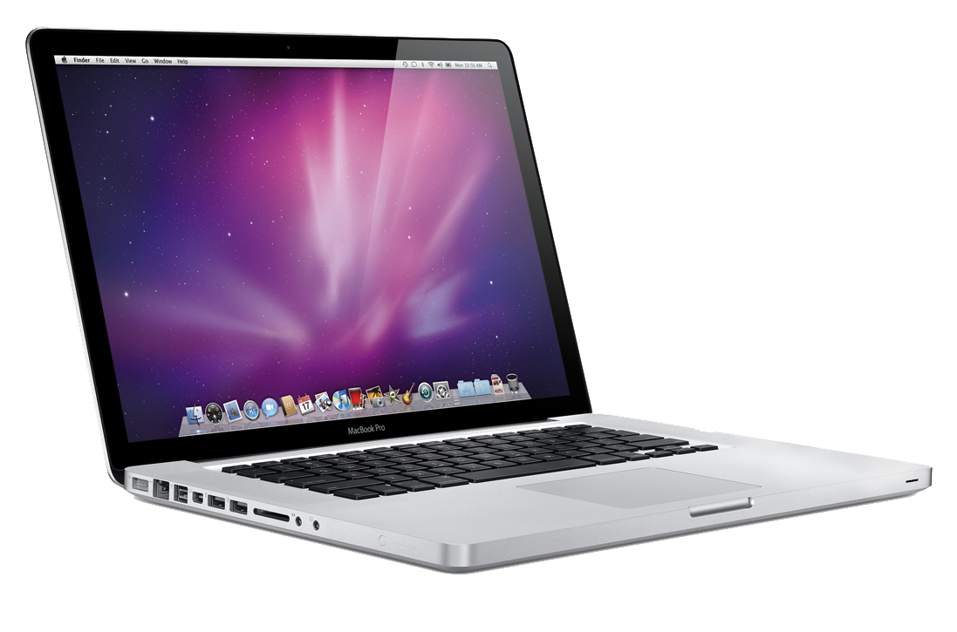
Apple Inc.
SWOT Analysis &
Conclusion

Slide 37
S
Faithful customers
Apple is a leading innovator in mobile device technology
Strong financial performance ($10,000,000,000 cash, gross profit margin 43.9% and no debt)
Brand reputation

Slide 40
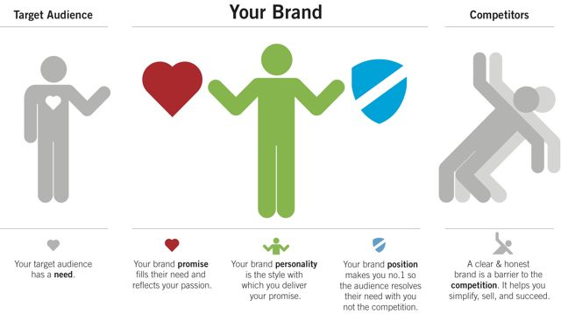
APPLE BRAND STRATEGY MODEL

Slide 41
1.High price
2.Decreasing market share
3.Further Change in management
4.Long term gross margin decline
W

Slide 42
O
1.High demand of iPad mini and iPhone 5
2.iTV launch
3.Growth of tablet and smartphone markets
4.Strong growth of mobile advertising market

Slide 43
1.Rapid technological change
2.2013 tax increases
3.Rising pay levels for Foxconn workers
4.Strong dollar
T

Slide 44
For more than 35 years apple has been a trends set company able to foresee the future of domestic computers and consumers electronics, it will continuing it because apple’s others name is innovation and apple know,
How to THINK DIFFERENT
Conclusion

Slide 45
Stay Hungry, Stay Foolish.
Think Different

