Slide 1
the most famous museums in the world

Slide 2
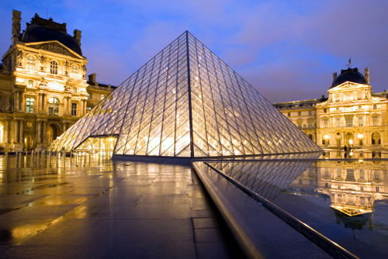
Louvre
Louvre Museum (Paris, France) - National Museum of France, one of the most visited museums in the world and the third largest in the world. In addition, the Louvre is one of the first European museums. The museum is located in the heart of Paris on the right bank of the Seine. The basis of the Louvre is the fortress of King Philip II Augustus of France, built in the late 12th century. The most famous masterpieces of the Louvre - Mona Lisa (Mona Lisa) by Leonardo da Vinci, the ancient Greek sculpture Venus de Milo (Venus de Milo) and Nike of Samothrace (Victory of Samothrace).

Slide 3
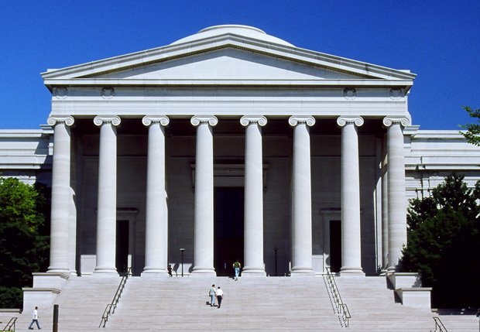
National Gallery of Art
National Gallery of Art (Washington DC, USA) - Museum of Art, located on the National Mall in Washington, DC. The gallery assembled one of the best museum collections in the world, including the works of art of European and American artists: paintings, graphics, sculptures, watercolors, photographs, a collection of porcelain and objects of decorative art.

Slide 4
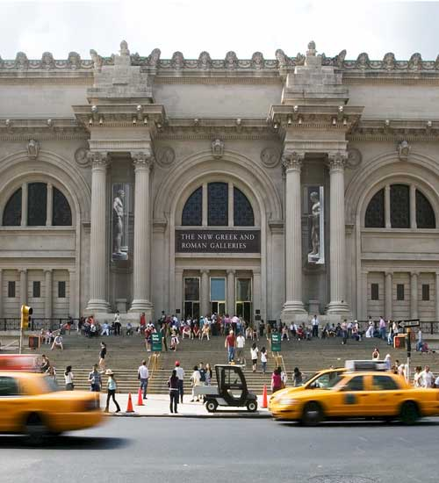
Metropolitan Museum
Metropolitan Museum of Art (New York) was founded by a group of American businessmen, artists and thinkers of the April 13, 1870. Collection of the museum's collection began with 174 pictures of the three European private collections. Metropolitan Museum first opened to the public in 1872. In the museum are, for example, the work of photographers Walker Evans, Diane Arbus, Alfred Stieglitz and others.

Slide 5
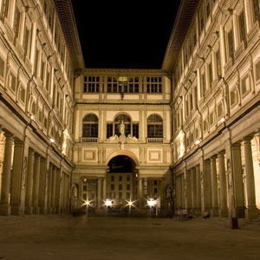
Uffizi Gallery
Uffizi Gallery (Florence, Italy) - one of the most famous museums of paintings and sculpture in the world, is located on an area the Uffizi in Florence. His collection includes paintings by recognized masterpieces of all time, including works by Giotto, Simone Martini, Piero della Francesca, Fra Angelico, Filippo Lippi, Botticelli, Mantegna, Correggio, Leonardo da Vinci, Raphael, Michelangelo and Caravaggio. As well the works of German, Dutch and Flemish masters such as Dürer, Rembrandt and Rubens.

Slide 6
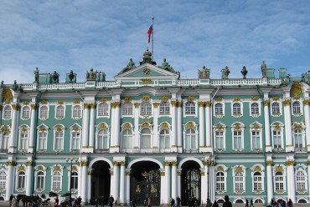
Hermitage
The State Hermitage Museum
(St. Petersburg, Russia) - one of the largest museums in the world, has a collection including about three million works of art and monuments of world culture. As part of the Hermitage collection - paintings, drawings, sculptures and works of applied art, archaeological finds, numismatic material, a gallery of jewelry (gold and diamond pantries).

Slide 7
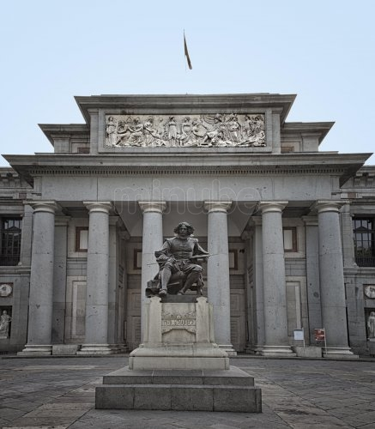
Prado Museum
Prado Museum (Madrid, Spain) - one of the largest museums, is the collection of paintings, sculpture and decorative arts, as well as masters of world masterpieces of Spanish, Italian, Flemish and other European schools. The museum's collection are stored some of the most comprehensive collections of Bosch, Velázquez, Goya, Murillo, Zurbaran and El Greco.

Slide 8
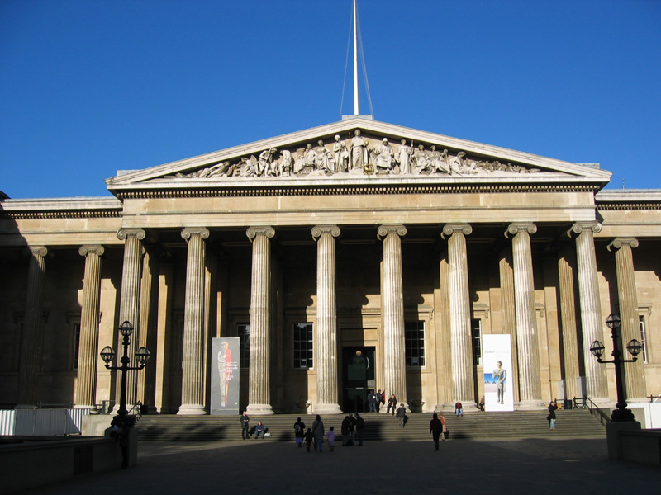
The British Museum
British Museum (London, UK), founded in 1753, is the first national public museum in the world and one of the largest museums in the world. The museum building occupies an area equivalent to nine football fields. The museum was originally conceived as a collection of antiquities of ancient Greece and Rome. Together with archaeological finds and art objects that were brought to London from all corners of the British Empire, the museum was replenished drawings, engravings, medals, coins and books of different eras.

Slide 9
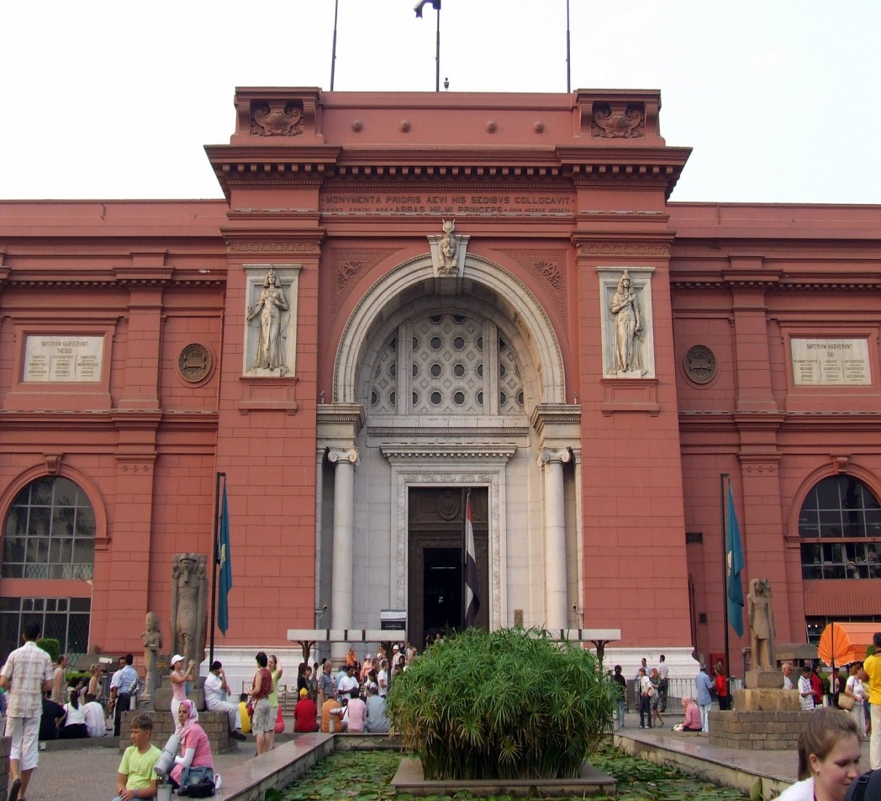
Egyptian Museum
In the Egyptian Museum (Cairo, Egypt) assembled the world's largest collection of ancient Egyptian art. The present museum building in the neo-classical style was built in 1900 by the French architect Marcel Dyunona (Marcel Dourgnon). The museum's collection includes more than 120,000 works of Egyptian art from the prehistoric era to the Greco-Roman period.

