Slide 1
Past Continuous

Slide 2
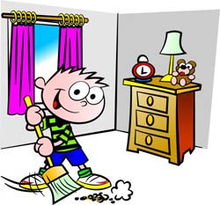
Past Continuous
вживається для вираження дії, що відбувається в певний момент чи період часу в минулому
I/he/she/it
you/we/they
was
were
V+ ing
He was tidying up the room at 5 o'clock in the evening.
They were singing a song at 9 p.m.

Slide 3
Remember
I was
He was
She was
It was
play – playing
sleep – sleeping
write - writing
get - getting
Ving
We were
You were
They were

Slide 4
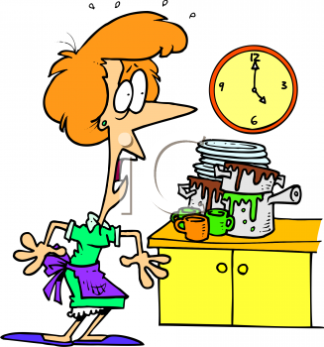
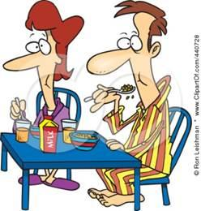
Negative (заперечення)
The woman was not (wasn't) washing up at 4 o'clock.
She was making dinner at that time.
was not = wasn’t
were not = weren’t
They were not sleeping at 8 a.m.
They were having breakfast
at that time.

Slide 5
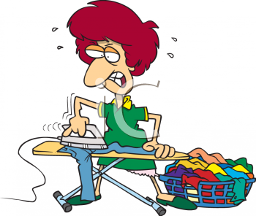
Question (запитання)
She was ironing when he came.
Was she ironing when he came?
Yes, she was./ No, she wasn't.
The children were playing at 4 p.m.
Were the children playing at 4 p.m.?
Yes, they were./ No, they weren't

Slide 6
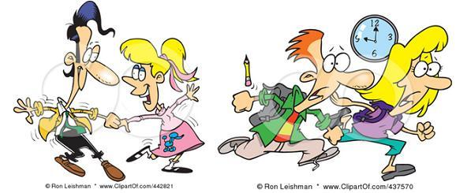
спеціальні запитання
Where was
What was підмет Ving
Why were
Whose
Where were they dancing at 9 p.m.? - They were dancing at the disco.
What were they doing at 9 a.m.? -They were running.
Who was watering the flowers at 8 a.m.? - My son was
Wh-questions:

Slide 7
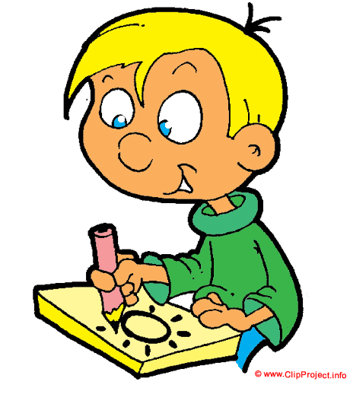
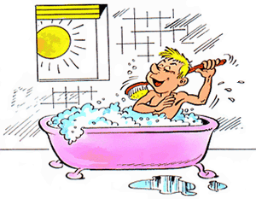
Remember.
Певний момент часу в минулому може бути виражений:
певним часом
періодом часу минулого
підрядним реченням
Bill was playing football at 5 p.m. yesterday
I was drawing from 5 till 7 o’clock yesterday
He was bathing
when I entered the room.
P.S.

Slide 8
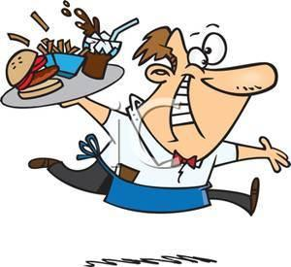
Підкреслюється процес дії в минулому за допомогою:
союзів: while
when
as
all day long
the whole evening
all the time
While Bill was working in the garden, Sam was washing clothes.
Ben was working the whole evening

