Slide 1
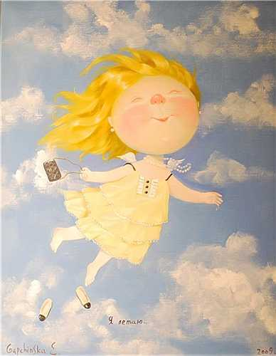
Speaking about art…
Art resembles a movement of the hands on a clock that show the reality of changes, moving through the empty intervals between the marks; the marks being only symbols of real time. Oleksandr Arkhypenko

Slide 2
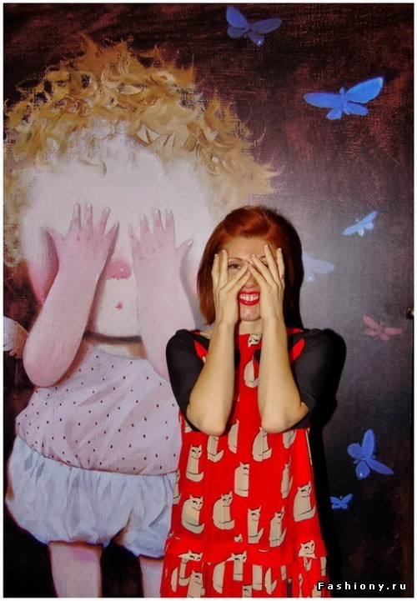
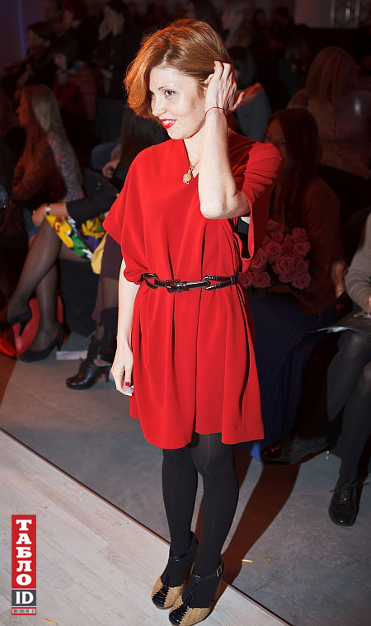

Slide 3
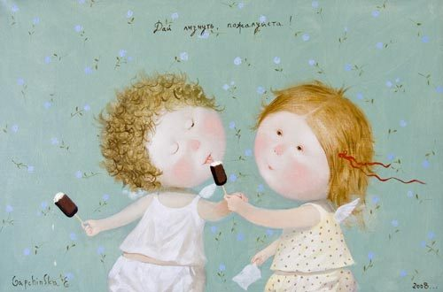
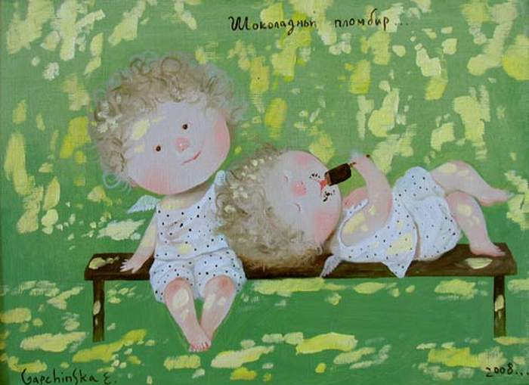
Therevheniya Gapchinskaya - popular Ukrainian artist-painter. was born November 15, 1974 in Odessa. The fifth child in a family. At the age of five went to school, and at age 13 became a student of the Kharkov Art College. Graduated from the Kharkov Art Institute.

Slide 4
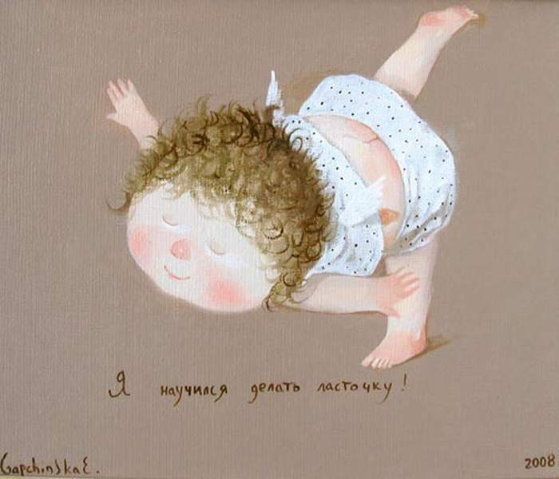
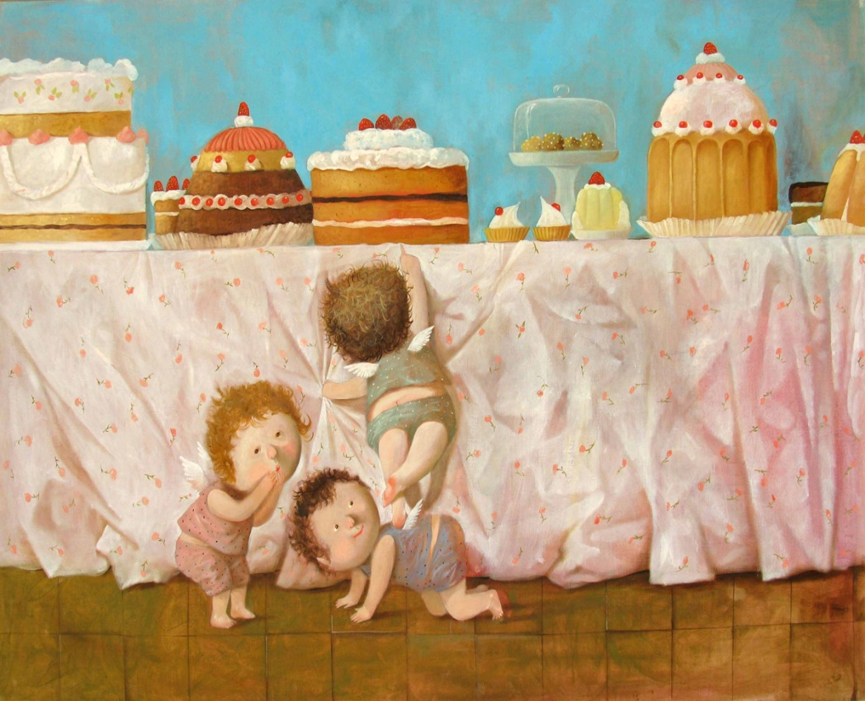
Eugene Gapchinska - one of the most famous Ukrainian artist who has a unique style. Drawing little funny little men with touching inscriptions Gapchinska calls himself "happiness Supplier number 1".

Slide 5
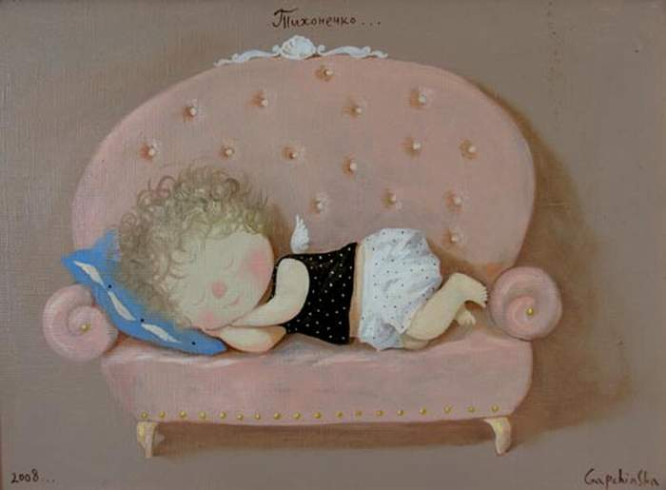
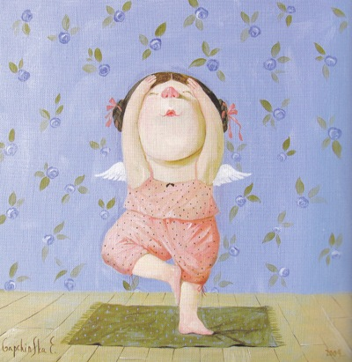
Eugene Gapchinska undoubtedly the most popular contemporary Ukrainian artist. The author touchingly funny baby pictures, smiles was born in Kharkov, in a large family.. Finding your own "I" she stated on their way into art. Gapchinska draws happiness. So is her personal gallery in Kiev, and this is the motto that characterizes its message of up to one million army of fans' number 1 provider of happiness. "

Slide 6
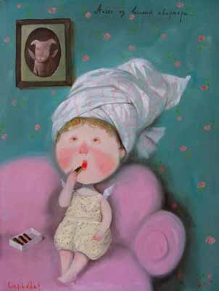
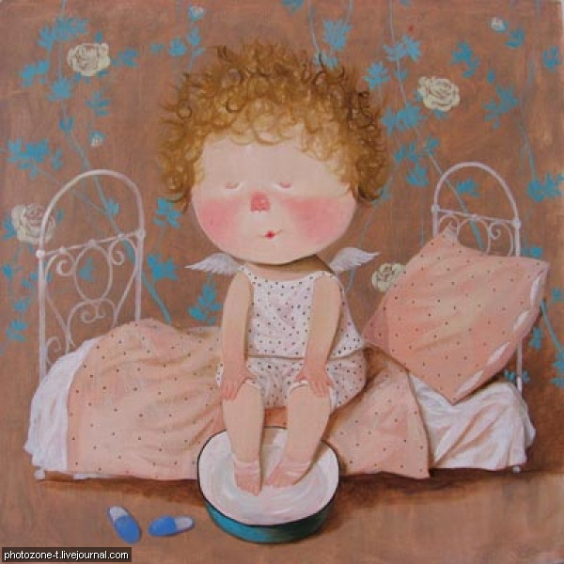
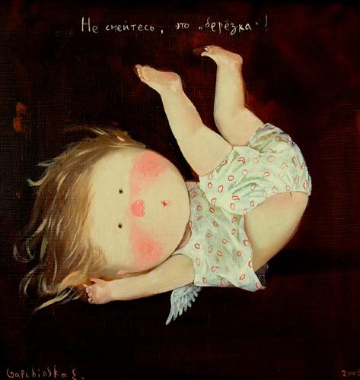
His goal - to make people smile, to remember the happy moments of childhood, notice all the good and light in the world around us has made Jack - hit the nail on the head! Explanations for the success of only one thing - the author's sincerity. She is so, this is the philosophy of life and these are her stories. Be happy!!

Slide 7
Thank you for your attention!

