Slide 1
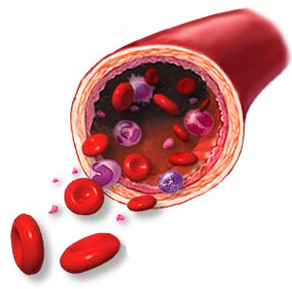
Hypertension
Objectives:
Understanding Hypertension
Hypertension Causes
How It Affects The Body
Hypertension Treatment

Slide 2
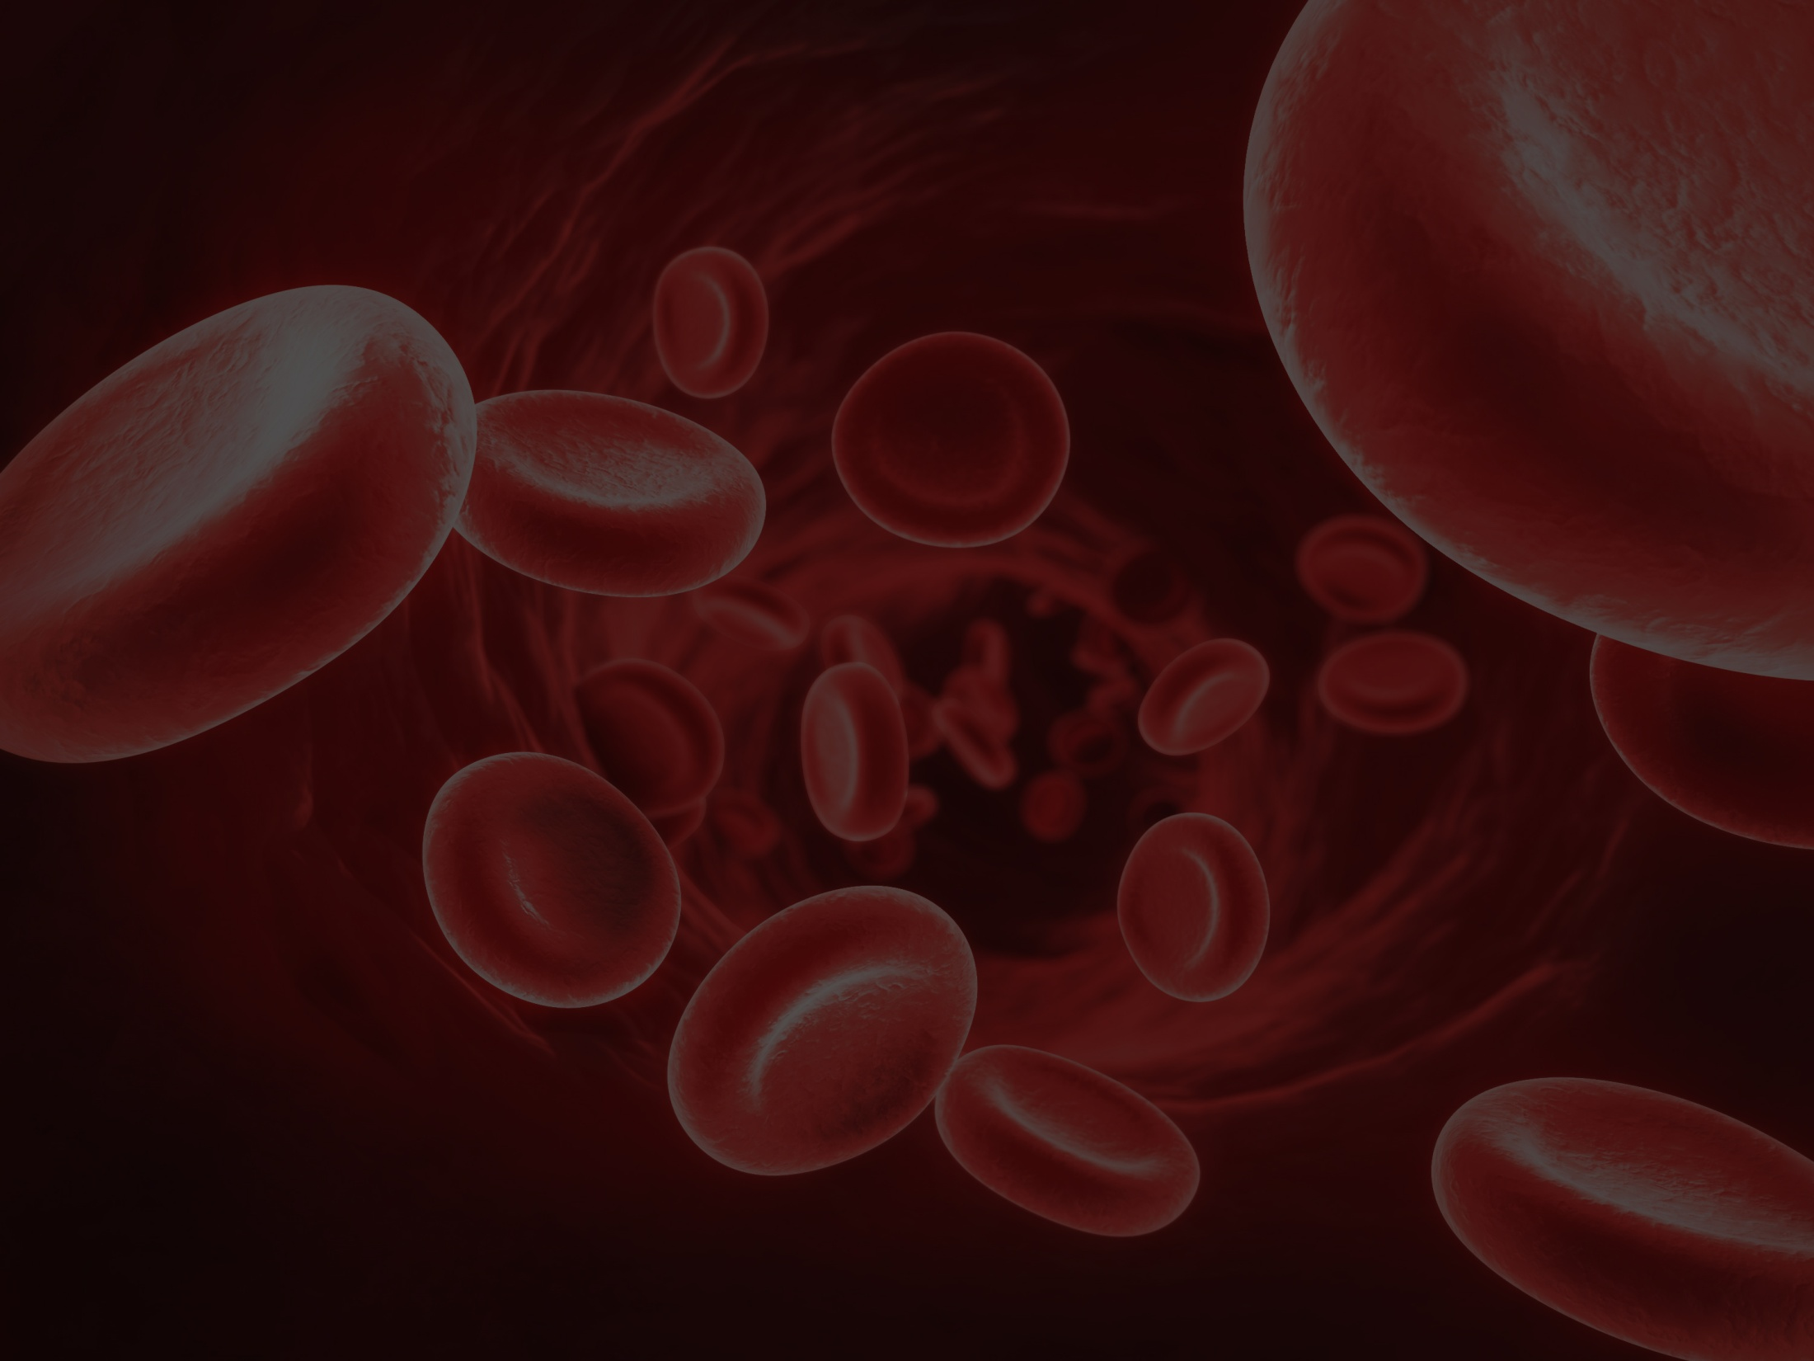
What Is Hypertension?
Hypertension is the medical term for high blood pressure.
Most people associate high blood pressure with getting older, so it may seem odd that teens can have the condition. Although high blood pressure is rare in young people (only about 1% to 3% of kids in the United States have hypertension), it's important to check for it. Even babies can have high blood pressure!
Blood pressure of less than 120 over 80 is considered a normal reading for people 18 and over. A borderline systolic pressure of 120 to 139 or a diastolic pressure of 80 to 89 needs to be closely monitored. This is called prehypertension. A blood pressure reading equal to or greater than 140 over 90 is considered high in people over the age of 18.
If you have a family history of high blood pressure, you're at a higher risk for developing hypertension.

Slide 3
What Causes Hypertension?
Most elevated blood pressure doesn't have a cause and is called essential or primary hypertension. In cases where the cause of high blood pressure is known (called secondary hypertension), it is usually the result of kidney problems, hormonal disorders, abnormalities of the aorta (the main artery that carries oxygenated blood to the body), or a narrowing of certain smaller arteries. Doctors screen teens with high blood pressure for secondary causes with physical examination and laboratory testing.
Some teens may inherit the tendency toward higher blood pressure from one or both parents. Kids and teens who are obese are at a higher risk for hypertension. Lack of exercise makes it easier to become overweight and increases the chance of high blood pressure.
In some cases, medications like steroids can cause high blood pressure.

Slide 4
How Does Hypertension Affect the Body?
High blood pressure adds to the workload of the heart and arteries. The heart must pump harder and the arteries must carry blood that's moving under greater pressure. If high blood pressure continues for a long time, the heart and arteries may no longer work as well as they should. Other body organs, including the kidneys, eyes, and brain also may be affected.
People can live with hypertension for many years without having any symptoms. That's why high blood pressure is often called "the silent killer." Though a person may not have any symptoms, it doesn't mean that the high blood pressure isn't affecting the body.
Having high blood pressure puts a person at more risk for strokes, heart attacks, kidney failure, loss of vision, and atherosclerosis (hardening of the arteries). In rare cases, severe hypertension can sometimes cause headaches, visual changes, dizziness, nosebleeds, and nausea.

Slide 5
How Is Hypertension Treated?
Hypertension can be a temporary or lifelong disease, depending on the cause. Anyway, the most important thing is to keep it under control. People who manage their high blood pressure with a treatment program lower their risk of having serious complications as they get older.
Although medication may be necessary to control high blood pressure, in many cases it can be managed with lifestyle improvements, such as exercising and dietary changes (eating less fat and salt), avoiding alcohol and cigarettes.
If you've been diagnosed with hypertension, you and your doctor will work as a team to decide on the best course of action for you.

Slide 6
Can I Prevent Hypertension?
Here are some suggestions that can lessen your chances of developing high blood pressure and help keep you healthy in many other ways:
Maintain a normal weight for your height.
Exercise regularly. It keeps your heart and blood vessels strong and healthy.
Eat a healthy diet that includes mostly whole grains, low-fat dairy products, fruits, and vegetables.
Decrease your sodium (salt) intake that is often found in breads, baked goods, and other processed/canned foods.
Give up bad habits (smoking, alcohol, drugs).
Keep your stress levels in check. It may help to practice relaxation techniques such as deep breathing exercises.
Know your blood pressure. Have it checked regularly.

