Slide 1
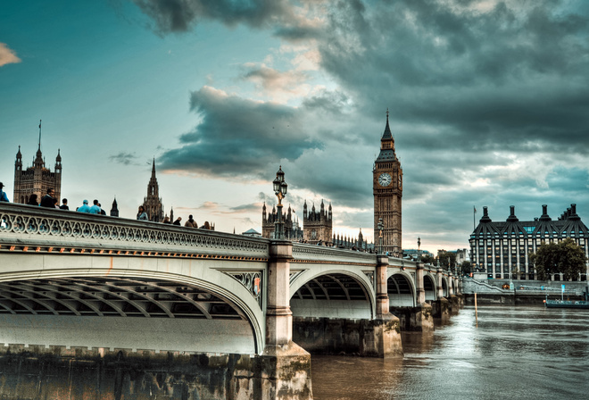
England - Foggy Albion

Slide 2
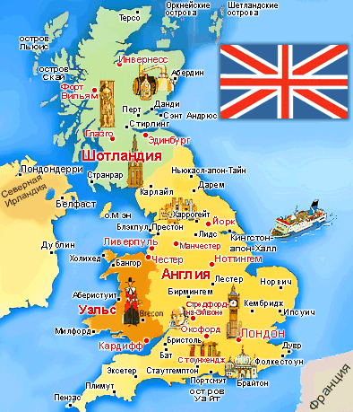

Slide 3
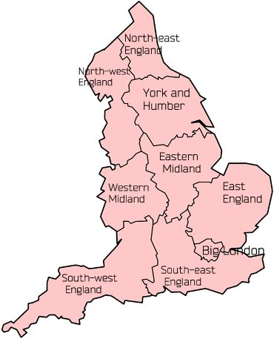
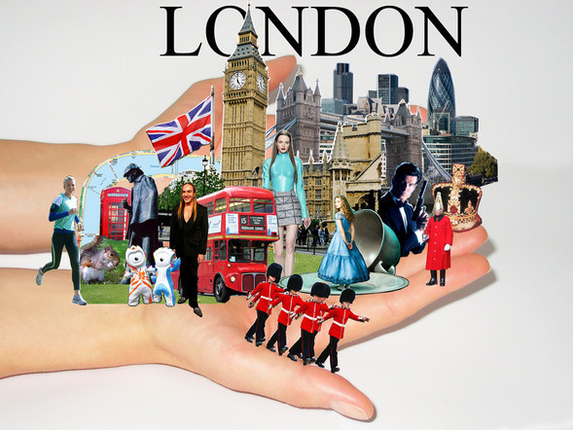
England
Population: 52 million
Capital: London
National Day: 23th April (St. George’s Day)
Regions: 9
Climate: mild, damp

Slide 4
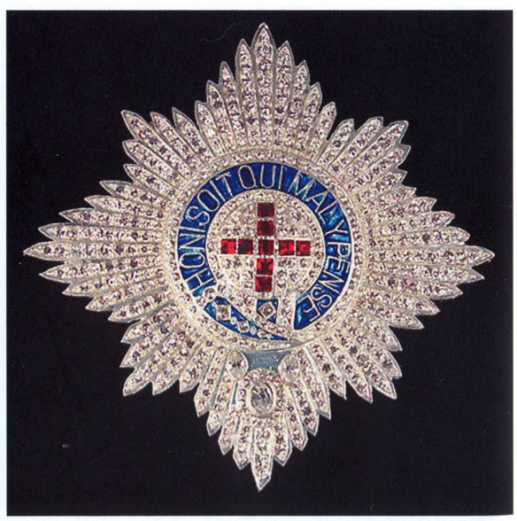
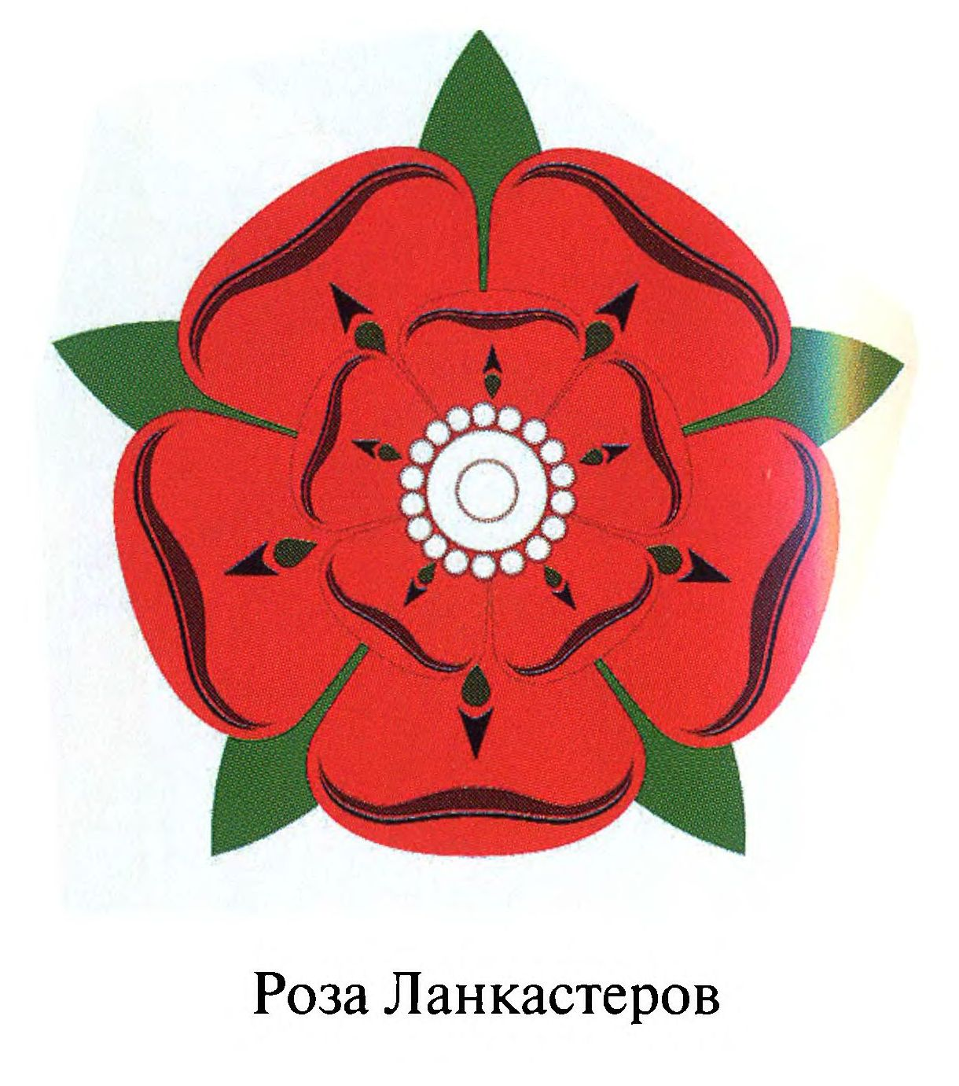
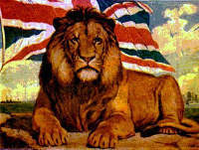
National symbol
Red Rose
Lion
Garter

Slide 5
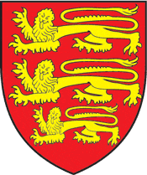
England
Flag of England
Emblem
Slogan
"God and my right"

Slide 6
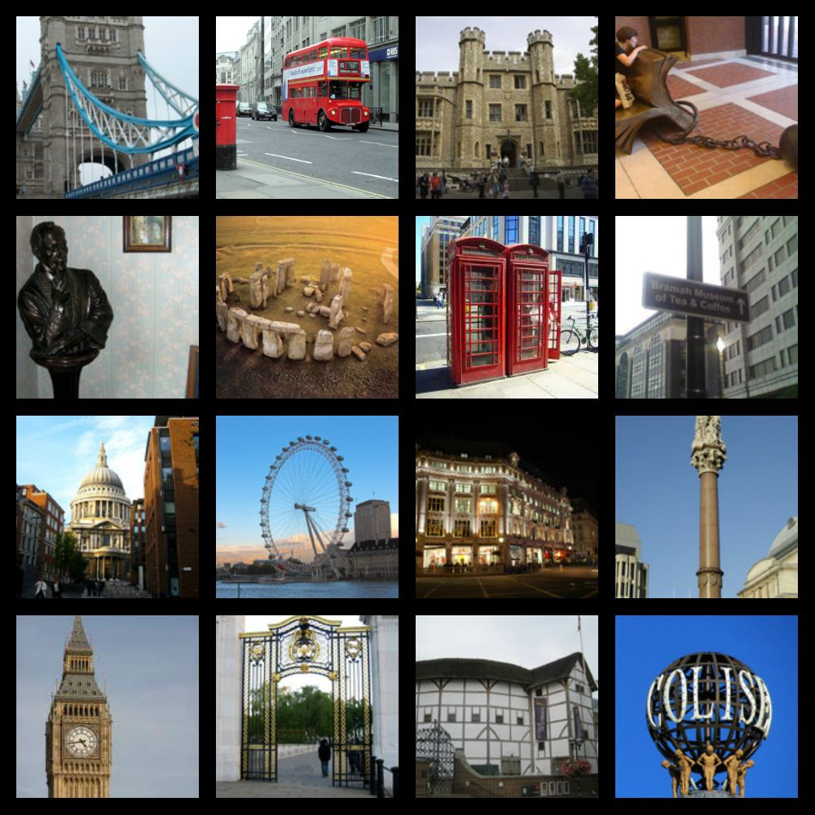
London Sightseeing

