Slide 1
Interesting Earthquake Facts
Olga Gavrulyuik, 10-B

Slide 2
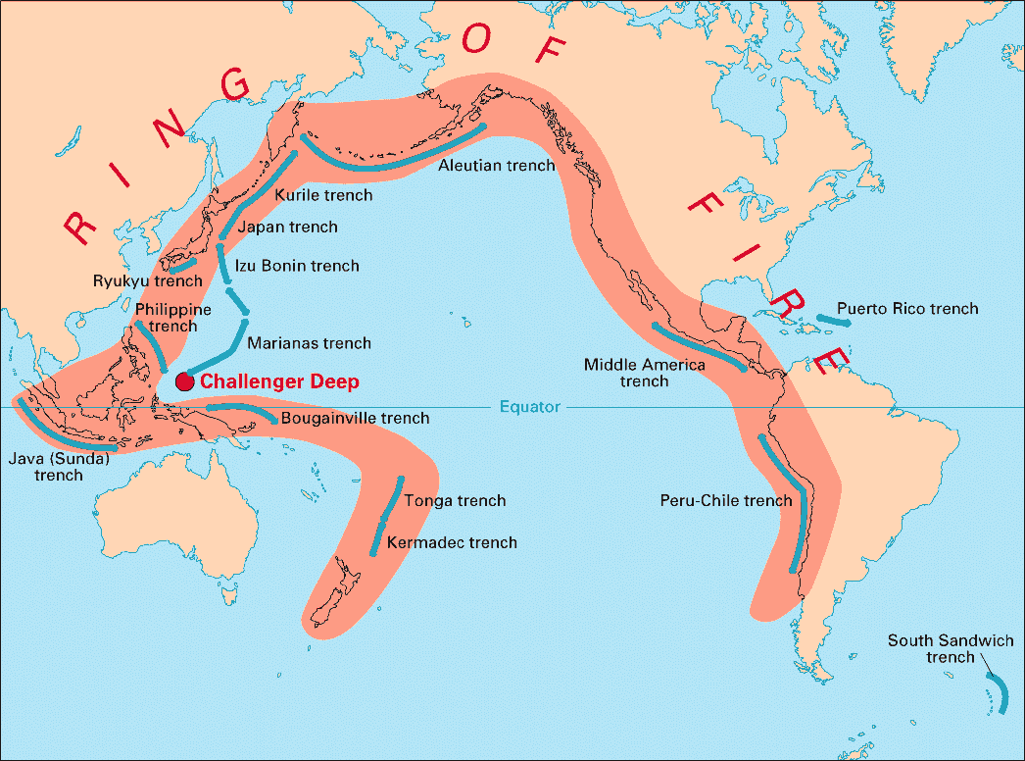
Pacific Ring of Fire
Most earthquakes happen along the edges of Earth's big plates.
4 out of 5 of the world's earthquakes take place along the rim of the Pacific Ocean, a zone called the Pacific Ring of Fire.

Slide 3
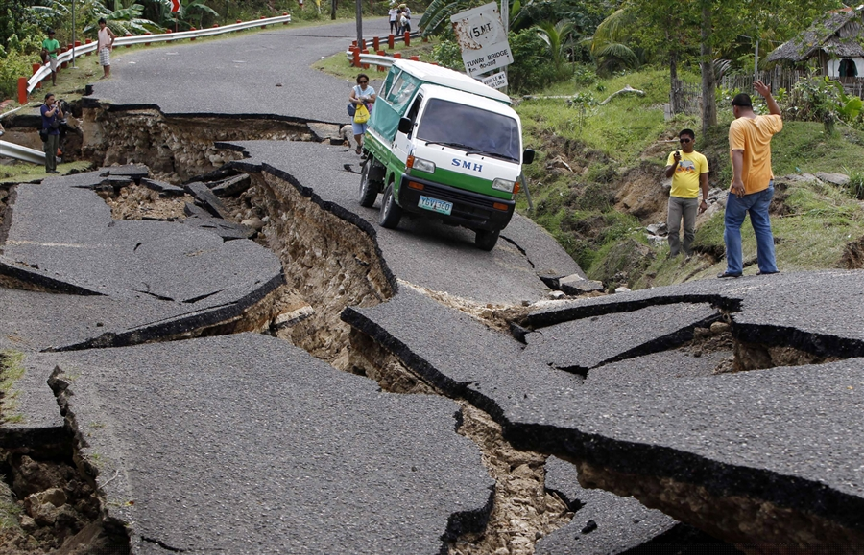
Small earthquakes
Sometimes there are many small earthquakes before the big one. These small ones are called foreshocks. After the big earthquake, the mainshock, again there may be many small quakes. These are called aftershocks. Aftershocks can follow an earthquake on and off for days or weeks.

Slide 4
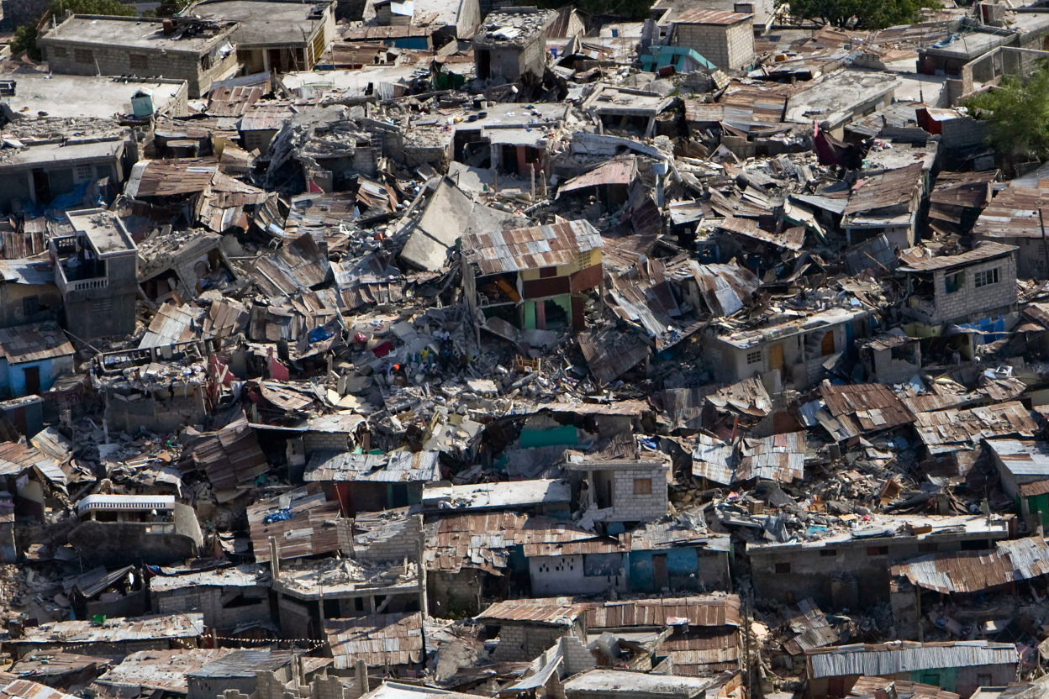
The Duration
An earthquake can last for just a few short seconds or go on for several long minutes.
Most Earthquakes last a minute or less.

Slide 5
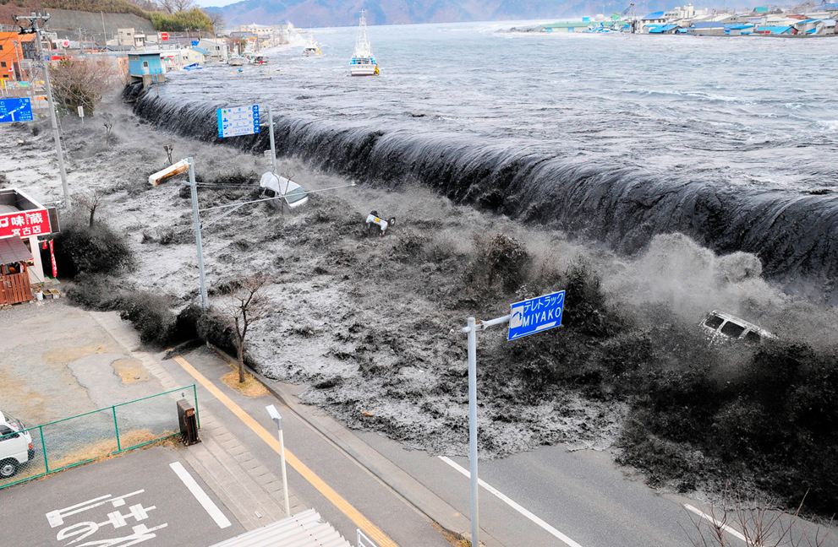
Tsunami
Many earthquakes happen on the ocean floor. Big ocean waves can form after a quake resulting in a tsunami.

Slide 6
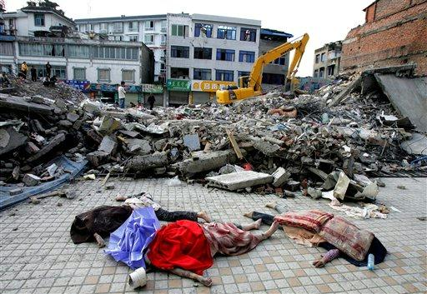
Victims
The shaking of the ground is not what kills most victims of earthquakes. The main killers in earthquakes are falling buildings, fires, landslides, avalanches and tsunamis.

Slide 7
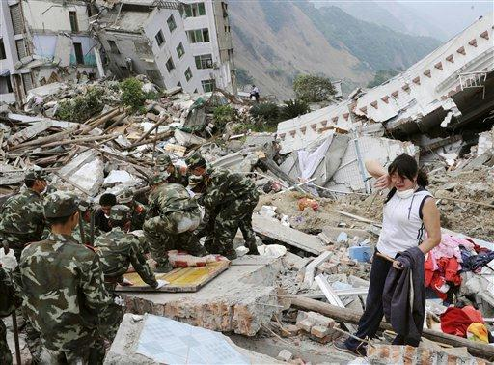
The deadliest quake
The deadliest known quake in history shook China in 1556, taking about 830,000 lives.

Slide 8
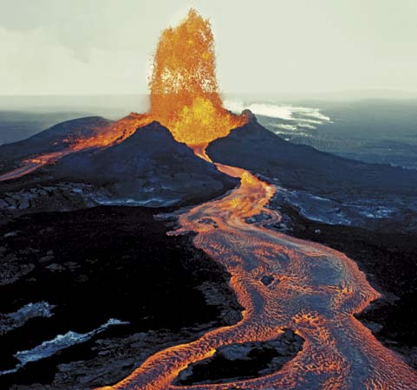
Volcanic eruption
An earthquake can trigger a volcano to erupt.

Slide 9
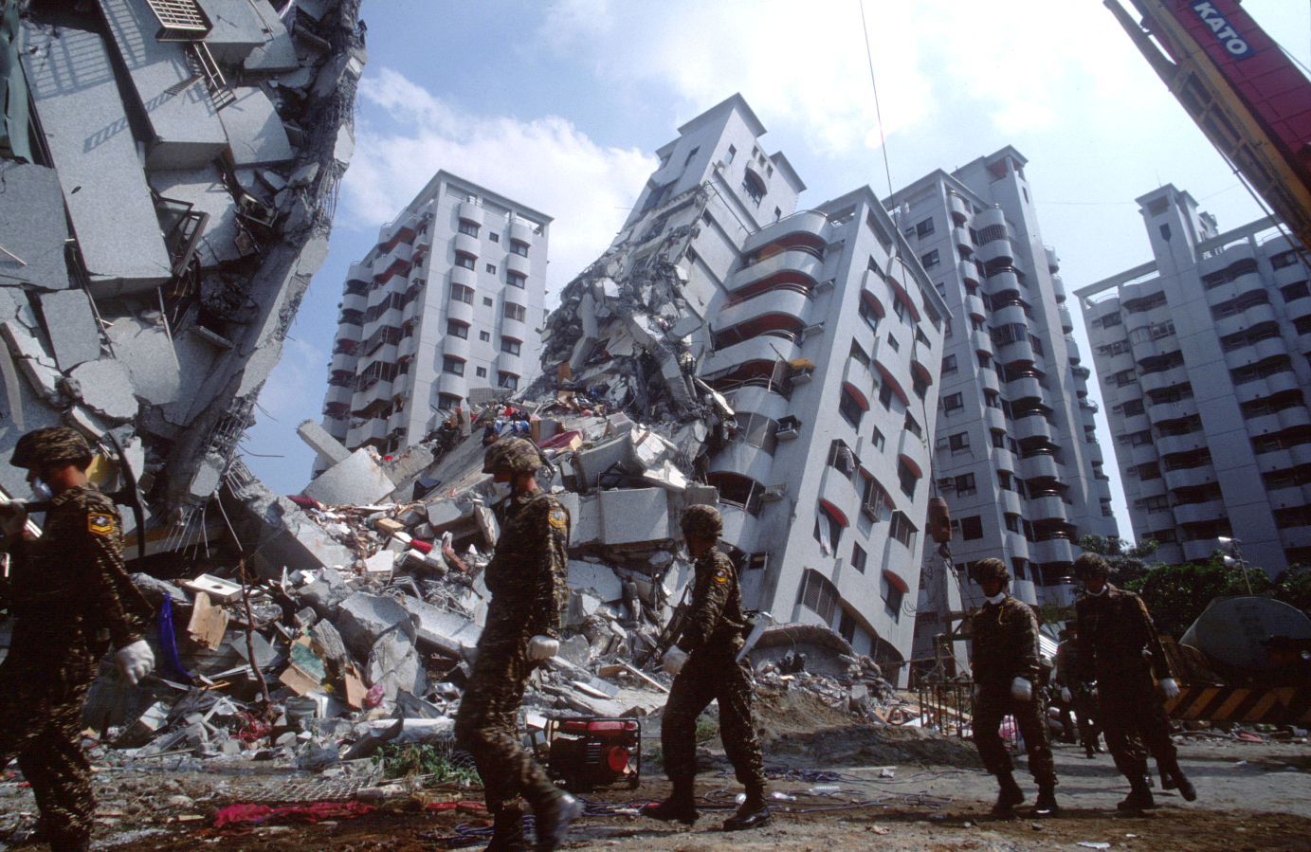
Several earthquakes
Each year, there are about a million earthquakes around the world. But only about 100 of these cause serious damage.

Slide 10
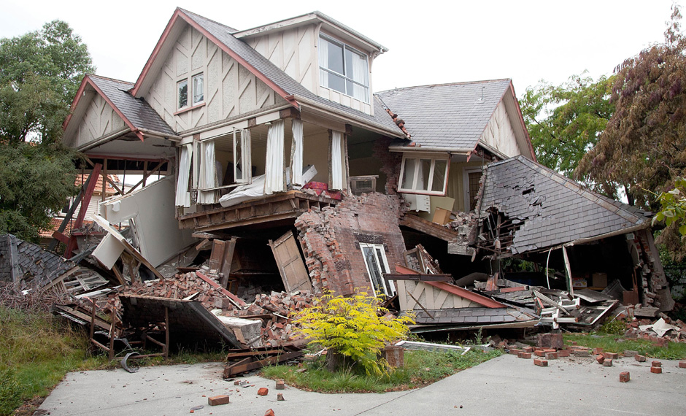
Thank you for your attention!
An earthquake happens somewhere in the world once every thirty seconds.
You may not notice a magnitude 2 quake.
You would feel the ground shake in a magnitude 3 quake.
A magnitude 7 or higher can destroy a city.
The largest recorded earthquake was a 9.5 quake in Chile in 1960.

