Slide 1
Audrey Hepburn

Slide 2
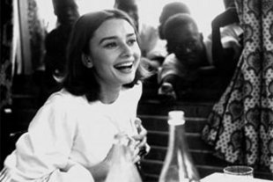
biography
Born on May 4, 1929.
Hometown is Brussels, Belgium.
Actress, Philanthropist.
She spent most of her younger years in England at a boarding School.
During World War II, she studied at the Arnhem Conservatory in The Netherlands.

Slide 3
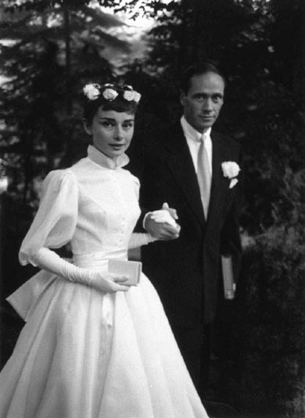
On Broadway
She went to New York and starred on the Broadway production of Gigi, at the age of 22.
Hepburn 2 years later went back to Broadway to star in Ondine with Mel Ferrer.
In 1954 she won a Tony Award for Best Actress in a play.
She ended up marrying Mel Ferrer on September 25, 1954.

Slide 4
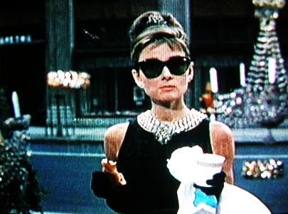
Breakfast at Tiffany’s
1961 romantic comedy.
Audrey portrayed of Holly Golightly.
Movie was released by Paramount Pictures.
The beginning of the movie the main place it takes place is at Tiffany Co. off 5th Avenue in New York City.
Audrey’s little black dress became famous and sold for over $947,000.
Audrey wore Ray Ban sunglasses.

Slide 5
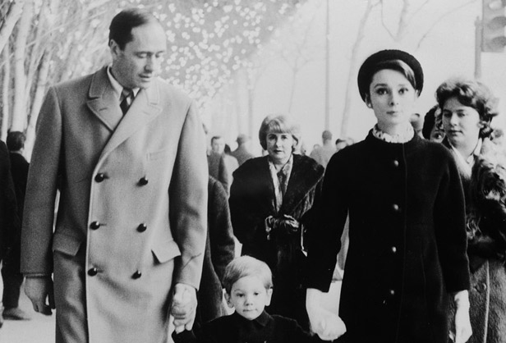
Audrey’s family
Before having their only son, Audrey had 2 miscarriages in March 1955 & 1959.
There only son was named Sean Hepburn Ferrer.
Sean was born July 17, 1960.
Mel was very controlling towards Audrey.
After a 14 year marriage they finally divorced December 5, 1968.
June 2008 Mel died of heart failure at age 90.

Slide 6
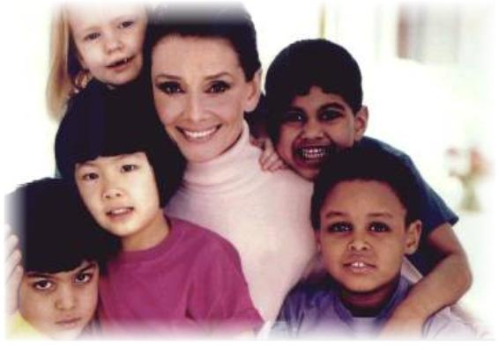
Raising Awareness
Audrey became a goodwill ambassador for UNICEF in the late 1980s.
She tried to raise awareness about children in need while traveling the world.
She won a special Academy Award for her humanitarian work in 1993.
She didn’t live long enough to receive her award.
Audrey died January 20, 1993.

Slide 7
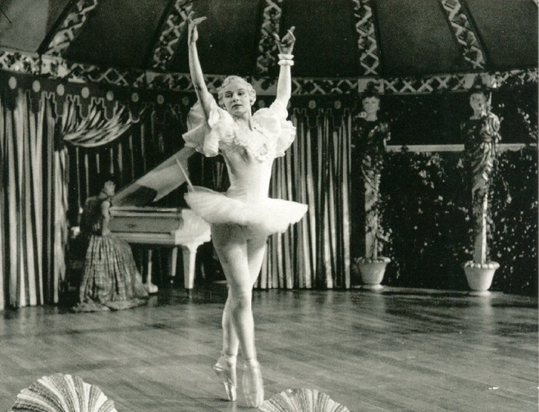
Dance
After World War II, she continued to pursue an interest in dance.
She studied ballet in Amsterdam and later on in London.
In 1948 Hepburn made her stage debut as a chorus girl in the musical High Button Shoes in London.
More small parts on the British stage followed.

Slide 8
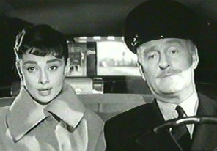
Film Star
Back on the big screen, Hepburn made another award worthy performance in Sabrina (1954).
In the movie Sabrina she was a daughter of a wealthy family’s driver.
Hepburn earned her Academy Award nomination for her work on this bittersweet romantic comedy.
Audrey co-starred in a movie with her husband Mel Ferrer.

Slide 9
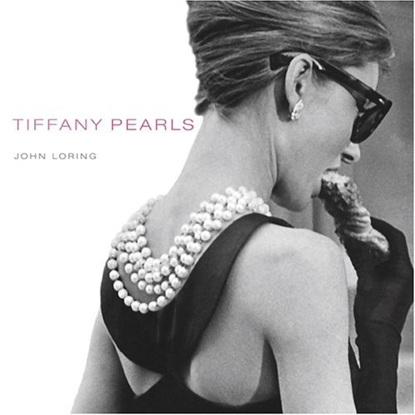
Fashion
Hepburn seen a fashion icon has still continued long since her death.
Her titles: Most beautiful woman of all time.
Givenchy gave her a look a silhouette.
Her signature look was a little black dress with her 2 earrings.
Even after 35 years, Audrey’s measurements had never changed.

