Slide 1
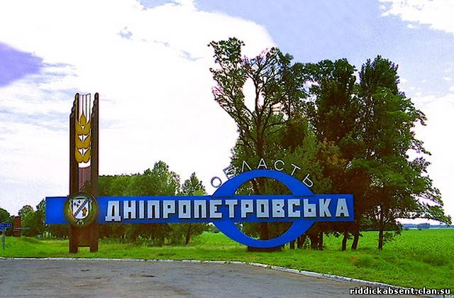
Dnipropetrovsk region

Slide 2
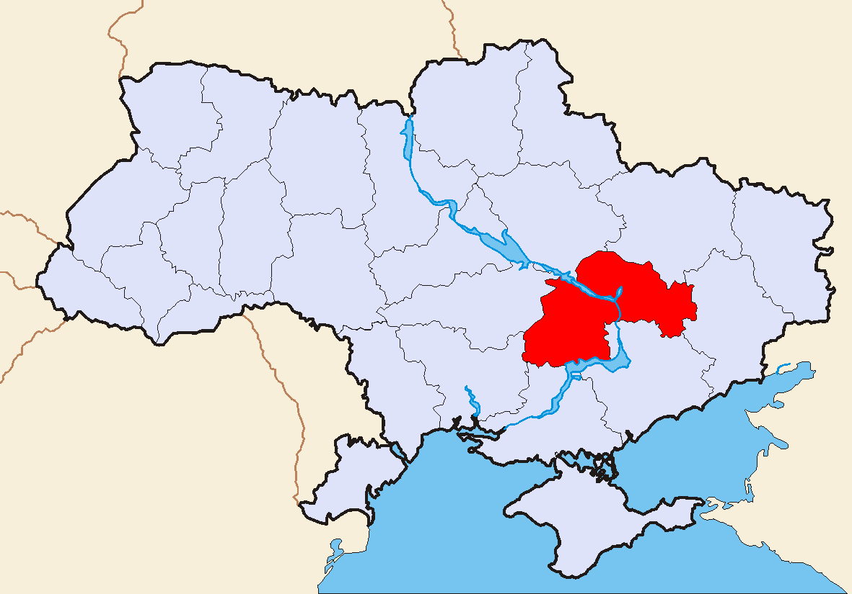
Dnipropetrovsk region is situated on the south-eastern Ukraine

Slide 3
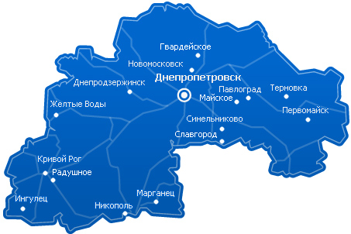
It consists of 22 small regions

Slide 4
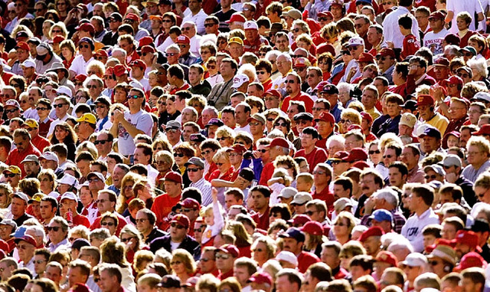
The largest city Dnepropetrovsk and Krivoy Rog. Population is 3567 thousand people

Slide 5
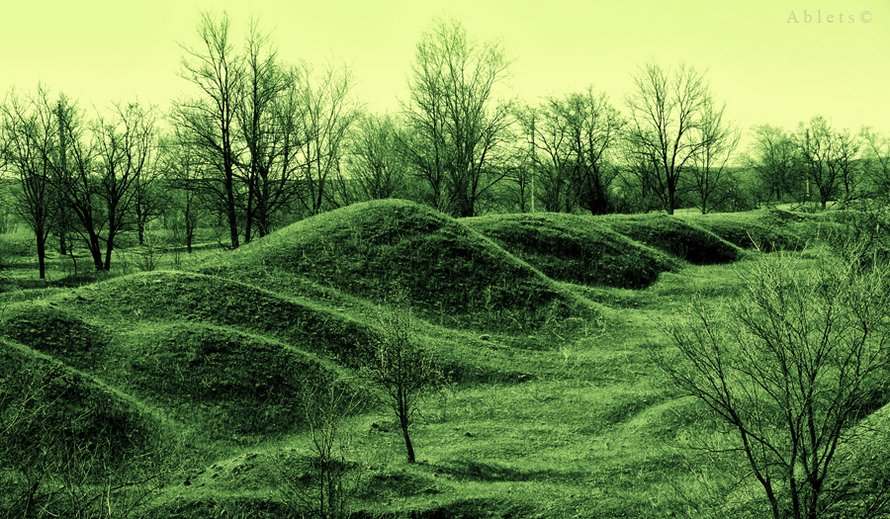
Relief is steppe

Slide 6
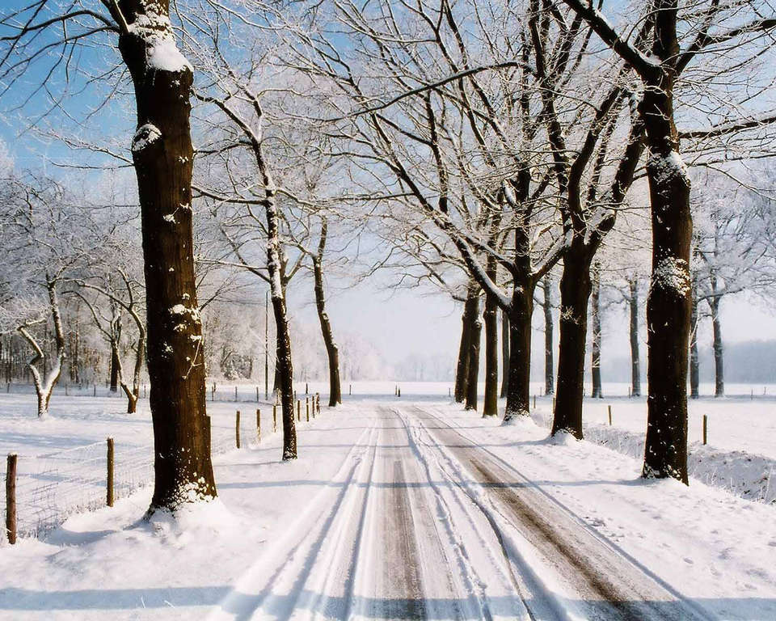
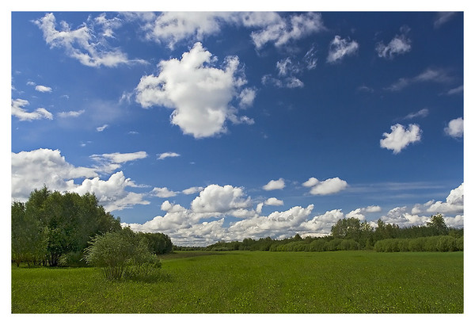
Climate - moderate. It is cold in winter, and it is hot in summer

Slide 7
In Dnipropetrovsk region growing plants such as feather grass, clover and alpine mountain, almonds steppe, birch, wild rose, blackthorn, oak, linden, elm, maple, alder, pine, elderberry, pear, ash, lime, hazel, field maple

Slide 8
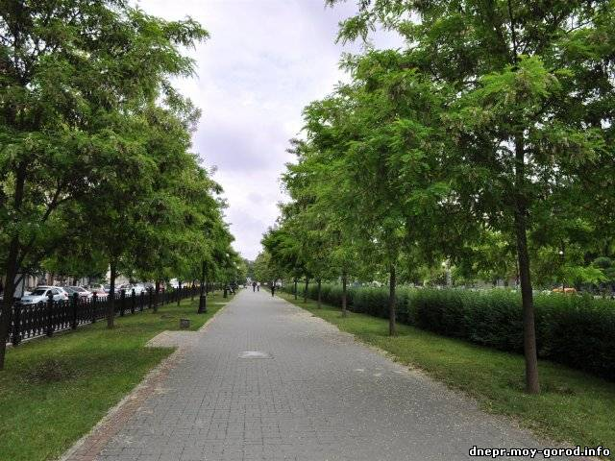
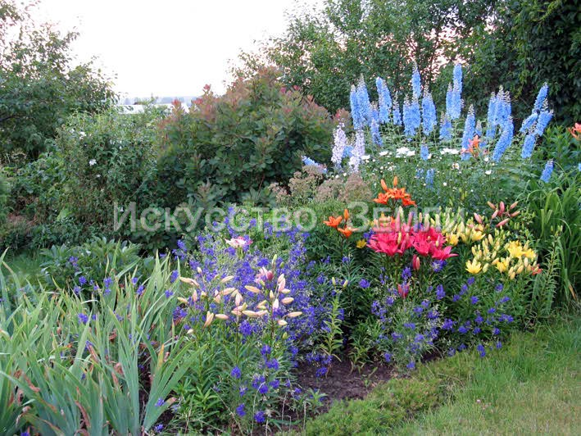
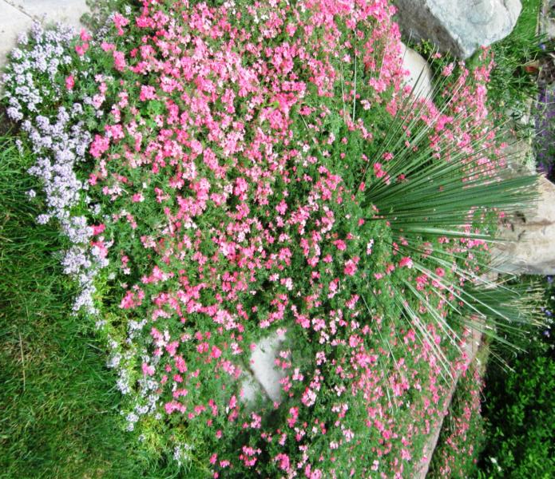
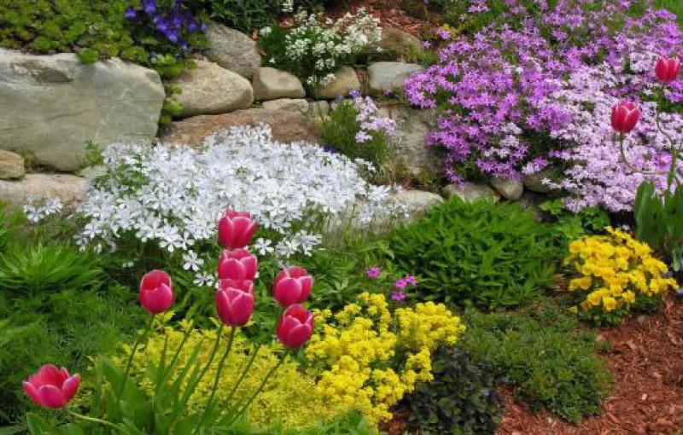

Slide 9
And live animals such as wolf, fox, marten and badger, squirrel, mole, hare, hawk, crane, lark, quail, the crow is gray, robin, sparrow, starling, wild ducks, sandpipers, herons, prairie snake, lizards, green toad, bream, pike, perch, deer

Slide 10
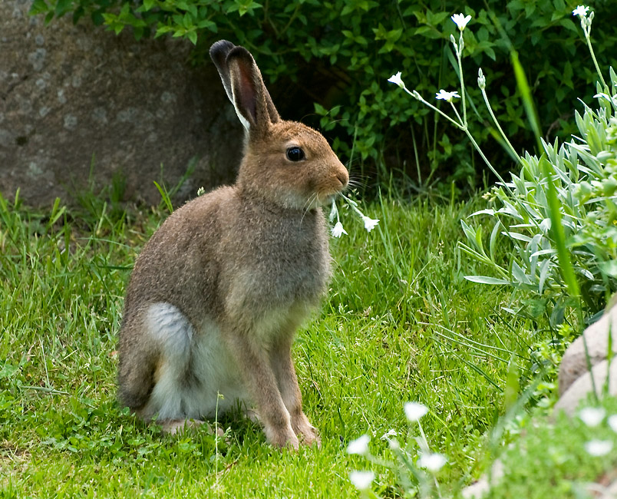
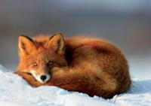
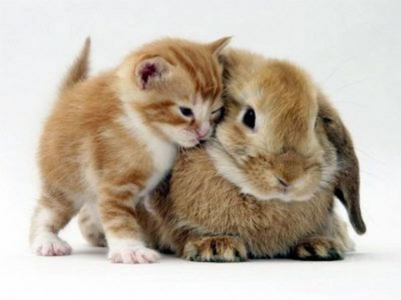
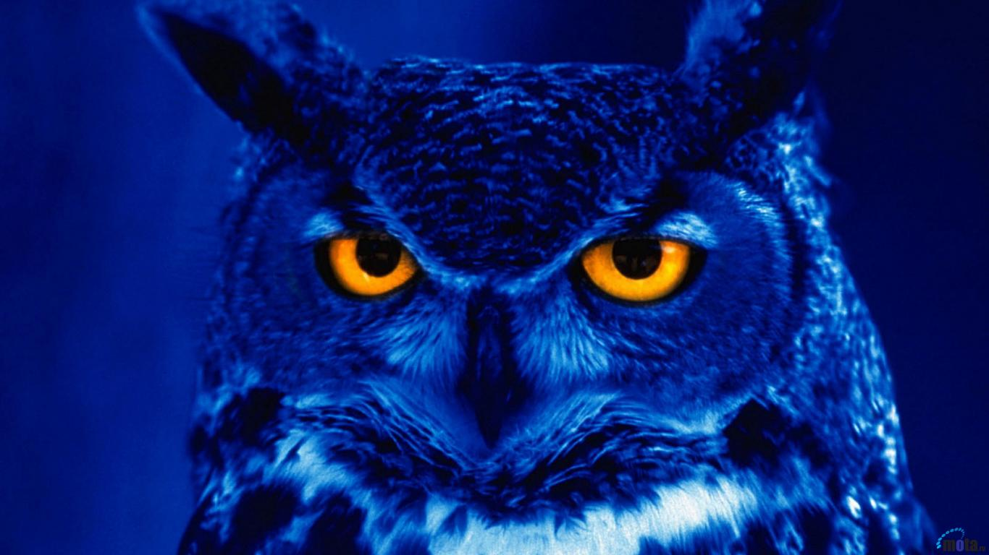

Slide 11
Dnepropetrovsk region is rich in various minerals: including iron ore, titanium and uranium ore, bauxite, nickel, cobalt, manganese ore, clay, iron, steel, brown coal and oil

Slide 12
That's it! Thank you for your attention!

