Slide 1
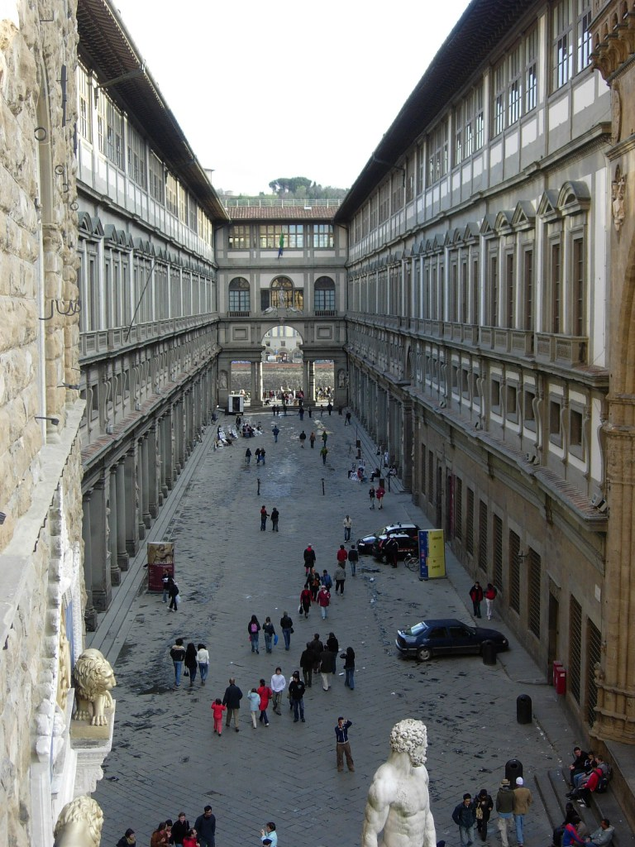
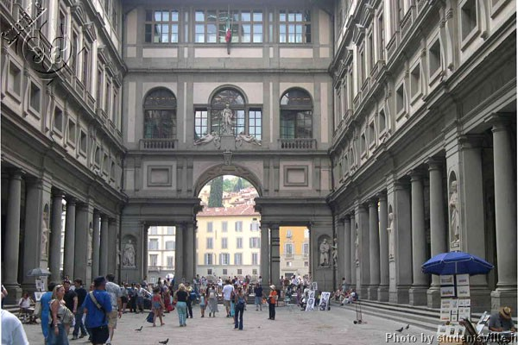
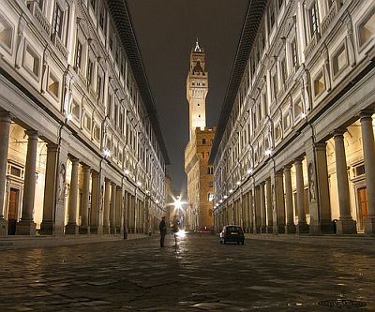
The Uffizi

Slide 2
The Uffizi Gallery is a museum in Florence, Italy.

Slide 3
The Uffizi Gallery, in the historical centre of Florence, houses what is one of the world’s greatest collections of Renaissance art.

Slide 4
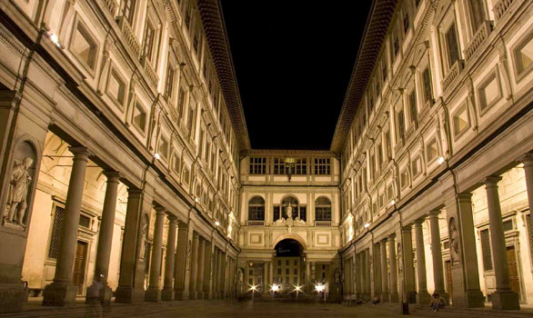
The Uffizi is one of the oldest museums in the world, the building was begun in 1560 for Cosimo Medici as an office building for the city of Florence but now holds one of the most amazing collections of Renaissance art in the world.

Slide 5
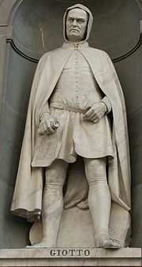
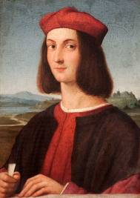
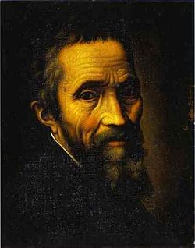
All of the famous names from Italy's rich artistic heritage, including Leonardo da Vinci, Giotto, Michelangelo, Botticelli, Piero della Francesca, Caravaggio, and Raphael, are represented at the Uffizi, making this a must-visit museum for all travelers, especially art lovers.

Slide 6
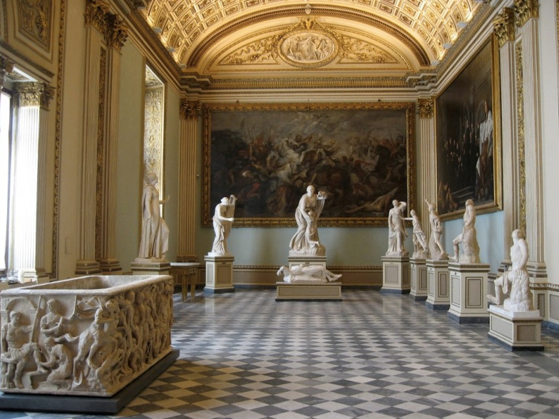
The museum is made up of forty-five rooms that group the paintings and artworks in chronological order.

Slide 7
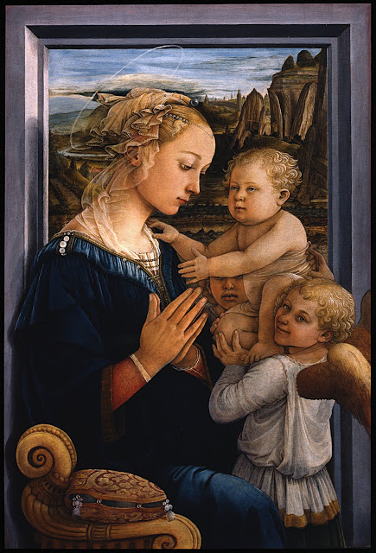
The museum primarily has Renaissance and Primitive paintings spanning the fourteenth to the eighteenth century.

Slide 8
The collection picture is so large that some of it has been relocated to other museums in Florence.

Slide 9
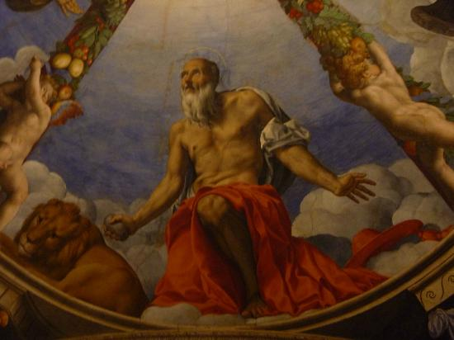
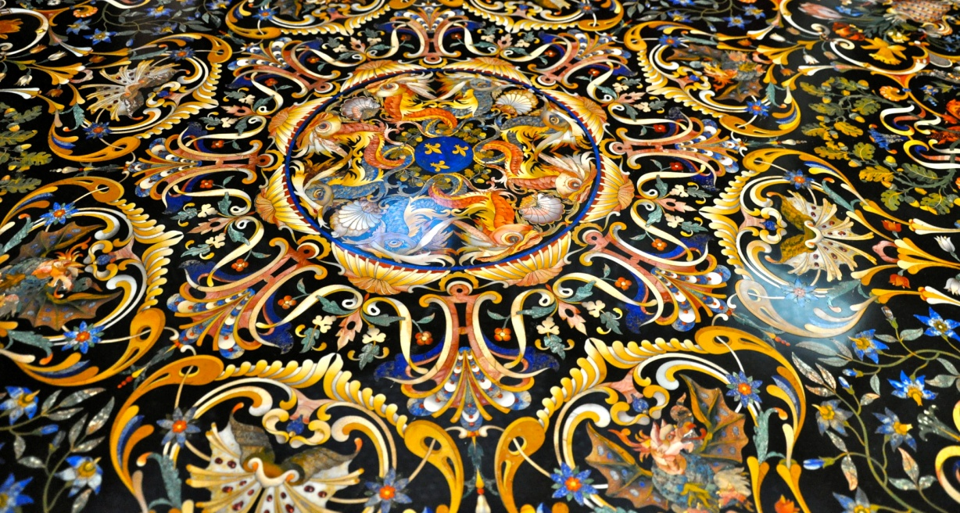

Slide 10
