Slide 1
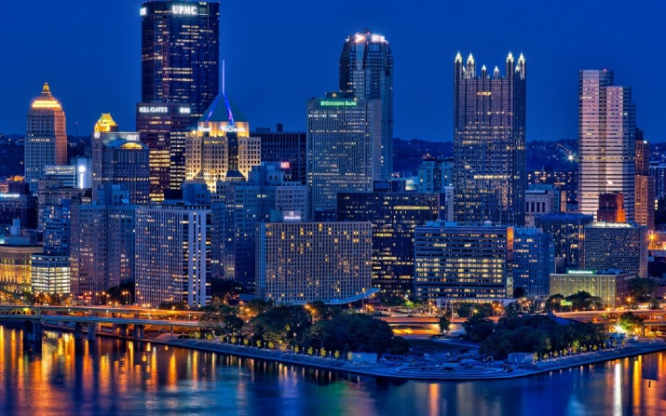
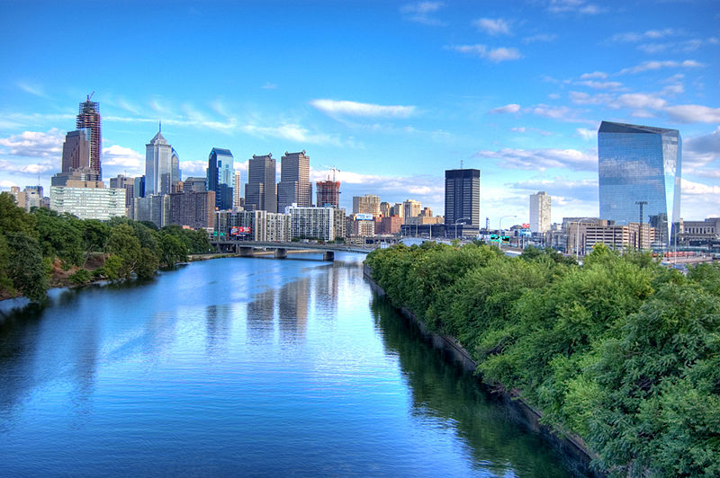
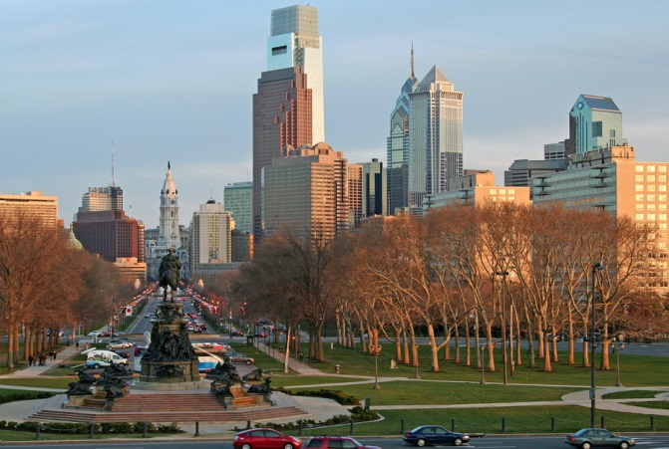
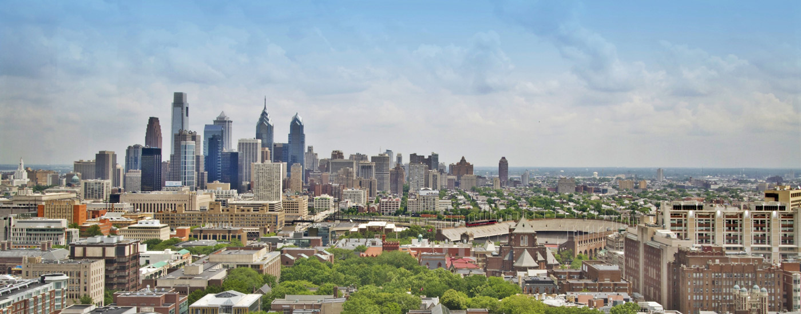
Pennsylvania

Slide 2
Pennsylvania is the 33rd most extensive, the 6th most populous, and the 9th most densely populated of the 50 United States. The state's four most populous cities are Philadelphia, Pittsburgh, Allentown, and Erie.

Slide 3
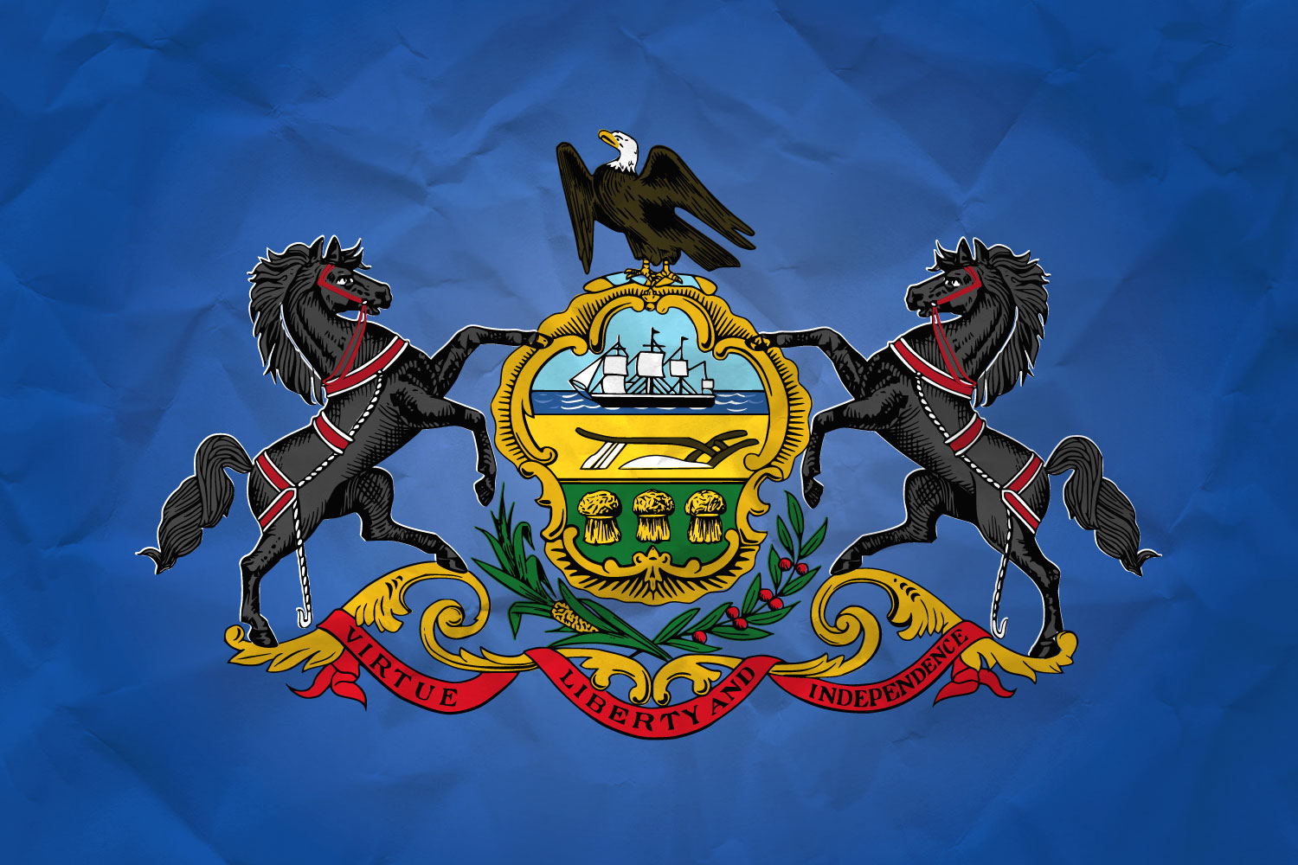
Pennsylvania's State Flag is composed of a blue field on which is embroidered the State Coat of Arms. The first State Flag bearing the State Coat of Arms was authorized by the General Assembly in 1799.

Slide 4
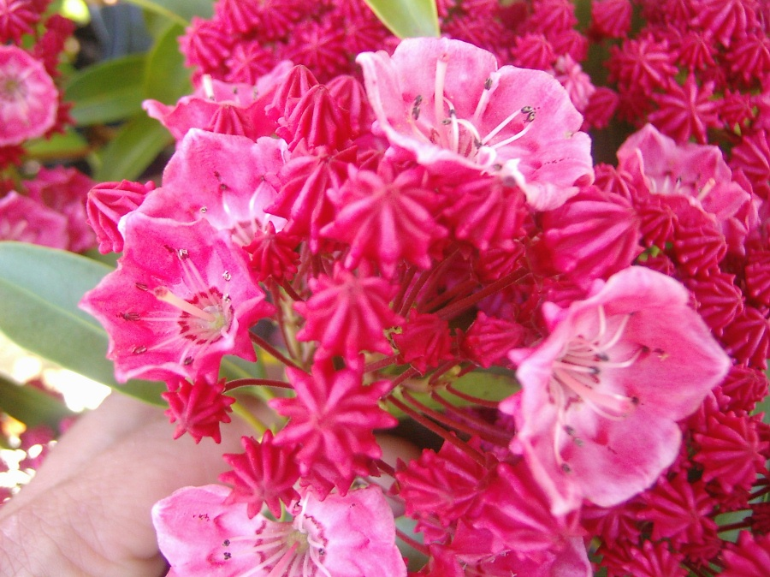
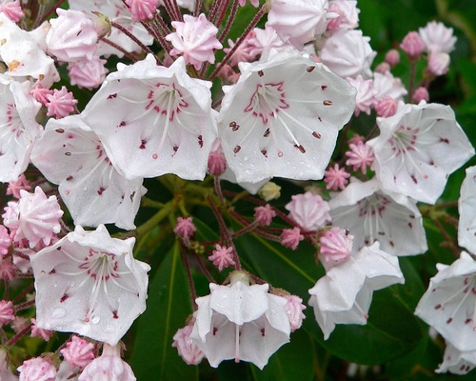
The State Flower is the Mountain Laurel, as enacted by the General Assembly on May 5, 1933.
The mountain laurel is in full bloom in mid-June, when Pennsylvania's woodlands are filled with its distinctive pink flower.

Slide 5
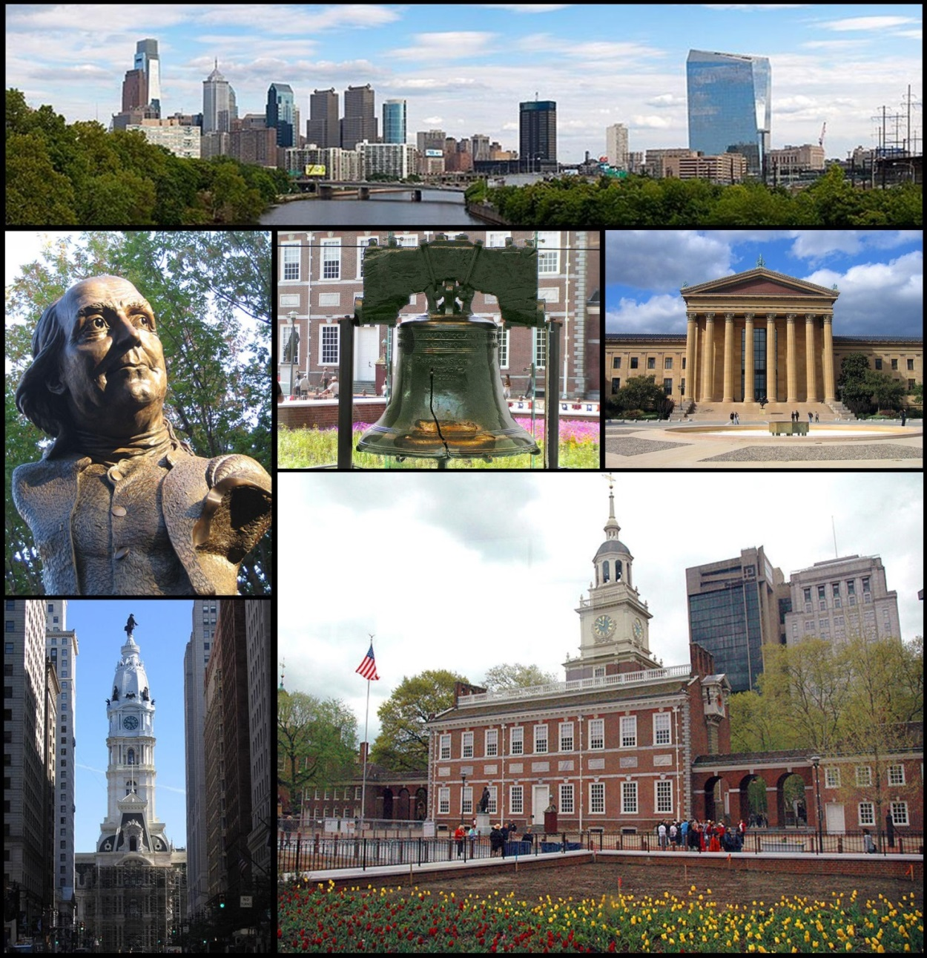
Philadelphia is the largest city in the Commonwealth of Pennsylvania

