Slide 1
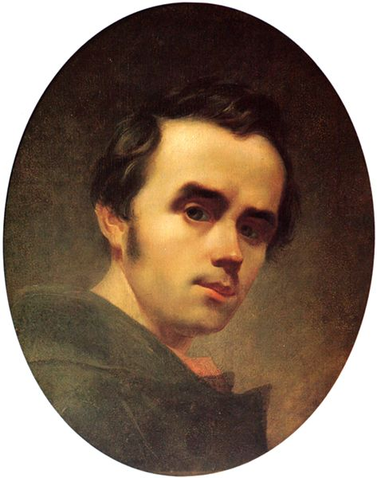
Taras Shevchenko

Slide 2
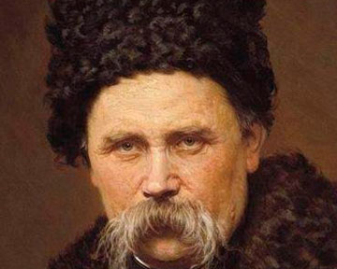
Taras Hryhorovych was a Ukrainian poet and artist. He is also known under the name Kobzar after his most famous literary work, a collection of poems entitled Kobzar. Shevchenko is also known for many masterpieces as a painter and an illustrator.

Slide 3
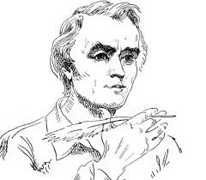
Shevchenko was accepted as a student into the Academy of Arts in the workshop of Karl Briullov. He became a resident student at the Association for the Encouragement of Artists. At the annual examinations at the Imperial Academy of Arts, Shevchenko was given a Silver Medal for a landscape.
He began writing poetry while he was a serf. In 1840 his first collection of poetry, Kobzar, was published.

Slide 4
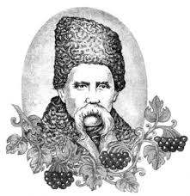
On March 22, 1845, the Council of the Academy of Arts granted Shevchenko the title of an artist. He again travelled to Ukraine
Shevchenko was imprisoned in Saint Petersburg. He was exiled as a private with the Russian military Orenburg garrison at Orsk, near the Ural Mountains.

Slide 5
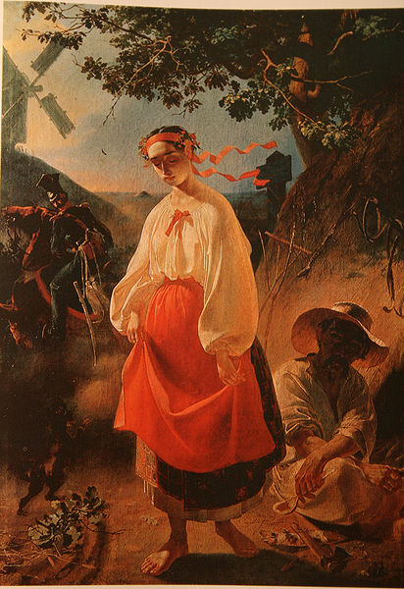
Kateryna (1842, Oil, Taras Shevchenko National Museum

Slide 6
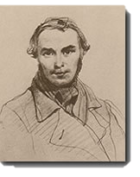
Self-portrait, 1845

Slide 7
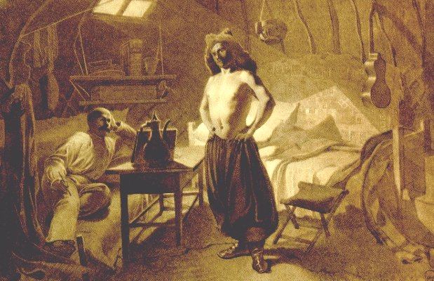
Shevchenko painting a friend. Raim.

Slide 8
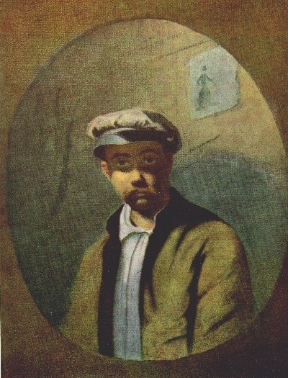
In a White Cap. Another copy.

Slide 9
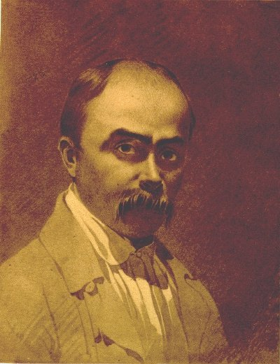
A gift to Iakiv Kukkharenko.

