Slide 1
Lviv National
Art Gallery

Slide 2
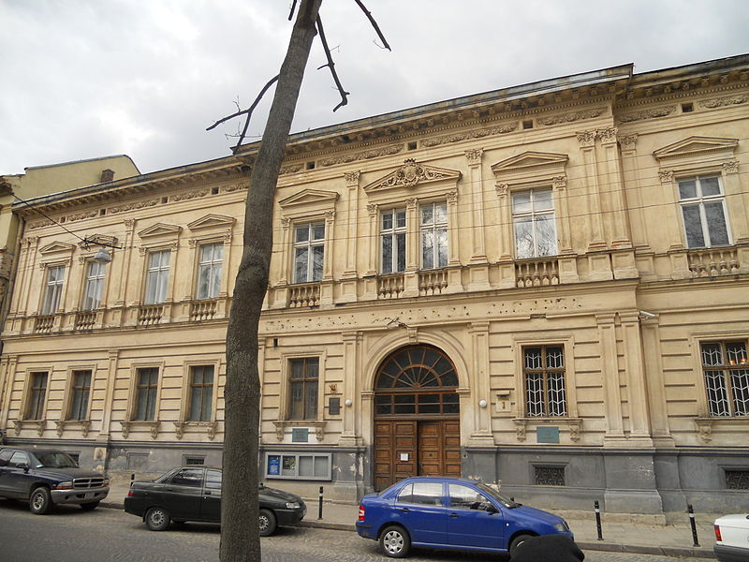
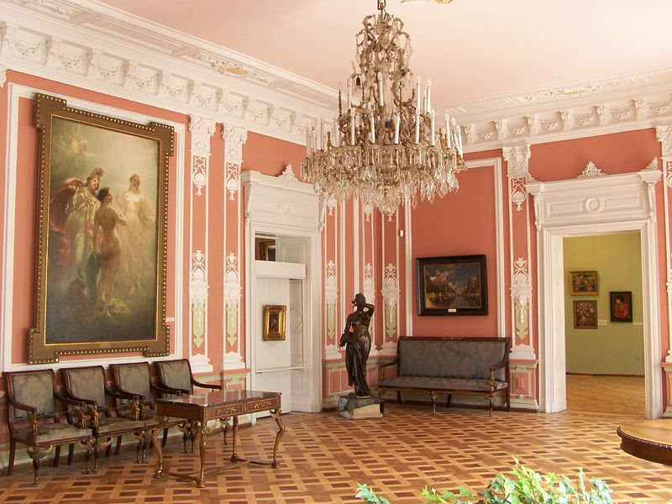
Lviv National Art Gallery , a leading art museum in Ukraine, has over 60,000 artworks in its collection, including works of Polish, Italian, French, German, Dutch and Flemish, Spanish, Austrian and other European artists.

Slide 3
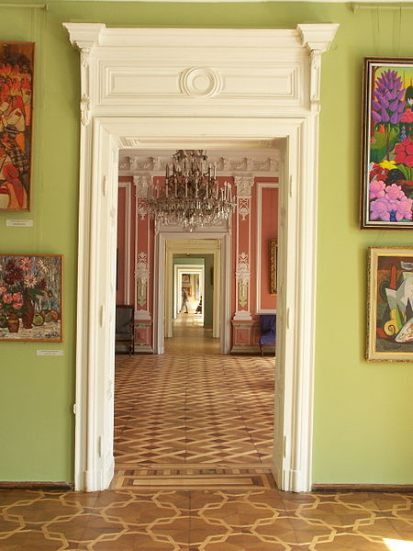
The gallery is based on a Polish institution,Lwowska Galeria Sztuki, which was founded in 1907 as a municipal museum, following the purchase of the collection of Jan Jakowicz by the city magistrate.

Slide 4
In 1940, after the city of Lviv/Lwów had been occupied by the Soviet Union, Soviet government ordered nationalization of private property. As a result, works from theLubomirski family museum, the Baworowscy Library, and some other private collections came into the possession of the gallery. All these works had until the 1939 Invasion of Poland belonged either to the Polish state, or to Polish private collectors, as well as Roman - Catholic church.
Ivan Shishkin At the edge of a pine forest

Slide 5
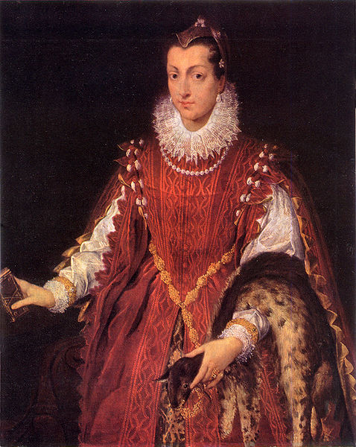
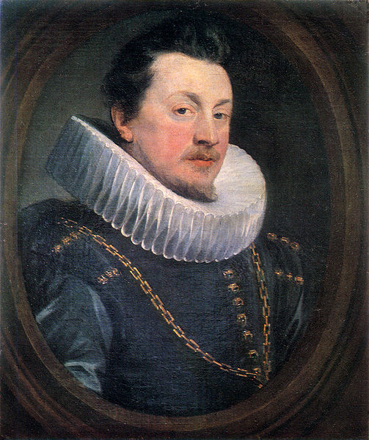
Sofonisba Anguissola. Portrait of a young patrician Peter Paul Rubens. Man Portrait

Slide 6
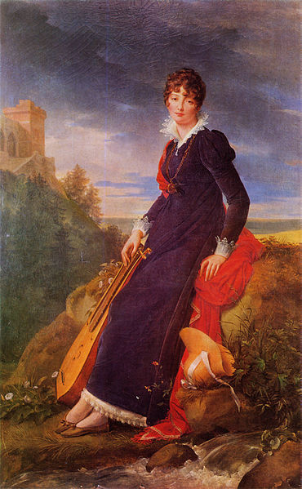
Francois Gerard - Portrait of Catherine Starzeńska

Slide 7
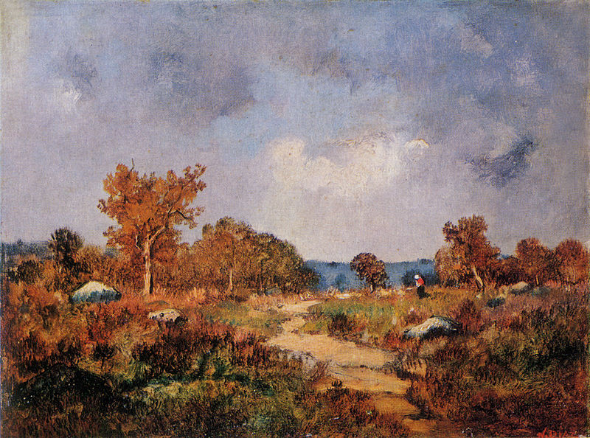
Narcisse Virgile Diaz de la Pena Autumn Landscape

Slide 8
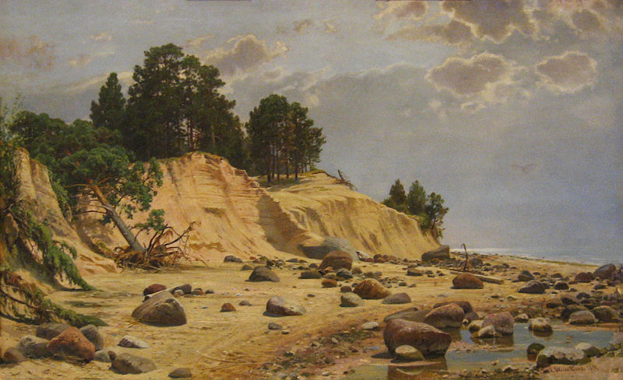
Ivan Shishkin After the storm in Mary-Howie 1891

Slide 9
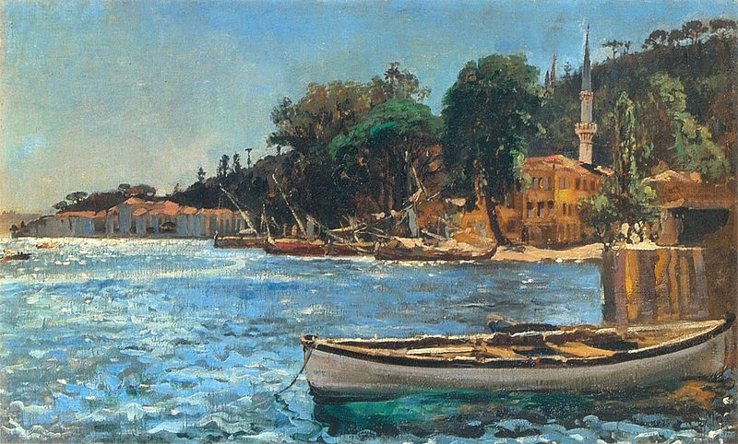
Jan Matejko, "Bebek near Constantinople"

