Slide 1
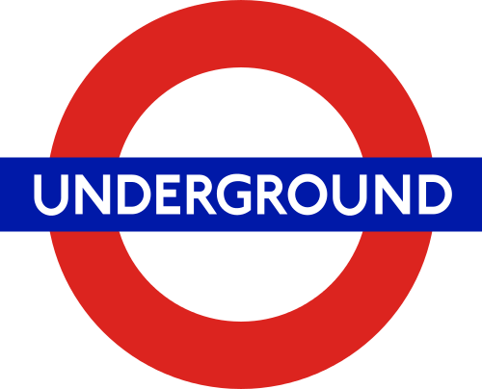
prepared by Denys Bielskyi

Slide 2
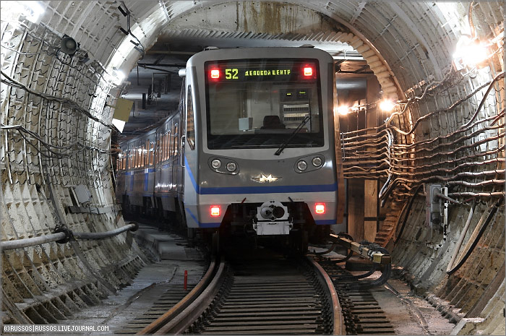
Subway
An underground rapid transit rail system

Slide 3
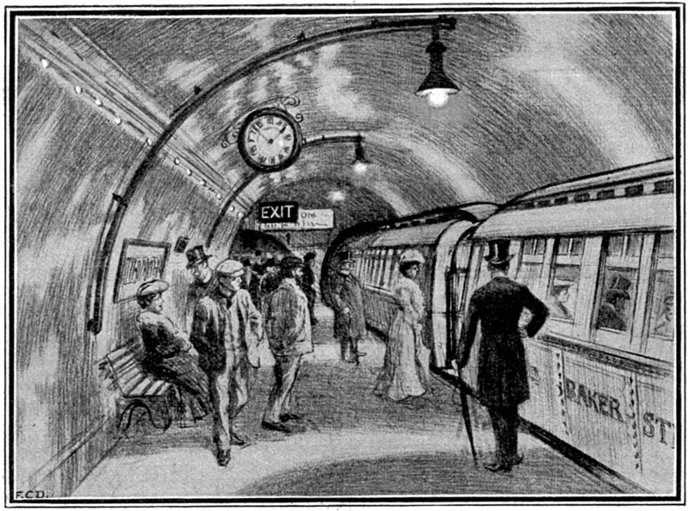
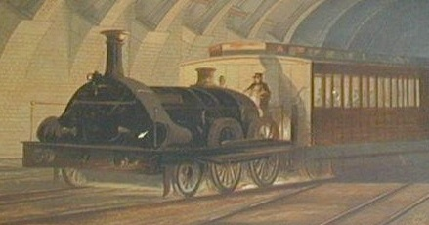
History OF The name "Metropoliten"
The name "Metropoliten" adopted in many countries. Derived from the name of the company «metropolitan Railway», which built the first underground road in London in 1863

Slide 4
The smallest underground
Metro is the smallest in Haifa. Line length two kilometers and it has six stations.

Slide 5
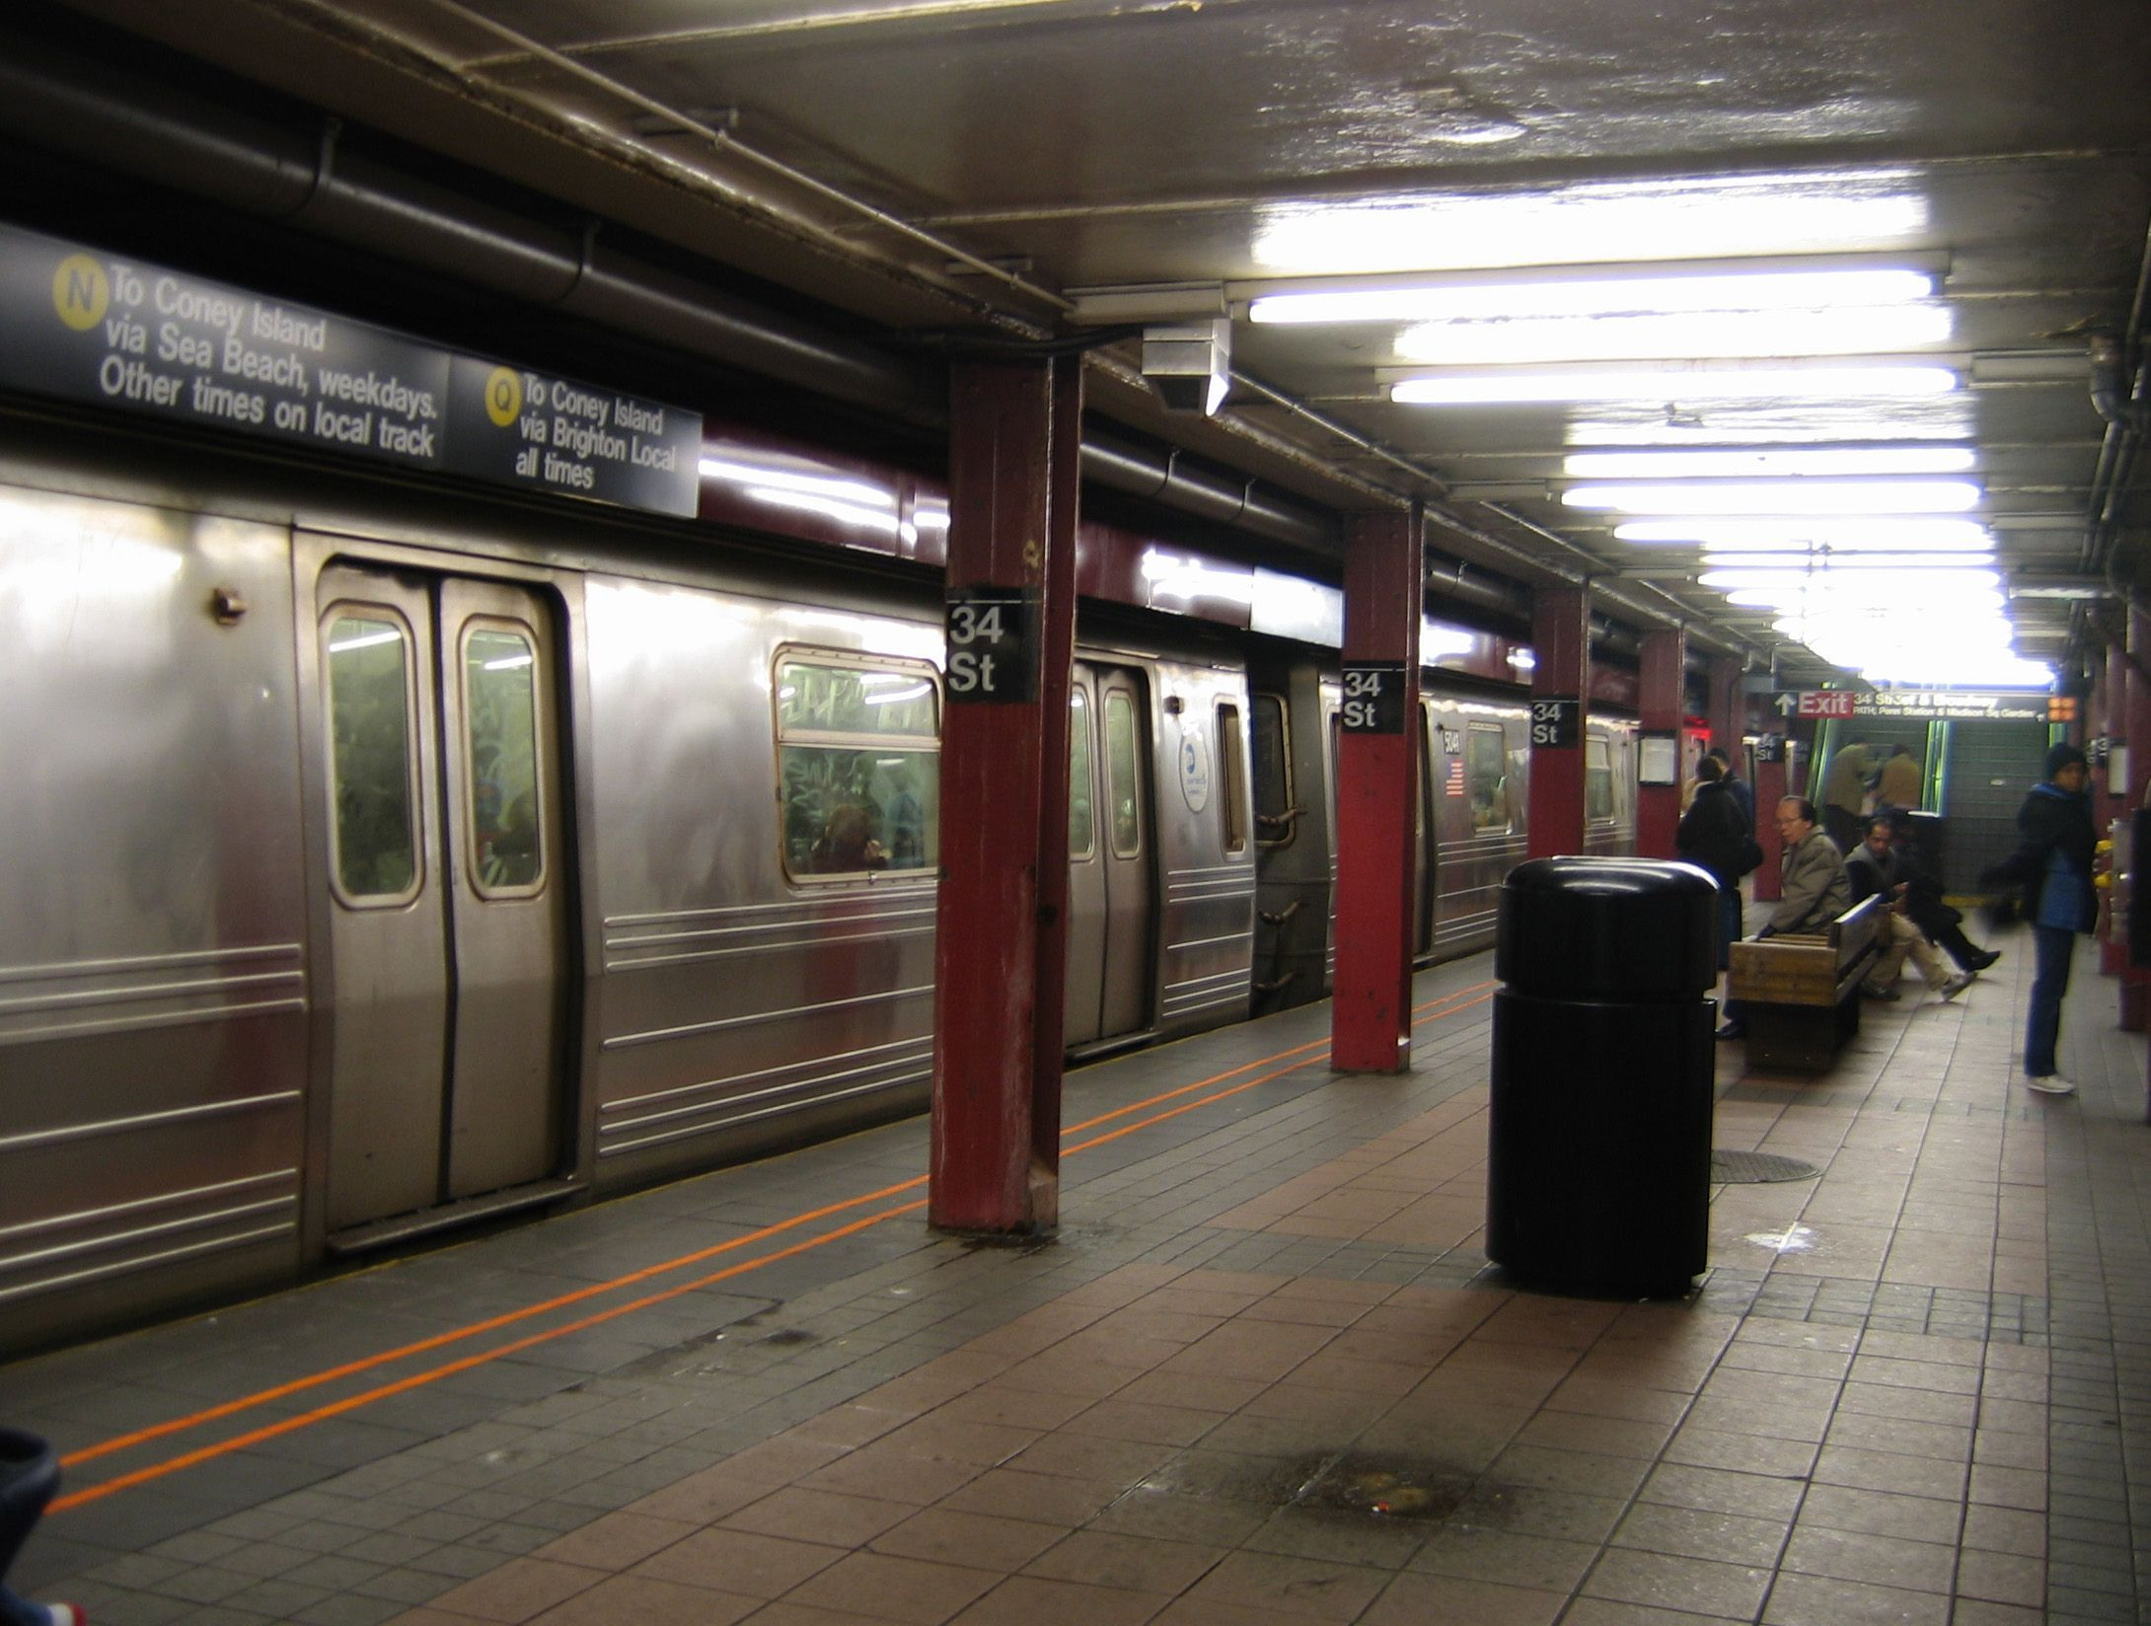
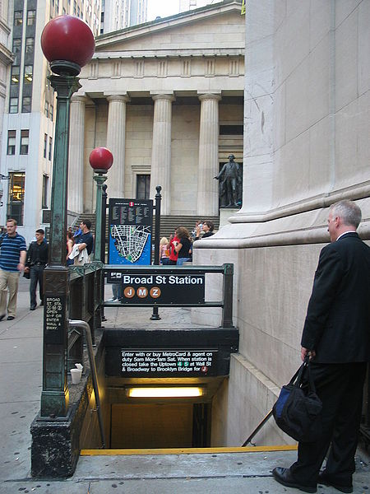
The biggest Subway
The total length of subway tracks in New York is 1355 kilometers.It is greater than the distance between the Luhansk and Lviv.

Slide 6
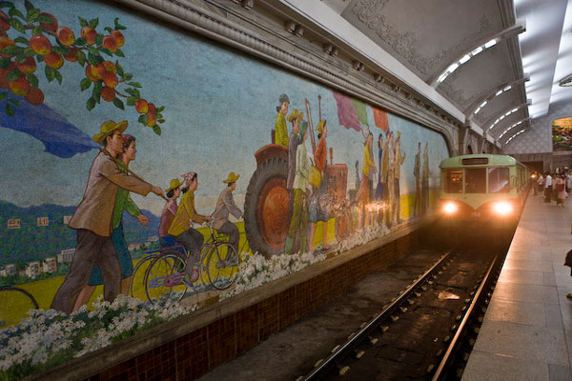
the cheapest
Fare in Pyongyang Metro is 3 cents

Slide 7
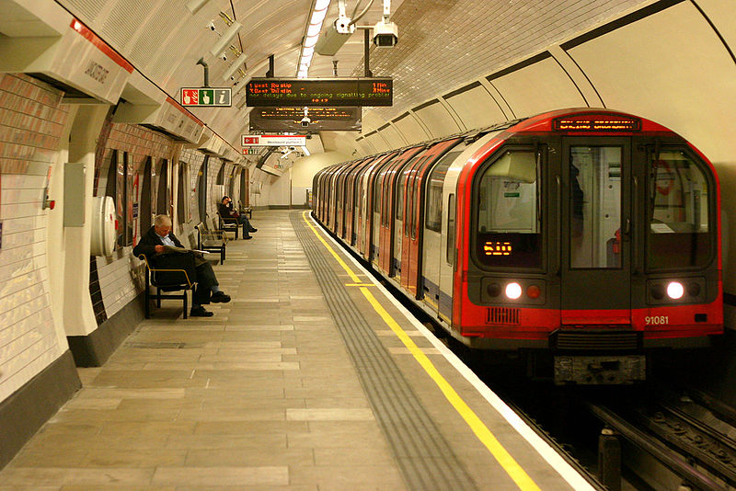
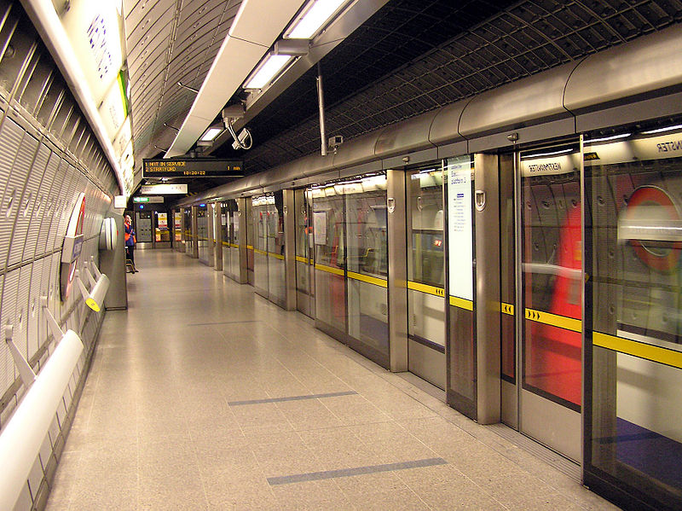
the most expensive
Average fare in London underground is 3.5 pounds

Slide 8
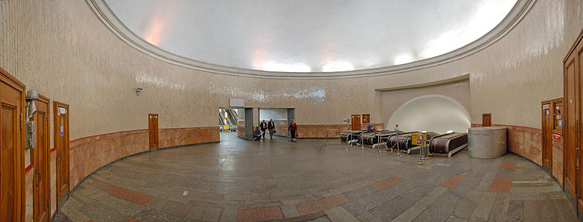
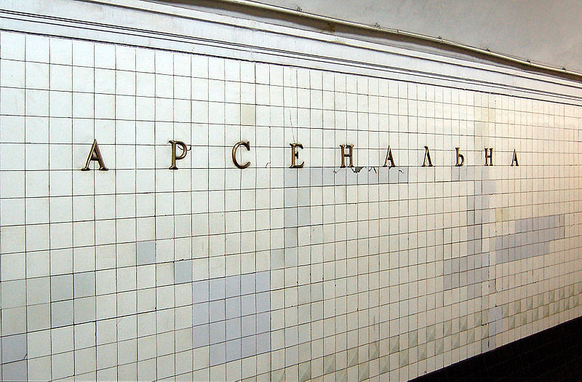
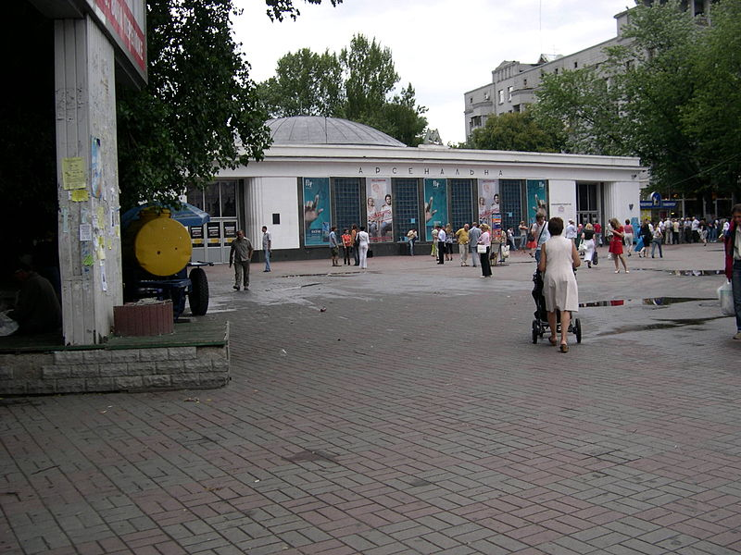
The deepest station
Arsenalna is a station on Kiev Metro's Sviatoshynsko-Brovarska Line. This is the deepest station in the world. Located at a depth 105.5 metres.

Slide 9
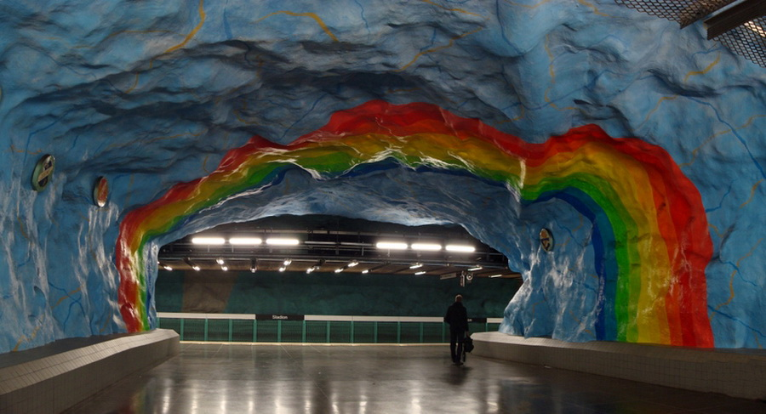
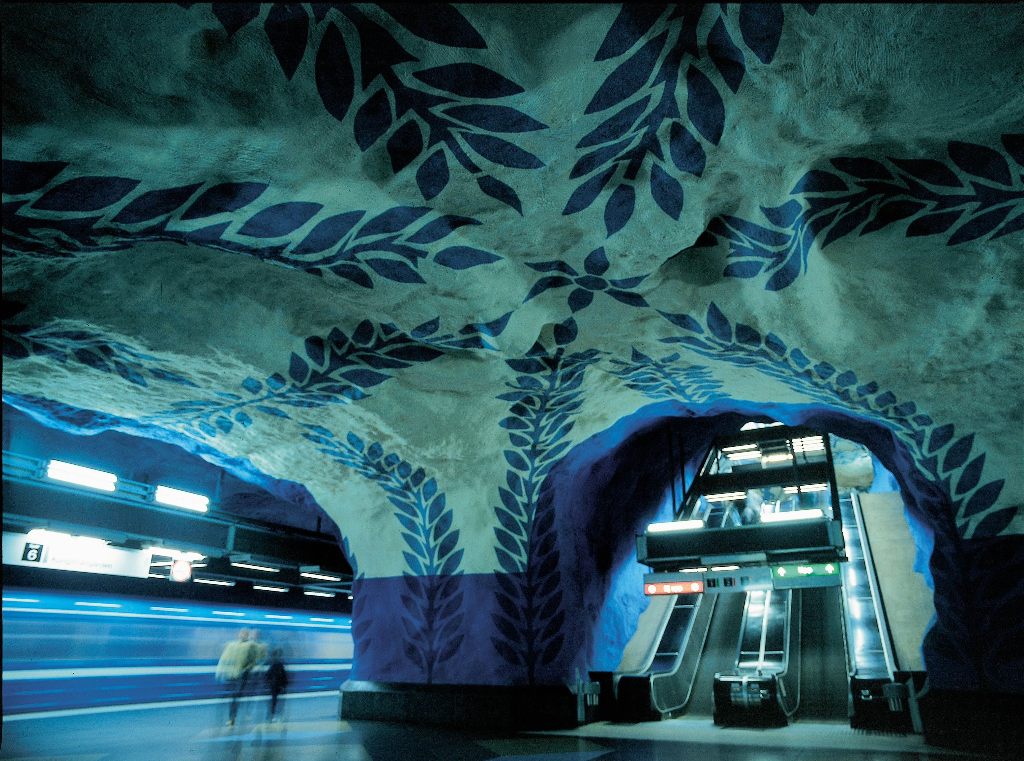
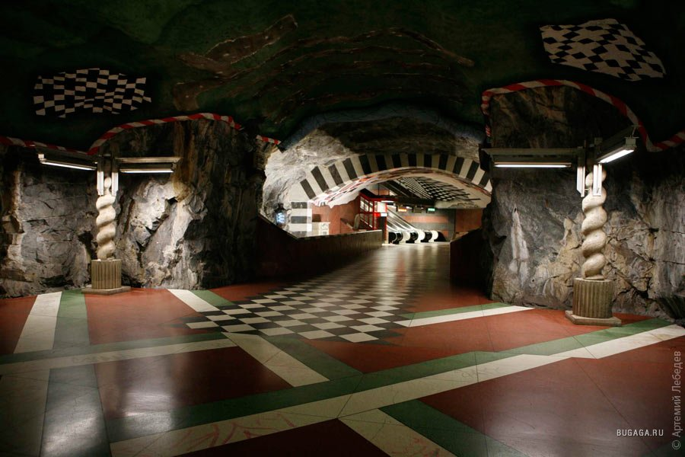
The most beautiful subway
The most beautiful metro is located in Stockholm

Slide 10
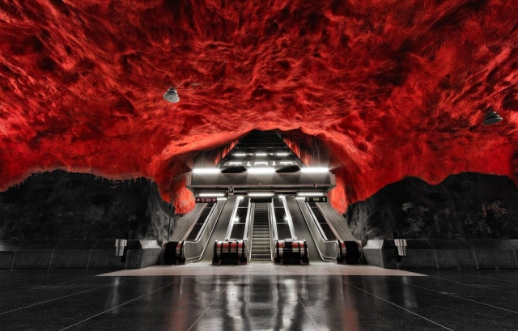
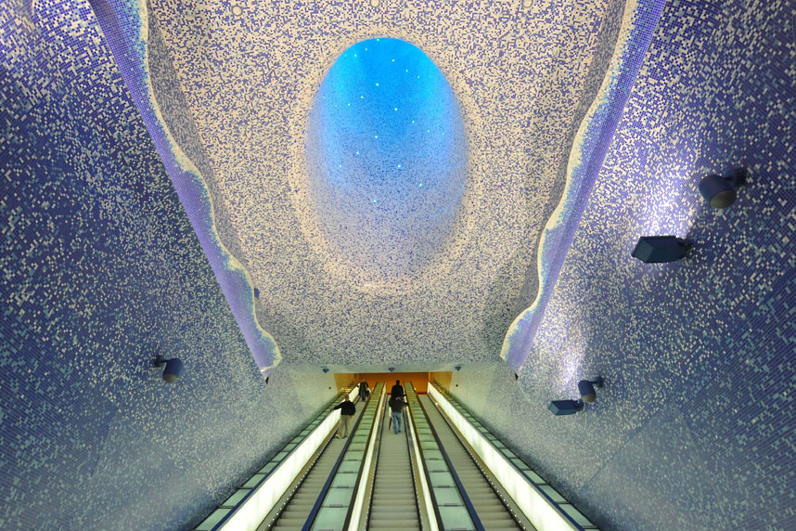
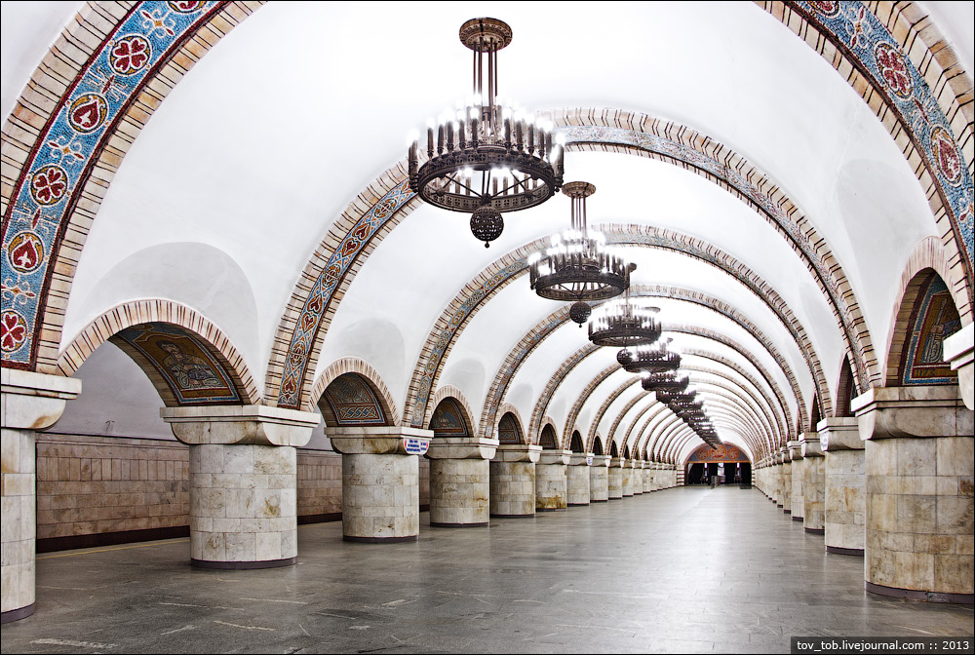
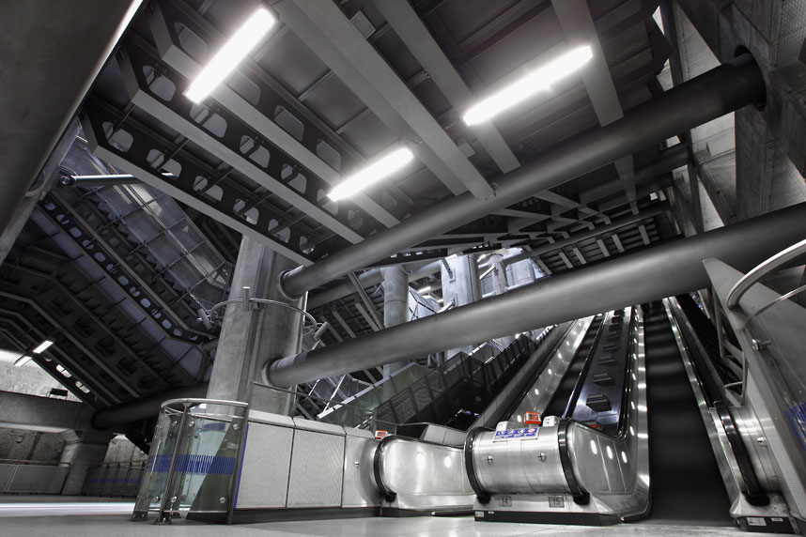
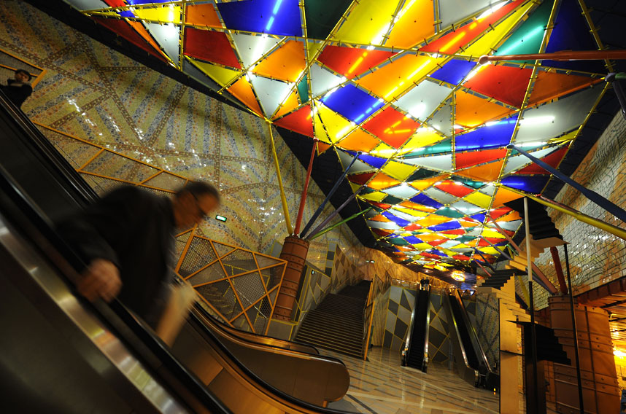
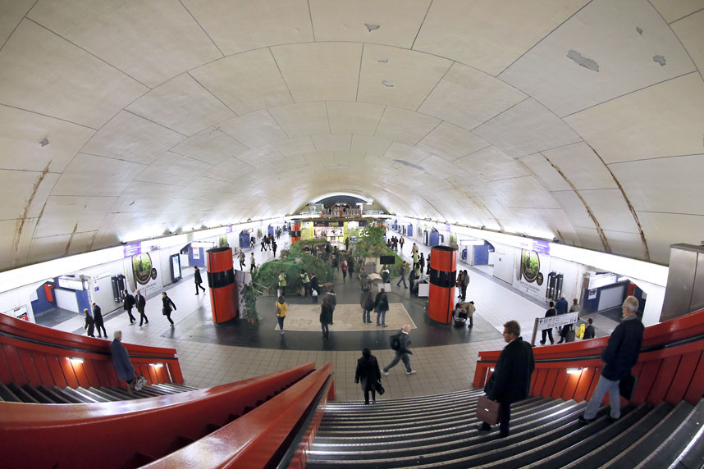
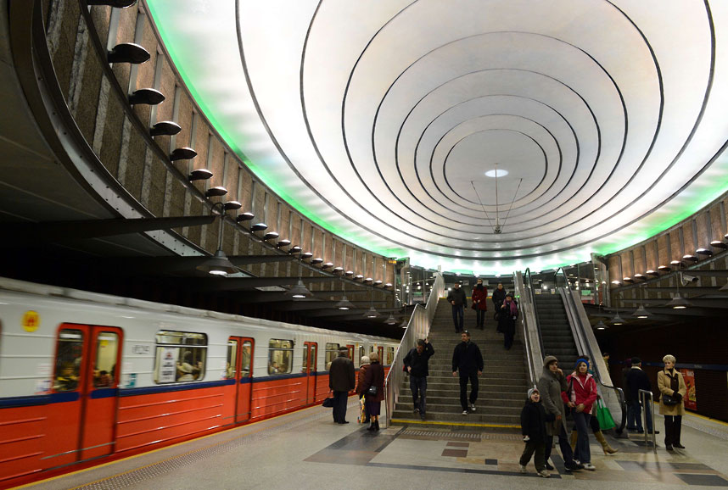
Ten of the most beautiful metro stations

