Slide 1
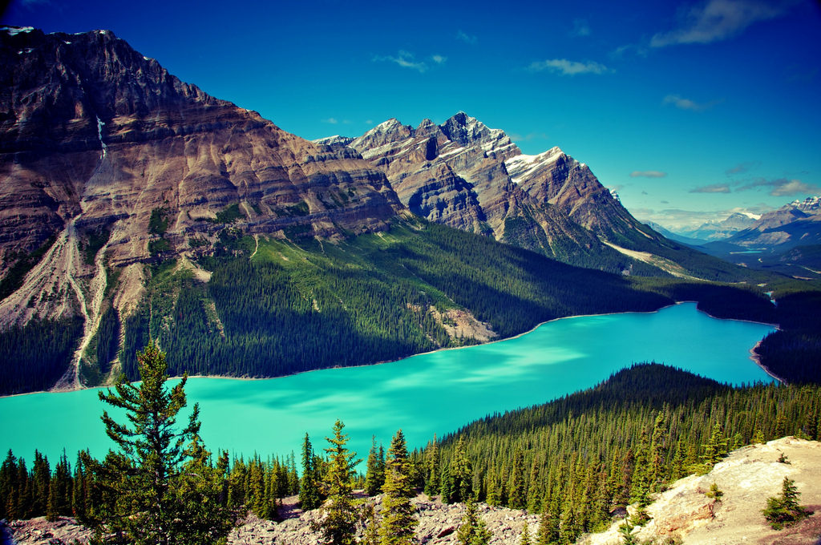
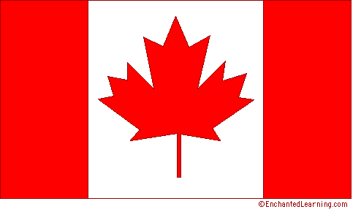
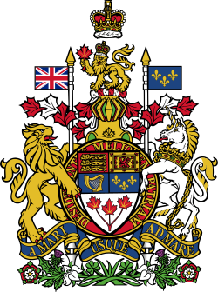
Sights of Canada
In this collection you wait for beautiful places to visit in Canada. It is the second largest country in the world with a vast multitude of natural wonders, therefore, any attempt to build them in ascending or descending order in advance is meaningless. Here you can find the most famous sights of Canada, known for its pristine nature and pure beauty.

Slide 2
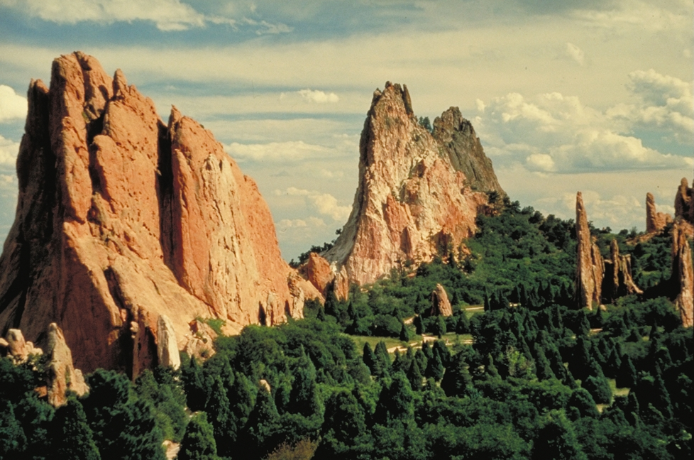
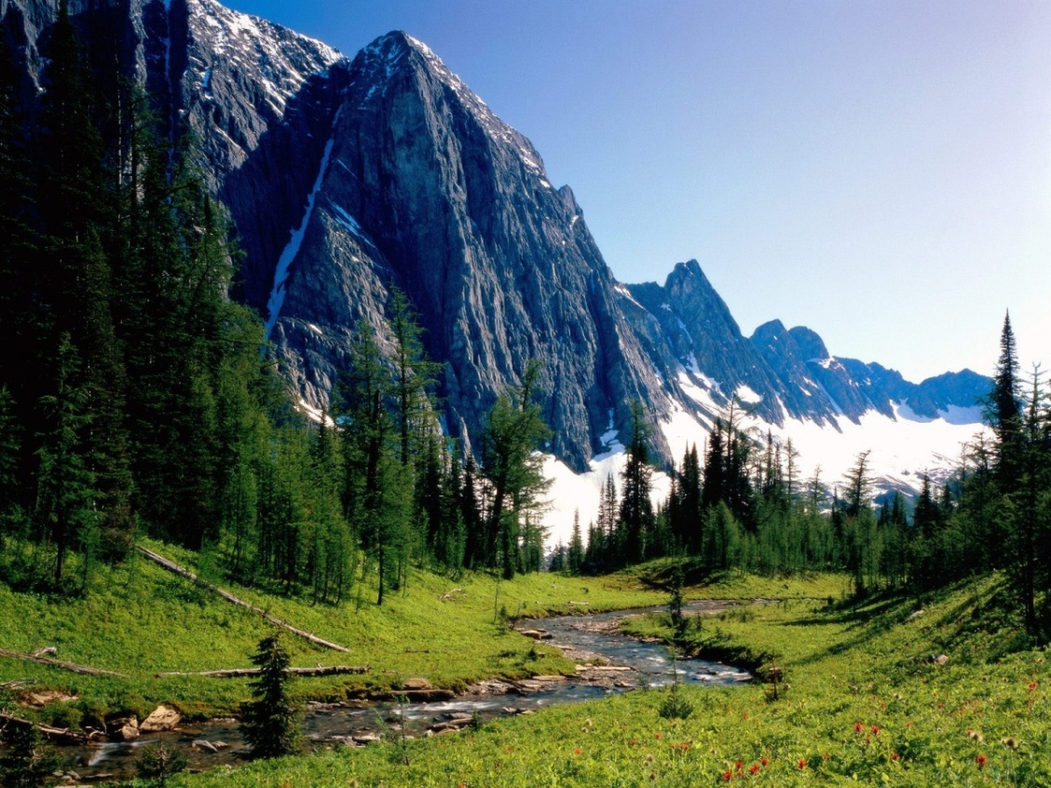
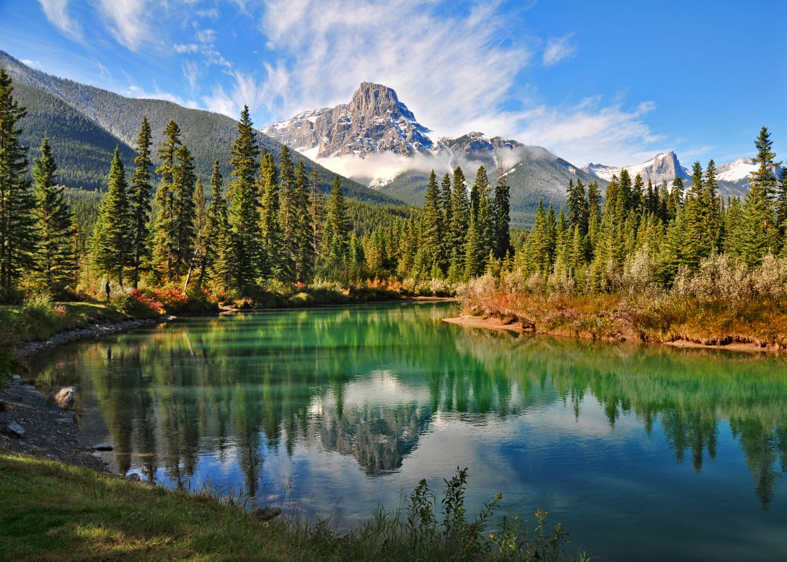
Rocky Mountains of Canada
While all of the Rocky Mountains extending as op the United States when it comes to stunning scenery, the northern neighbor taught all his trumps . This includes hiking in summer and skiing in winter. Including 5 national parks ( Banff, Ice , Jasper , Yoho and Kotenau ), this area should be on the top of any list and ranking. Express The Rocky Mountaineer - ideal trip for many honeymooners , with its glassed cars, opening the magnificent views of the glaciers, high peaks mountains, waterfalls , canyons and lakes. Among the natural attractions of Canada these mountains and national parks stand out most clearly.

Slide 3
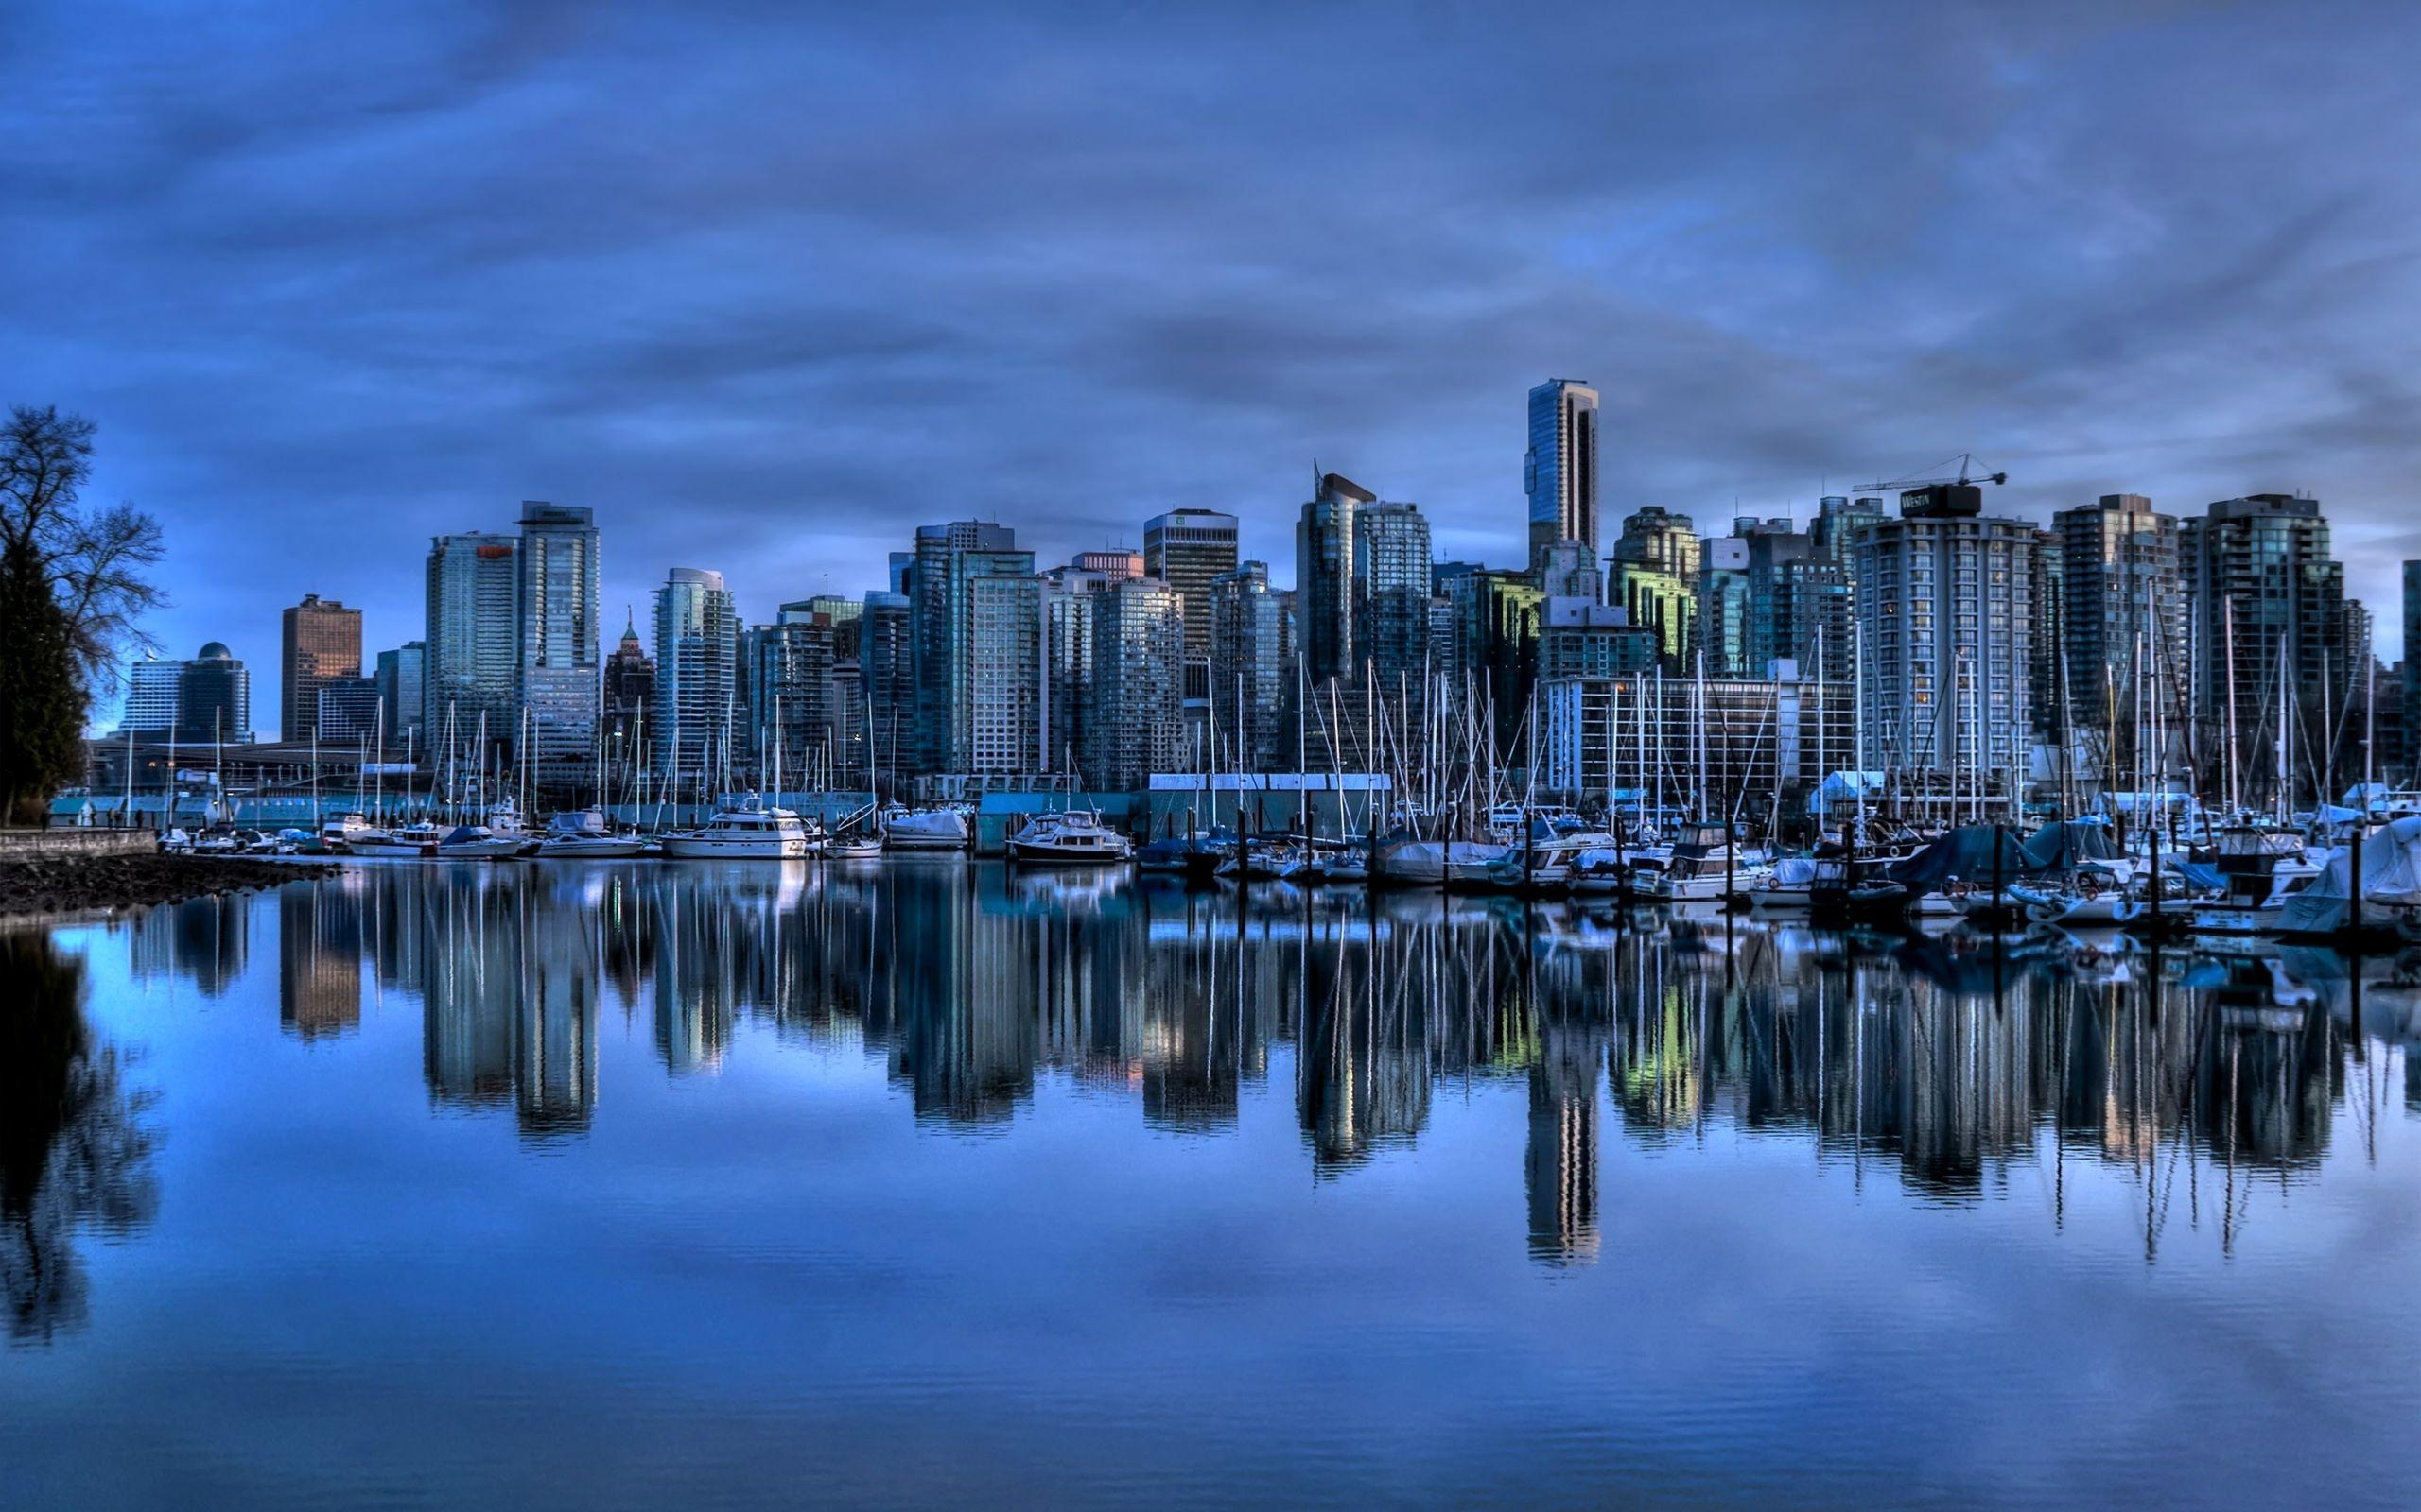
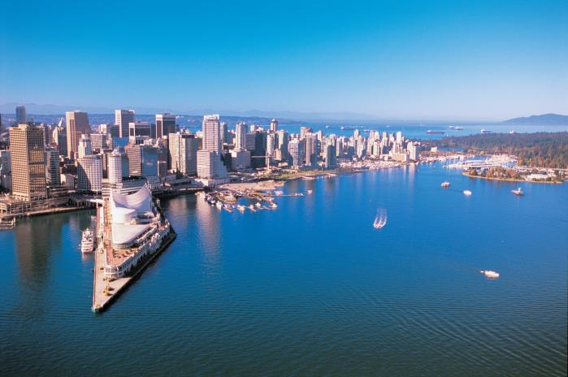
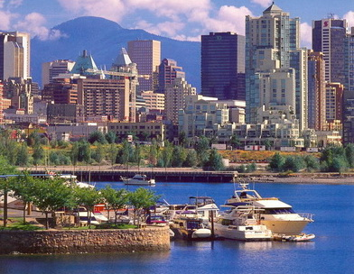
Vancouver Island and Johnstone Strait
Surfers like wild strong waves of the local coastline. With the nickname "graveyard of the Pacific" to the west coast of Canada should be treated with caution. Come here and animal lovers to see dolphins, killer whales in the waters of Johnstone Strait.

Slide 4
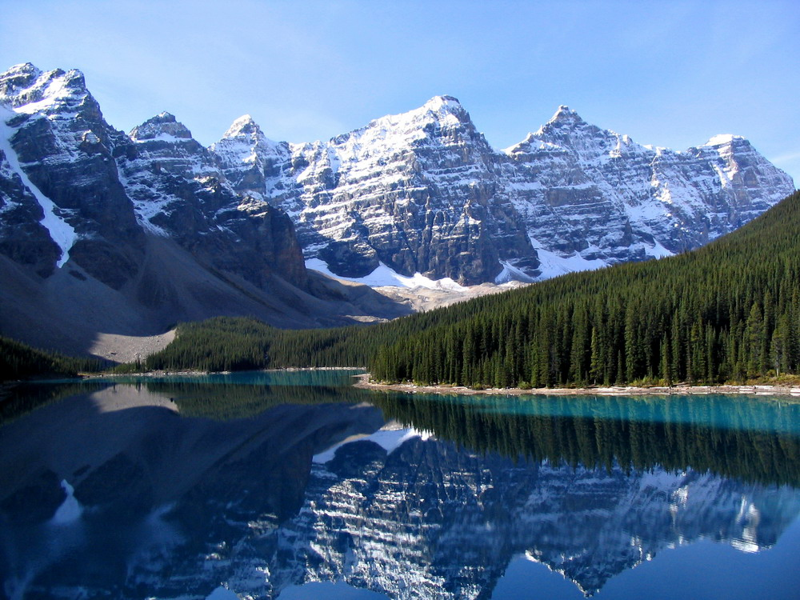
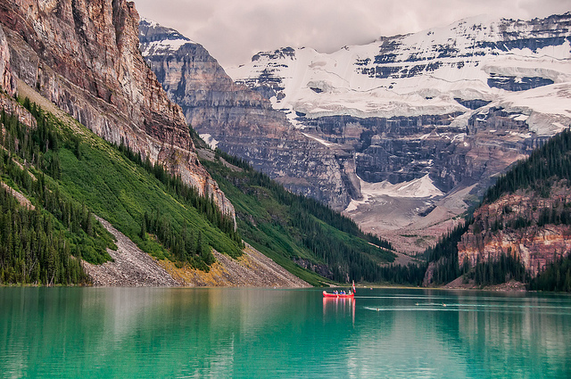
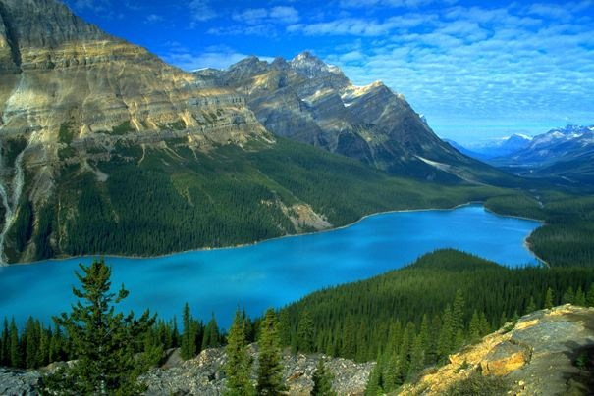
Lake Louise
Lake Louise is located in the Rocky Mountains of Canada, but deserves special mention. These photos of the water, almost perfect turquoise blue, capture the imagination and impress even seasoned travelers. There is always a lot of tourists - it is one of the most visited attractions in Canada with excellent infrastructure.

Slide 5
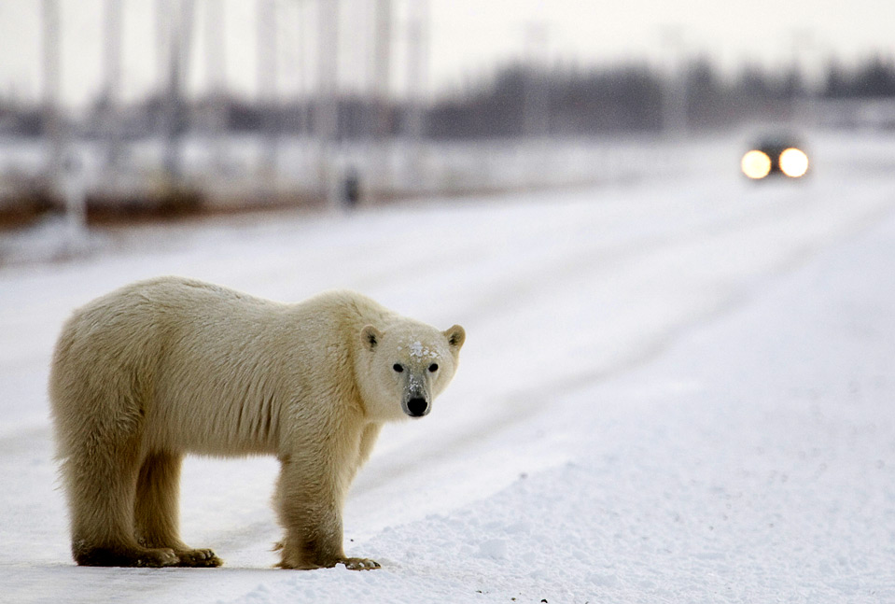
Churchill, Manitoba
Fans of the animals in their natural environment is a great place known as the world capital of polar bears. It's main purpose to see these beautiful polar bears, as well as beautiful nature and many other animals. Add to this the opportunity to admire the northern lights in the dead of winter and see colorful wildflowers in June and August.

Slide 6
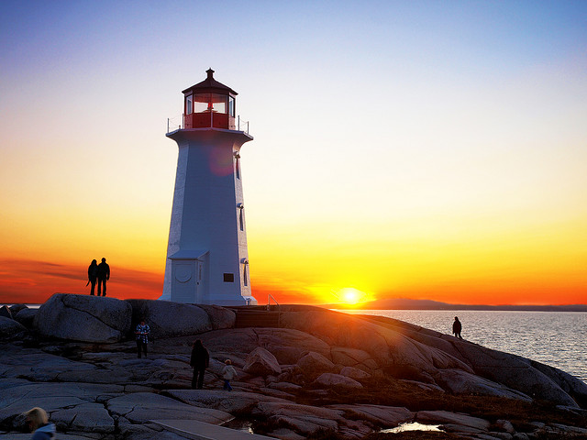
Nova Scotia
Pier 21, known as the U.S. equivalent of Ellis Island was the "Gateway to Canada" for the thousands of immigrants who came here on an ocean liner in 1928-1971 and is now one of the most important museums in Canada. It often happened wreck that claimed the lives of many passengers.

Slide 7
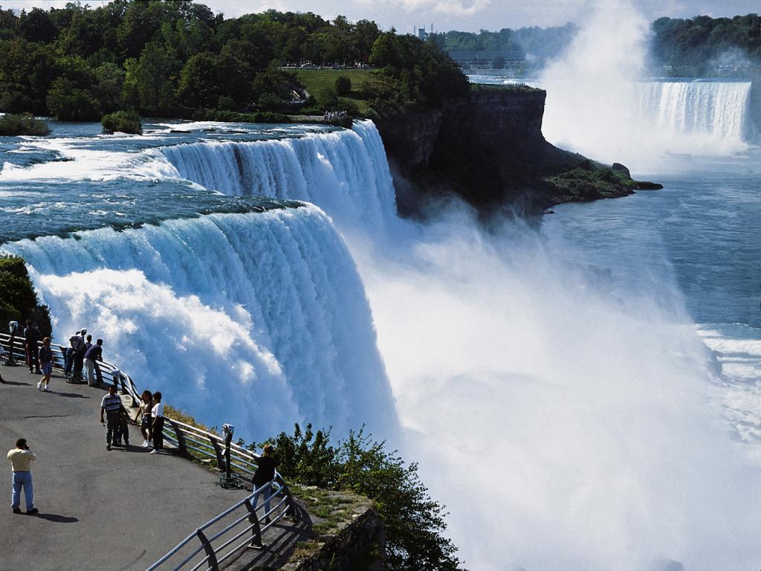
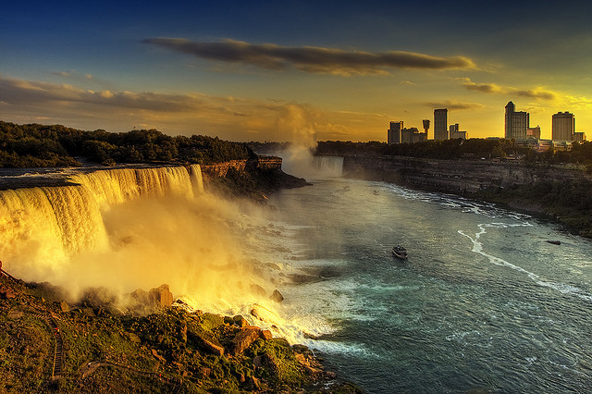
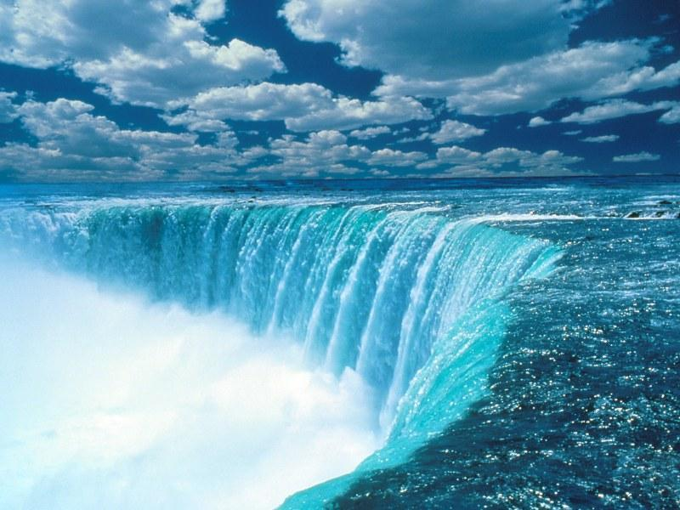
Niagara Falls
Angel Falls can be higher and the Victoria Falls can be broader, but Niagara still holds the status of the most famous waterfall in the world. You can visit both the American and the Canadian country. This is a very popular tourist attraction in Canada, attracting tens of thousands of tourists annually.

Slide 8
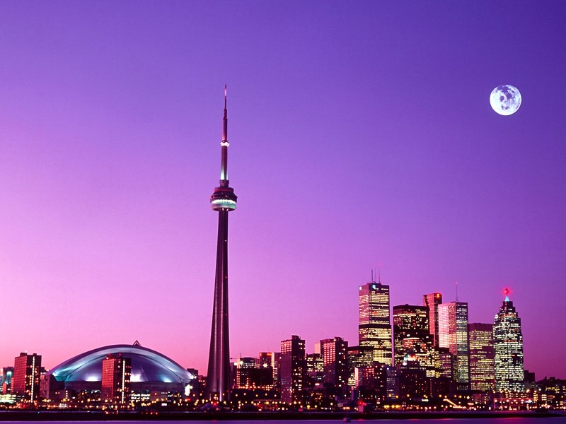
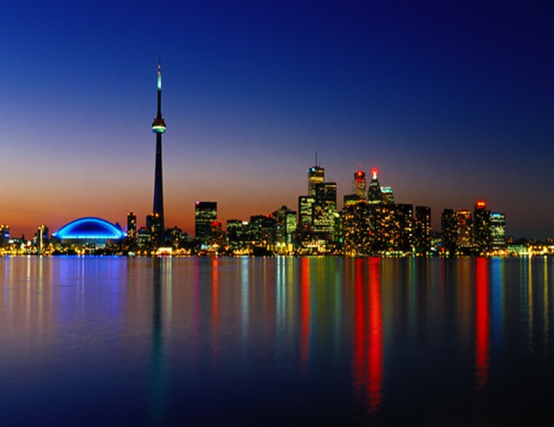
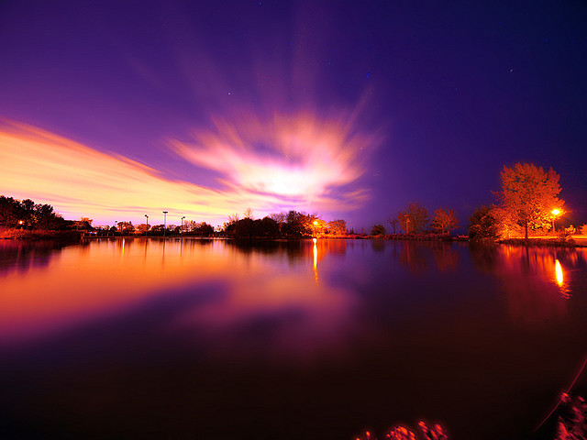
Toronto
Even the most dedicated nature traveler will be in sooner or later. Be sure to cover all that city life has to offer in Toronto. Many create a first impression that Toronto is like a smaller, cleaner, more tidy version of New York. Views from the CN Tower (which held the title of the highest autonomous structure in the world for over 30 years) so incredible that you can not even imagine, while the Royal Ontario Museum - the perfect place to explore the history and cultural life of Canada.

Slide 9
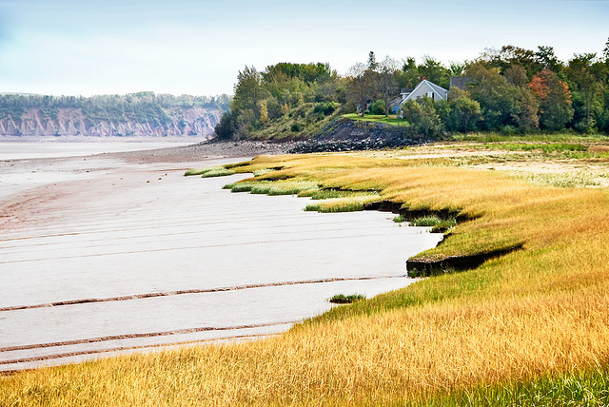
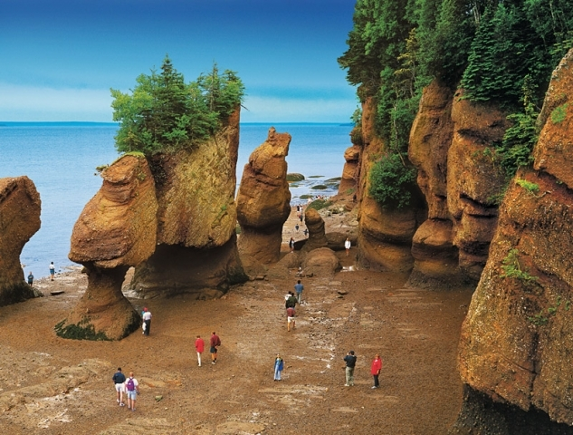
Bay of Fundy
Almost as world-renowned as some of the other places on this list. It attracts kayakers and canoe lovers from all over the world to overcome the highest flows of the planet. The unique geography allows you to admire the whales that swim here.

Slide 10
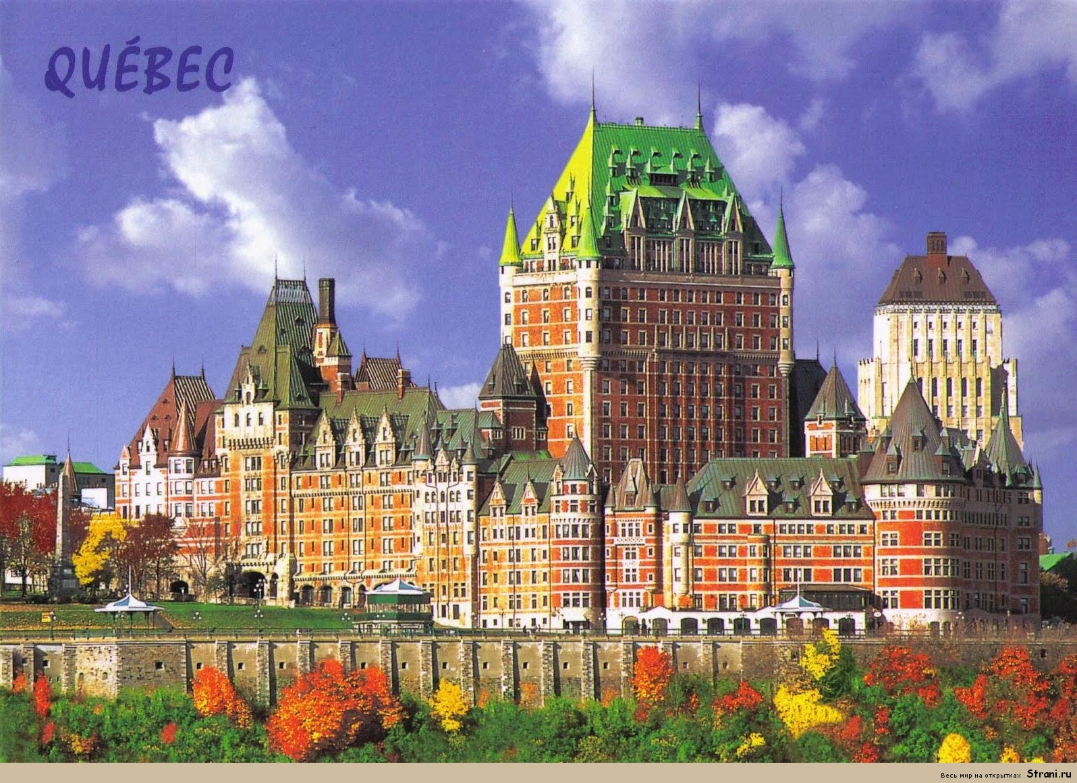
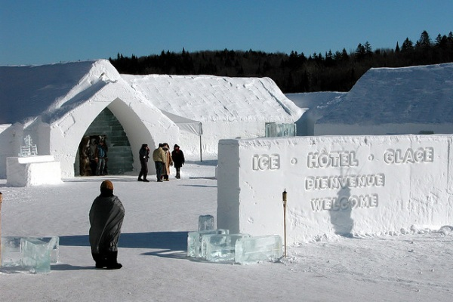
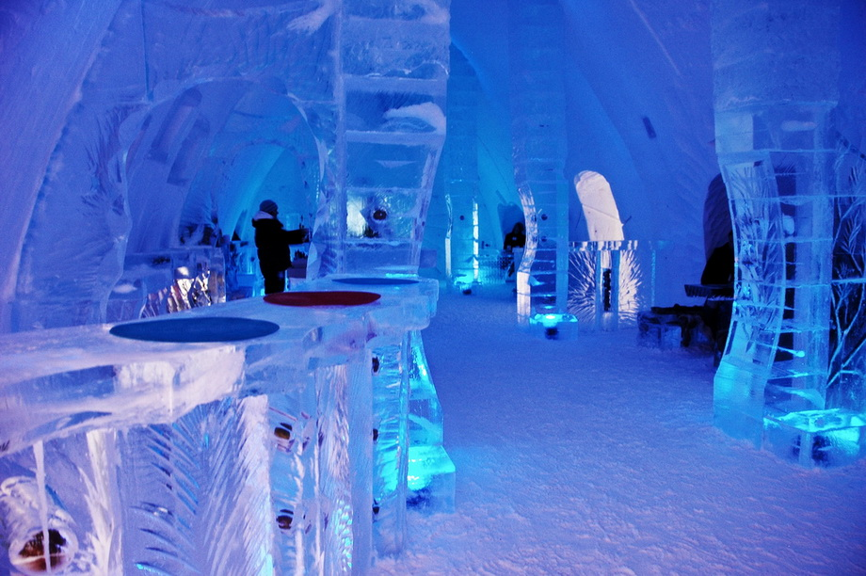
Quebec
In the French-speaking province of Quebec also have to look at. Of course, there are no attractions such as Toronto, but Quebec attracts others. The most photographed hotel in the world is located in the city center, is the only hotel in North America, is made of ice. 400-year-old city is famous also for its history.

Slide 11
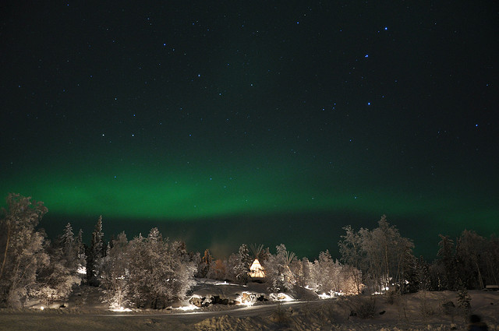
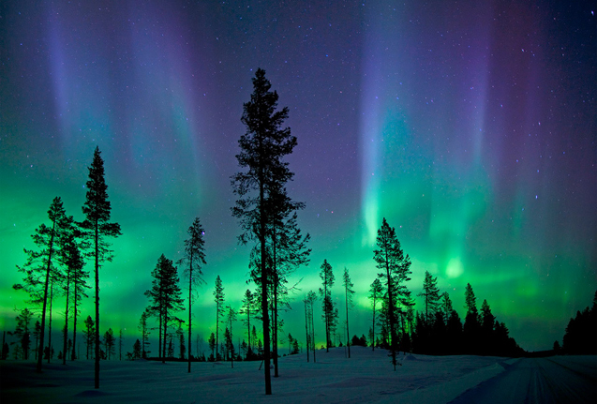
Northwest Territories Yellowknife
When you visit the oldest city in North America and will look polar bears in the wild, be sure to evaluate properly the north in search of the Northern Lights Aurora Borealis. The best place to observe them - is Yellowknife in the Northwest Territories. Just do not forget to bring a large number of warm clothes!

Slide 12
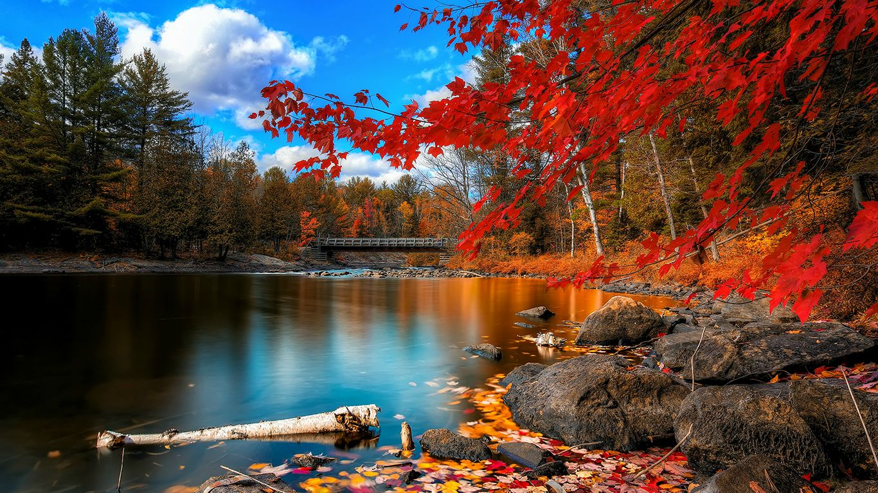
Thanks for your attention
Alyona Boreyko 11-A

