Slide 1
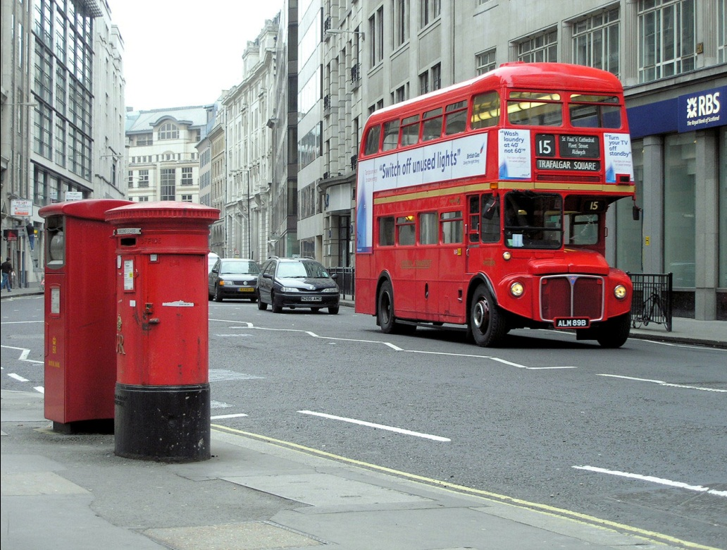
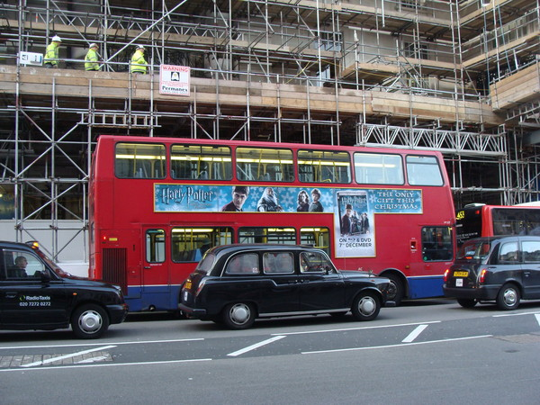
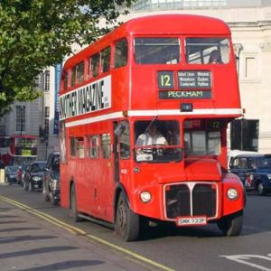
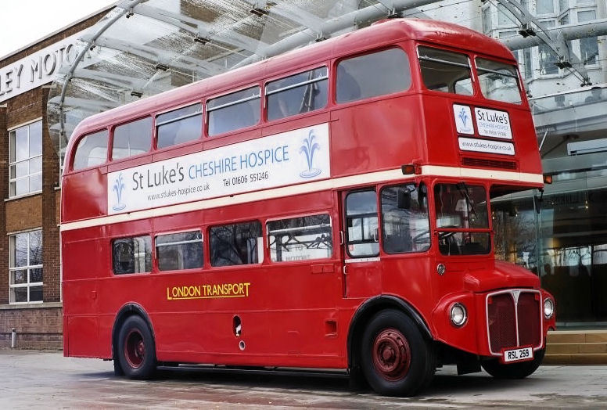
Means of transport

Slide 2
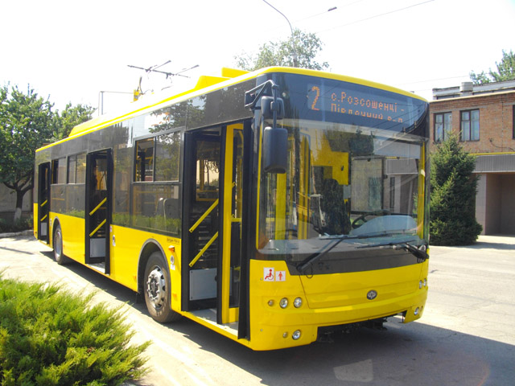
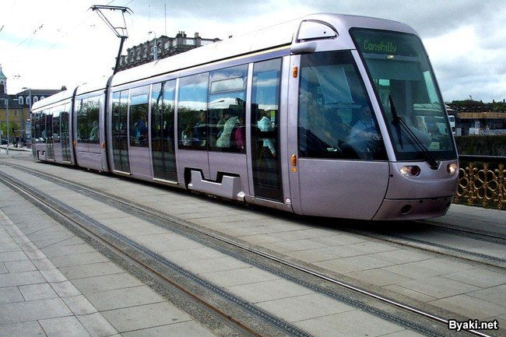
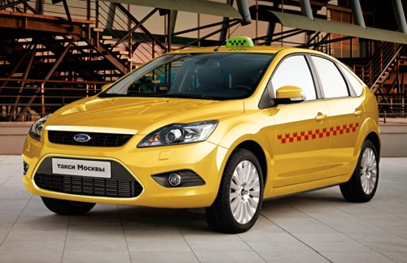
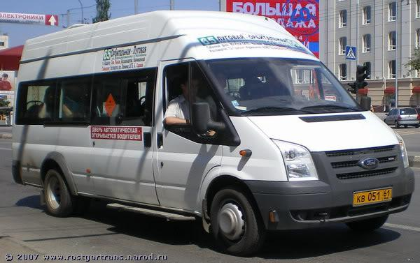
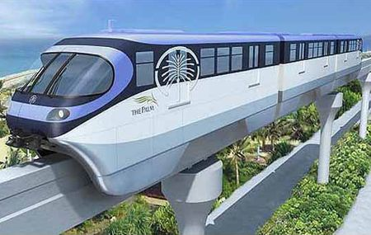
In England there are many kinds of transport: buses, trolleybuses, trams, minibuses, subways, taxi and trains.

Slide 3
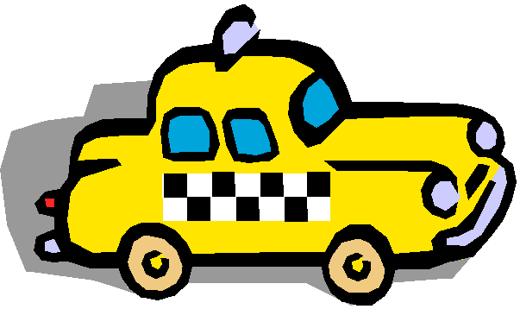
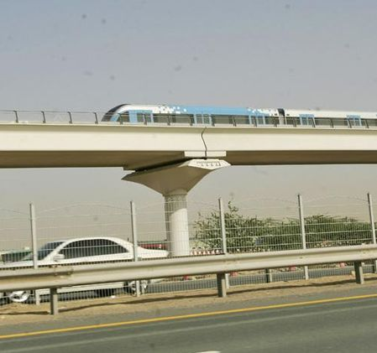
Means of transport
Buses, trolleybuses and trams are the most popular means of transport. But they are not very fast.
Novays become very popular. They are faster than buses and trolleybuses.
The underground is quicker than the bus.It it faster and the most comfortable means of transport.
A taxi is very comfortable way of travelling.

Slide 4
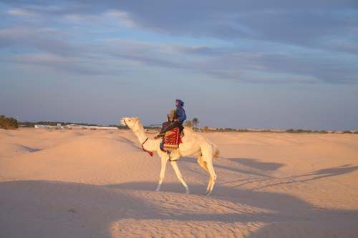
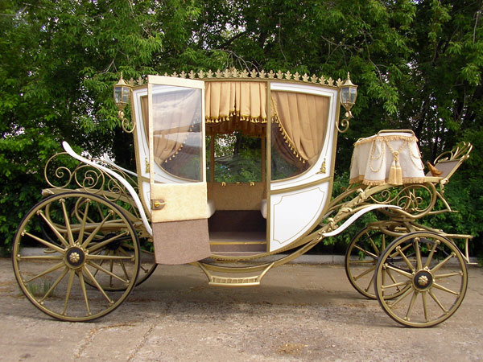
The origin of transport
Transport has a long and interesting history.In old times people didn`t know anything about the kinds of modern transport, they travelled by foot, by horses, camels or coaches. This could continue for many days. Everything changed when people invented cars .......

Slide 5
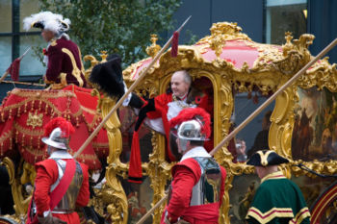
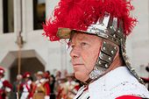
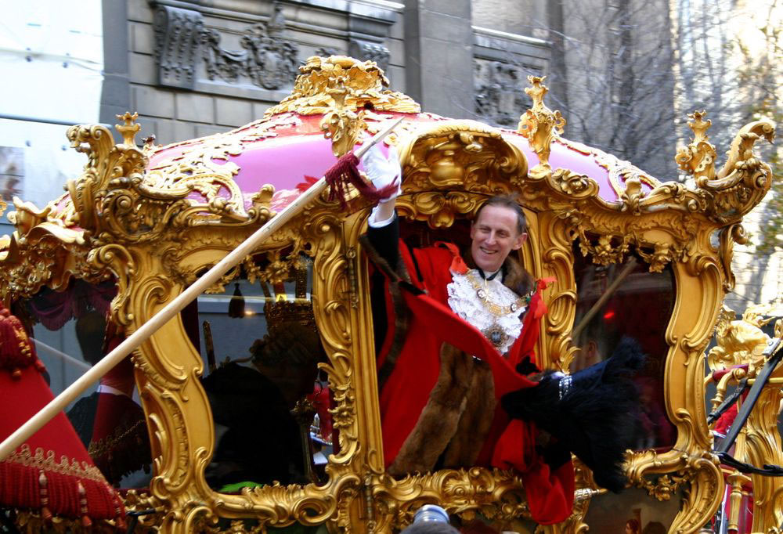
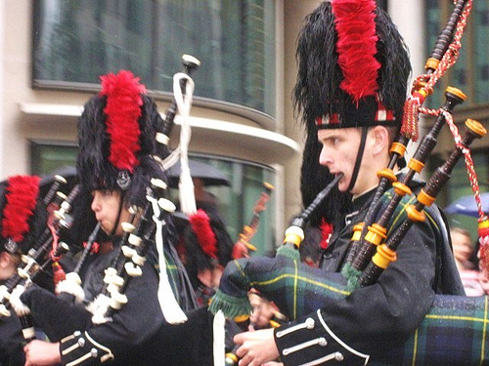
The second Satuarday in November is always the day for the Lord Mayor`s show. It is the biggest parade in London. The Lord Mayor travels along London streets in a coach. The coach is two hundred years old. It is red and gold and it has six horses.

Slide 6
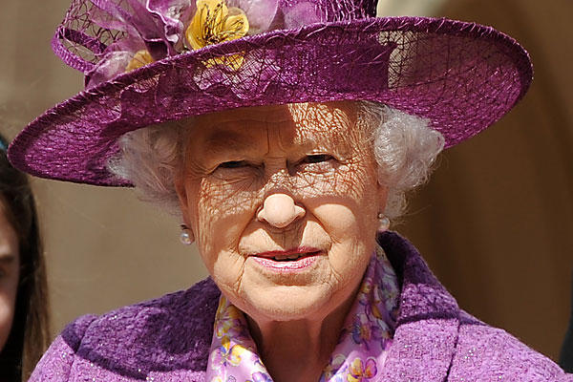
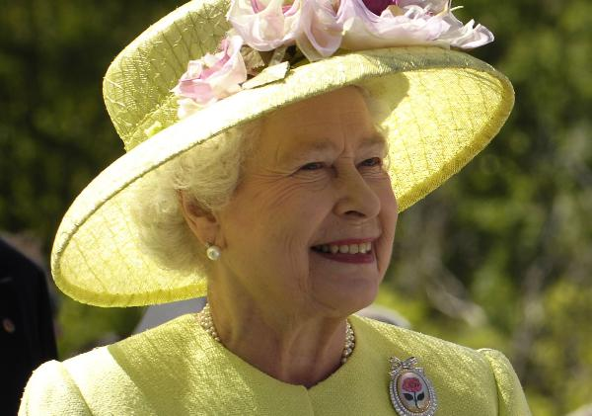
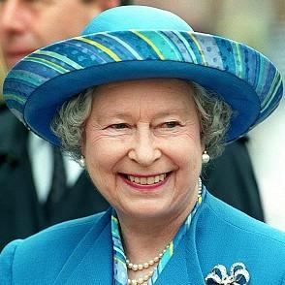
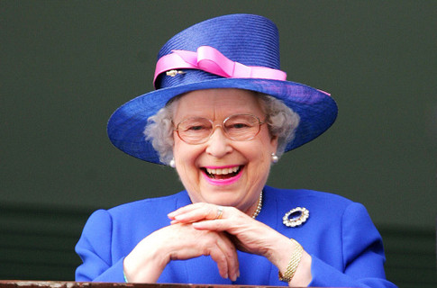
Traditionally the Queen of Great Britain opens the Parliament every autumn. The Queen travels from Buckingham Palase to the Houses of Parliament in a golden coach. Thousands of Londoners and visitors are glad to see the Queen in the golden coach.

Slide 7
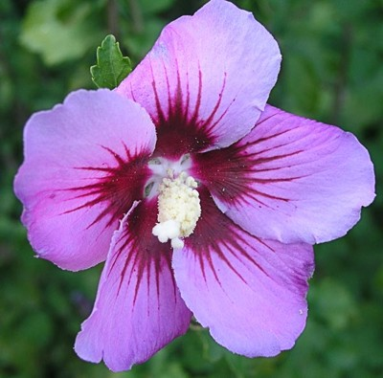
By
Marta Ogonovska
Form 7 A
Educational complex
“Sophiya”

