Slide 1
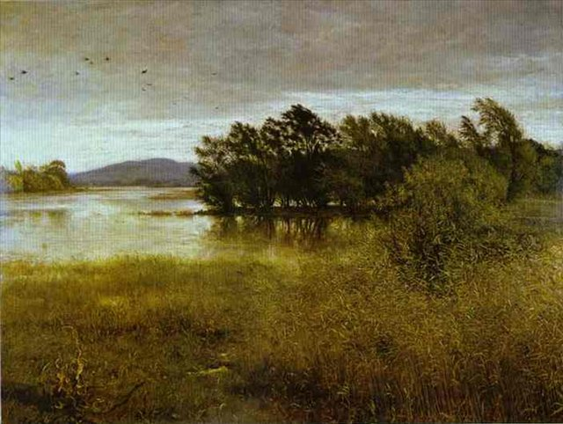
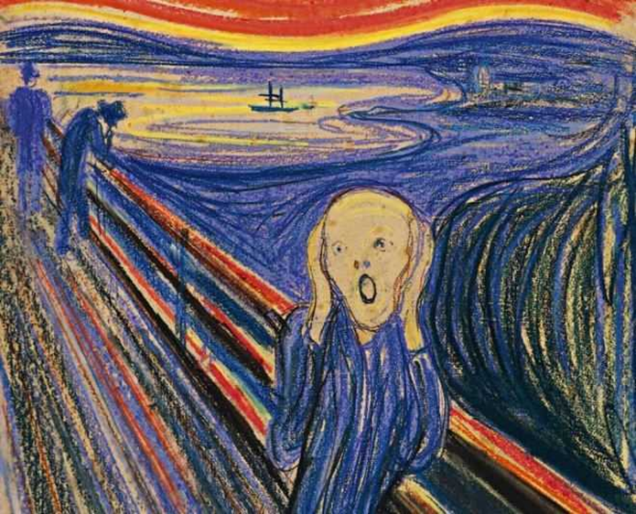
Painting
By Poberezhnyi Andrei

Slide 2
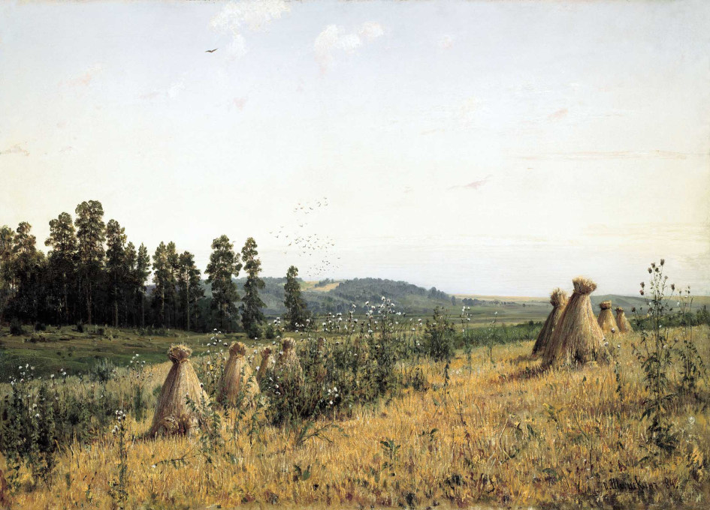
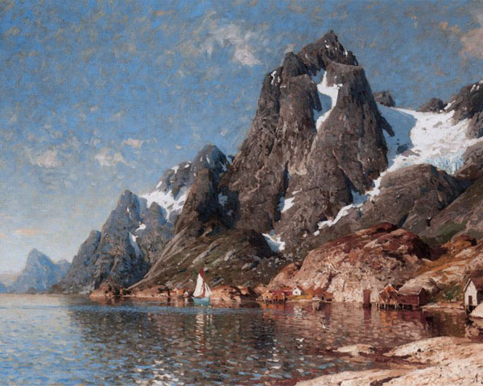
Painting is the practice of applying paint, pigment, color or other medium to a surface. The medium is commonly applied to the base with a brush but other implements, such as knives, sponges, and airbrushes, can be used.
In art, the term painting describes both the act and the result of the action. Paintings may have for their support such surfaces as walls, paper, canvas, wood, glass, lacquer, clay, leaf, copper or concrete, and may incorporate multiple other materials including sand, clay, paper, gold leaf as well as objects.

Slide 3
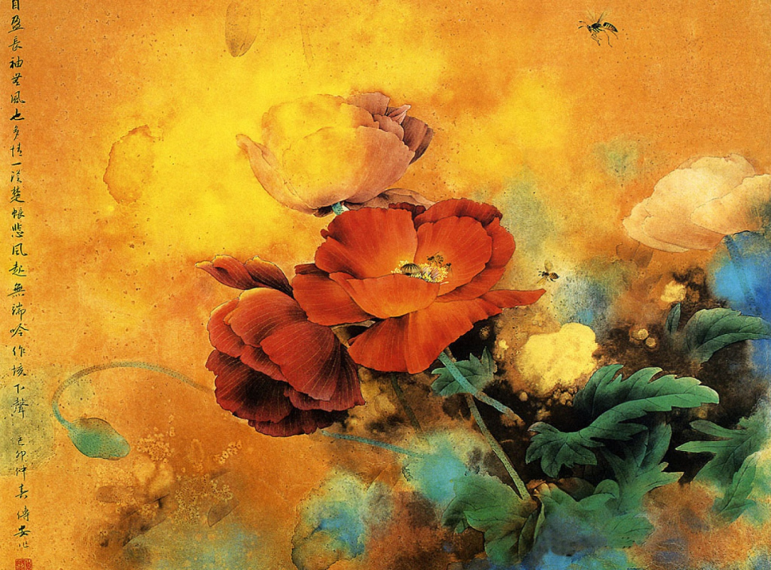
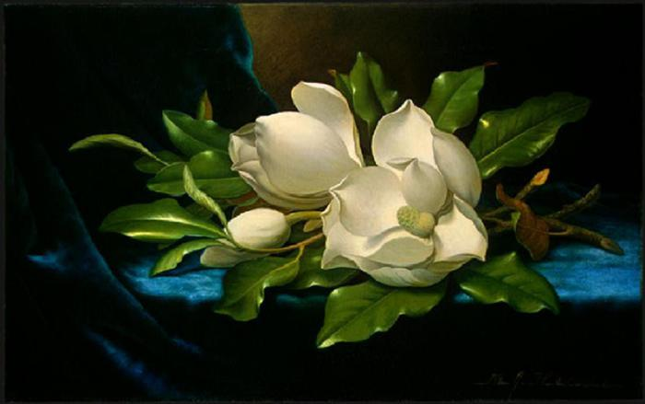
The term painting is also used outside of art as a common trade among craftsmen and builders. Painting is a mode of creative expression, and the forms are numerous. Drawing, composition or abstraction, among other aesthetics, may serve to manifest the expressive and conceptual intention of the practitioner.
Paintings can be naturalistic and representational (as in a still life or landscape painting), photographic, abstract, be loaded with narrative content, symbolism, emotion or be political in nature.

Slide 4
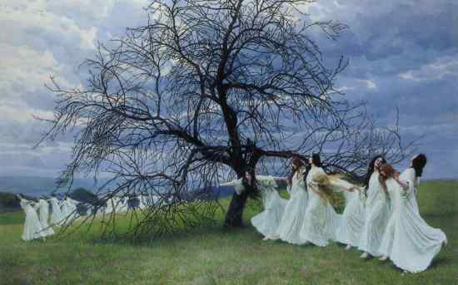
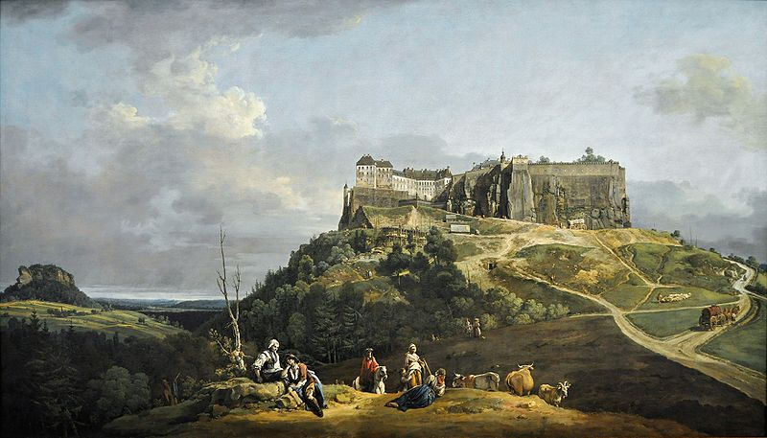
A portion of the history of painting in both Eastern and Western art is dominated by spiritual motifs and ideas; examples of this kind of painting range from artwork depicting mythological figures on pottery to Biblical scenes rendered on the interior walls and ceiling of the Sistine Chapel, to scenes from the life of Buddha or other images of eastern religious origin.

Slide 5
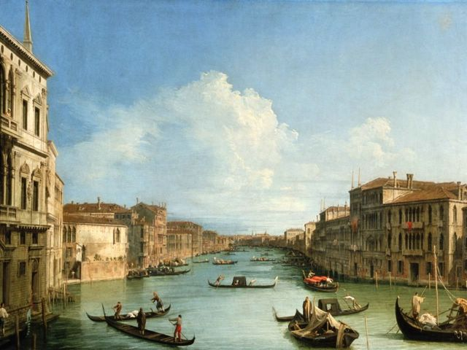
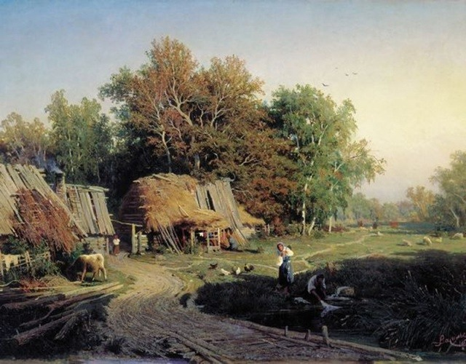
The oldest known paintings are at the Grotte Chauvet in France, which some historians believe are about 32,000 years old. They are engraved and painted using red ochre and black pigment and show horses, rhinoceros, lions, buffalo, mammoth, abstract designs and what are possibly partial human figures.
However the earliest evidence of the act of painting has been discovered in two rock-shelters in Arnhem Land, in northern Australia. In the lowest layer of material at these sites, there are used pieces of ochre estimated to be 60,000 years old.

Slide 6
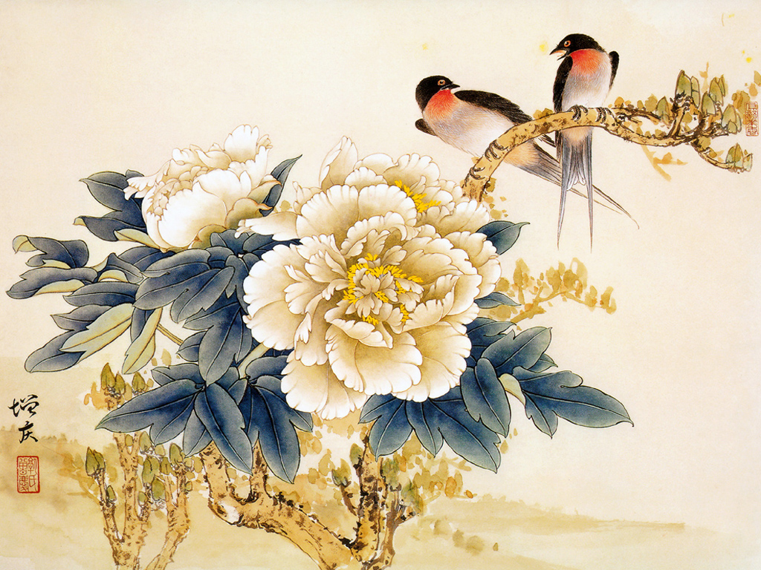
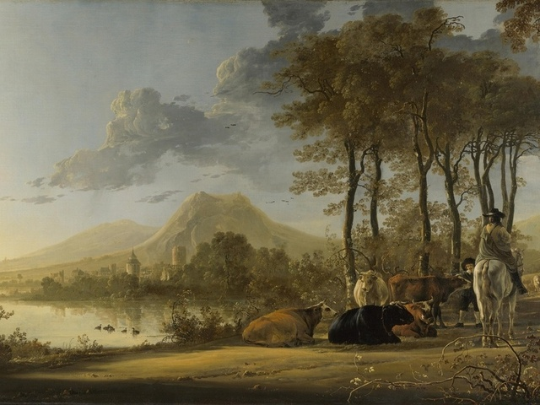
Archaeologists have also found a fragment of rock painting preserved in a limestone rock-shelter in the Kimberley region of North-Western Australia, that is dated 40 000 years old.
There are examples of cave paintings all over the world—in India, France, Spain, Portugal, China, Australia, Mexico etc.

Slide 7
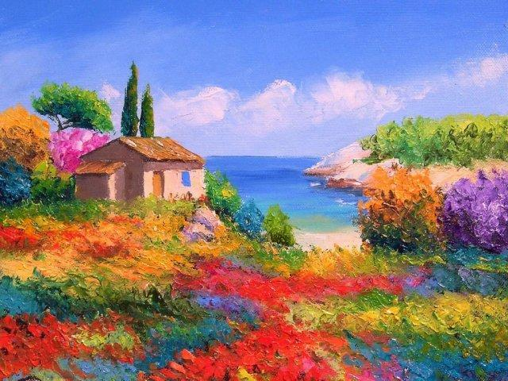
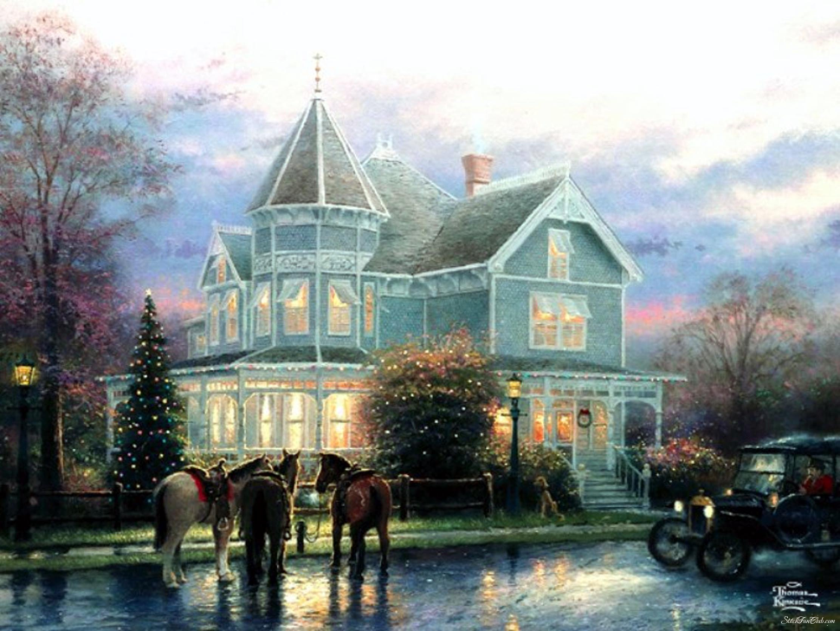
In Western cultures oil painting and watercolor painting have rich and complex traditions in style and subject matter. In the East, ink and color ink historically predominated the choice of media with equally rich and complex traditions.
The invention of photography had a major impact on painting. In the decades after the first photograph was produced in 1829, photographic processes improved and became more widely practiced, depriving painting of much of its historic purpose to provide an accurate record of the observable world.

Slide 8
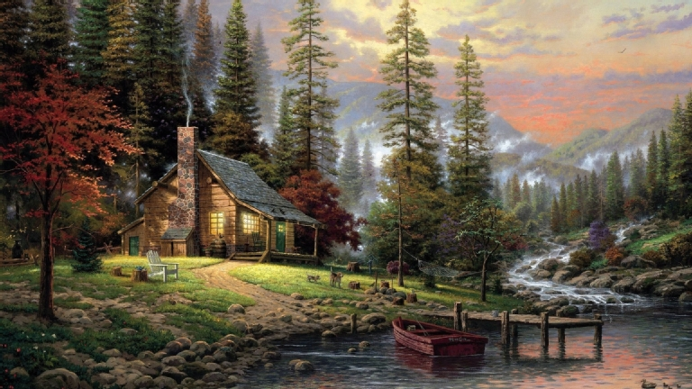
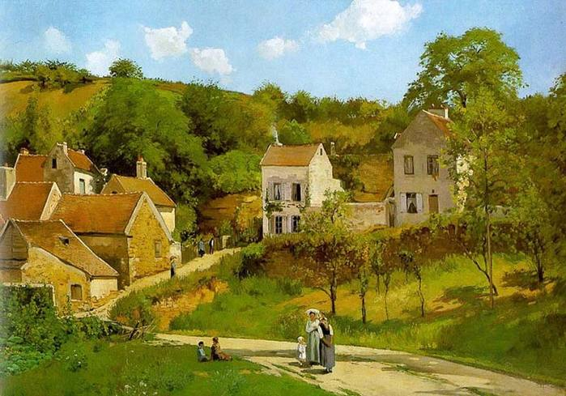
A series of art movements in the late 19th and early 20th centuries—notably Impressionism, Post-Impressionism, Fauvism, Expressionism, Cubism, and Dadaism—challenged the Renaissance view of the world. Eastern and African painting, however, continued a long history of stylization and did not undergo an equivalent transformation at the same time.
Modern and Contemporary Art has moved away from the historic value of craft and documentation in favour of concept; this led some to say in the 1960s that painting, as a serious art form, is dead.

Slide 9
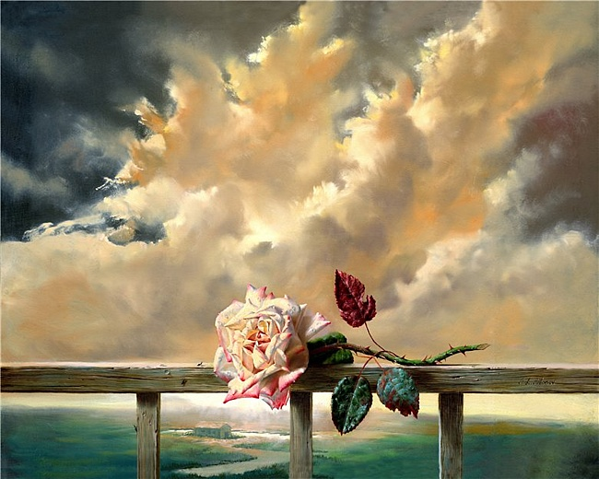
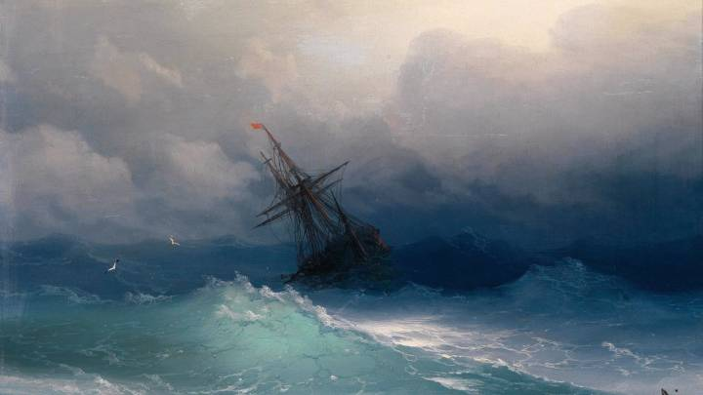
This has not deterred the majority of living painters from continuing to practice painting either as whole or part of their work. The vitality and versatility of painting in the 21st century belies the premature declarations of its demise. In an epoch characterized by the idea of pluralism, there is no consensus as to a representative style of the age.
Artists continue to make important works of art in a wide variety of styles and aesthetic temperaments—their merit left to the marketplace to judge.

Slide 10
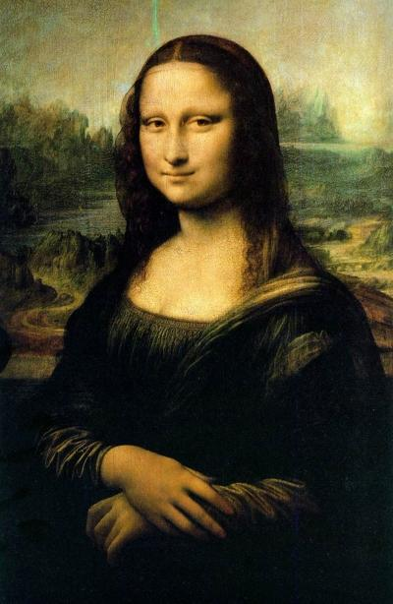
Among the continuing and current directions in painting at the beginning of the 21st century are Monochrome painting, Hard-edge painting, Geometric abstraction, Appropriation, Hyperrealism, Photorealism, Expressionism, Minimalism, Lyrical Abstraction, Pop Art, Op Art, Abstract Expressionism, Color Field painting, Neo-expressionism, Collage, Intermedia painting, Assemblage painting, Computer art painting, Postmodern painting, Neo-Dada painting, Shaped canvas painting, environmental mural painting, traditional figure painting, Landscape painting, Portrait painting, and paint-on-glass animation.

